Slide 1



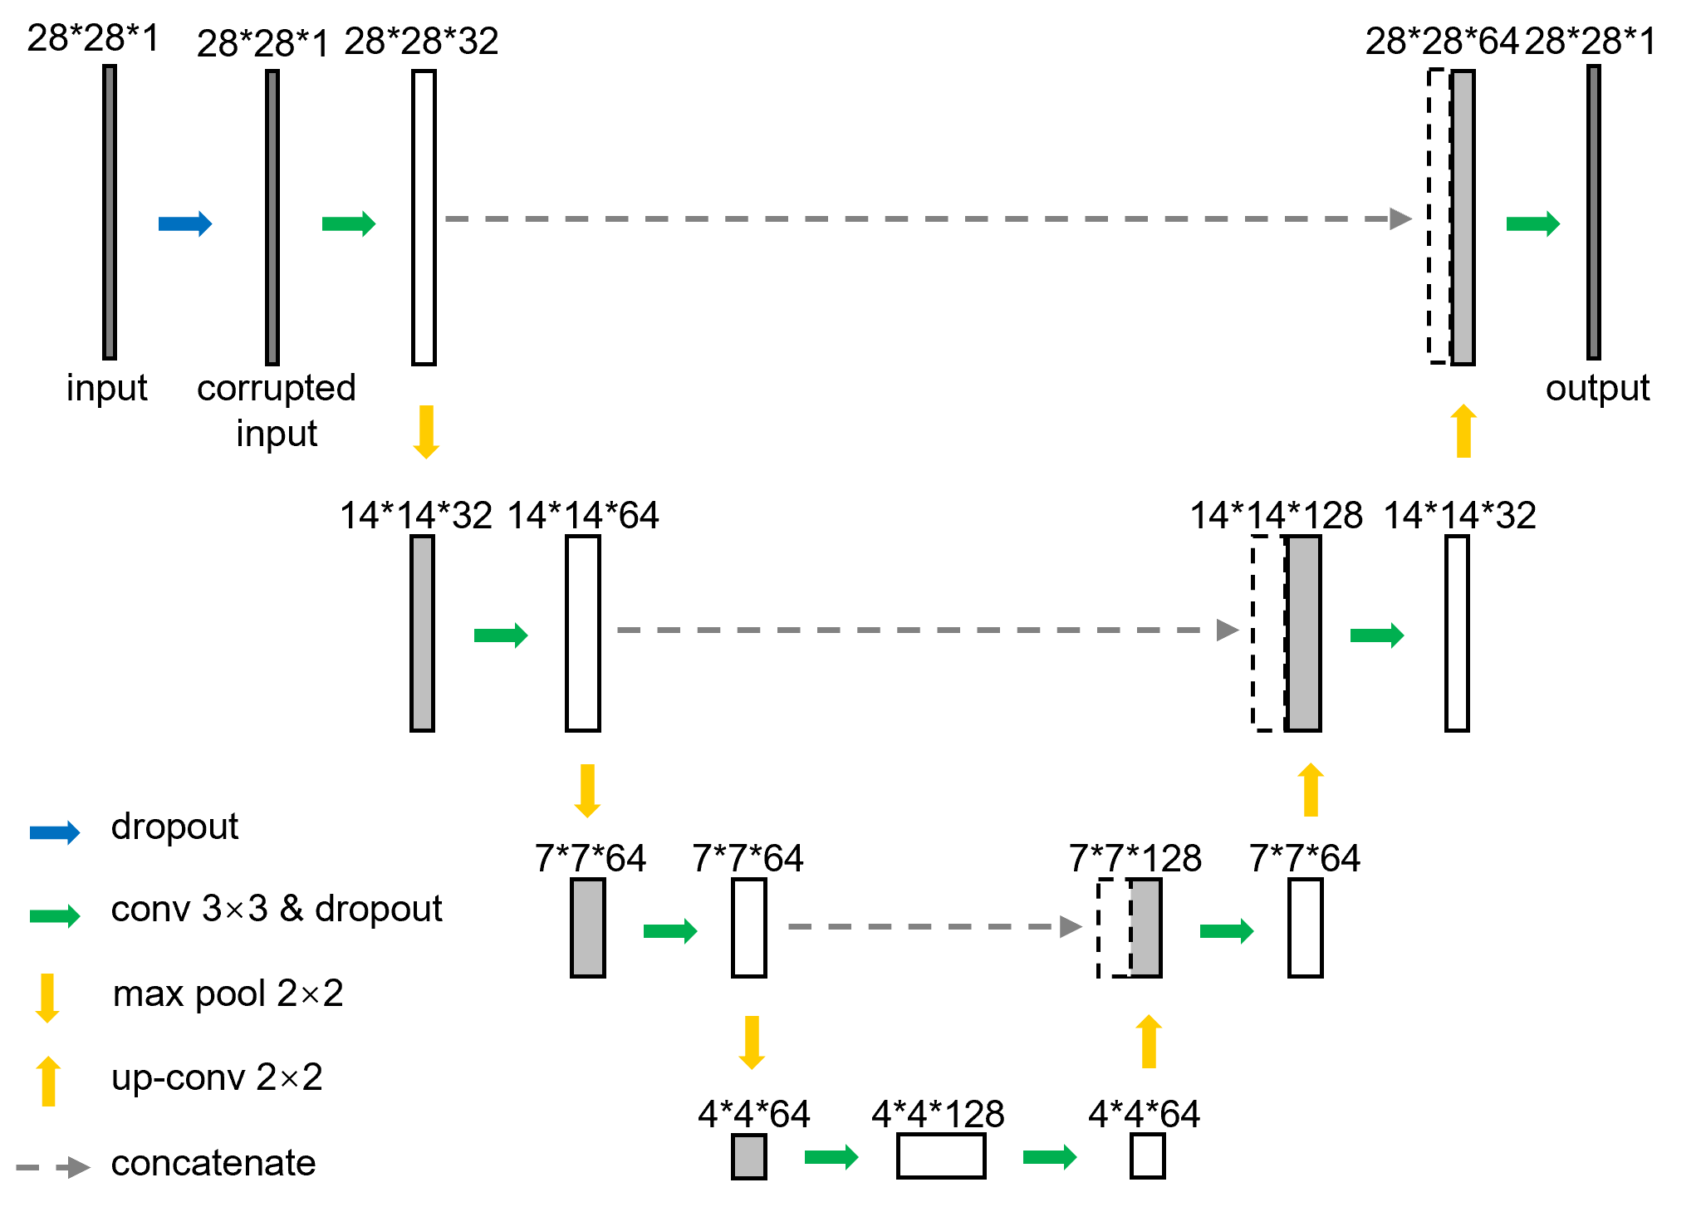
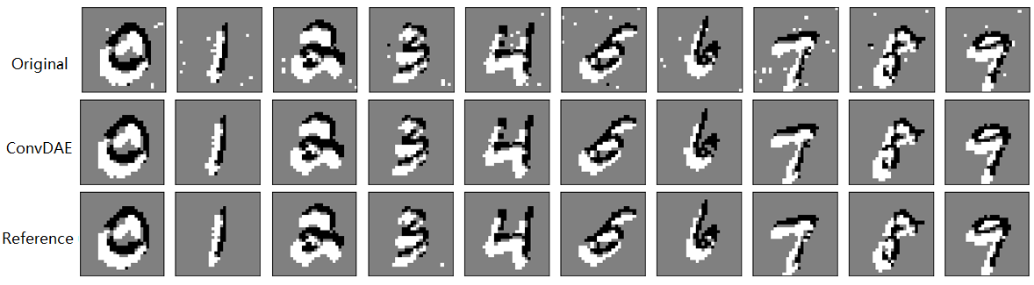
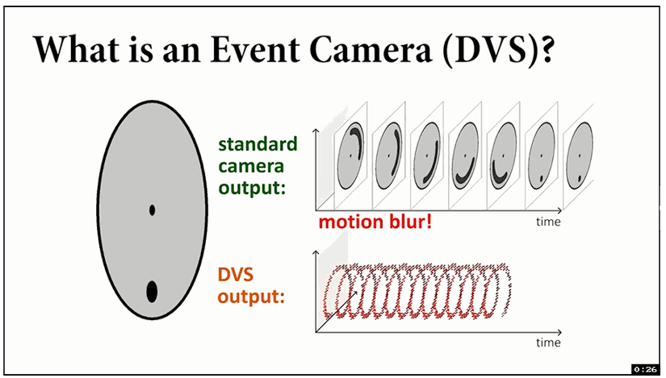
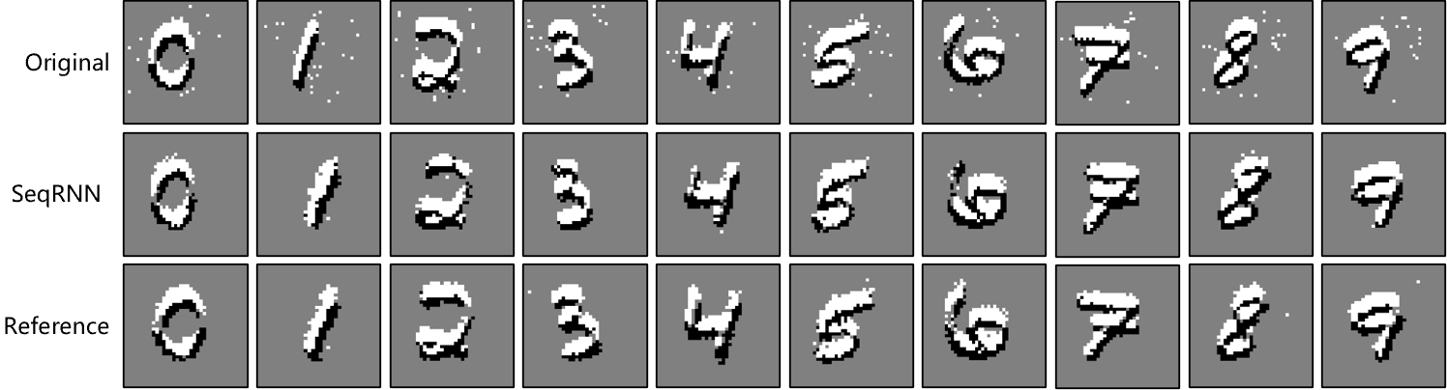
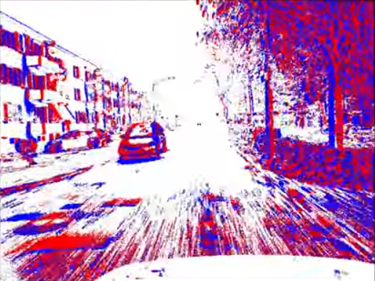
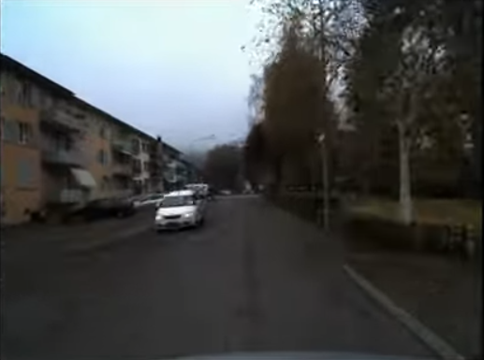
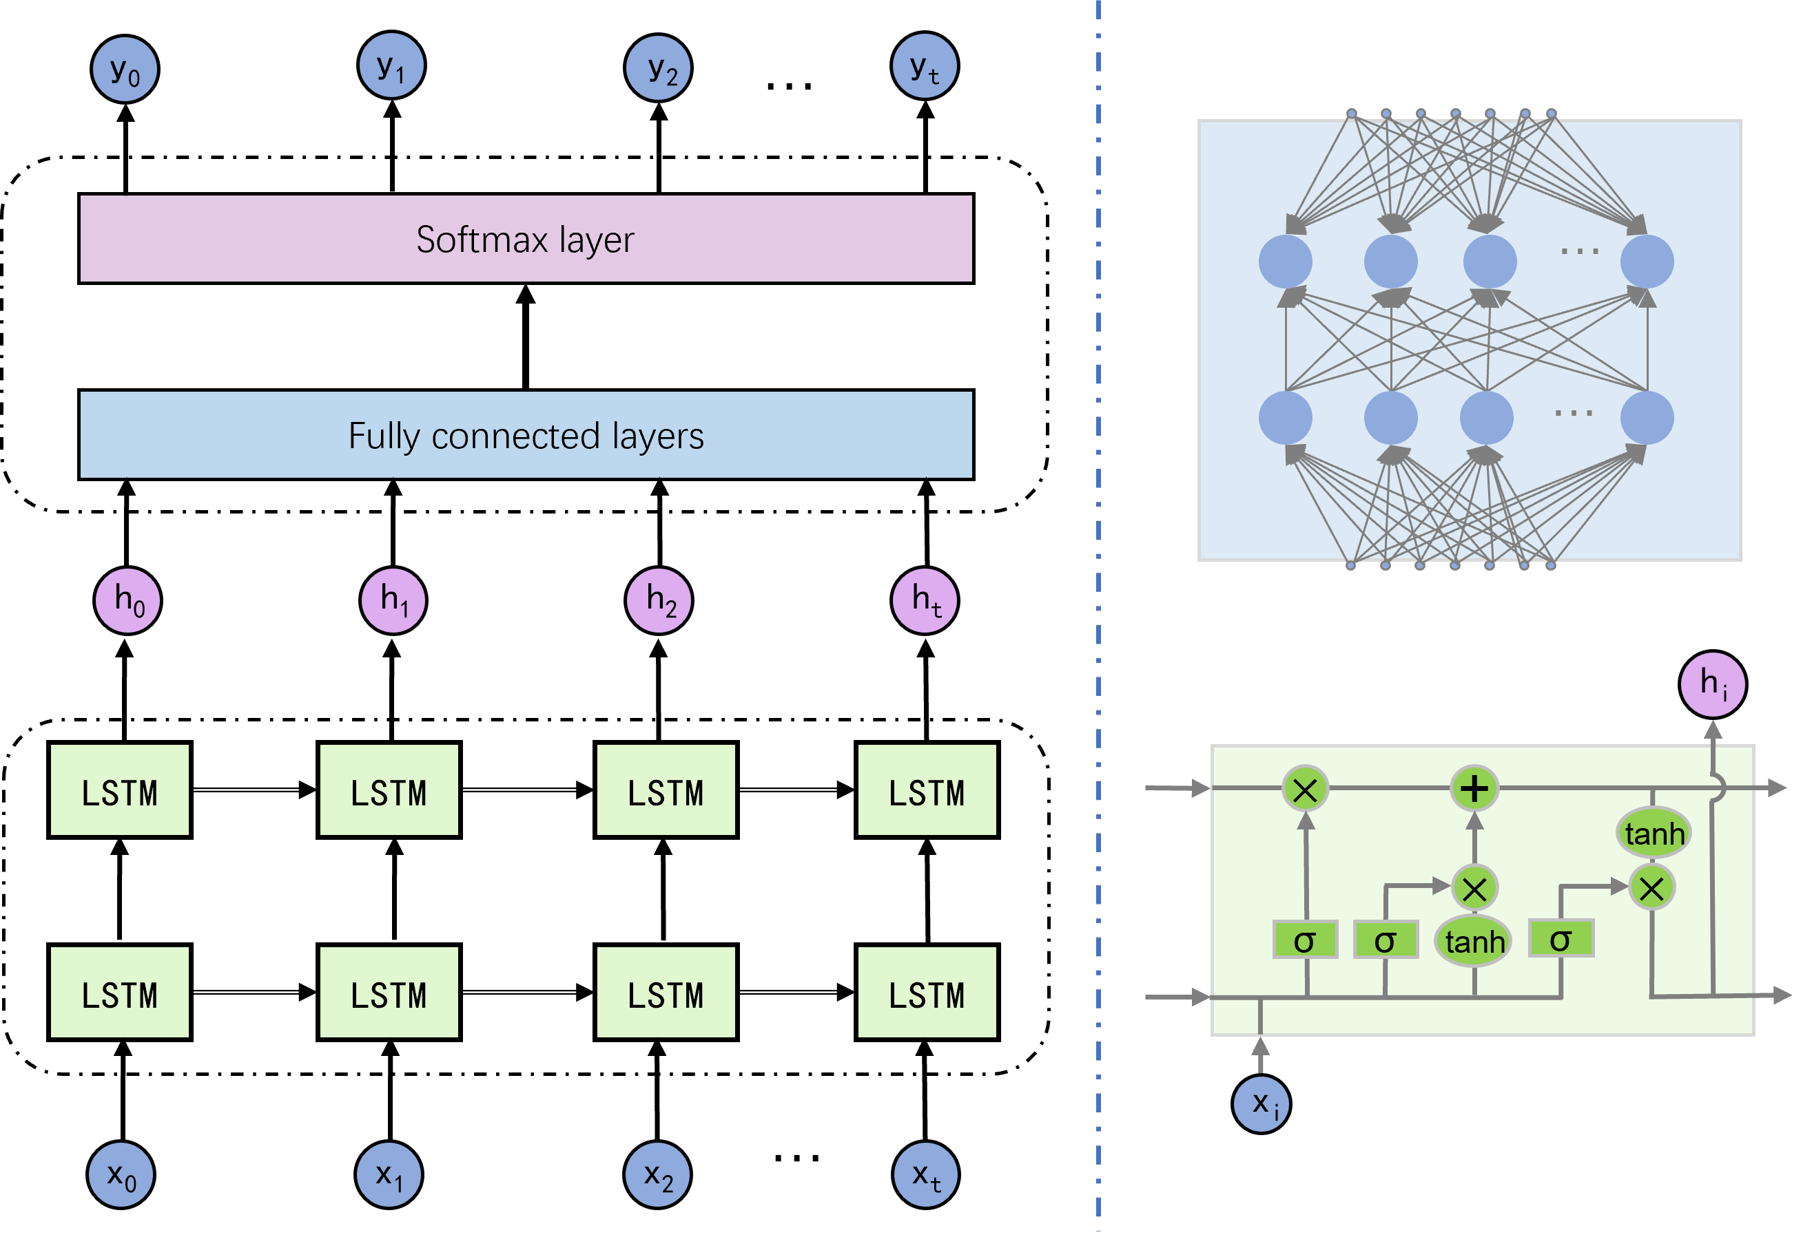


Denoising of event-based sensors
with deep neural networks
Zhihong Zhang, Jinli Suo, Qionghai Dai
Department of Automation, Tsinghua University
Photonics
Asia
2021
ABSTRACT
METHODS
RESULTS
We propose two learning-based methods for the denoising of event-based sensor measurements:
ConvDAE : convolutional denoising auto-encoder
  Based on the convolutional neural network (CNN)
  Compatible with existing image-based deep denoisers and high-level vision tasks
SeqRNN： sequence-fragment recurrent neural network
  Based on the recurrent neural network (RNN)
  Realize online denoising while keeping the event’s original AER representation.
ConvDAE: convolutional denoising auto-encoder
we demonstrate the effectiveness of proposed ConvDAE and SeqRNN with N-MNIST dataset, which is collected by capturing static images in classical computer vision dataset MNIST with a moving event camera.
The basic structure of ConvDAE is a simplified U-Net, with only one convolutional layer in each encoding or decoding layer. Dropout layer corrupted original images and nearest neighbor filter pre-denoised reference images serve as input and “ground truth” respectively.
Original: images mapped from original event sequences;
Reference: reference images mapped from the pre-denoised event sequences via nearest neighbor filtering (NNF).
INTRODUCTION
Fig. 4 The denoising results of ConvDAE.
ConvDAE efficiently removes the dispersed noise and performs better in distinguishing the signal and noise especially around the objects compared with NNF pre-denoised reference images.
Fig. 2 The architecture of the proposed self-supervised convolutional denoising auto-encoder (ConvDAE).
The event sequence is mapped into a series of video frames before denoising
SeqRNN: sequence-fragment recurrent neural network
The first part consists of two LSTM layers, and the second part is composed of three fully connected layers and a softmax layer. Original event segments and nearest neighbor filter pre-denoised reference event segments serve as input and “ground truth” respectively.
Fig. 4 The denoising results of SeqRNN.
The noise shown in the original event segments can be filtered out clearly by SeqRNN, which meanwhile outperforms the NNF algorithm in some details.
CONCLUSIONS
event camera
standard camera
We come up with two learning-based methods named ConvDAE and SeqRNN for the denoising of event camera data, and demonstrate their effectiveness and flexibility with real data experiments.
As light-weight denoisers, CNN-based ConvDAE and RNN-based SeqRNN can be easily adapted to image-based and event-based downstream tasks’ solutions, respectively
Fig. 1 The working mechanism of the event camera and its comparison with standard frame-based cameras.
A novel neuromorphic imaging sensor
Responses only to brightness changes asynchronously
The output is a stream of events containing positions, time, and polarities (±1）
Features: low power consumption, low latency, HDR, but noisy
In the future, we will test the proposed methods on more complicated datasets, and evaluate their denoising performance based on their assistance for the downstream high-level vision tasks.
Fig. 3 The architecture of the proposed sequence-fragment recurrent neural network (SeqRNN).
REFERENCES
CONTACT
1. Lichtsteiner, P., Posch, C., and Delbruck, T., IEEE Journal of Solid-State Circuits 43(2), 566–576 (2008).
2. Liu, H., Brandli, C., Li, C., Liu, S.-C., and Delbruck, T., ISCAS 2015, 722–725 (2015).
3. Czech, D. and Orchard, G., BioRob 2016, 19–24 (2016).
4. Xie, X., Du, J., Shi, G., Hu, H., and Li, W., ICVIP 2017, 176–180 (2017).
5. Padala, V., Basu, A., and Orchard, G., Frontiers in Neu-roscience 12, 118 (2018).
6. Gehrig, M., Aarents, W., Gehrig, D., Scaramuzza, D., IEEE Robotics and Automation Letters 6(3), 4947-4954 (2021).
7. Hochreiter, S. and Schmidhuber, J., Neural Computation 9, 1735–1780 (1997).
8. Orchard, G., Jayawant, A., Cohen, G. K., and Thakor, N., Frontiers in Neuroscience 9, 437 (2015).
Zhihong Zhang ( 张志宏 )
Department of Automation, Tsinghua
University, Beijing 100084, China
email: zhangzh19@mails.tsinghua.edu.cn
website: zhihongz.github.io

