Slide 1

Getting Started with Research Computing
From Command Line to Job Scheduling

Slide 2

Useful CURC links
Website: www.rc.colorado.edu
Documentation: curc.readthedocs.io
Support request form: colorado.service-now.com/req_portal?id=ucb_sc_rc_form
2

Slide 3
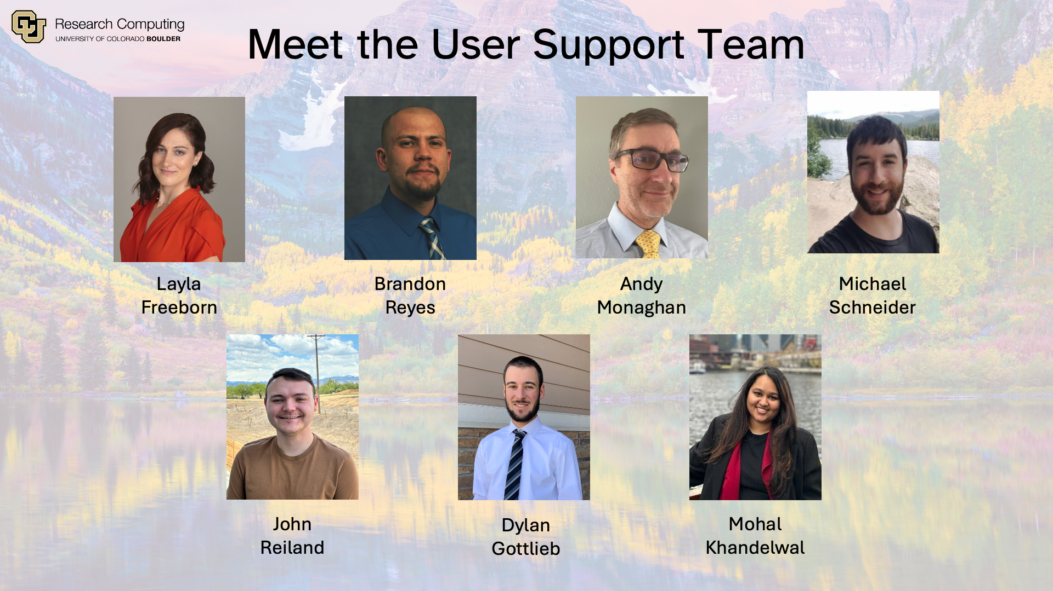
The user support team

Slide 4
Ask Questions
Notes:
This workshop is meant to be empowering and information-rich – to help you get the most out of your HPC workflow.
Feel free to ask questions during the presentations and to discuss ideas/thoughts during breaks and the hands-on portion of the workshop.

Slide 5


General Overview of Job Submission
1
2
3
Login Node
Resources
Job Request
Notes:
3. Jobs do not run immediately but instead wait in a SLURM managed queue. A job’s placement in the queue is dependent on multiple factors. We will discuss a few of the most common factors, but a general rule to follow is that the more resources a job requests the longer it will wait in the queue.

Slide 6
Login Nodes
  Navigate to https://ondemand-rmacc.rc.colorado.edu
Choose your organization
Enter your password
Authenticate by accepting the Duo push to your smartphone
Select the “Clusters” app to bring up an Alpine terminal
  https://curc.readthedocs.io/en/latest/open_ondemand/index.html
A Login Node is the entryway onto our system. They are meant for:
Viewing or editing files
Submitting Jobs
Login nodes should never be used to run code or software.
Once you are on a terminal, you will know you are on a login node by looking at the command prompt. If it contains “login”, you are on a login node
[ralphie@login-ci3]$

Slide 7
Accessing the Terminal (SSH)
  Navigate to https://ondemand-rmacc.rc.colorado.edu
Choose your organization
Enter your password
Authenticate by accepting the Duo push to your smartphone
Select the “Clusters” app to bring up an Alpine terminal
  https://curc.readthedocs.io/en/latest/open_ondemand/index.html
SSH
Available to CU Boulder, CSU,
CU Anschutz

Slide 8

Accessing the Terminal (Open OnDemand)
  Navigate to https://ondemand-rmacc.rc.colorado.edu
Choose your organization
Enter your password
Authenticate by accepting the Duo push to your smartphone
Select the “Clusters” app to bring up an Alpine terminal
  https://curc.readthedocs.io/en/latest/open_ondemand/index.html
SSH
Available to CU Boulder, CSU,
CU Anschutz

Slide 9
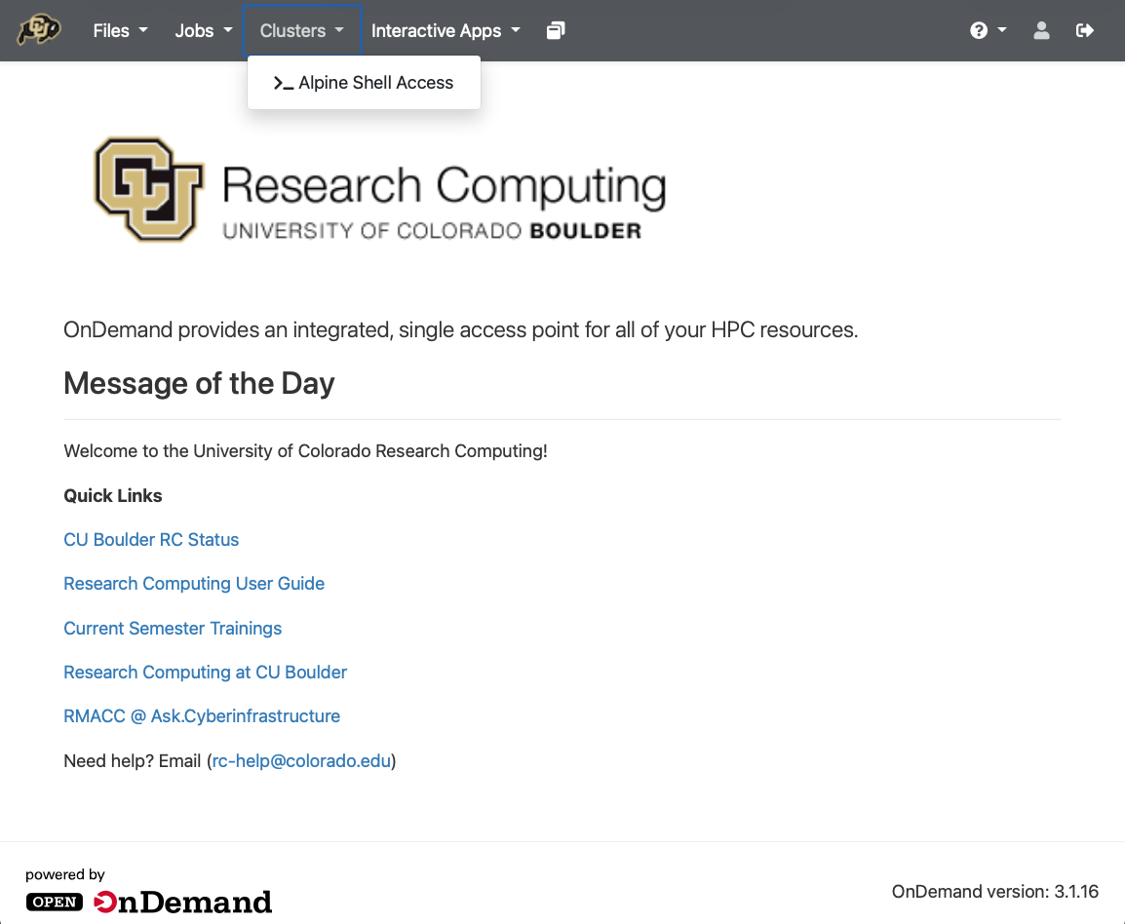
Accessing the Terminal
If you would like to access a terminal via ssh, please see:
curc.readthedocs.io/en/latest/getting_started/logging-in.html#terminal-access-for-different-operating-systems

Slide 10

Linux Command Line
File Operations
Scripting

Slide 11
List Files and Directories
ls [option] [file/directory]
-l (long format) -a (all files)
-h (readable file size) -r (reverse sort)
-S (sort by file size)
-t (sort by modification time)

Slide 12
Standard CURC Directories
/curc
/home
/projects
/scratch
/pl
(software stack)
/home/<user>
/projects/<user>
/scratch/alpine
/pl/active
/pl/archive
/scratch/alpine/<user>
/pl/active/<group>
/pl/archive/<group>

Slide 13
File Operations
Change
Directory
Make
Directory
cd [-o] <path>
mkdir [-o] <path>
Copy / Move
Files & Directories
Delete
Files
cp [-o] <source> <dest>
rm [-o] <path>

Slide 14
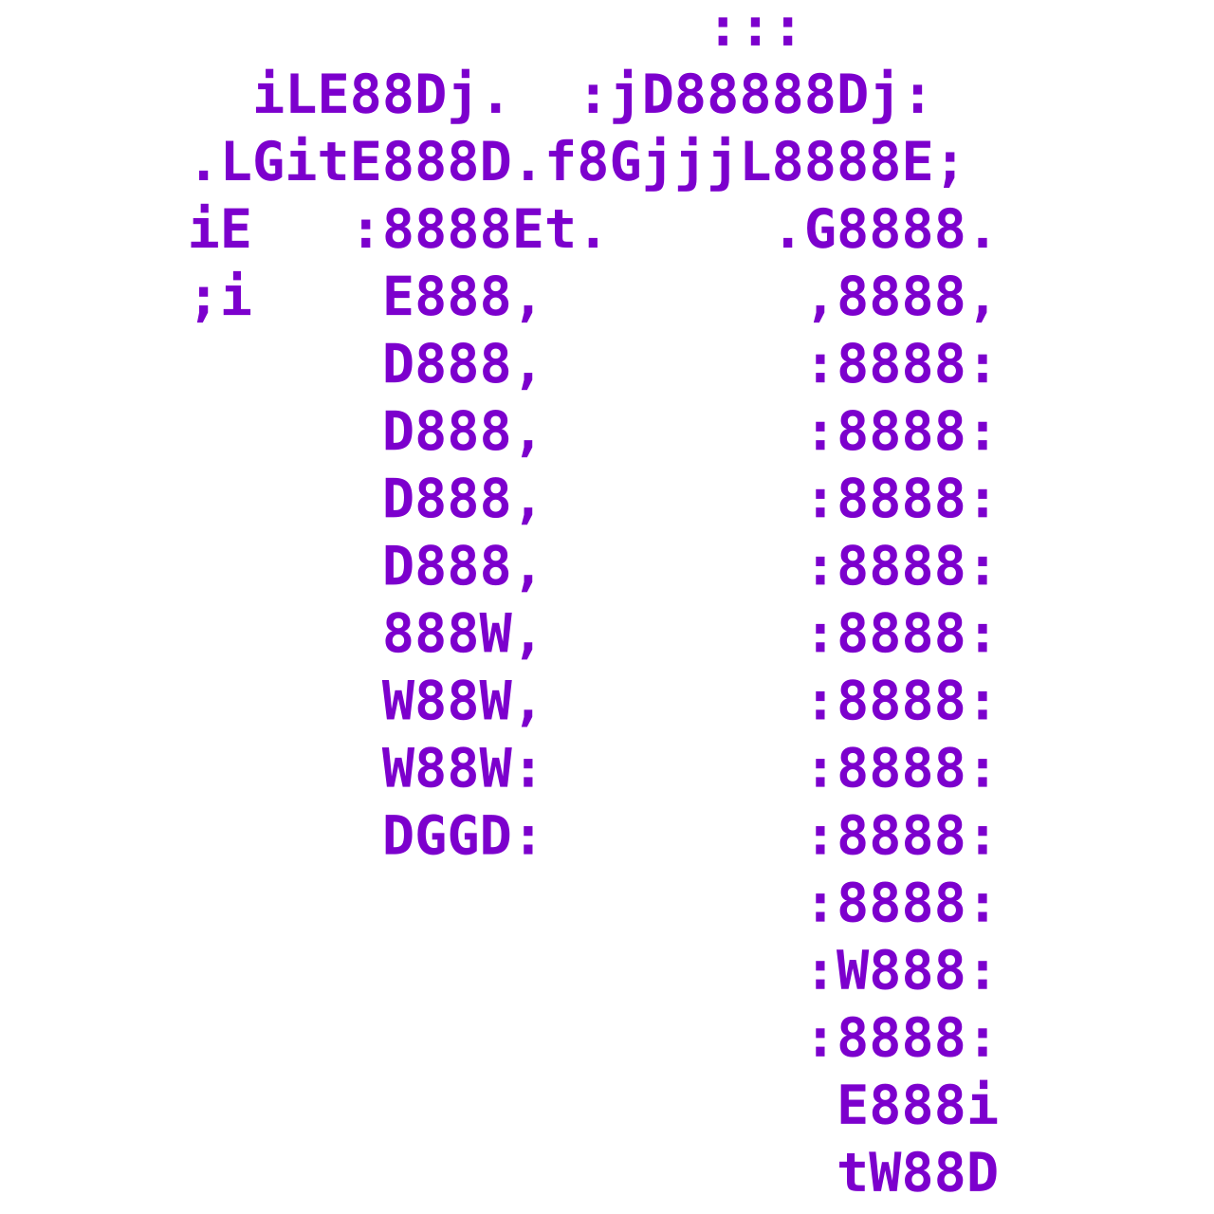


Create and edit a file – Terminal Text Editors
Vim
Nano
Emacs

Slide 15
Creating a Bash Script

Slide 16
Shell script basics
In shell scripts, the first line must specify the shell e.g. #!/bin/bash
The program loader recognizes the #! and will interpret the rest of the line (/bin/bash) as the interpreter program.
If a line starts with #, it is a comment and is not run.
#!/bin/bash
#look at the files in /tmp
cd /tmp
ls
Shell to run
Comment
Change directories
List everything in /tmp
Notes:
The hello.sh file you chmod’d was a bash shell script.
This implies that the Bash script is running in a separate independent shell. This separate shell terminates at the end of the script, leaving the parent shell, the shell we’re in, unaffected.
pwd
echo $$
PID OF CURRENT PROCESS

Slide 17
Selecting Resources
1
2
3
Login Node
Resources
Job Request
Notes:
3. Jobs do not run immediately but instead wait in a SLURM managed queue. A job’s placement in the queue is dependent on multiple factors. We will discuss a few of the most common factors, but a general rule to follow is that the more resources a job requests the longer it will wait in the queue.

Slide 18
Common Resource Requests
Partition
Quality of Service
Cores, GPUs,
and Nodes
Wall Time
Notes:
Partition – Defines what type of hardware your job has access to.
Ntasks – How many CPU cores your job is requesting
Nodes – How many nodes your job will run across (typically 1, but can be more)
Wall Time – How much time your job needs to run on the system (can be a few minutes, a few hours, to multiple days)
Quality of Service (QOS) – Defines additional job constraints – i.e. limits to how much your job can request.

Slide 19
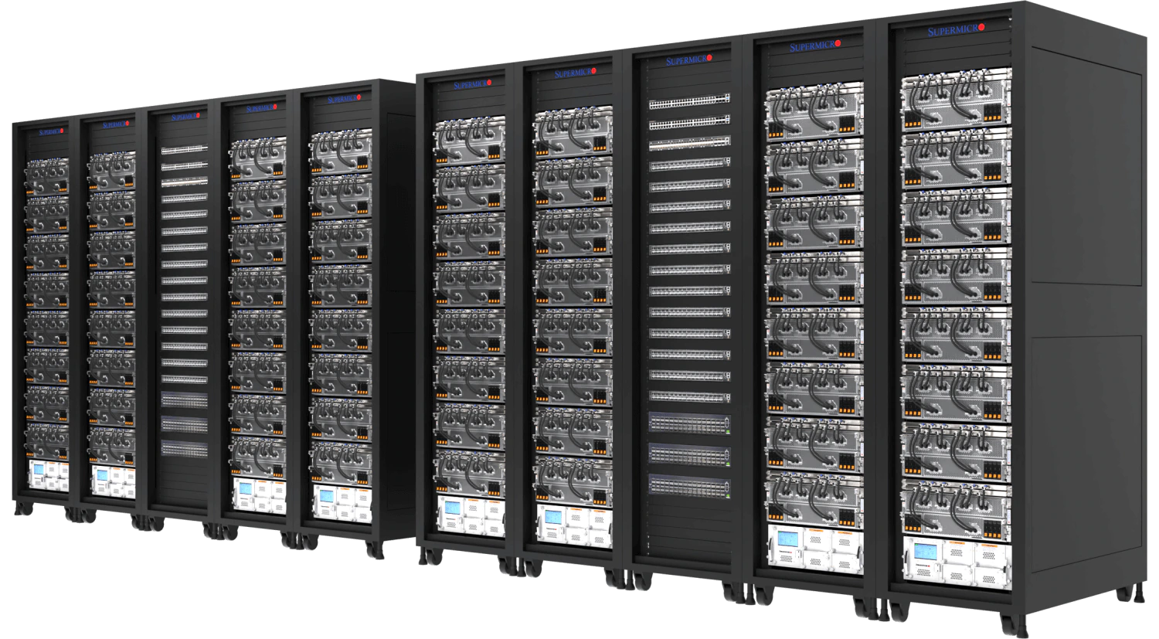
Alpine Partitions
Partitions are a collection of compute nodes with common characteristics
Compute nodes can be thought of as a desktop without a monitor
For in-depth information on partitions see: curc.readthedocs.io/en/latest/clusters/alpine/alpine-hardware.html#partitions
COMPUTE
Notes:
Compute nodes are organized into partitions – logical groups of similarly spec’d hardware.
Partitions make it easier to request specific resources and ensure a more consistent user experience.
The Alpine Cluster has four primary partitions.
Detailed Information on Alpine Hardware:
https://curc.readthedocs.io/en/latest/clusters/alpine/alpine-hardware.html

Slide 20
Alpine Partitions - acpu
acpu
General CPU
Overview
Nodes
Data
Login
Notes:
amilan:
285 Nodes
64 CPU Cores per Node
3.75 GB of RAM per CPU (240 GB total)
Detailed Information on Alpine Hardware:
https://curc.readthedocs.io/en/latest/clusters/alpine/alpine-hardware.html

Slide 21
Alpine Partitions - amem
acpu
General CPU
amem
High Memory CPU
Notes:
amem:
22 Nodes
48 CPU Cores per node (12)
64 CPU Cores per node (10)
21.5 GB of RAM per CPU (1 TB total)
Detailed Information on Alpine Hardware:
https://curc.readthedocs.io/en/latest/clusters/alpine/alpine-hardware.html

Slide 22
Alpine Partitions – NVIDIA GPUs
aa100
al40
ah200
artxpro6000
Nvidia GPUs
acpu
General CPU
amem
High Memory CPU
Notes:
aa100
12 Nodes
64 CPU Cores per Node
3.75 GB of RAM per CPU (240 GB total)
3 GPU’s per Node (Nvidia A100)

Slide 23
Alpine Partitions – AMD GPUs
aa100
al40
ah200
artxpro6000
Nvidia GPUs
acpu
General CPU
amem
High Memory CPU
ami100
AMD GPUs
Notes:
ami100
8 Nodes
64 CPU Cores per Node
3.75 GB of RAM per CPU (240 GB total)
3 GPU’s per Node (AMD MI100)
Detailed Information on Alpine Hardware:
https://curc.readthedocs.io/en/latest/clusters/alpine/alpine-hardware.html

Slide 24
Alpine Testing Resources
For several of the different types of hardware, we provide testing resources. These resources enable quicker access.
  There are restrictions on the amount of resources you can request
Access to testing resources is enabled through a combination of partition and QoS selection
Available testing resources:
  Standard CPUs
  Compute nodes for verifying parallel applications
  NVIDIA A100 and AMD MI100 GPUs
For more information see: curc.readthedocs.io/en/latest/clusters/alpine/alpine-hardware.html#special-purpose-resources

Slide 25
Quality of Service (QoS)
Quality of Service specifies additional constraints for a given partition.
On Alpine, QoS can be used to run long jobs, specify testing partitions, and select high-memory nodes
QoS | Description | Max wall time | Max jobs/user | Max nodes/user
normal | Default QoS | 24 H | 1000 | 128
long | For jobs needing longer wall times | 7 D | 200 | 20
mem | High-memory jobs | 7 D | n/a | 12
testing | For jobs submitted to testing partitions | 1 H | 1 | n/a
compile | For jobs submitted to compile partition | 12 H | 1 | n/a
Notes:
Note: long qos has longer queue wait times

Slide 26
Selecting Hardware
Once a partition and QoS are selected, we need to say how much of the hardware we would like to use
The most common selections are
  The number of cores (often called “ntasks” on our system)
  The number computes nodes (often referred to as “nodes”)
  The type of GPU
Notes:
Note: long qos has longer queue wait times

Slide 27
GRES Type
Once
MIG
Notes:
Note: long qos has longer queue wait times

Slide 28
Walltime
Walltime or “run time” is how long you want to run on the selected resources
How long do I specify?
  Downsides to requesting too much time
Notes:
Note: long qos has longer queue wait times

Slide 29
Selecting Resources
1
2
3
Login Node
Resources
Job Request
Notes:
3. Jobs do not run immediately but instead wait in a SLURM managed queue. A job’s placement in the queue is dependent on multiple factors. We will discuss a few of the most common factors, but a general rule to follow is that the more resources a job requests the longer it will wait in the queue.

Slide 30
Planned Maintenance
Planned maintenance is …
Notes:
Now that you have a general idea of what resources you plan to request, you will need to consider the type of job you are wanting to schedule. A batch job or an interactive job.

Slide 31
Batch vs Interactive Jobs
Batch
Job
Interactive
Job
Notes:
Now that you have a general idea of what resources you plan to request, you will need to consider the type of job you are wanting to schedule. A batch job or an interactive job.

Slide 32
Batch Jobs
Runs a job script
No need for user input
Best for tested workflows and long/big jobs
Batch
Job
Interactive
Job

Slide 33
Interactive Jobs
Terminal or GUI
Requires active user input
Best for development and exploration
Batch
Job
Interactive
Job

Slide 34
Slurm Directives
Slurm is a popular resource manager for High-Performance Computing systems
  Grabs the resources you are requesting
  Determines when your job will run
Slurm directives are how we tell Slurm what resources we would like
  Are used for both interactive and batch jobs
Notes:
Now that you have a general idea of what resources you plan to request, you will need to consider the type of job you are wanting to schedule. A batch job or an interactive job.

Slide 35
Common Slurm Directives
Partition – A collection of compute nodes
  --partition=<partition_name>
Quality of service (QoS) – System defined constraints for a job (more on this later!)
  --qos=<qos>
Allocation – Account to “charge to”
  --account=<account_name>
Number of nodes to run on
  --nodes=<nodes>
Number of cores to run on
  --ntasks=<number-of-tasks>
ADD GRES
- Must be specified for every job

Slide 36
Common Slurm Directives cont.
Wall time – How long you want to run on these resources
  --time=<wall time>
Job name
  --job-name=<jobname>
Output – Where all output that would be written to the terminal should go
  --output=<name>
Send an email when events happen in the job
  --mail-type=<type>
Email address to send updates to
  --mail-user=<user>
- Must be specified for every job

Slide 37
Starting an interactive job
acompile
A custom CURC command
Submits an interactive job to the acompile testing resources
Limit of 4 CPUs for up to 12 hours
Focused on compiling/building software and small workflows
sinteractive
Request any partition, more resources, and longer walltime
Subject to standard wait times (not immediate access)
As the name implies, allows you to access a job interactively

Slide 38
Running an interactive job
Here we will run a Python script using an interactive job
First request resources:
When the job starts you will be put on a compute node and you can execute your commands:
To quit:
[ralphie@login-ci3]$ sinteractive --partition=acpu --qos=cpu-normal --time=10 --ntasks=1 --nodes=1
[ralphie@c3cpu-e2-u1]$ module load anaconda
[ralphie@c3cpu-e2-u1]$ python my_very_cool_script.py
[ralphie@c3cpu-e2-u1]$ exit

Slide 39
Batch Jobs
Batch Jobs are jobs you submit to the scheduler that are run later without supervision
A job script is simply a script that includes SLURM directives (resource specifics) ahead of any commands.

Slide 40
Anatomy of a job script
#!/bin/bash
## Directives
#SBATCH --<option>=<value>
## Software
module load <software>
## User scripting
<command>

Slide 41
Directives in a job script
#SBATCH --<option>=<value>

Slide 42
Creating a Job Script

Slide 43
Example job script
#!/bin/bash
## Directives
#SBATCH --ntasks=1 # Number of requested tasks/cores
#SBATCH --time=0:01:00 # Max run time
#SBATCH --partition=acpu # Specify Alpine CPU node
#SBATCH --qos=cpu-normal # Specify QoS
#SBATCH --output=test_%j.out # Rename standard output file
## Software
module purge # Purge all existing modules
## User commands
echo "This is a test submitted by $USER"
Notes:
Output files are important for debugging and verifying a job has completed successfully. Always include a --output directive!
The output file is created in directory job was run unless specified in your --output directive.
If the directive --output is not provided, then a generic file name will be used (slurm_xxxxxx.out).

Slide 44
Submitting a Job script
sbatch <job_file> <other-directives>
Command to submit a job to the SLURM job scheduler

Slide 45
Submitting a Job script
sbatch <job_file> <other-directives>
Command to submit a job to the SLURM job scheduler
If we created the job script “my_first_job.sh” then we would submit it as follows:
sbatch /path/to/my_first_job.sh

Slide 46
Submitting a Job script
sbatch <job_file> <other-directives>
Command to submit a job to the Slurm job scheduler
If we created the job script “my_first_job.sh” then we would submit it as follows:
sbatch /path/to/my_first_job.sh
Modify Slurm directives in the batch script:
sbatch /path/to/my_first_job.sh --ntasks=12

Slide 47
Checking your jobs
squeue: Monitor your jobs status in queue and while running:
  By default, shows all jobs in queue can specify using:
sacct: Check back on usage statistics of previous Jobs
  By default, only checks all jobs from the start of the current day can specify using:
$ squeue –u <username>
$ squeue –p <partition>
$ sacct –u <username>
$ sacct --start=MM/DD/YY –u <username>
$ sacct –j <job-id>
47

Slide 48
Checking your jobs
To check the percentage of CPU and memory usage of a job after it completes, use seff
To see general statistics for your submitted jobs, use jobstats
$ module load slurmtools
$ seff <job number>
$ module load slurmtools
$ jobstats <username> <# of days>
48

Slide 49
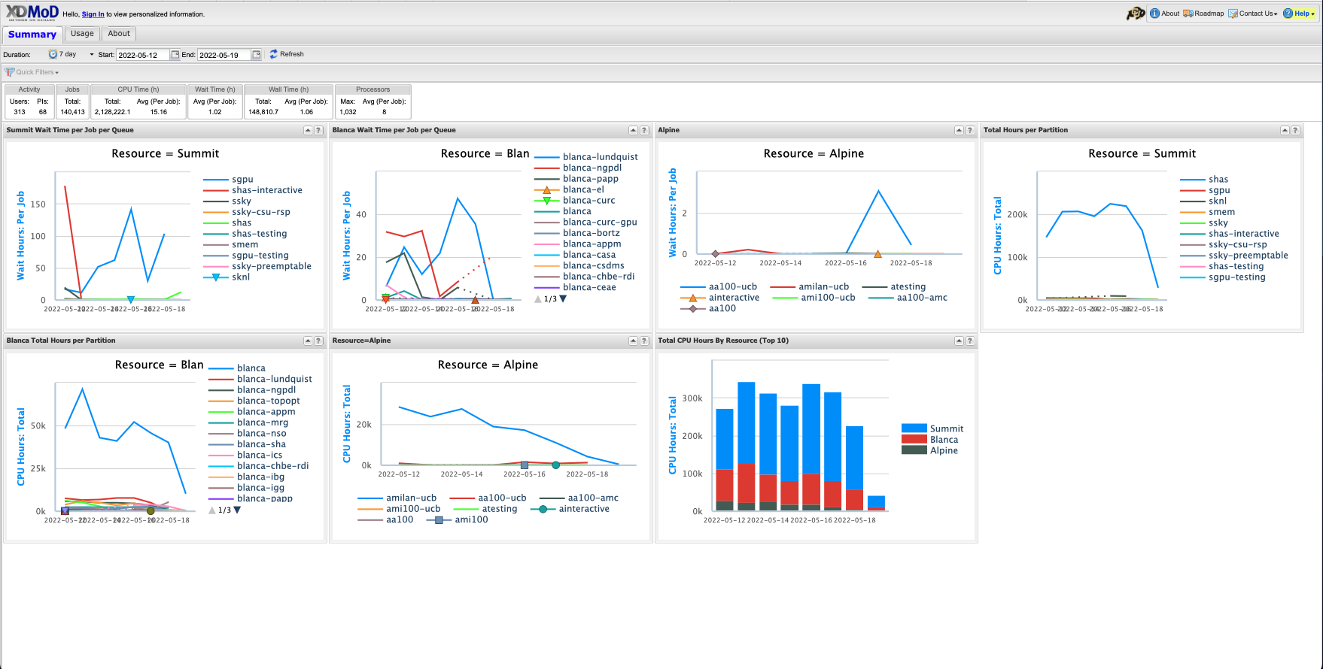
Job Monitoring - XDMOD

Slide 50
Help! I’m stuck, where do I go?
Documentation: curc.readthedocs.io
Trainings with Center for Research Data and Digital Scholarship (CRDDS): www.colorado.edu/crdds
Support request form: colorado.service-now.com/req_portal?id=ucb_sc_rc_form
Consult Hours (Tuesday 1:00-2:00pm in-person or virtually, Thursday 1:00-2:00pm virtually)

Slide 51

Survey and feedback
https://s.zoom.us/m/bPlTUoGhy

