Slide 1
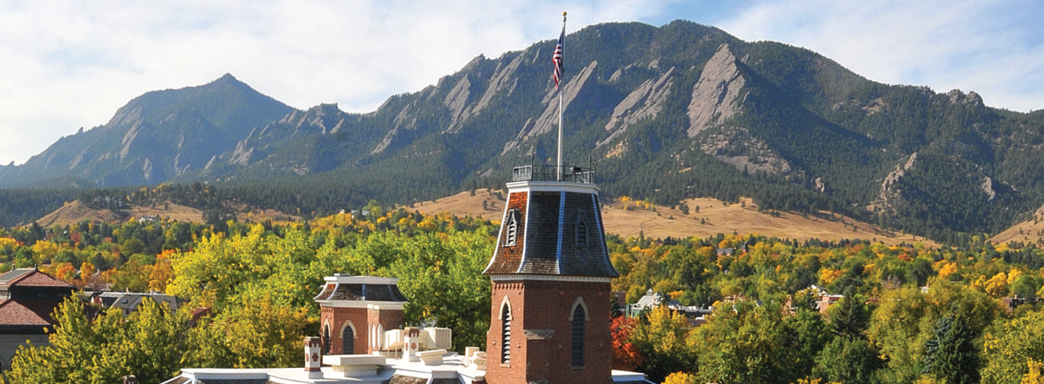
New User Seminar

Slide 2

Useful CURC links
Website: www.rc.colorado.edu
Documentation: curc.readthedocs.io
Support request form: colorado.service-now.com/req_portal?id=ucb_sc_rc_form
2

Slide 3
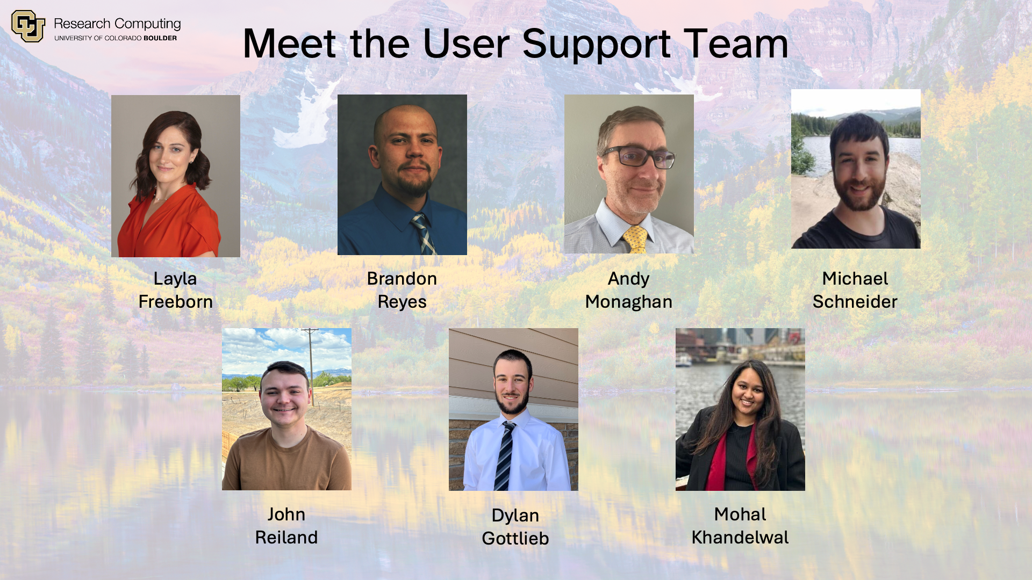
The user support team

Slide 4
RC Resources
Tech Support
High-Performance Computing (HPC)
Data Management
Cloud Computing
Secure Research
Human Support
Training Materials & Workshops
Consultations & Office Hours
Help Tickets
Notes:
The Secure Research manages the CMMC environment (Preserve), but we can help users connect with the SR team if they have confidential data (e.g. HIPA, Financial, FERPA, Government data, etc.)

Slide 5
Slide encouraging questions and discussion
Ask Questions
Discuss Ideas
Notes:
This workshop is meant to be empowering and information-rich – to help you get the most out of your HPC workflow.
Feel free to ask questions during the presentations and to discuss ideas/thoughts during breaks and the hands-on portion of the workshop.

Slide 6
Learning Goals
HPC
Overview
Nodes &
Partitions
Data
Storage
System
Access

Slide 7
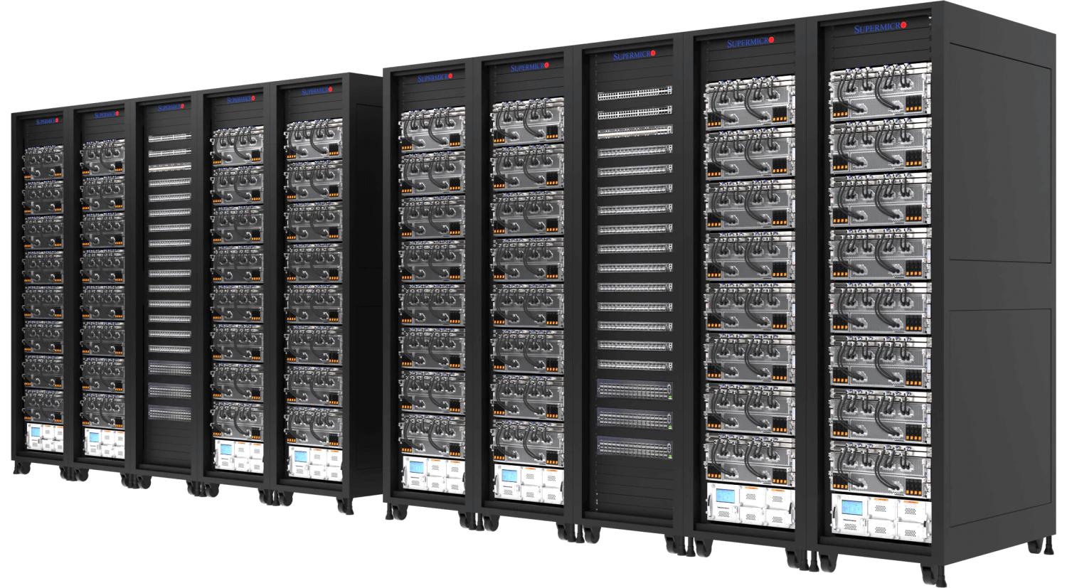
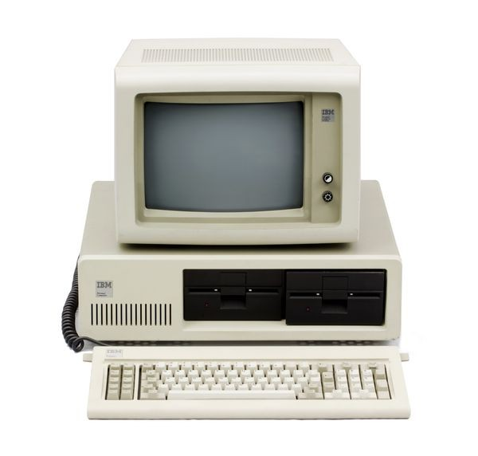
High-Performance Computing
Scale
vs
Speed
Overview
Nodes
Data
Login
Notes:
Be careful when comparing the performance of your personal computer and an HPC system.
You may find your personal computer runs some jobs faster than the HPC system but remember an HPC system’s strength comes from its ability to scale.
An HPC system provides 100’s of CPU’s, terabytes of RAM, and petabytes of data storage.

Slide 8
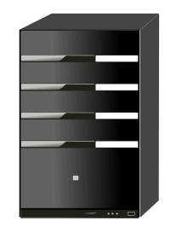
What can I use HPC for?
Tiny Job
Big Job
Tiny Job
Tiny Job
Parallel Jobs
Serial Jobs
Overview
Nodes
Data
Login
Notes:
Parallel Jobs - Divide and Conquer
A job that can be divided into smaller pieces, which can be independently run.
Serial Jobs
A collection of small jobs which can be done simultaneously

Slide 9
What can I use HPC for? Cont.
Big Data
Viz/Rendering
Shared Work Environment
Overview
Nodes
Data
Login
Notes:
Big Data:
- Require lots of RAM (memory) or data storage
- Need more CPU’s, distributed system
Visualization Rendering
Unique Hardware
- GPU’s, Linux, Shared team environment

Slide 10
HPC Cluster: Alpine
Heterogeneous cluster
Hardware provided by CU Boulder, CSU, and AMC
Access available to CU Boulder, CSU, AMC and RMACC users
Overview
Nodes
Data
Login
Notes:
Update Icon

Slide 11
Node Types
LOGIN
COMPILE
COMPUTE
Overview
Nodes
Data
Login

Slide 12
Node Types (Login Nodes)
LOGIN
COMPILE
COMPUTE
Entry to system
View or edit files
Submit jobs
Overview
Nodes
Data
Login
Notes:
Do not run software applications on a login node!
Examples:
No loading anaconda, do not run python scripts, or start a compiled software program.

Slide 13
Node Types (Compile Nodes)
LOGIN
COMPILE
COMPUTE
View or edit files
Submit jobs
Compile/install software
Test software
Overview
Nodes
Data
Login

Slide 14
Node Types (Compute Nodes)
LOGIN
COMPILE
COMPUTE
Run scheduled jobs
Handle calculations
Overview
Nodes
Data
Login

Slide 15
Alpine Partitions
COMPUTE
Overview
Nodes
Data
Login
Notes:
Compute nodes are organized into partitions – logical groups of similarly spec’d hardware.
Partitions make it easier to request specific resources and ensure a more consistent user experience.
The Alpine Cluster has four primary partitions.
Detailed Information on Alpine Hardware: https://curc.readthedocs.io/en/latest/clusters/alpine/alpine-hardware.html

Slide 16
Alpine Partitions - acpu
acpu
General Usage
Overview
Nodes
Data
Login
Notes:
amilan:
285 Nodes
64 CPU Cores per Node
3.75 GB of RAM per CPU (240 GB total)
Detailed Information on Alpine Hardware: https://curc.readthedocs.io/en/latest/clusters/alpine/alpine-hardware.html

Slide 17
Alpine Partitions - amem
acpu
General Usage
amem
High Memory
Overview
Nodes
Data
Login
Notes:
amem:
22 Nodes
48 CPU Cores per node (12)
64 CPU Cores per node (10)
21.5 GB of RAM per CPU (1 TB total)
Detailed Information on Alpine Hardware: https://curc.readthedocs.io/en/latest/clusters/alpine/alpine-hardware.html

Slide 18
Alpine Partitions – NVIDIA GPUs
aa100
al40
ah200
artxpro6000
Nvidia GPUs
acpu
General Usage
amem
High Memory
Overview
Nodes
Data
Login
Notes:
aa100
12 Nodes
64 CPU Cores per Node
3.75 GB of RAM per CPU (240 GB total)
3 GPU’s per Node (Nvidia A100)

Slide 19
Alpine Partitions – AMD GPUs
aa100
al40
ah200
artxpro6000
Nvidia GPUs
acpu
General Usage
amem
High Memory
ami100
AMD GPUs
Overview
Nodes
Data
Login
Notes:
ami100
8 Nodes
64 CPU Cores per Node
3.75 GB of RAM per CPU (240 GB total)
3 GPU’s per Node (AMD MI100)
Detailed Information on Alpine Hardware: https://curc.readthedocs.io/en/latest/clusters/alpine/alpine-hardware.html

Slide 20
Data Storage
Core
PL
Personal Storage
Includes 3 Directories
/home (2 GB)
/projects (250 GB)
/scratch (10 TB)
PetaLibrary
Tiered Storage
Active, Archive
Paid storage
Starts at 1 TB
Overview
Nodes
Data
Login

Slide 21
Core
Home
Projects
Scratch
Personal data
Config files
Backed up
Do not share!
Code, Job scripts
Installed software
Backed up
Shared data
Job data (in/out)
Shared data
Deleted after 90 days and no backups
2 GB
250 GB
10 TB
Overview
Nodes
Data
Login
Notes:
Documentation on Filesystem/Storage: https://curc.readthedocs.io/en/latest/compute/filesystems.html

Slide 22
PetaLibrary
Active
Archive
Performance tier
Accessible by all nodes
No file limit
Integrity tier
Accessible by login node
10,000 file limit
Overview
Nodes
Data
Login
Notes:
Documentation on PetaLibrary: https://curc.readthedocs.io/en/latest/storage/petalibrary/index.html

Slide 23

Data Sharing: Within RC
/home ← Private!!!
/project
/scratch
PetaLibrary Space
Overview
Nodes
Data
Login
Notes:
*Users manage access to their /project and /scratch directories.
RC Staff manage access to the PetaLibrary Space

Slide 24
Data Sharing: Outside RC
Tools for data transfers:
Globus (Recommended)
Open OnDemand (for data <1GB)
Terminal/Command Line:
rsync
rclone
sftp
scp
Overview
Nodes
Data
Login
Notes:
DTN require internal CU Network access (VPN)

Slide 25
Data Transfer Nodes (DTN)
Dedicated nodes that support data transfers
Automatically utilized by Globus
Can be selected when using command line tools
dtn.rc.colorado.edu
DTNs
Overview
Nodes
Data
Login

Slide 26
Acceptable data storage and use
CURC systems and services should not be used to store any data that is US government Classified, nor any Controlled Unclassified Information.
For users requiring storage for sensitive data types, please see the secure research computing resources:
www.colorado.edu/rc/secure-research-computing-resources
Overview
Nodes
Data
Login

Slide 27

Cloud Computing
CURC supports AWS, Azure, and GCP
Alternative or augmentation to HPC
Interested and need help? Submit a support request form: colorado.service-now.com/req_portal?id=ucb_sc_rc_form
Overview
Nodes
Data
Login
Notes:
Cloudbursting

Slide 28
How to Access RC Resources?
Get an RC account
Set up two-factor authentication (Duo and/or Microsoft MFA)
Log in via 1) terminal or 2) Open OnDemand
Create greatness! (responsibly)
Overview
Nodes
Data
Login

Slide 29
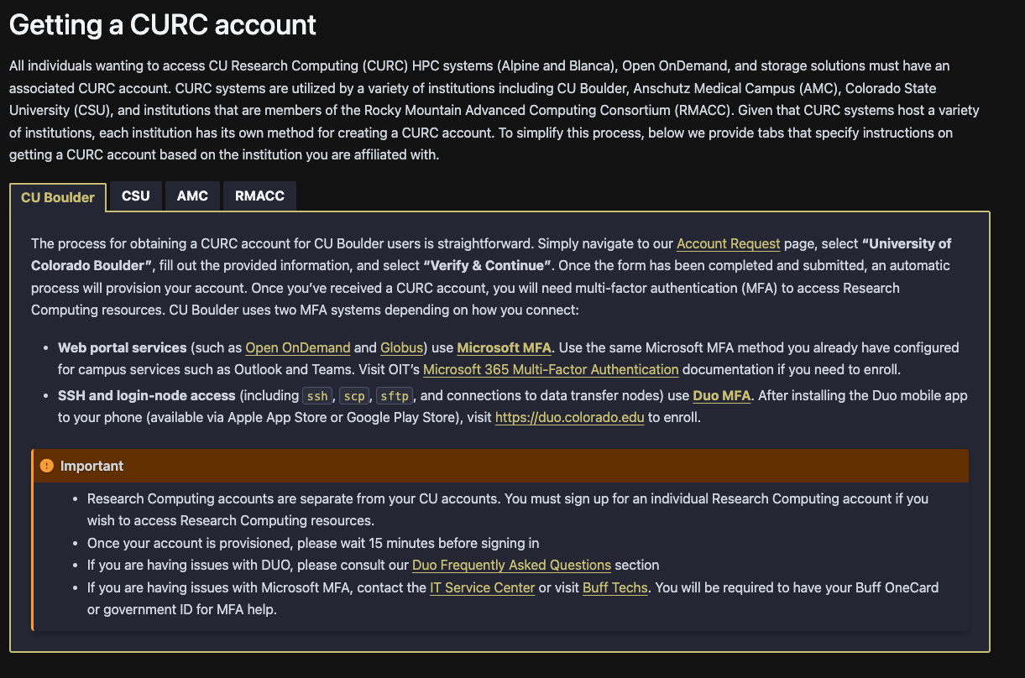
Getting an Account
Visit the appropriate tab under “Getting a CURC account” in the CURC documentation and follow the provided instructions:
curc.readthedocs.io/en/latest/getting_started/logging-in.html#getting-a-curc-account
Overview
Nodes
Data
Login

Slide 30
Your RC Account
Access to:
Alpine Cluster
Core Storage
PetaLibrary Storage*
Open OnDemand
Approximately 2,000 Service Units (SUs) per month
*If purchased
Overview
Nodes
Data
Login
Notes:
https://ondemand.rc.colorado.edu/
https://ondemand-rmacc.rc.colorado.edu/

Slide 31
Demo: logging in with Open OnDemand
CURC Open OnDemand is a browser based, integrated, single access point for all of your HPC resources at CU Research Computing.
CU Boulder: visit https://ondemand.rc.colorado.edu.
All other Institutions: visit https://ondemand-rmacc.rc.colorado.edu/
Institution specific instructions: https://curc.readthedocs.io/en/latest/open_ondemand/index.html#getting-started-with-open-ondemand
The type of two-factor authentication (Duo/Microsoft MFA) needed is institution dependent.
Overview
Nodes
Data
Login

Slide 32
Terminal Access
A terminal interface is accessible via the “terminal” application in Open OnDemand. This application is hosted on our login nodes. A local terminal that connects to CURC resources is available as follows*:
Mac or Linux
Terminal application
Windows
PuTTY
Powershell
[user0083@login-ci1 ~]$ pwd
/home/user0083
[user0083@login-ci1 ~]$
* Local terminal access is exclusive to CU and CSU accounts. Available upon request for AMC. Not available to RMACC.
Overview
Nodes
Data
Login

Slide 33
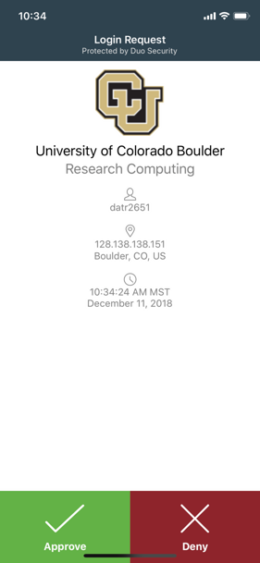
Duo Authentication
Currently, all ssh access is authenticated through Duo. Duo authentication can be completed via
Duo smartphone app (recommended)
Phone Call/Text is an alternatives
Overview
Nodes
Data
Login

Slide 34
Demo: Logging in via Terminal
To login to an RC login node* :
$ ssh <username>@login.rc.colorado.edu
Supply your institutional password and your Duo app will alert you to confirm the login
* Exclusive to CU and CSU accounts. Available upon request for AMC. Not available to RMACC.
Overview
Nodes
Data
Login

Slide 35
Help! I’m stuck, where do I go?
Documentation: curc.readthedocs.io
Trainings with Center for Research Data and Digital Scholarship (CRDDS): www.colorado.edu/crdds
Support request form: colorado.service-now.com/req_portal?id=ucb_sc_rc_form
Consult Hours (Tuesday 1:00-2:00pm in-person or virtually, Thursday 1:00-2:00pm virtually)
Or….

Slide 36
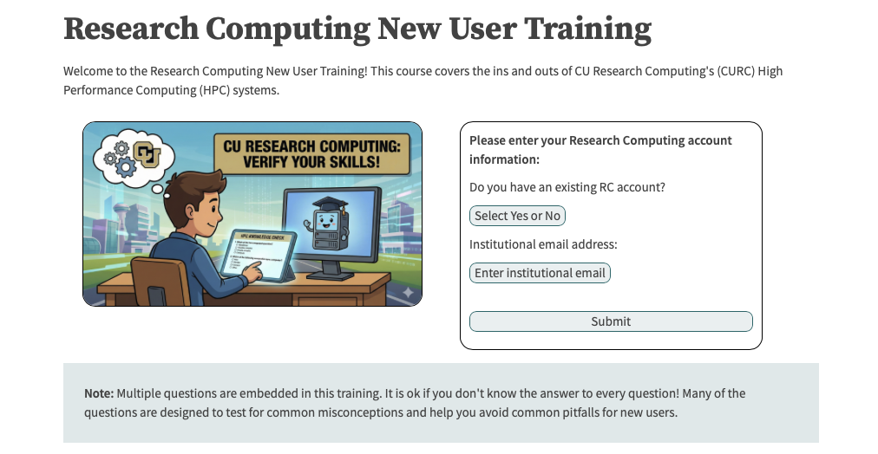
…try CURC’s new self-paced training!
researchcomputing.github.io/New_User_Async_Training

Slide 37

Survey and feedback
https://s.zoom.us/m/bPlTUoGhy

