Slide 1
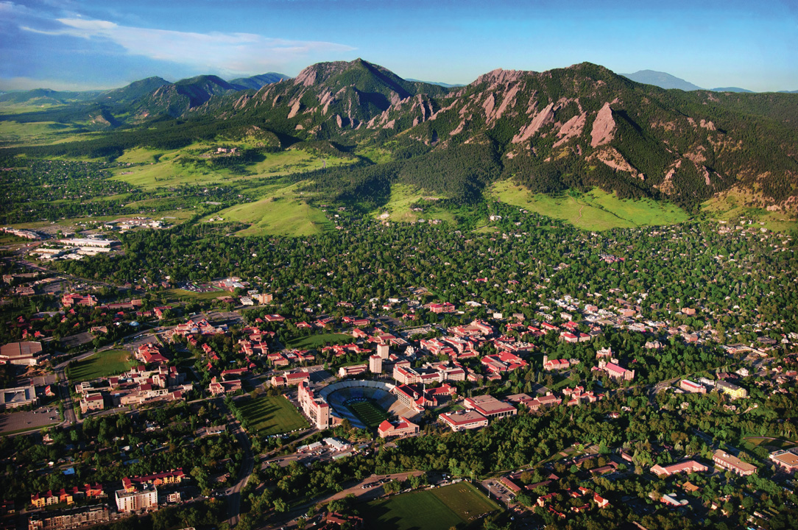
Choosing the right computing environment
Andrew Monaghan
Andrew.Monaghan@colorado.edu
www.colorado.edu/rc
Slides will be available for download from TBD link from RMACC website
Acknowledgement: Brett Milash (CHPC, U. Utah)

Slide 2
Which computing environment is right for the problem I am addressing?

Slide 3
Possible Answers:
My laptop or desktop computer
A high performance computing (HPC) platform
A high-throughput computing (HTC) platform
A cloud computing platform
A combination of the above

Slide 4
Steps toward a solution
Step 1: Initial assessment to understand your workflow.
Step 2: Assess and choose a compute resource
Step 3: Profile/scale your code on chosen compute resource to obtain optimal performance.

Slide 5
1. Initial Assessment
Can the workflow be completed quickly on my laptop/desktop?
Does my workflow require a single core or multiple cores?
How much memory (RAM) does my workflow require?
How much hard disk space does my workflow require?
What type of hard disk space does my workflow require?
Does the workflow require graphical processing units (GPUs)?
Can my workflow be checkpointed (saved as you progress)?
Is my data sensitive/protected?

Slide 6
2. Assess and Choose resource
Can the resource accommodate the number of cores I need?
Can the resource accommodate the type of cores I need?
Can the resource accommodate my memory (RAM) requirements?
Can the resource accommodate my hard disk requirements?
Do the wall clock limits on the resource fit my workflow?
Does the resource allow preemption?
Does the resource accommodate sensitive data (if needed)?

Slide 7
What resources are available? (1)
Institutional Cyberinfrastructure (CI)
On-site CI available at CU, CSU, Utah, Wyoming, UNM, NMSU, etc.
Smaller institutions can use RMACC CI allocation through CU
HPC is a good “general purpose” resource that can run both serial and parallel workflows
Usually have a few high-memory nodes and gpu nodes.
Have parallel filesystems
Possible limitations: Wall clock limits, RAM, size of resource, queues, sensitive data

Slide 8
What resources are available? (2)
National Cyberinfrastructure (NSF XSEDE)
HPC platforms (including very high memory, GPU, etc.)
Open Science Grid (OSG; High throughput computing)
Great for hundreds to thousands of serial jobs, 1-12 hours in length, <2 GB RAM, <10 GB hard disk
Jetstream Cloud environment
Great for highly customized workflows that may have time-variable resource requirements
Possible limitations: allocation process, allocation limits, preemption (in some cases)
More: https://portal.xsede.org/allocations/resource-info

Slide 9
What resources are available? (3)
Commercial Cloud
e.g., AWS, Google Cloud, MS Azure, IBM Cloud
Provides flexible, on-demand computing (convenient)
High reliability (uptime)
Increasingly can accommodate low-latency parallelism
Some providers can host sensitive data
Possible limitations: cost, large-scale parallelism

Slide 10
3. Optimize workflow for chosen resource
“Test drive” your workflow on the resource
Profiling
Look at memory and swap space usage during active job
How many threads are being used?
Is code CPU-bound or I/O bound?
Scaling
Does code performance change when I add/remove cores? (parallel workflows)
What is the optimal number of cores for load balance? (serial workflows)
Does code performance improve when I change compilers, compiler flags or MPI?
Iteratively optimize your workflow through testing. Then deploy.

Slide 11
Thank you
Feedback?: http://tinyurl.com/curc-survey18
Contact: Andrew.Monaghan@colorado.edu
Resources:
XSEDE: https://www.xsede.org
OSG: https://osgconnect.net
RMACC Summit: https://www.colorado.edu/rc

