Slide 1
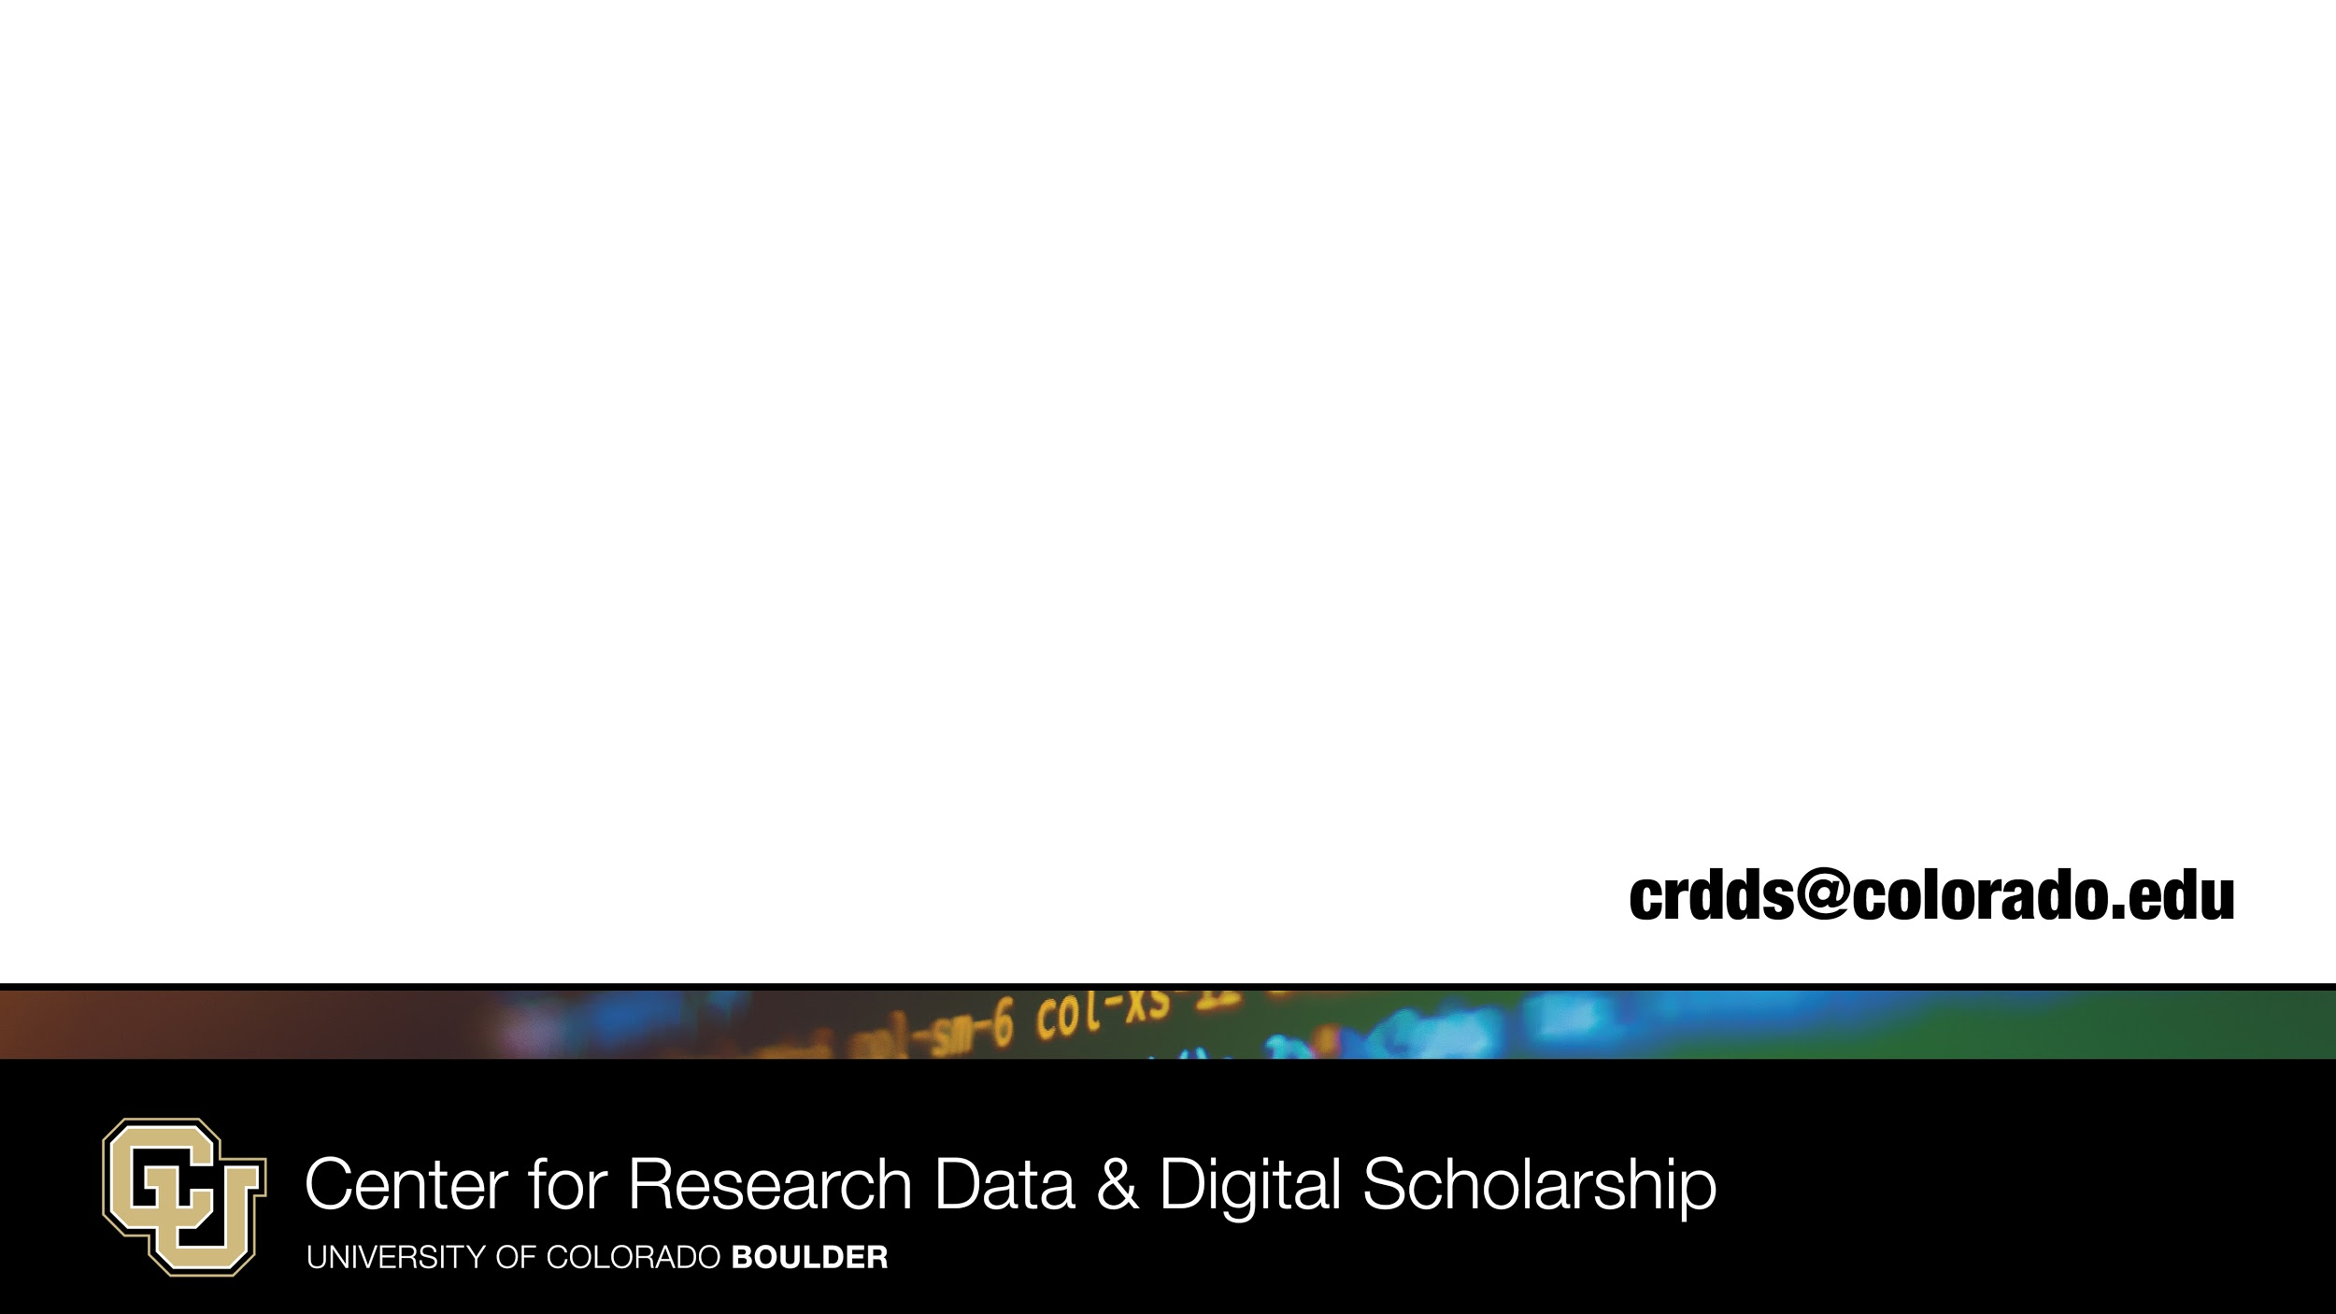
Data Management at CU Boulder
Presenter: Andy Monaghan
Content developed by Aditya Ranganath and Dylan Perkins
https://www.colorado.edu/crdds/
Notes:
Introduce CRDDS via website https://www.colorado.edu/crdds/

Slide 2
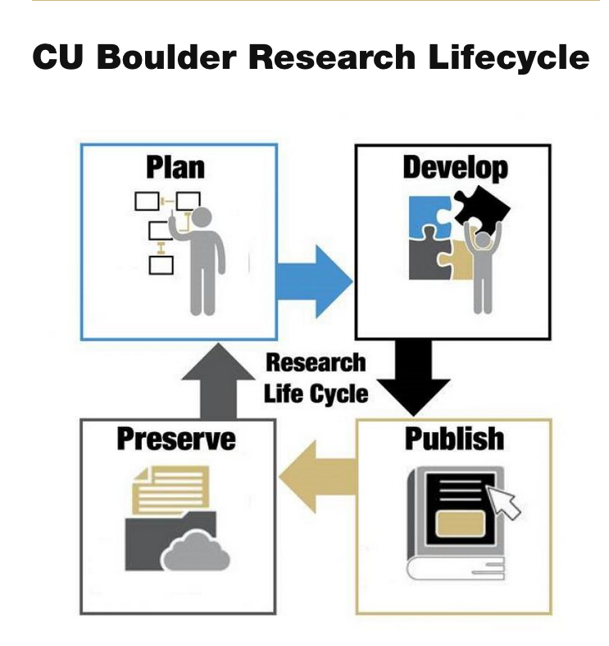
Data Management and the Research Lifecycle
Data management is implicated in every stage of the research lifecycle
Notes:
“Research data management (or RDM) is a term that describes the organization, storage, preservation, and sharing of data collected and used in a research project. It involves the everyday management of research data during the lifetime of a research project (for example, using consistent file naming conventions). It also involves decisions about how data will be preserved and shared after the project is completed (for example, depositing the data in a repository for long-term archiving and access).” (Source: https://pitt.libguides.com/managedata)

Slide 3
Presentation Scope
Our discussion about data management today will be cast in fairly broad terms, focusing on general principles that apply across projects
But each project has its own idiosyncrasies, and these are best discussed in the context of a 1:1 consultation
If you’d like to discuss your specific data management needs, please contact us! We host drop-in consultation hours on Tuesdays and Thursdays, and you can also make an appointment: crdds@colorado.edu

Slide 4
Presentation Roadmap
Why is data management important?
Data management planning
Data management during a research project
Data management after a research project
Data Management, Big Data, and High-Performance Computing
Notes:
Why is data management important?
As researchers, why is this data management something you should invest your time in?
Data management planning
Increasingly, funding agencies require researchers to put together data management plans (DMPs) as part of their grant applications. What exactly are DMP’s and what should you consider when writing them?
Data management during a research project
What are some tools and strategies you can use to keep all of your data organized while you are collecting and analyzing it?
Data management after a research project
The norms of open science, as well as funding agency and journal policies, are increasingly requiring research data to be publicly disseminated after research is published. How can CRDDS assist you with the process of making your data publicly available, so that it can be reused and cited by other researchers?
Data Management, Big Data, and High-Performance Computing

Slide 5
The Value of Research Data Management
Saves time
Facilitates continuity and communication in collaborative research settings
Facilitates reproducibility and the data publication process
Improves the quality of published data
Notes:
Saves time
Facilitates continuity and communication in collaborative research settings
If people cycle through a lab or research group over time, data management ensures that new members can quickly get up to speed and pick up where departing members left off
In the context of team member turnover, attention to data management minimizes the risk of data becoming misused or becoming unusable because of missing context or metadata
Facilitates reproducibility and the data publication process
Improves the quality of published data
This benefits you as the producer of data, since it increases the likelihood that your data will be useful to others, which leads to citations and influence
It benefits you as a consumer of data, since using well-managed and well-documented data from other labs to saves you time

Slide 6
Data Management Planning
Putting in place a framework for how you will manage your research data over the lifecycle of the project
Facilitates addressing possible issues and approach things in a deliberate and intentional way
Data management plans can be internally facing, as well as externally facing; they are increasingly a requirement of funding agencies
Notes:
Data management planning is about putting in place a framework for how you will manage your research data over the lifecycle of the project
Putting things in writing helps you to think through various issues that might arise, and approach things in a deliberate and intentional way, rather than figuring things out as you go.
Data management plans can be internally facing, as well as externally facing; they are increasingly a requirement of funding agencies, which ask you to submit formal data management plans as a part of funding applications.
When starting a project consider drafting two plans:
One for funding agencies
Another for internal use, which can be based on the externally facing plan, but which goes into greater detail on operational issues, and thereby facilitates project continuity

Slide 7
The Elements of a Data Management Plan
The NSF’s Data Management plan guidelines for engineering fields (https://nsf.gov/eng/general/ENG_DMP_Policy.pdf) require discussion of the following:
Research products
Data formats and standards
Dissemination, Access, and Sharing of Data
Re-use, Redistribution, and Production of Derivatives
Archiving of Data
Notes:
Research products: What data products will result from the research being proposed? What metadata will be collected and distributed to facilitate the data’s legibility to others?
Data formats and standards: What are the file formats in which the data will be stored and distributed, and what issues arise with respect to issues such as accessibility and interoperability?
Dissemination, Access, and Sharing of Data: How will the data be disseminated to the broader research community after the research is complete (i.e. disciplinary repository? Institutional repository?). Are there privacy-related, or legal or ethical constraints on the ability to share data?
Re-use, Redistribution, and Production of Derivatives: What can other parties do with the research data that you will share? Are there any constraints on how the data you produce can be used by these external parties?
Archiving of Data: What data will be archived, and how will it be preserved over time?

Slide 8
Support for Data Management Planning at CU-Boulder
One of CRDDS’s roles is to assist researchers with writing DMPs
CU subscribes to a useful tool, called “dmptool” that has pre-formatted DMP templates from various funding agencies, and which walks you through the process of completing one: https://dmptool.org/
When signing in, indicate that you’re from CU Boulder
The data librarians are happy to read drafts and provide feedback on your draft DMPs, so please send them their way! (crdds@colorado.edu)
Notes:
Brief DMPTool Activity
Select a DMP Template relevant for your field (if you’re having trouble choosing, pick the generic NSF template)
Look through the prompts
Think of a project you plan to initiate in the near future that will require the use of data. Attempt to answer the prompts in the context of your proposed project, and use the tool to generate your draft DMP.
Were any of the prompts challenging or confusing? Is there anything you would like clarification on?

Slide 9
Data Management During a Project
Storage
Documentation
Metadata! See https://libraries.mit.edu/data-management/store/documentation/
File management
Pprimer on file naming and organization conventions: https://researchdata.wisc.edu/file-naming-and-versioning/
Notes:
Storage
Where will data be stored? One Drive, PetaLibrary etc.
How will data be backed up?
What security measures are in place to protect the data?
Documentation
Don’t wait until the end of a project to generate metadata! Documenting your data workflows as you go will make life much easier. For guidance on best practices for data documentation and metadata, this document (from MIT) is a good place to start: https://libraries.mit.edu/data-management/store/documentation/
File management
Data files can quickly proliferate, and it’s important to have a framework in place that regulates how files are named, where they are stored, and how they are versioned. For a useful primer on file naming and organization conventions, see this resource: https://researchdata.wisc.edu/file-naming-and-versioning/

Slide 10
Data Management Tools for Managing Data and Files During a Project
The Unix Shell/Command Line
Git and GitHub
https://github.com
Open Science Framework
https://osf.io/
CRDDS offers workshops on all of these tools (and more!)
Notes:
The Unix Shell/Command Line:
Create, name, delete, and move around files and directories,programmatically (For an excellent tutorial on using the Unix shell for file management, see here: https://swcarpentry.github.io/shell-novice/.
Git and GitHub
Among other things, helps to track changes made to files containing data and code over time.
Open Science Framework
Designed to be a one-stop shop for all of your data and project management needs.
It integrates various data storage, analysis, versioning, and management applications into one unified platform
https://osf.io/
CRDDS offers workshops on all of these tools (and more!)

Slide 11
Data Management in a Project’s Afterlife: Dissemination and Archiving
Almost all funding agencies require data to be publicly disseminated and stored over a long time horizon
In a DMP, stating that data will be shared “upon request” or on personal websites is generally inadequate; the norm is that data will be disseminated through a dedicated online repository with a digital object identifier (DOI)
Will require metadata and documentation to facilitate reuse; easier to generate this information if you’ve paid attention to data management from the start
Notes:
Funding agencies increasingly require data to be publicly disseminated and stored over a long time horizon
The DMPs required by these agencies ask researchers about their plans in these areas
Saying that data will be shared “upon request” or on personal websites is increasingly seen as inadequate; the norm taking hold is that data will be disseminated through a dedicated online repository with a digital object identifier (DOI)
These repositories can be discipline-specific, or institutional repositories (generally, either is seen as acceptable)
Will require metadata and documentation to facilitate reuse; easier to generate this information if you’ve paid attention to data management from the start

Slide 12
Data Management and Big Data
As the size and complexity of your data increases, storage and data management issues are likely to become increasingly complex
Such “big” datasets (on the terabyte or petabyte scale) require specialized tools and infrastructure for data management
CU Boulder’s offers:
Microsoft OneDrive (up to 5 TB per CU Boulder person)
“PetaLibrary” (unlimited TB, accessed via CU Research Computing)

Slide 13
Gateways for PetaLibrary Access
OnDemand
https://www.ondemand.rc.colorado.edu (Currently CU-Boulder only)
https://www.ondemand-rmacc.rc.colorado.edu (Everyone else)
Globus
https://www.globus.org
Command Line
URL (for sharing)

Slide 14
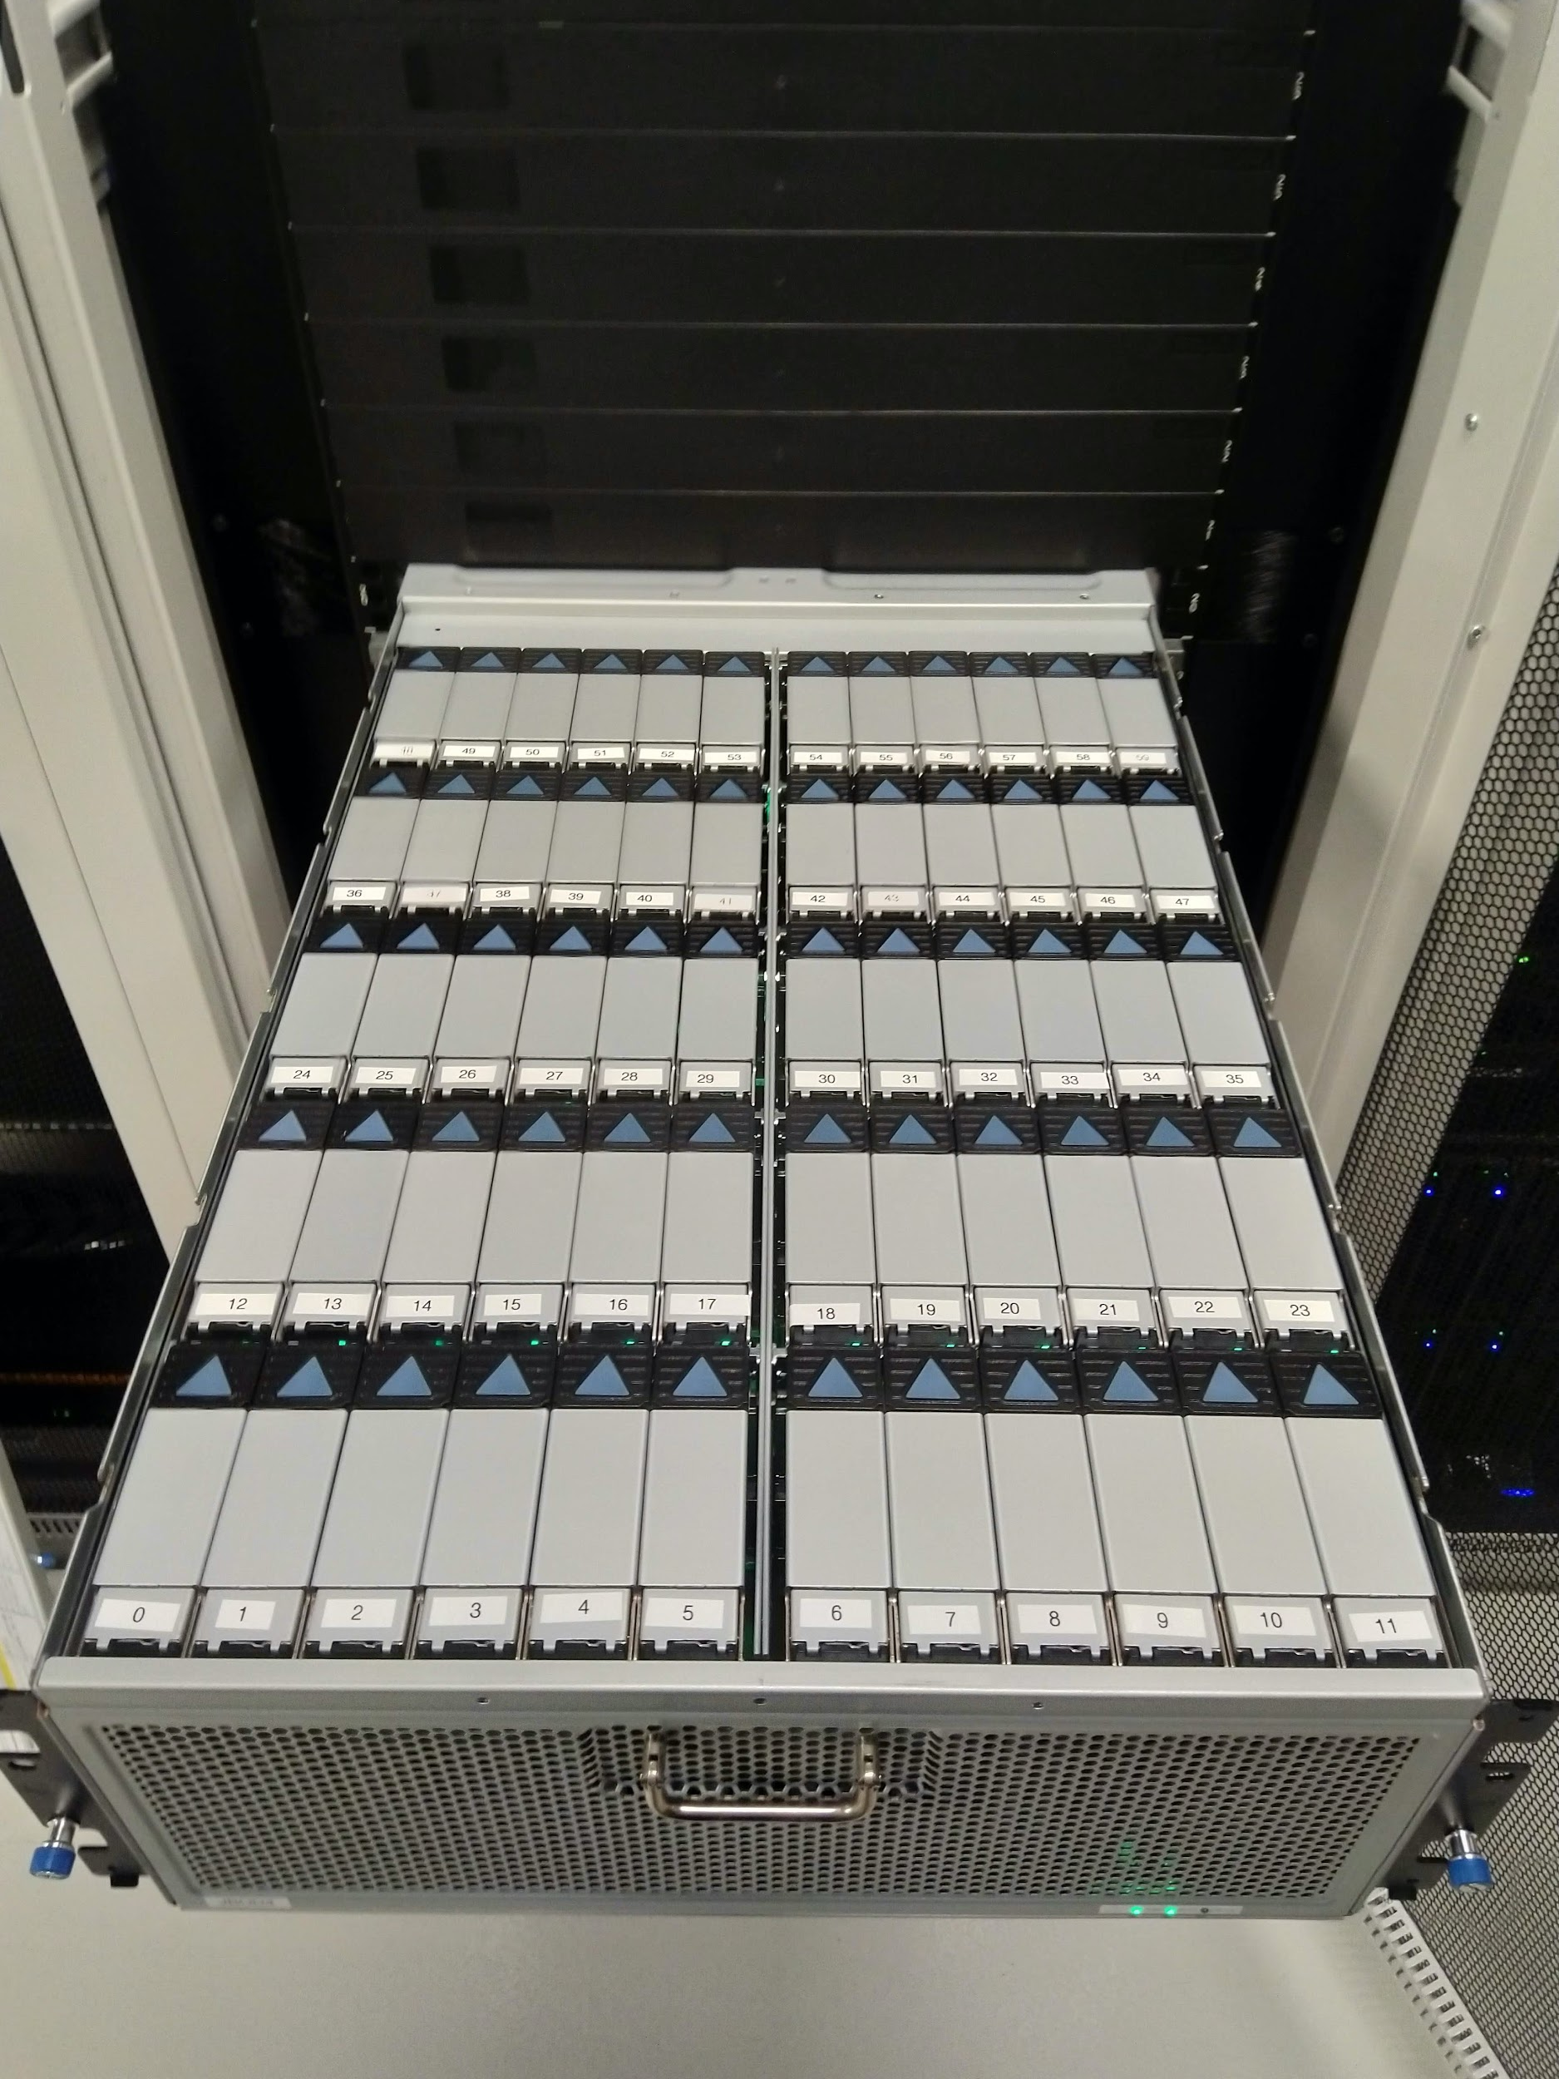
PetaLibrary
Active disk storage
$45/TB/year
Accessible from all RC compute nodes
Archive tape storage
$20/TB/year
iRODS

Slide 15
Questions?
Email: crdds@colorado.edu
Website: www.colorado.edu/crdds

