Slide 1
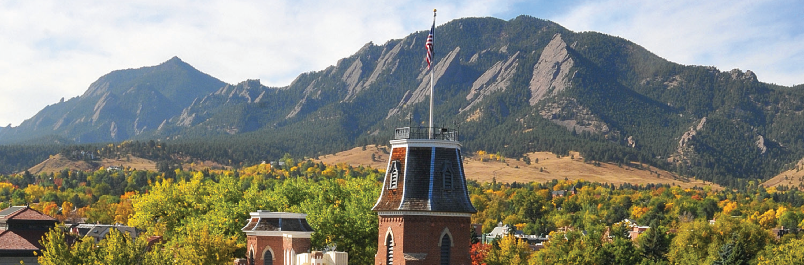
Applied Containerization for Machine Learning in HPC

Slide 2

Applied Containerization for Machine Learning in HPC
Website: http://www.colorado.edu/rc
Documentation: https://curc.readthedocs.io
Helpdesk: rc-help@colorado.edu
Slides
https://github.com/ResearchComputing/applied_containerization_for_ml_short_course

Slide 3
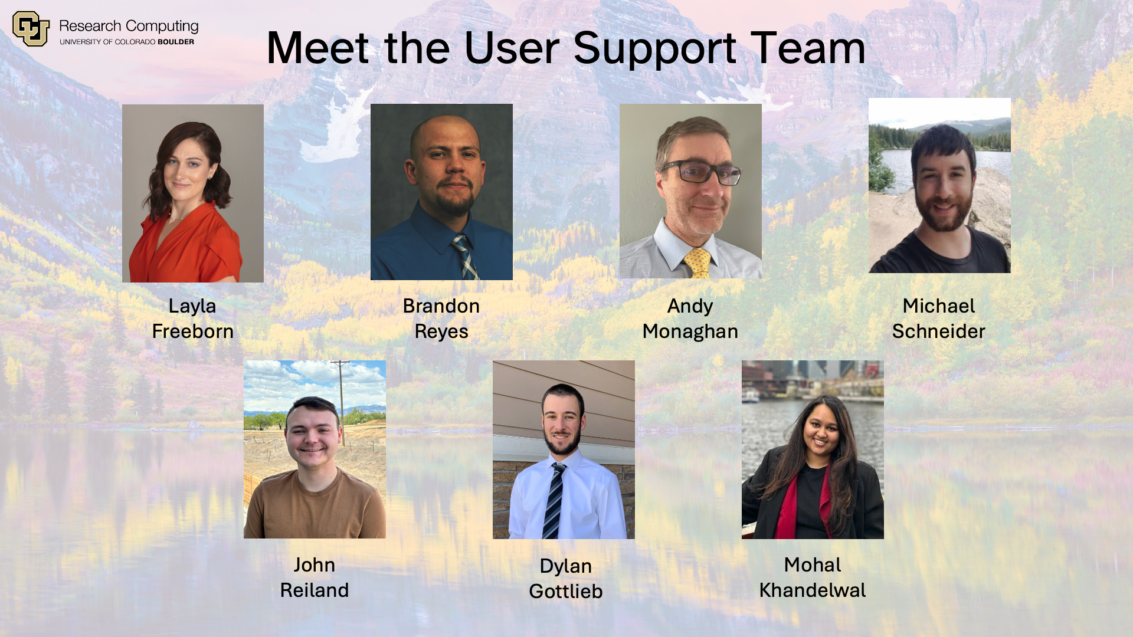

Slide 4
Overview
Goals:
  Understand containerization in HPC context
  Learn Apptainer for ML workloads
  Run TensorFlow and PyTorch containers
  Submit jobs with SLURM
Agenda:
  Intro to containers
  Apptainer deep-dive
  TensorFlow & PyTorch demos
  SLURM integration
  Best practices & troubleshooting tips

Slide 5
Why Containers for ML in HPC?
Dependency Management
  Package complex ML software stacks with all dependencies.
  Resolve version conflicts and avoid "dependency hell."
Portability
  Run the same environment across different HPC systems, local machines, or cloud platforms.
  "Build once, run anywhere."
Scalability
  Easily scale workloads from a laptop to thousands of nodes.
  Integrate seamlessly with schedulers like SLURM for large ML jobs.

Slide 6
Why Containers for ML in HPC? (cont.)
Reproducibility
  Capture the exact software environment for consistent, repeatable results.
Performance
  Near-native speed with minimal overhead; direct access to GPUs and high-speed interconnects.
  Optimized images can boost job throughput and resource utilization.

Slide 7
Containerization Concepts

Slide 8
What is a container?
Container Image: A self-contained read-only file (or files) used to run the packaged application
Container: A running instance of a container image
  An isolated, encapsulated user-space instance.
  Runs on a shared OS kernel but has its own:
    Filesystem
    Processes
    Network interfaces (can be configured)
Notes:
Lightweight compared to Virtual Machines (VMs) as they don’t require a full guest OS.

Slide 9
Containers vs. Virtual Machines (VMs)
Feature | Virtual Machine (VMs) | Containers
Isolation | Full (hardware/emulated) | Process/user-space
Guest OS | Full OS per VM | Shares host OS kernel
Setup | Slow (minutes) | Fast (seconds)
Resource Use | Heavy (more RAM/CPU) | Lightweight (minimal overhead)
Portability | Hypervisor-dependent | Build once, run anywhere
Use case | Legacy apps, OS-level isolation | ML, microservices, HPC, CI/CD

Slide 10
Key Components
Container Images
  Read-only templates used to create containers.
  Contain application code, libraries, dependencies, and metadata.
  Examples: Docker Hub images, SIF files (Apptainer).
Runtime Environments
  Software that runs containers (e.g., Apptainer, Docker).
  Manages container lifecycle, isolation, and resource allocation.

Slide 11
Key Components (cont.)
Mount Points for Data (Bind Mounts)
  Mechanism to make host directories/files accessible inside the container.
  Essential for accessing datasets, scripts, and output directories.
Resource Allocation
  Containers share host resources (CPU, memory, GPUs).
  HPC schedulers (like SLURM) manage resource allocation for containerized jobs.

Slide 12

Apptainer (formerly Singularity)
Apptainer is the direct successor to Singularity.
Requires a Linux system
Runs without requiring root access
Single-file SIF format is easy to transport and share with others
Can convert existing Docker images to Apptainer images
Apptainer comes pre-installed on all Alpine compute nodes, so no need to load any specific software modules!

Slide 13
Apptainer Definition Files
Bootstrap: docker
From: ubuntu:20.04
%post
export DEBIAN_FRONTEND=noninteractive
apt-get update && apt-get install -y \
python3 python3-pip python3-dev \
libtcl8.6 libglu1-mesa libgomp1 \
libblas3 liblapack3 libgfortran5 \
wget git
# 1. Install OpenSeesPy via pip
pip3 install openseespy
# 2. Add the 'wrapper' for Tcl usage
echo '#!/usr/bin/python3' > /usr/local/bin/OpenSees
echo 'import openseespy.opensees as ops; import sys' >> /usr/local/bin/OpenSees
echo 'if len(sys.argv) > 1: ops.source(sys.argv[1])' >> /usr/local/bin/OpenSees
chmod +x /usr/local/bin/OpenSees
%environment
export LC_ALL=C
export PATH=/usr/local/bin:$PATH
%runscript
exec OpenSees "$@"
A Definition File (or “def file” for short) is a set of blueprints explaining how to build a custom container.
  It includes specifics about the base OS, software to install, environment variables and other metadata.
    https://apptainer.org/docs/user/latest/definition_files.html
Notes:
SIF = singularity image file

Slide 14
Working with Apptainer on CURC
View list of Apptainer commands.
$ apptainer --help
Look at CURC's collection of pre-built containers.
$ echo $CURC_CONTAINER_DIR
$ ls $CURC_CONTAINER_DIR
By default, the cache directory for Apptainer builds is /scratch/alpine/$USER
$ echo $APPTAINER_CACHEDIR
Pro Tip: change APPTAINER_CACHEDIR and APPTAINDER_TMPDIR to $SLURM_SCRATCH for faster builds.
Notes:
SIF = singularity image file

Slide 15
Working with Apptainer on CURC
On CURC systems, a running container automatically bind mounts these paths: /home/$USER, $PWD.
To bind any additional folders/files to your container, use the -B flag in your apptainer run, exec, and shell commands:
$ apptainer run -B /source/directory:/target/directory sample-image.sif
$ apptainer run -B /projects/$USER,/pl/active,/scratch/alpine/$USER sample-image.sif
Notes:
SIF = singularity image file

Slide 16
Useful Commands
apptainer inspect #See labels/environment vars, run scripts
apptainer pull #pull an image from hub
apptainer exec #Execute a command to your container
apptainer run #Run your image as an executable
apptainer build #Build a container
apptainer shell #Access the command line of your container
Notes:
SIF = singularity image file

Slide 17
Using images from a pre-built container
You can fetch container images from container registries such as:
  Docker Hub
  NVIDIA NGC Catalog
Let’s walk through an example of using pre-built Tensorflow container to train a classification model….
Start an interactive testing job on a GPU node:
$ sinteractive --partition=aa100 --qos=gpu-testing --nodes=1 --ntasks=4 --time=1:00:00 --gres=gpu:a100_3g.20gb:1

Slide 18
Getting Started with TensorFlow
# Export paths
$ export IMAGES=/projects/$USER/containers/
$ export WORKDIR=/projects/$USER/containers/ml_work
$ mkdir -p $IMAGES $WORKDIR && cd $WORKDIR
# Pull TensorFlow container (GPU version)
$ export APPTAINER_IGNORE_PROOT=1 # temporary workaround for bug
$ apptainer pull $IMAGES/tensorflow-2.15.0-cuda12.8.sif docker://tensorflow/tensorflow:2.15.0-gpu
# Inspect container metadata
$ apptainer inspect $IMAGES/tensorflow-2.15.0-cuda12.8.sif
Notes:
See labels, environment variables, or definition file info.
Good way to verify if the image has CUDA/GPU, Python, etc

Slide 19
Binding Paths & Running TF Script
Bind mount your script directory.
Create minst_tf.py that builds and trains a simple image classification model
--nv: Enables NVIDIA GPU access.
# Bind paths
$ apptainer exec -B $WORKDIR:/work,$IMAGES:/images $IMAGES/tensorflow-2.15.0-cuda12.8.sif ls /work
# Run the script
$ apptainer exec --nv -B $WORKDIR:/work $IMAGES/tensorflow-2.15.0-cuda12.8.sif python3 $WORKDIR/mnist_tf.py

Slide 20
Sample TensorFlow Script: mnist_tf.py
import tensorflow as tf
mnist = tf.keras.datasets.mnist
(x_train, y_train), _ = mnist.load_data()
x_train = x_train / 255.0
model = tf.keras.models.Sequential([
tf.keras.layers.Flatten(input_shape=(28,28)),
tf.keras.layers.Dense(128, activation='relu'),
tf.keras.layers.Dropout(0.2),
tf.keras.layers.Dense(10, activation='softmax')
])
model.compile(optimizer='adam', loss='sparse_categorical_crossentropy', metrics=['accuracy'])
model.fit(x_train, y_train, epochs=1)
print("Done training.")

Slide 21
Access container interactively
Shell into it
$ apptainer shell --nv $IMAGES/tensorflow-2.15.0-cuda12.8.sif
Then run
$ python3
>>> import tensorflow as tf
>>> tf.__version__
>>> tf.config.list_physical_devices('GPU')
If it returns a list (e.g. [PhysicalDevice(name='/physical_device:GPU:0', ...)]), then TensorFlow successfully detected the GPU inside the container!
Notes:
SIF = singularity image file

Slide 22
SLURM Integration: run_mnist_tf.sh
#!/bin/bash
#SBATCH --gres=gpu:a100_3g.20gb:1
#SBATCH --partition=aa100
#SBATCH --ntasks=4
#SBATCH --nodes=1
#SBATCH --qos=gpu-testing
#SBATCH --time=1:00:00
#SBATCH --job-name=tf-classify
#SBATCH --output=tf-classify.%j.out
#SBATCH --mail-type=ALL
#SBATCH --mail-user=<your email>
export IMAGES=/projects/$USER/containers/sif
export WORKDIR=/projects/$USER/containers/ml_work
cd $WORKDIR
apptainer exec --nv -B $WORKDIR:/work $IMAGES/tensorflow-2.15.0-cuda12.8.sif python3 $WORKDIR/mnist_tf.py

Slide 23
Getting Started with PyTorch
# Start an interactive job on a GPU testing node
$ sinteractive --partition=aa100 --qos=gpu-testing --nodes=1 --ntasks=4 --time=1:00:00 --gres=gpu:a100_3g.20gb:1
# Export paths
$ export IMAGES=/projects/$USER/containers/
$ export WORKDIR=/projects/$USER/containers/ml_work
$ mkdir -p $IMAGES $WORKDIR && cd $WORKDIR
# Pull TensorFlow container (GPU version)
$ export APPTAINER_IGNORE_PROOT=1 # temporary workaround for bug
$ apptainer pull $IMAGES/pytorch-2.9.0-cuda12.8.sif docker://pytorch/pytorch:2.9.0-cuda12.8-cudnn9-runtime
Notes:
See labels, environment variables, or definition file info.
Good way to verify if the image has CUDA/GPU, Python, etc

Slide 24
Run PyTorch Container
Build and train a small neural network with the code polyfit.py:
import torch
x = torch.linspace(-1, 1, 100).unsqueeze(1)
y = 3 * x ** 2 + 2 * x + 1 + 0.1 * torch.randn(x.size())
model = torch.nn.Sequential(torch.nn.Linear(1, 10), torch.nn.ReLU(), torch.nn.Linear(10, 1))
loss_fn = torch.nn.MSELoss()
optimizer = torch.optim.Adam(model.parameters())
for epoch in range(100): optimizer.zero_grad(); loss_fn(model(x), y).backward(); optimizer.step()
print("Done training.")
Run polyfit.py:
$ apptainer exec --bind $WORKDIR:/work $IMAGES/pytorch-2.9.0-cuda12.8.sif python3 $WORKDIR/polyfit.py

Slide 25
Troubleshooting Common Issues
Check GPU access:
  apptainer exec --nv $IMAGES/tensorflow-2.15.0-cuda12.8.sif python3 -c "import tensorflow as tf; print(tf.config.list_physical_devices('GPU'))"
Environment variables:
  Pass with --env or set inside the container.
Resource monitoring:
  Use htop, nvidia-smi, or squeue to monitor jobs.

Slide 26
Best Practices: Container Management
Version Control & Tagging
  Tag containers with specific versions (e.g., myimage:1.0.0, myimage:latest-cuda11.8).
  Store definition files (.def, Dockerfiles) in version control (Git).
Data Management
  Use bind mounts for large datasets to avoid including them in images.
  Keep images small and focused on software environment.
Resource Allocation
  Match container resource needs to SLURM (or other scheduler) requests.
  Avoid over-subscribing resources.

Slide 27
Any Questions

