Slide 1

RC Quick Byte: Supercharge Your Python with Dask

Slide 2

Supercharge Your Python with Dask
• Date: September 8, 2026
• Instructor: Mohal Khandelwal
• Website: www.rc.colorado.edu/rc
• Helpdesk: rc-help@colorado.edu
• Documentation: https://curc.readthedocs.io/en/latest/programming/dask.html
CURC DASK DOCS
Scan for the full walkthrough

Slide 3
What you’ll learn
01
Why single-core Python hits a wall
02
What Dask is, and how a cluster is wired
03
Launch a cluster from Open OnDemand Jupyter Notebook
04
Dask Dashboard
05
Scale NumPy and pandas: Arrays and DataFrames
06
Live demo on Alpine, plus when Dask is worth it

Slide 4
Python is great… until it isn’t
MEMORY
CPU
SCALING
Your data doesn’t fit
One core is doing all the work
Your workflow outgrows one machine
Your dataset is larger than available RAM.
Pandas and NumPy often load the data into memory at once.
Large files can quickly lead to Memory Error.
You need a way to process the data in smaller pieces.
Large computations can take hours even when other cores are idle.
Manually splitting and coordinating the work is difficult.
Traditional approaches may require significant changes to your code.
Managing distributed work, dependencies, and results can become complicated.
You want to scale your existing Python workflow without starting over.
Dask helps you cross these boundaries.
Same Python ecosystem. Larger data. More cores. Multiple machines.

Slide 5
What is Dask?
A parallel computing library in Python that allows you to scale computations from a single machine to a distributed cluster. It is particularly useful when:
1
Your data does not fit in memory
2
Your code is CPU-bound and slow
3
You want to parallelize Python workflows without rewriting everything

Slide 6
Dask Distributed Cluster
To perform work, a scheduler must be assigned resources in the form of a Dask cluster. The Dask cluster has three main components for processing computations in parallel.
YOU
CONDUCTOR
THE ORCHESTRA
Client
Scheduler
Workers
The client is responsible for submitting tasks to be executed to the scheduler. It also enables you to monitor job progress and access the dashboard.
Decides how work is split across workers and coordinates the parallelized workload.
The workers compute tasks and store and return computations results. Workers can be threads, processes, or separate machines in a cluster.

Slide 7
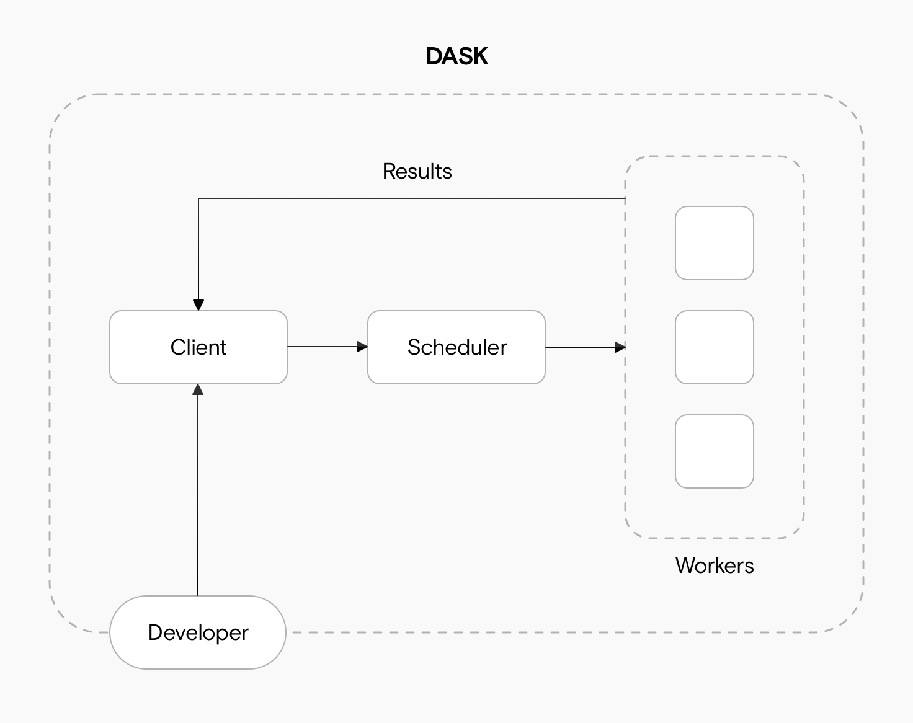
What that looks like

Slide 8
Launch a local cluster from Open OnDemand
• A LocalCluster runs all components on a single node and is useful for development and small-scale parallel workloads.
• For this we need to set up a LocalCluster using dask.distributed and connect a client to it.
from dask.distributed import LocalCluster, Client
cluster = LocalCluster(
n_workers=4,
threads_per_worker=2,
memory_limit='auto',
)
client = Client(cluster)
client # dashboard link lives here
Things to note:
• Match workers × threads to the cores you requested
• No arguments? Dask sizes itself to the session
• When you are done: client.close() and cluster.close()

Slide 9
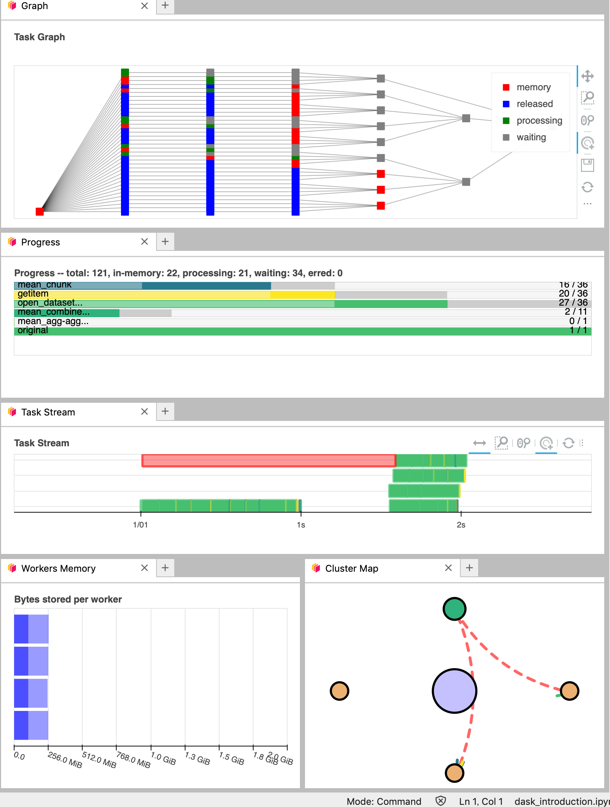
The dashboard is your X-ray
Dask Dashboard is a web interface that provides real-time insights into task execution, CPU and memory usage, and worker activity.
WATCH FOR:
• Task stream: are many workers busy at once?
• Progress: which functions are stuck?
• Worker memory: is one worker stockpiling?
• Graph: did you accidentally build one task?

Slide 10
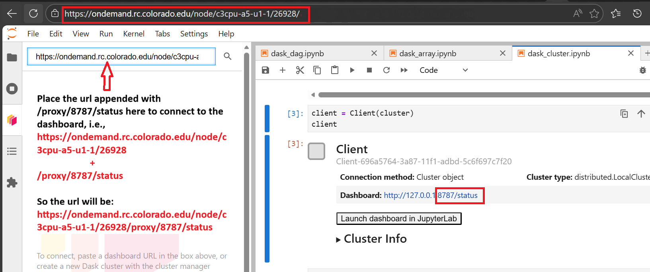
Caveat: the proxy URL
REWRITE THE URL
Dask reports this and it will not open in OOD:
http://127.0.0.1:8787/status
Your Jupyter session looks like this:
https://ondemand.rc.colorado.edu/node/<node>/<port>/
Append the proxy path:
https://ondemand.rc.colorado.edu/node/<node>/<port>/proxy/8787/status

Slide 11
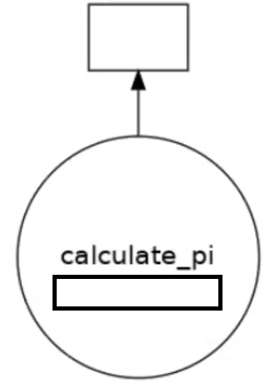
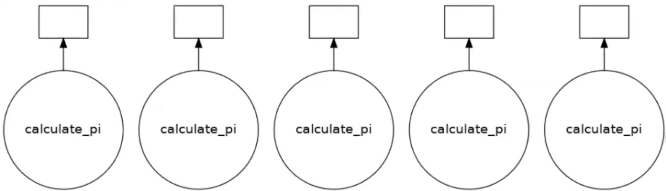
Visualizing the Task Graph
One call = one task. Nothing to parallelize.
Five independent calls = five workers can go at once.
import dask
results = [dask.delayed(calculate_pi)(10000 * (i + 1)) for i in range(5)]
dask.visualize(results) # inspect the graph first
dask.compute(*results) # then run it

Slide 12
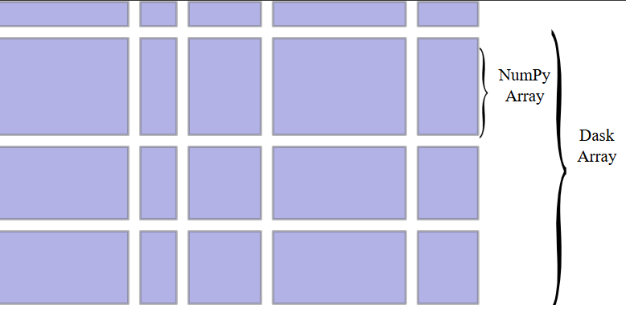
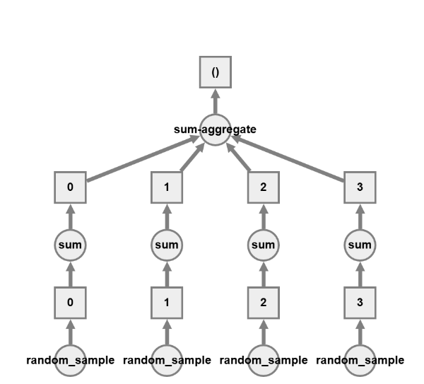
Dask Arrays: NumPy, in chunks
import dask.array as da
x = da.random.random(
(10000, 10000), chunks=(1000, 1000)
)
y = (x + x.T).mean() # still lazy
y.compute() # now it runs
One Dask Array = many NumPy chunks
Works like NumPy arrays but can handle data larger than memory.
Splits large arrays into smaller chunks and processes them in parallel.
Operations on different chunks run simultaneously across CPU cores or workers.

Slide 13
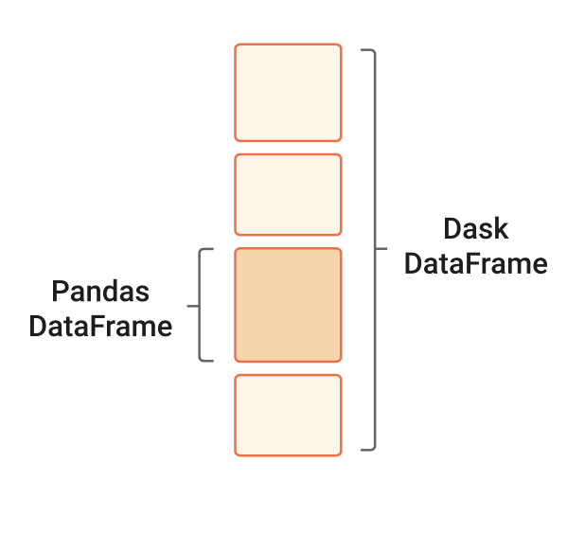
Dask DataFrames: Pandas, in partitions
import dask.dataframe as dd
df = dd.read_csv('data/file.csv') # lazy
filtered = df[df['column'] > 10]
grouped = filtered.groupby('category').mean()
result = grouped.compute() # pandas DataFrame
Splits a large DataFrame into smaller Pandas DataFrames called partitions.
Follows lazy computations, so it delays computations until needed, allowing Dask to optimize the workflow.

Slide 14
Demo·
Open OnDemand
1
Jupyter session on Alpine with enough cores to see parallelism.
LocalCluster + Client
2
Start workers, then connect. Confirm total threads.
Fix the dashboard URL
3
Session URL + /proxy/8787/status. Then open Task Stream.
Compute an array
4
Dask Array (x + x.T).mean(), and watch chunks run in parallel.
Close the client
5
client.shutdown() so workers and memory are released.

Slide 15
Any Questions

