Slide 1
Requesting Research Computing Resource Allocations
Foundations of High Performance Computing Micro-Credential
January 10, 2025
Layla Freeborn
Notes:
When you receive a Research Computing account you are automatically assigned a fixed share of the Alpine ‘general’ account. To accommodate a variety of allocation sizes on Alpine, CURC offers two application-based tiers that provide a share of the Alpine ‘project’ account. The ‘general’ and ‘project’ accounts are structured in a way such that your jobs are likely to have a higher priority if they are running in the ‘project’ account.

Slide 2
Requesting an Ascent Allocation
Let’s get Ascent Allocations!

Slide 3
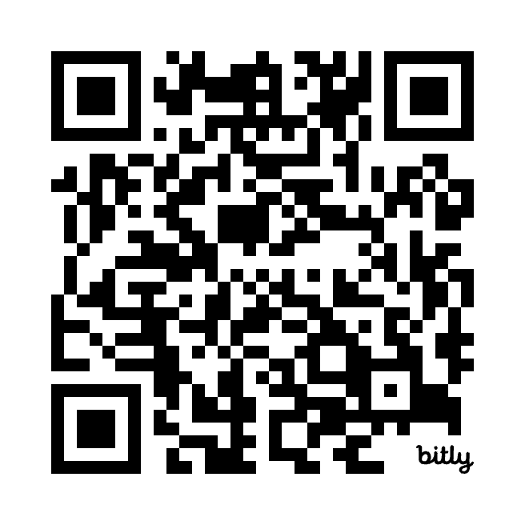
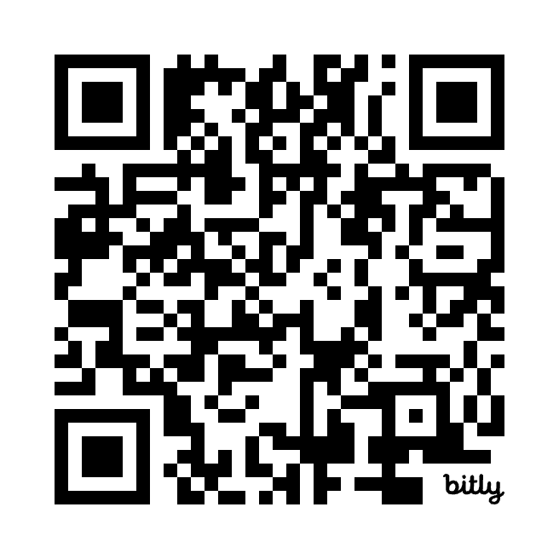
Forms
Ascent Form for RMACC
https://bit.ly/rmaccascent
Ascent Form for CU Boulder
https://bit.ly/boulderascent

Slide 4
Overview
FairShare & Priority
Service Units (SUs) & Allocations
Alpine Allocation Tiers

Slide 5
FairShare Scheduling
Jobs submitted by people who have underutilized their allocated resources get higher priority, while jobs submitted by people who have overutilized their allocated resources get lower priority.
Jobs submitted by people who have underutilized their allocated resources get higher priority,

Slide 6

Level FairShare
Level Fairshare (LevelFS) is a value calculated by Slurm’s Fairshare Algorithm.
A user’s assigned shares (determined by their allocation) and usage (based on their job history) contribute to their LevelFS value.
If there are no other pending jobs and enough resources are available
then your job will run regardless of your previous usage.

Slide 7
Priority Score
When you request resources on Alpine, your job’s priority determines its position in the queue relative to other jobs.
A job’s priority is based on multiple factors, including (but not limited to)
FairShare score
job age
resources requested
job size
QOS

Slide 8
Allocations
An allocation is a way for us to specify your cut of Alpine’s computational resources.

Slide 9
general vs projects
ucb-general (20%)
The ‘general’ and ‘project’ accounts are structured such that your jobs are likely to have a higher priority if they are running in the ‘project’ account.
ucb-projects (80%)
Notes:
The ‘general’ and ‘project’ accounts are structured in a way such that your jobs are likely to have a higher priority if they are running in the ‘project’ account.
ucb-general
rmacc-general
amc-general
csu-general

Slide 10
Service Units (SUs)
Service units (SUs), sometimes called “core hours”, reflect the processing that a core performs in one hour.
Virtual currency
Usually modified by a scaling factor that varies by partition or hardware type
If you reserve one whole amilan compute node (which means you're effectively reserving all 64 cores of that node), and your job runs for one hour, that job will use 64 SUs
e.g., 64 cores x 1 hour x scaling factor of 1 = 64 SUs

Slide 11



Alpine Allocation Tiers (CU Boulder)
Trailhead
Automatic with a CURC account.
~couple thousand SUs in ucb-general
Does not expire
ucb-general
ucb-projects
Ascent
Peak
https://curc.readthedocs.io/en/latest/clusters/alpine/allocations.html

Slide 12
Ascent vs Peak Allocations (CU Boulder)
Ascent
Peak
Size Limits- 350,000 SUs over 12 months per user, 1,400,000 SUs per research group
Required Info- Title and project description, FOS, PI and role, collaborator usernames, partitions, acknowledgment of CURC User Policies; provide via Ascent Allocation Form
Approval Process- quick, no review by CURC Allocations Committee
Expiration & Renewal- auto expires after 1y, complete Ascent Renewal Form
Size Limits- 6,000,000 SUs over 12 months per research group
Required Info- all info required by Ascent, plus example jobs and software info, via Peak Allocation application form
Approval Process- reviewed by CURC Allocations Committee, may need to improve job efficiency
Expiration & Renewal- auto expires after 1y, complete Peak Renewal form, justify size
Size- 350,000 SUs over 12 months, limit of 1,400,000 SUs per research group/PI
Required info- Complete Ascent Allocation application form
Approval process- quick, no review by allocations committee
Renewal- annual, complete renewal form

Slide 13
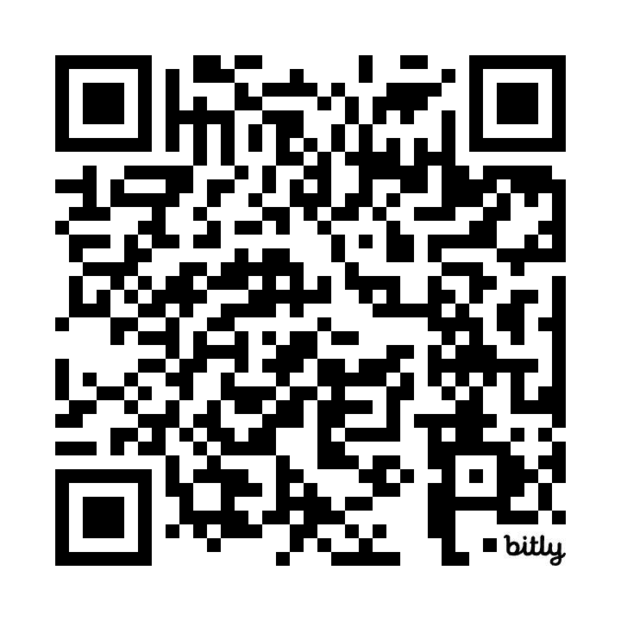
Peak Allocation Supp Info Form
Provide workflow details, list software requirements, calculate SU request with example jobs:
https://bit.ly/boulderpeaksuppform
Notes:
Note that process may be similar for AMC and other institutions

Slide 14
Ascent vs Peak Allocations (RMACC)
Ascent
Size Limits- 100,000 SUs over 12 months per user, 400,000 SUs per research group
Required Info- Title and project description, FOS, PI and role, collaborator usernames, partitions, acknowledgment of CURC User Policies; provide via Ascent Allocation Form
Approval Process- quick, no review by CURC Allocations Committee
Expiration & Renewal- auto expires after 1y, complete RMACC Ascent Renewal Form

Slide 15
Using Your Allocation
Allocations are referred to as accounts in Slurm’s documentation and are indicated by the --account directive:
#SBATCH --account=<your allocation name>
or
sbatch --account <your allocation name> yourjob.sh

