Slide 1
Monitoring Resource Use
Foundations of High Performance Computing Micro-Credential
August 15, 2024
Layla Freeborn

Slide 2
Learning Objectives
Learn how to access information on
your high-performance computing resource consumption on Alpine and Blanca
average wait times in the CURC queues and your relative "priority"
the efficiency of your research workflows

Slide 3
Overview
Part 1: Command line tools (the slurmtools module)
Part 2: Web-based tools (CURC XDMoD)

Slide 4
Part 1: Command Line Tools
Allow us to answer questions such as
What jobs have I run over the past N days?
How many Service Units (SUs) have I used?
Who is using all the SUs on my group’s account?
How efficient are my jobs?
How efficiency are my array jobs?
What is my priority?

Slide 5
The slurmtools Module
Available commands
seff-array
A module that loads a collection of functions to assess recent usage statistics
suacct
jobstats
$ module load slurm/alpine
$ module load slurmtools
suuser
levelfs
seff
Notes:
can be accessed from any node
need to load slurm/blanca for blanca usage info

Slide 6
jobstats
What jobs have I run over the past N days?
$ jobstats
Purpose: This function shows statistics for each job run by a specified user over N days.
Usage: jobstats [userid] [days, default 5]
Hint: jobstats ralphie 15

Slide 7
Service Units
Service units (SUs), sometimes called “core hours”, reflect the processing that a core performs in one hour modified by some scaling factor
Virtual currency

Slide 8
suuser
How many Service Units (SUs) have I used?
$ suuser
Purpose: This function computes the number of Service Units (SUs) consumed by a specified user over N days.
Usage: suuser [userid] [days, default 30]
Hint: suuser ralphie 15

Slide 9
suacct
Who is using all the SUs on my group’s account?
$ suacct
Purpose: This function computes the number of Service Units (SUs) consumed by each user of a specified account over N days.
Usage: suacct [account_name] [days, default 30]
Hint: suacct ucb-general 15

Slide 10
seff
How efficient are my jobs?
$ seff
Usage: seff [Options] <Jobid>
Options:
-h Help menu
-v Version
-d Debug mode: display raw Slurm data

Slide 11
seff-array
How efficient are my array jobs?
$ levelfs
usage: seff-array.py [-h] [-c CLUSTER] [--version] jobid
positional arguments: jobid
options:
-h, --help show this help message and exit
-c CLUSTER, --cluster CLUSTER
--version show program's version number and exit

Slide 12
Priority
When you request resources on Alpine, your job’s priority determines its position in the queue relative to other jobs. A job’s priority is based on multiple factors, including (but not limited to) FairShare score, job age, resources requested, job size, and QOS.

Slide 13
levelfs
What is my priority?
$ levelfs
Purpose: This function shows the current fair share priority of a specified user.
A value of 1 indicates average priority compared to other users in an account.
A value of < 1 indicates lower than average priority
(longer than average queue waits)
A value of > 1 indicates higher than average priority
(shorter than average queue waits)
Usage: levelfs [userid]
Hint: levelfs ralphie

Slide 14

Part 2: Web-Based Tool
XDMoD is a web portal for viewing metrics at the system, partition, and user levels.
XDMoD can query a seemingly endless number of metrics!

Slide 15
XDMoD
Visit https://xdmod.rc.colorado.edu/
Demo

Slide 16
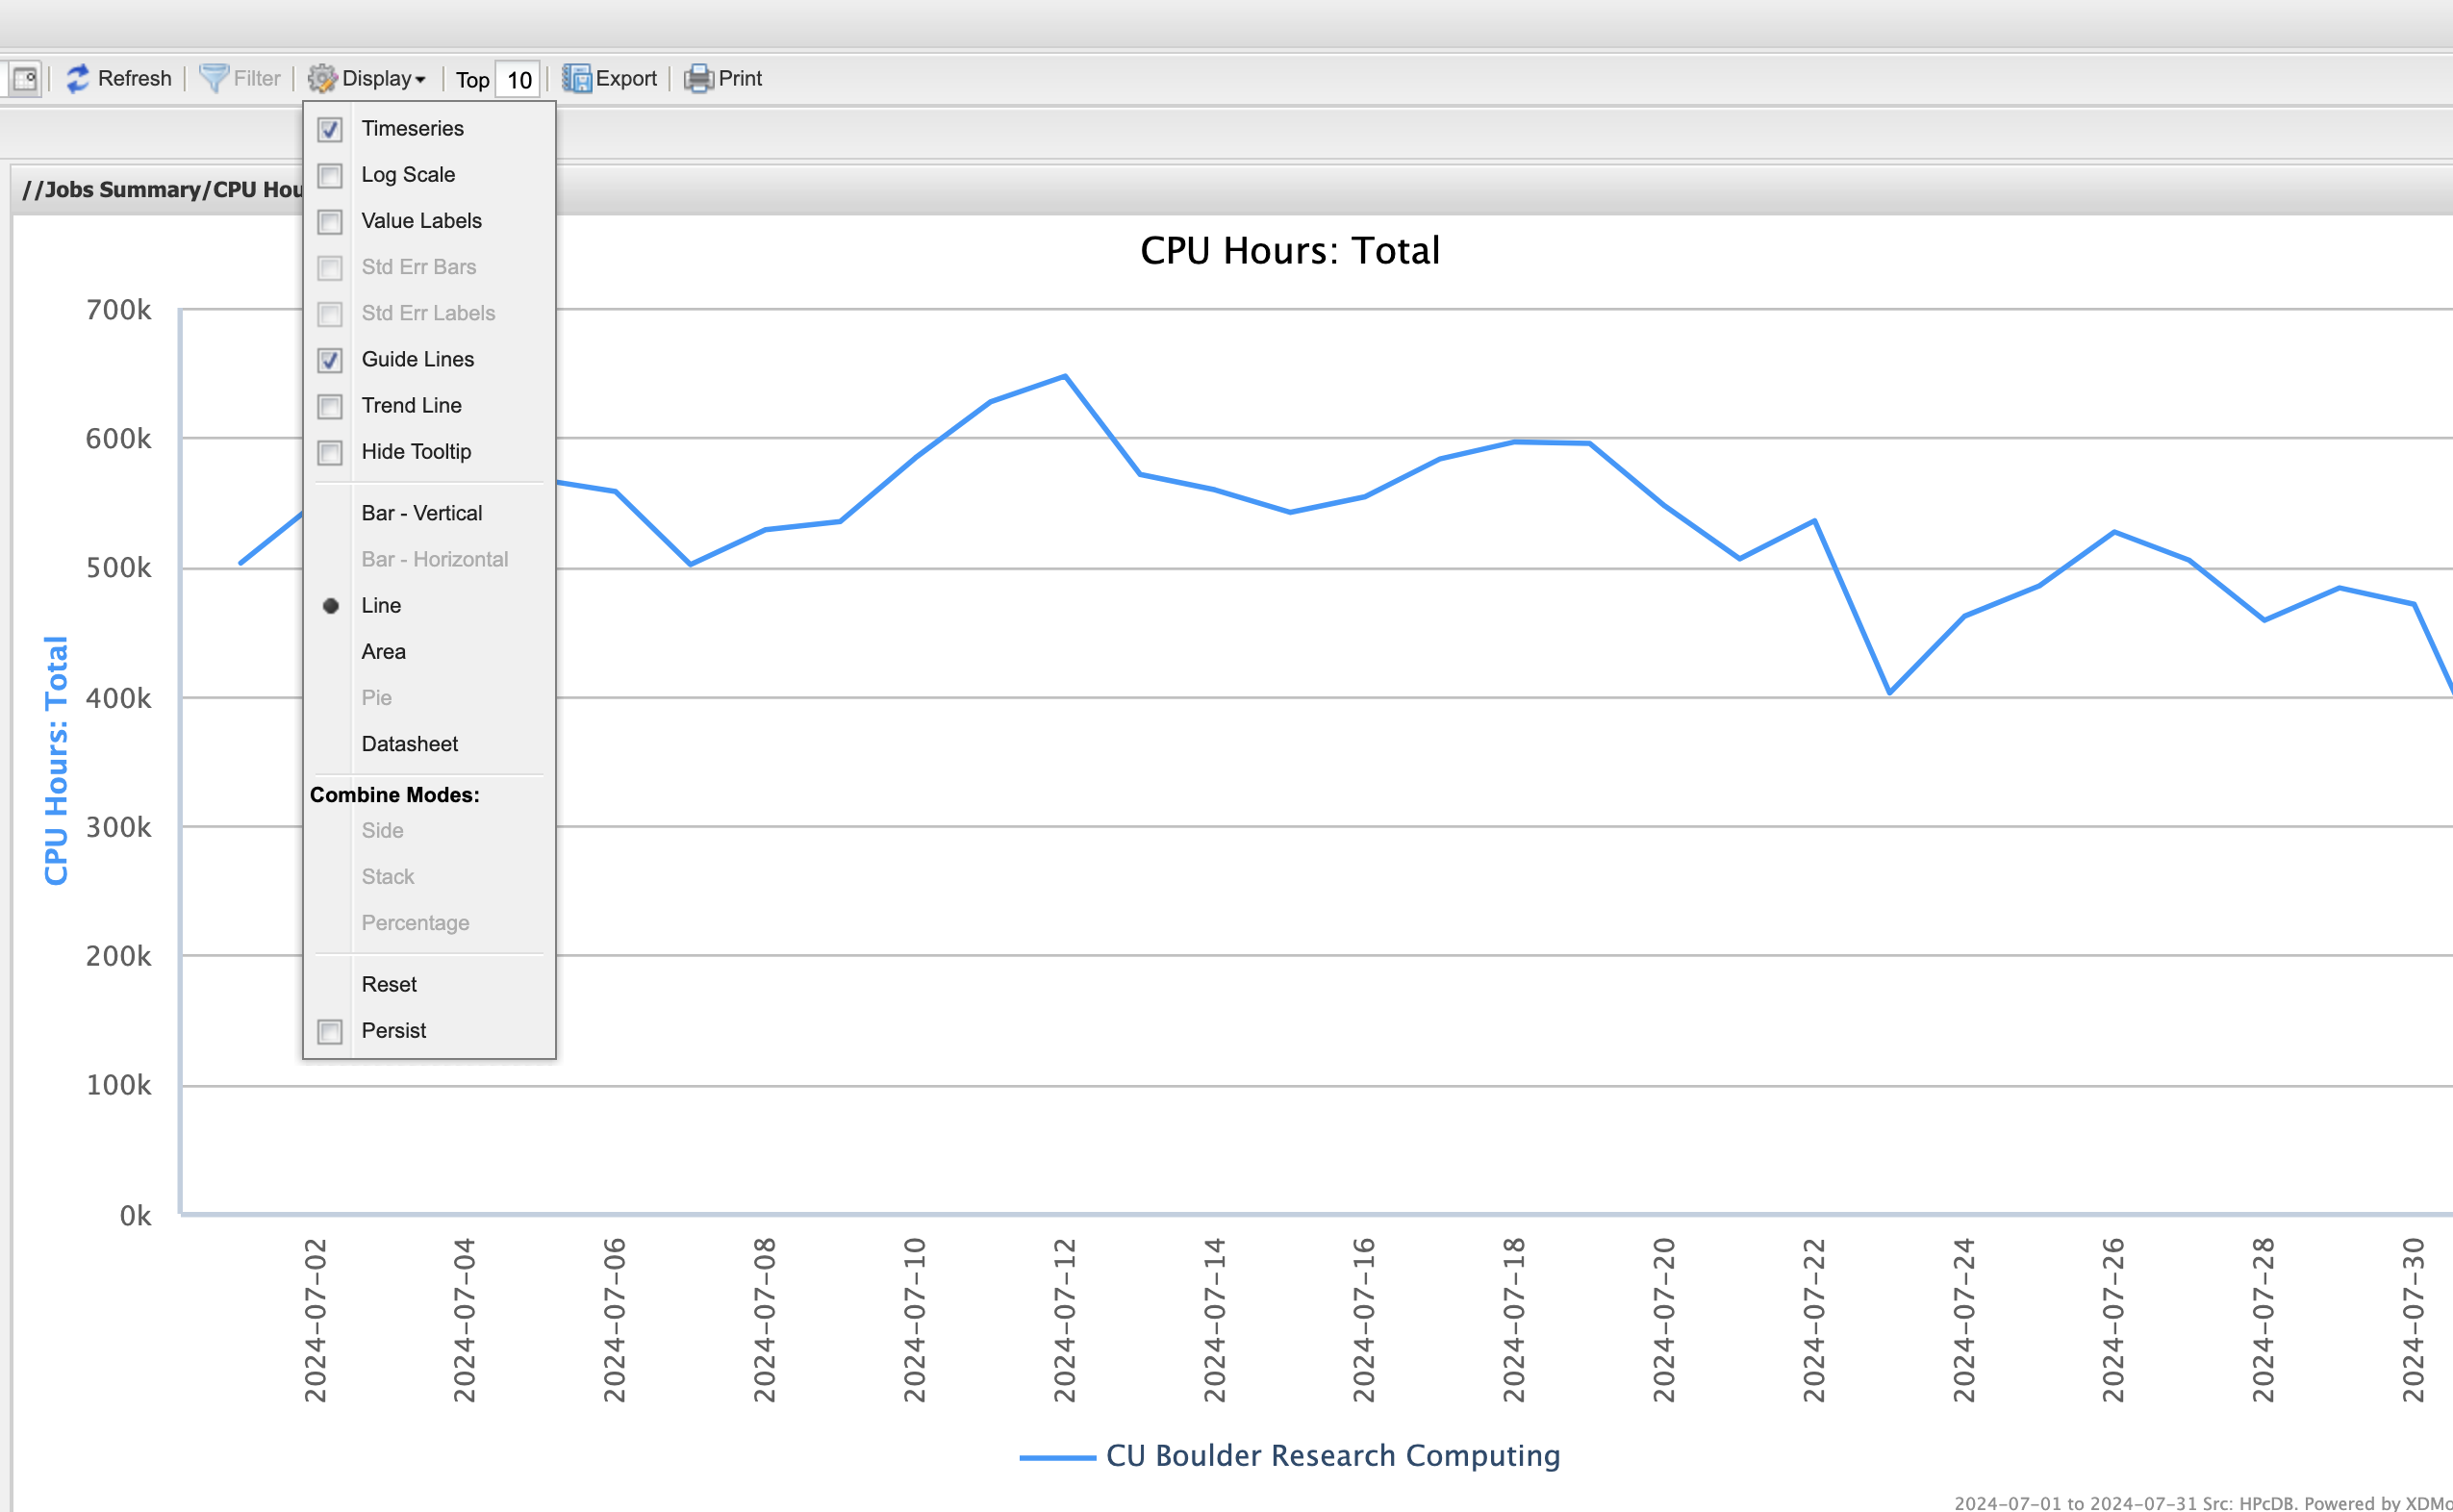
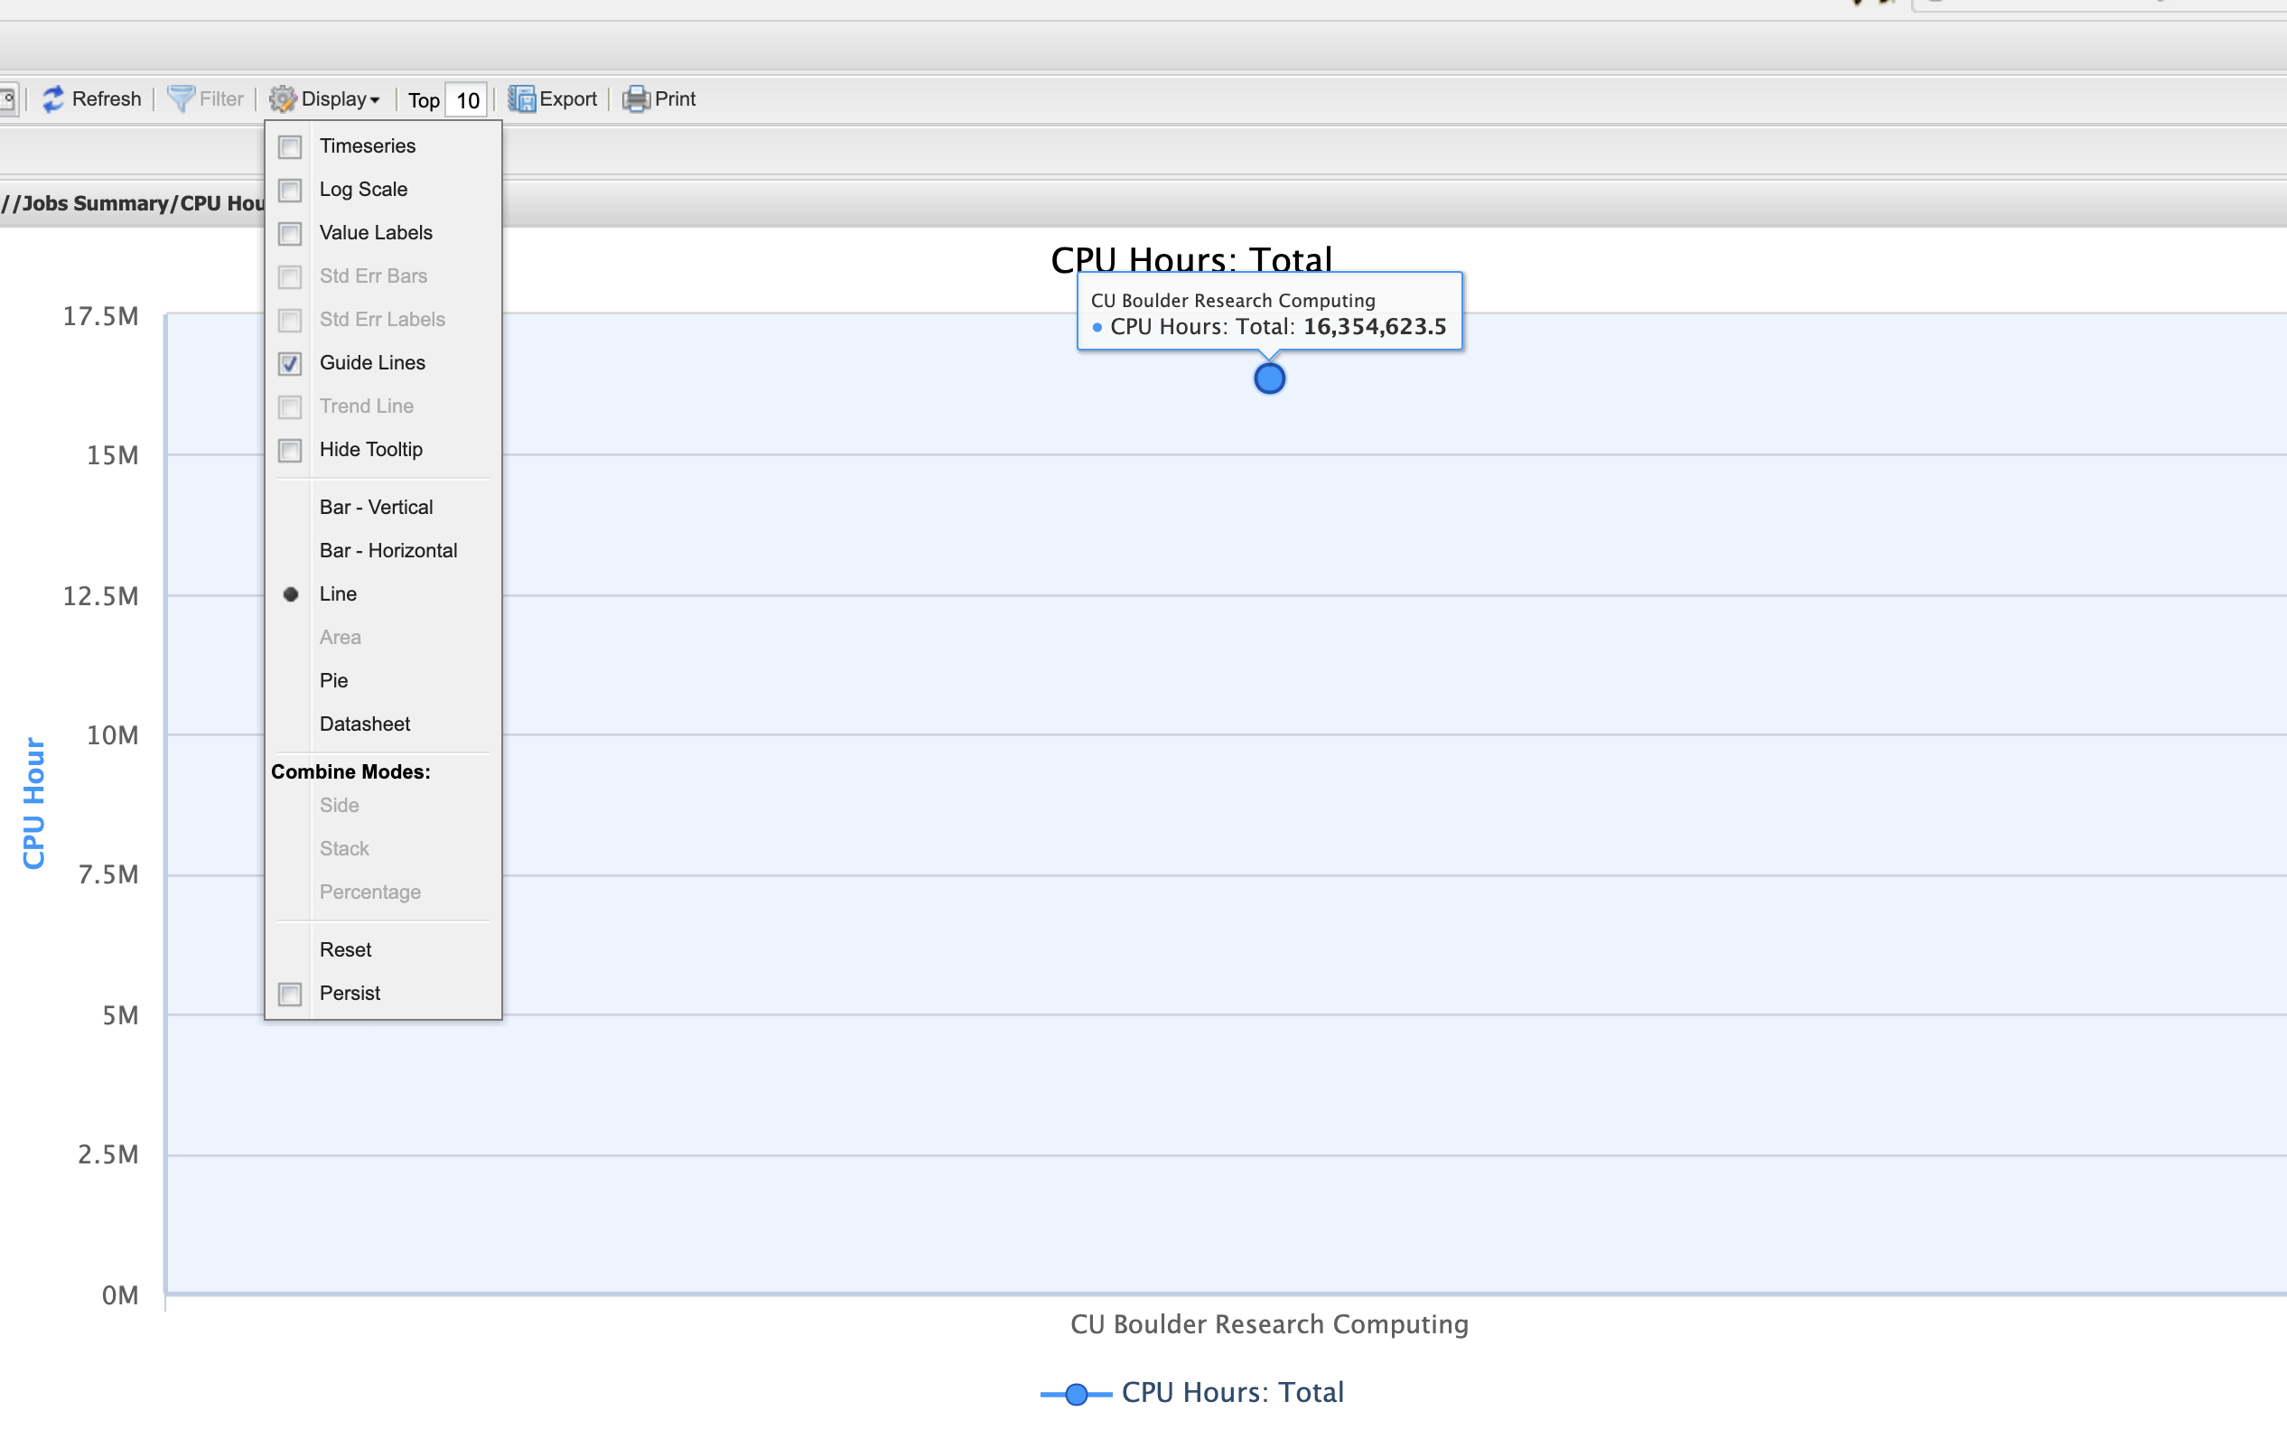
XDMoD Display Menu Defaults
Display Menu: timeseries checked (default)
Display Menu: timeseries unchecked

Slide 17
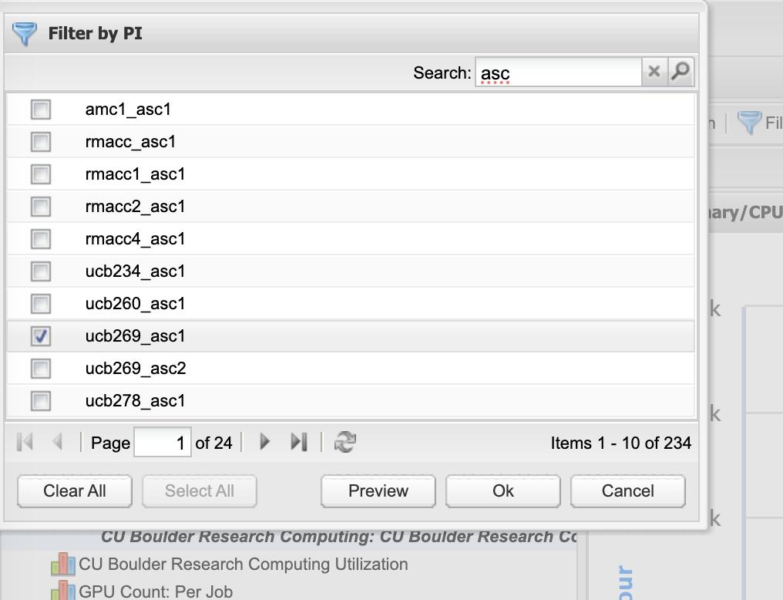
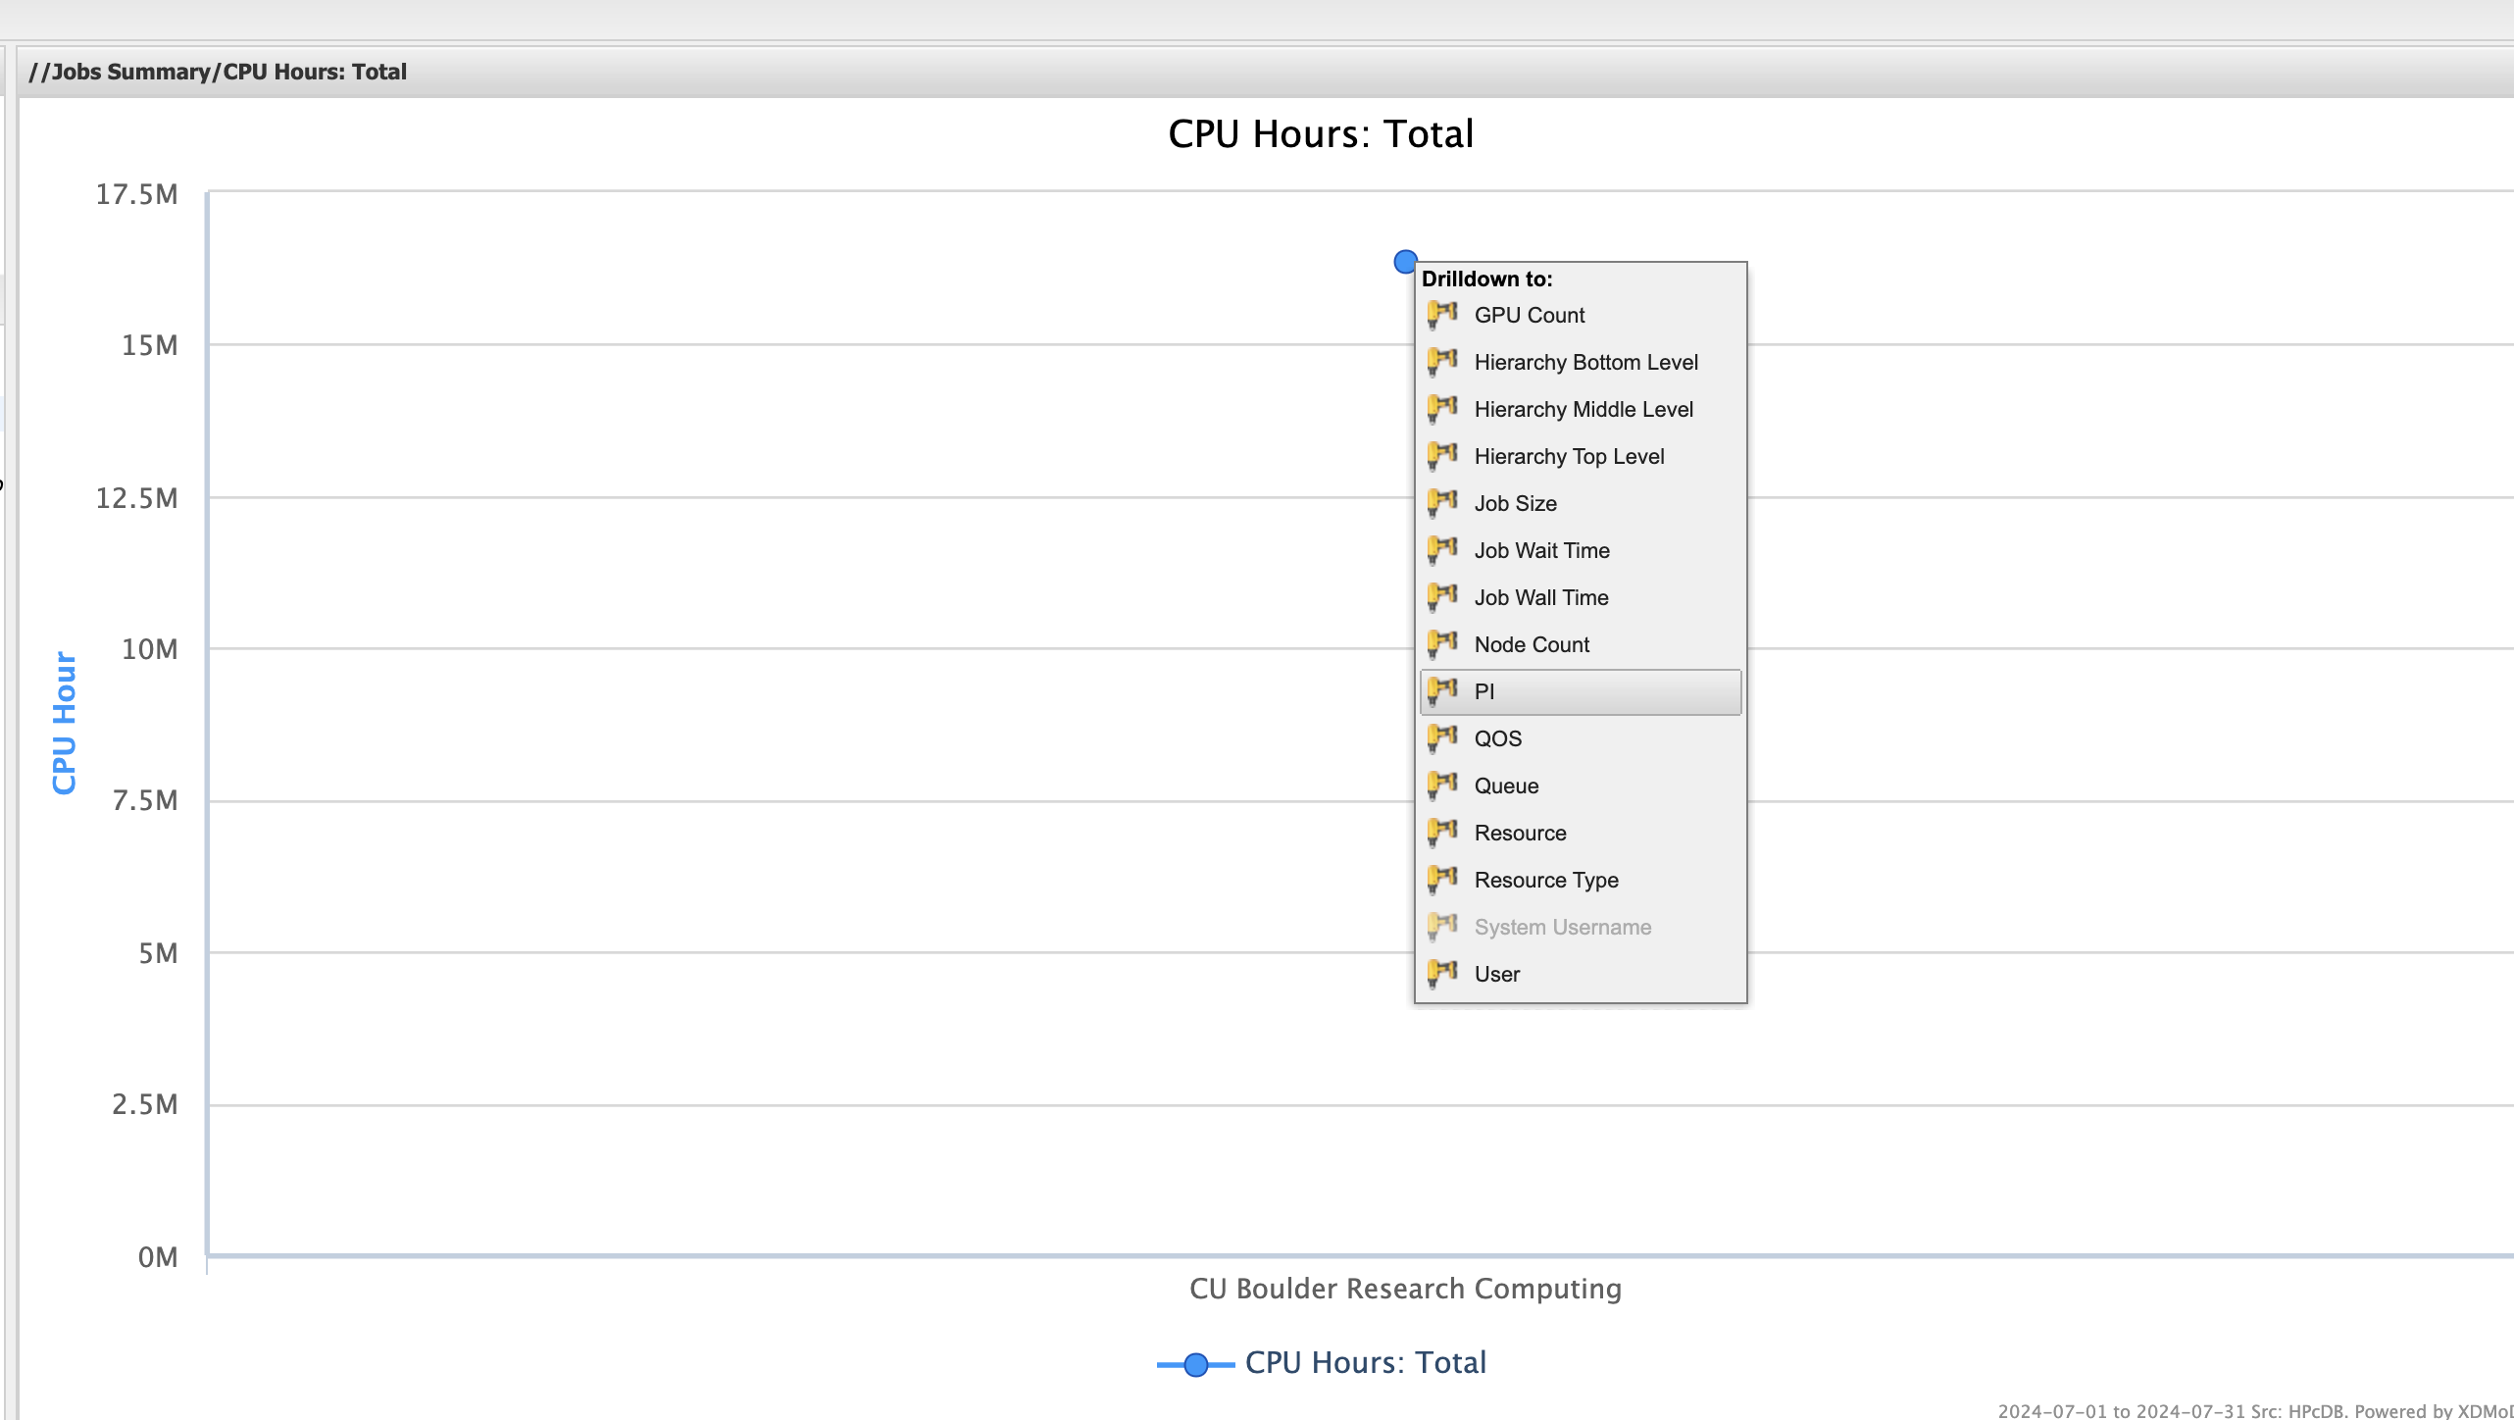
XDMoD Drilldown and Filter
Click on a data point to see Drilldown menu
(PI = Slurm allocation)
Filter and search

