Slide 1

Workflow Management with persistence1
John Reiland, CU Research Computing

Slide 2

Workflow Management with persistence1: Resources
Website: http://www.colorado.edu/rc
Documentation: https://curc.readthedocs.io
Helpdesk: rc-help@colorado.edu
Slides: https://github.com/ResearchComputing/workflow_management_persistence1

Slide 3
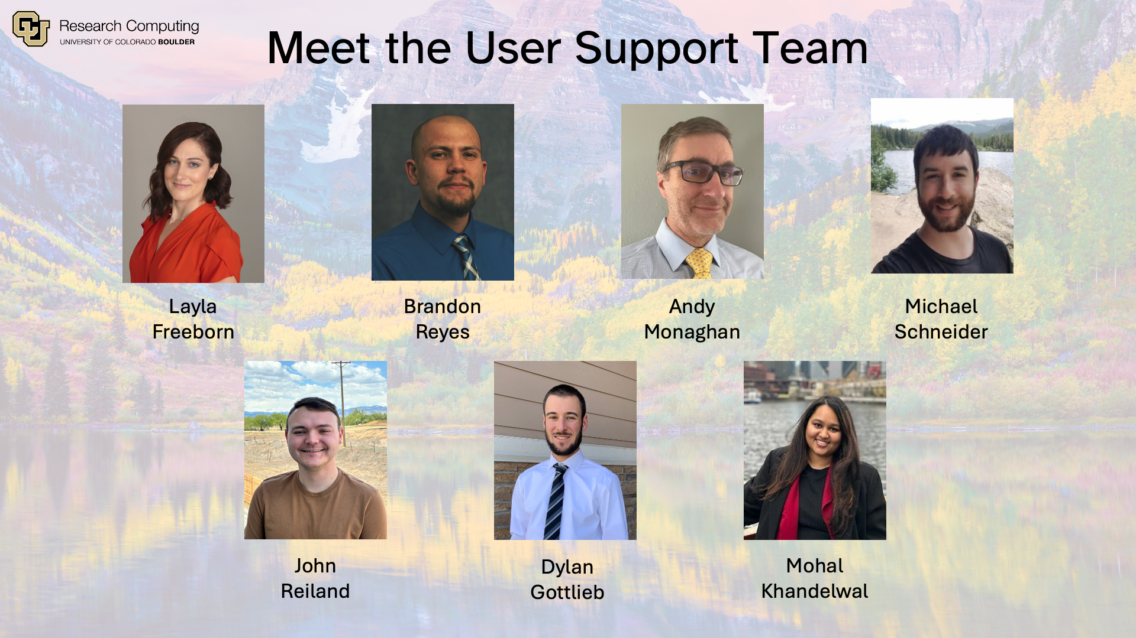
Meet the User Support Team

Slide 4
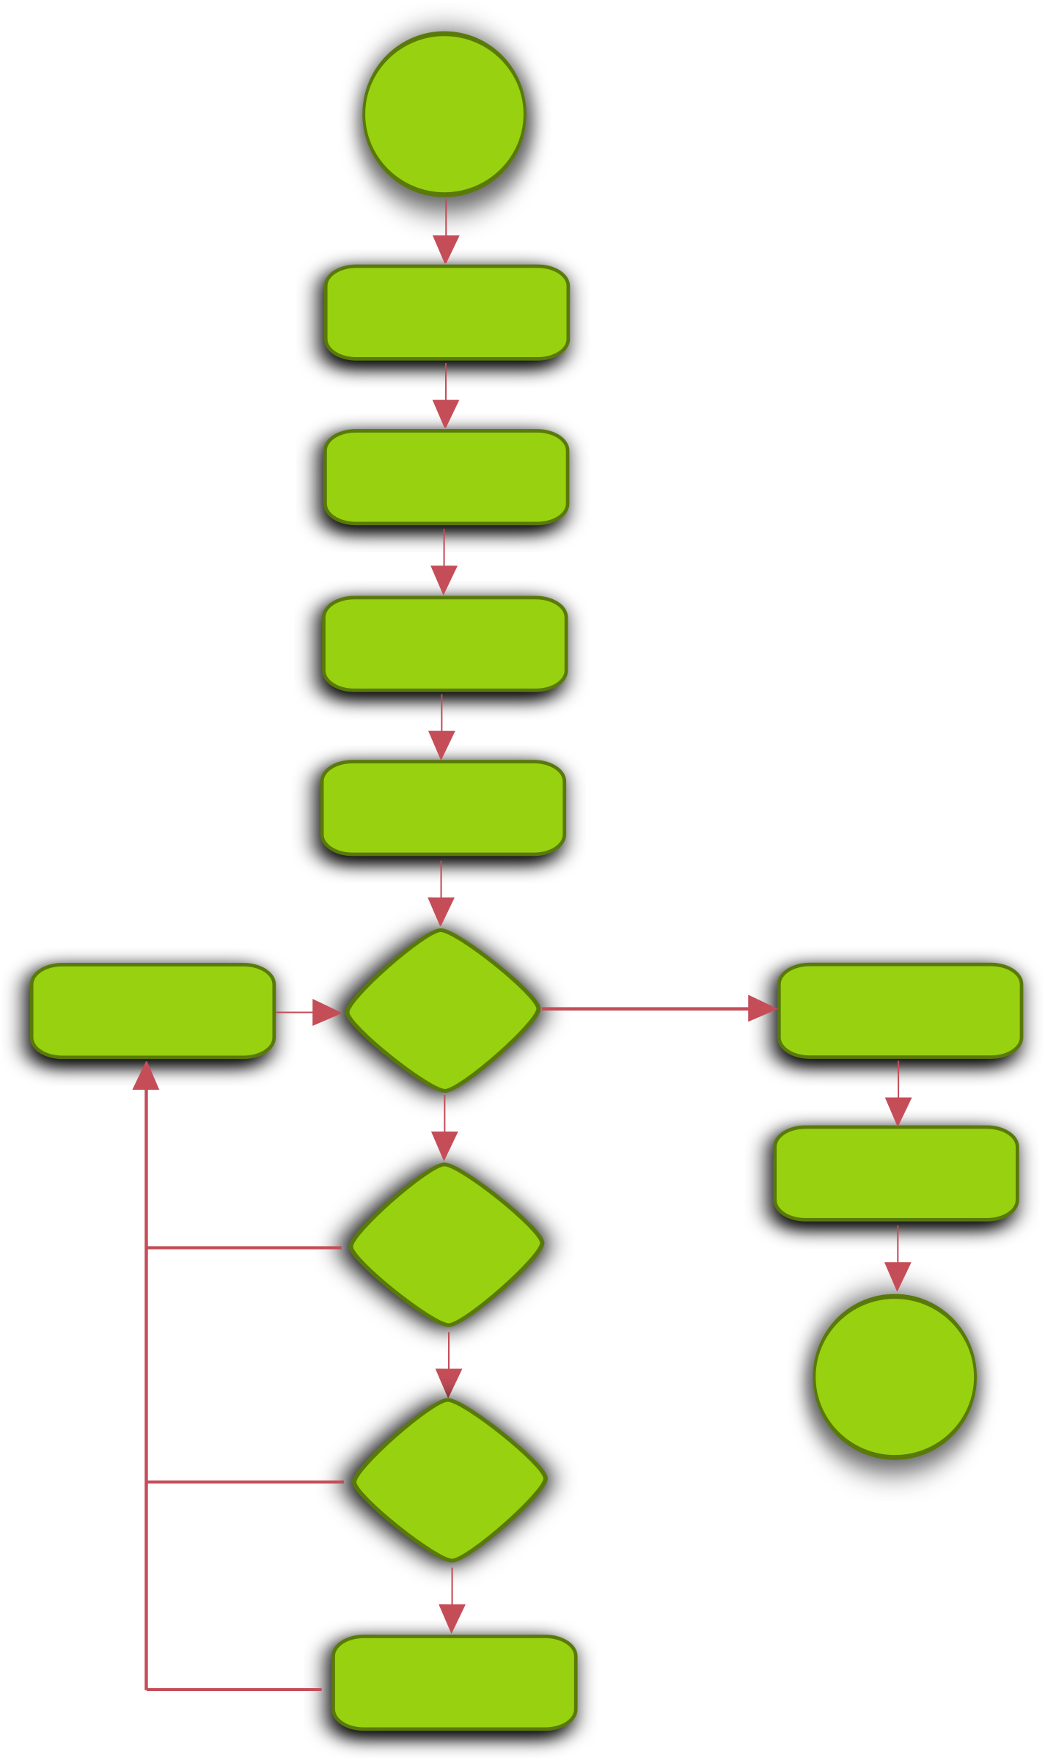
What is a workflow?
Any/all steps needed to produce a computational result
  Typically involves repetition, such as the same computation being performed on different pieces of data
  Computations/analyses are done in a specific order
  Can be sequential or parallel
Also sometimes called a “pipeline”

Slide 5
What are workflow managers?
Workflow managers are a type of software designed to set up, coordinate, launch, and monitor jobs and workflows on various types of computing environments, including HPC systems like Alpine and Blanca.
While schedulers such as Slurm decide where and when a job runs, a workflow manager decides which jobs run, in which order, and what is needed for the whole workflow to complete successfully

Slide 6
Use Cases and Benefits
Define workflow once, run many times
Dependency management
Parallelization
Restart workflow at any time
Reproducibility

Slide 7
When Not to Use Workflow Managers
Infrequent or “one-off” workflows
Simple workflows
Interactive workflows
Highly performance-sensitive tasks

Slide 8



Examples of Workflow Management Software
Snakemake
Nextflow
  nf-core
KinBot
  Not a traditional workflow manager, but functions similarly

Slide 9
Example Workflow Management Pipeline
#!/usr/bin/env nextflow
params.in = "$baseDir/data/sample.fa"
// Split a fasta file into multiple files
process splitSequences {
input:
path 'input.fa'
output:
path 'seq_*'
"""
awk '/^>/{f="seq_"++d} {print > f}' < input.fa
"""
}
Notes:
Example from https://www.nextflow.io/example1.html

Slide 10
Example Workflow Management Pipeline (continued)
// Reverse the sequences
process reverse {
input:
path x
output:
stdout
"""
cat $x | rev
"""
}
// Define the workflow
workflow {
splitSequences(params.in) \
| reverse \
| view
}
Notes:
Example from https://www.nextflow.io/example1.html

Slide 11
Challenges of Workflow Managers in HPC Environments
HPC environments are typically job-based (through schedulers such as Slurm or PBS)
  Jobs generally come with time limits, which can be challenging to manage
    Frequently restarting workflow manager jobs, pipelines, etc. leads to inefficiency
Login nodes on HPC systems must not be used for any computation or long-running tasks
  While generally lightweight, workflow managers do consume resources
    Performance impact for others trying to access the HPC system
  Workflow management software can run for weeks at a time

Slide 12
Addressing Challenges Using persistence1
A more powerful, robust, controlled-access server
  Like a high-powered login node
    More powerful than a standard login node, less powerful than a compute node
  Controlled-access prevents contention with users trying to access standard resources
No job submission required for workflow management applications
Long-running processes allowed (as long as they don’t perform computation/analyses themselves)

Slide 13
How to Access persistence1
Submit a Support Request Form or email rc-help@colorado.edu requesting access
  Describe your intended workflow and software usage
Once granted, login to a terminal on the system as normal, then type ssh persistence1
  You will immediately be connected to the persistence1 server
Set up your workflow manager and run!
More details: https://curc.readthedocs.io/en/latest/running-jobs/persistence1.html

Slide 14
Limitations of persistence1
The computational tasks of your workflow must not be run on persistence1
  persistence1 may be used to run the workflow manager only
    Only software relevant to workflow management and job submission is available
SSH connections to persistence1 can still “die” from inactivity or connection issues, which will likely terminate your processes
  Consider software such as screen or tmux to keep sessions alive

Slide 15

Please take our survey!
https://s.zoom.us/m/bPlPdNq5M

Slide 16
Any Questions?

