Slide 1
Pipeline
2/28/24

Slide 2
0. Read logsheet

Slide 3
1. Import

Slide 4
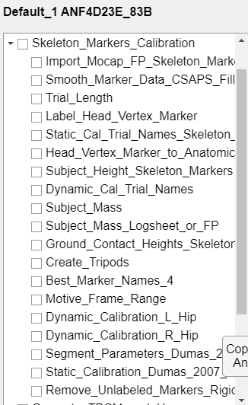
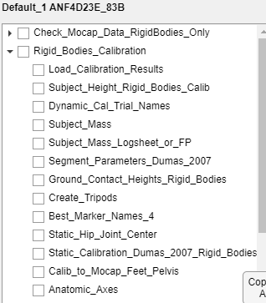
2. Calibration (Skeleton & Rigid Bodies)

Slide 5
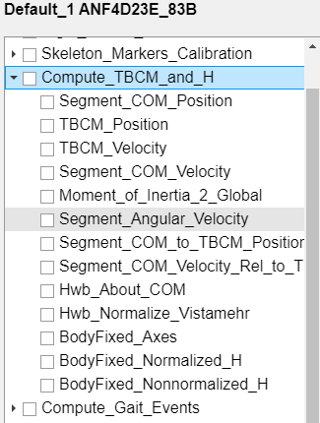
3. Compute TBCM and H

Slide 6
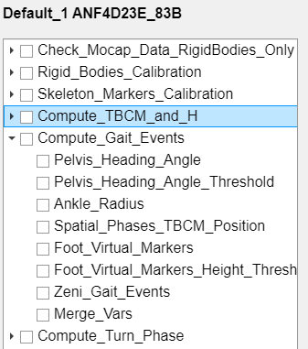
4. Compute Gait Events

Slide 7
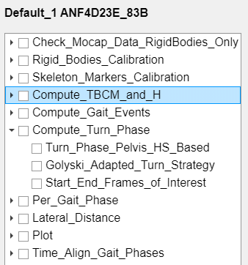
5. Compute Turn Phase

Slide 8
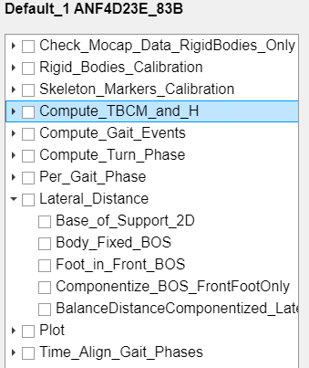
6. Compute Lateral Distance

Slide 9
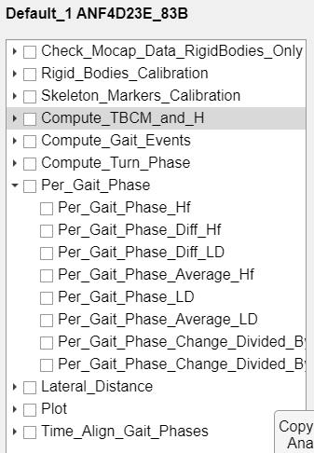
7. Compute per gait phase

