Slide 1

shinycustomloader
shinycustomloader
shinycustomloader
shinycustomloader
shinycustomloader
shinycustomloader
shinycustomloader
shinycustomloader
http://hexb.in/sticker.html

Slide 2
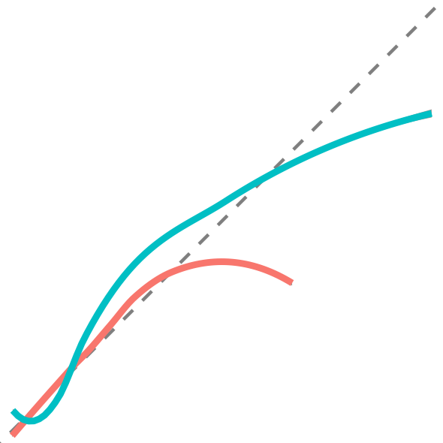

raptools
10.32614/CRAN.package.raptools

Slide 3


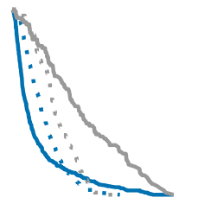

raptools
10.32614/CRAN.package.raptools

