Slide 1

XXSim
An EoS Based General Purpose
Reservoir Simulator
http://www.peclouds.com
Notes:
XXSim is a general purpose reservoir model based on the equation of state (EOS) and K values (thermal equilibrium constant for each component). It has thermal recovery module, conventional composition module, and black oil module. In terms of basic functions, it is not particularly different from other commercial simulators. The main features of XXSim are the most advanced thermal and non-thermal recovery models equipped with fully coupled EOS three phase flash and three-phase separator. The three-phase flash algorithm, use the THREE-PHASE (Aqueous Oilic, Vapor) equation of state to calculate the solubility of every component in each phase, or the number of moles of every component in each phase. For example, carbon dioxide can exist at the same time in oil phase, aqueous phase and gas phase. How to calculate the number of moles of Co2 in each phase? The literature reviews showed that all commercial simulators used table of Co2 solubility in Water or Henry’s law. In contrast to others, XXSim uses the innovative three-phase flash algorithm.

Slide 2
The Unique EoS System of XXSim
Thermal
PR-EOS
3 Phase Flash
3 Phase Separator
W-O-G Only
Notes:
The fully coupled EOS three phase flash and three-phase separator thermal model can be used to model injections of steam, steam+solvent, gas processes. It also can be used to better understand the in situ water in oil phenomena (oil swelling effect: water/steam invaded into oleic phase and entrapped) or the oil shrinking effect (cooling and water out) at surface conditions. It is fit for steam injection in the light to medium oil reservoirs.
XXSim also has the K-Value based traditional thermal module which is more fit for heavy oil reservoirs.

Slide 3
The Unique EoS System of XXSim
Thermal
PR-EOS
3 Phase Flash
3 Phase Separator
W-O-G Only
Isothermal
Compositional
PR-EOS
3 Phase Flash
3 Phase Separator
Isothermal
Notes:
XXSim can also run in isothermal (traditional) compositional mode with fully coupled three-phase flash and three-phase separator algorithms. This module allow users to calculate the solubilities of light components (CH4, C2H6, C3H8, N2, Co2, H2S) in water or aqueous phase. It can be used for oil or gas reservoirs.

Slide 4
The Unique EoS System of XXSim
Thermal
PR-EOS
3 Phase Flash
3 Phase Separator
W-O-G Only
Isothermal
Compositional
PR-EOS
3 Phase Flash
3 Phase Separator
Isothermal
3→2
Compositional
PR-EOS
2 Phase Flash
Isothermal
Notes:
Without considering the solubilities of light components in water or aqueous phase, the fully coupled three-phase flash and three-phase separator module can be further simplified into the traditional fully coupled two-phase flash and two-phase separator module, user can simulate the conventional gas injection, flooding, cycling processes and conventional water floods.

Slide 5
The Unique EoS System of XXSim
Thermal
PR-EOS
3 Phase Flash
3 Phase Separator
W-O-G Only
Isothermal
Compositional
PR-EOS
3 Phase Flash
3 Phase Separator
Isothermal
3→2
Compositional
PR-EOS
2 Phase Flash
Isothermal
K Value
Isothermal
Compositional
EOS->KV
Notes:
If the interactive influences among components can be ignored, the EOS based compositional model can generate K values internally, and automatically turned into an K values based isothermal compositional model.

Slide 6
The Unique EoS System of XXSim
Thermal
PR-EOS
3 Phase Flash
3 Phase Separator
W-O-G Only
Isothermal
Compositional
PR-EOS
3 Phase Flash
3 Phase Separator
Isothermal
pseudo-component
3→2
Compositional
PR-EOS
2 Phase Flash
Isothermal
EOS->KV
K-Values
Isothermal
Compositional
Balck Oil
Isothermal
Notes:
The black oil model is the special case of the K values based isothermal compositional model with two pseudo components: dead oil and gas. The dead oil is always stay in liquid oil phase and the light component (gas) can be co-existed in liquid oil phase and gas phase. In other words, the black oil model can be ‘seen’ or treated as the multiple components in the K values based isothermal compositional model are lumped into two pseudo components, and their PVT properties are represented by the traditional Differential Liberation Test. XXSim will convert user specified traditional black oil PVT table(s) into Two-Component K-Value table(s). This approach is different from the traditional black oil model using black oil PVT table(s) directly.

Slide 7
The Unique EoS System of XXSim
Traditional K-Values based thermal model
Thermal
PR-EOS
3 Phase Flash
3 Phase Separator
W-O-G Only
Thermal
K-Values
Compositional
Isothermal
Isothermal
Compositional
PR-EOS
3 Phase Flash
3 Phase Separator
Isothermal
pseudo-component
3→2
Compositional
PR-EOS
2 Phase Flash
Isothermal
EOS->KV
K-Values
Isothermal
Compositional
Balck Oil
Isothermal
Notes:
The simplifying path of EOS approach is clearly shown on the left diagram:
Thermal model with three-phase flash ==> Isothermal composition model with three-phase flash ==> composition model with Two-phase flash .
The simplifying path of K-Value approach is clearly shown on the right diagram:
Traditional thermal or steam model ==> Isothermal composition model ==> Black oil model.
Is there any link between two diagrams?

Slide 8
The Unique EoS System of XXSim
Traditional K-Values based thermal model
Thermal
PR-EOS
3 Phase Flash
3 Phase Separator
W-O-G Only
Thermal
K-Values
Compositional
Isothermal
EOS->KV
Isothermal
Compositional
PR-EOS
3 Phase Flash
3 Phase Separator
Isothermal
pseudo-component
3→2
Compositional
PR-EOS
2 Phase Flash
Isothermal
EOS->KV
K-Values
Isothermal
Compositional
Black Oil
Isothermal
Notes:
Yes, one of the most important feature of XXSim, (green slanted arrow), is to use the EoS based composition model internally generate K values, then conduct thermal simulation. It is worth to mention that this approach requires user provides a set of well tuned EOS parameters as inputs.

Slide 9
Technical Features of Thermal Model
 | EoS based thermal model ( XXSim ) | K-Values based thermal model （Traditional simulator）
Extra-heavy oil | Can accurately describe But not necessary as effects of light components are negligible | An effective and simple approximation
Heavy oil | Can accurately describe | Can reasonable accurately describe
Light or Volatile oil | Can accurately describe | Can’t accurately describe
Notes:
What are the limitations of XXSIM’s unique and advanced EOS based thermal module? Can it be used to simulate steam injection in light oil, heavy and even extra-heavy oil recovery processes? The answer is yes, as long as users have well tuned EOS parameters. For extra-heavy oil recovery, it is too expensive to use this feature because the K-value based thermal model is quite effective and simple by the use of dead-oil approach (K-value of the extra-heavy oil equals to 0).
To simulate the medium heavy or heavy oil recovery processes, Either fully EOS based or K-value based thermal module can be used, highly depends on whether the effects of water in oil at high temperature is simulated or not. Only the fully coupled, EOS based thermal model can simulate the temperature effect on water solubility in oil.
The light oil steam flood can be simulated effectively by the use of XXSIM’s fully coupled, EOS based thermal model with three phase equation of state together with fully coupled (single stage or multi-stage) three-phase separator. The composition changes of each component in Aqueous Phase, Oil-Rich phase and Vapor Phase at reservoir conditions and surface conditions will be simulated and reported. The K value approach is not convenient and accurate, because the K-value of each component is generated with a fixed composition for all tabulated temperature and pressure points.

Slide 10
Technical Features of Compositional Model
 | EoS based XXSim | EoS based Others （Commercial simulators）
Co2 solubility in water and Co2 flood | Can accurately describe with 3-phase flash & Sep | Approximation with Tabular or Henry’s Law
Three Phase Multi-Stage separator | Fully coupled | N/A
Conventional Gas Cycling, WAG | same | same
Notes:
For simulations of isothermal Co2 flood cases, XXSIM’s fully coupled EOS three-phase flash and three-phase separator module is found much stable than the traditional compositional module

Slide 11
Other Technical Features
Import and Convert Eclipse/CMG models
Multiple PVT, Equilibration Regions
Cartesian, Radial and Corner Point grid
Faults, Non-Neighbor Connections
Dual porosity and dual permeability
Group Constraints, Voidage Replacements
Isothermal Endpoint Scaling: 2, 3 points
Temperature Dependent Endpoint Scaling
Five and nine point formulation
SAGD with Steam Trap Constraint
Notes:
Other functions/features: XXSIM launcher can convert basic eclipse and CMG models of black oil, compositional and thermal to XXSIM’s format
Users are encouraged to convert your models and XXSIM’s engineers will help you and even develop the features you need.

Slide 12
Unique Templates
Thermal Model
CO2 Flooding
Case 1
Case 2
Purpose: To demonstrate the thermodynamic process of the steam entering the oil phase at the reservoir condition.
Purpose: To demonstrate the process of CO2 dissolving in water at the reservoir condition, The CO2 solubility in water may reduce the efficiency of CO2 flooding.
Thermal Model
Case 3
Purpose: To compare two PVT modeling methods.
1) The K-values are generated internally;
2) The K-value tables are explicitly inputted.
Notes:
Above three unique examples are selected to demonstrate our special three phase flash technology and flexibility of XXSIM’s PVT modules.

Slide 13
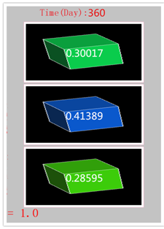
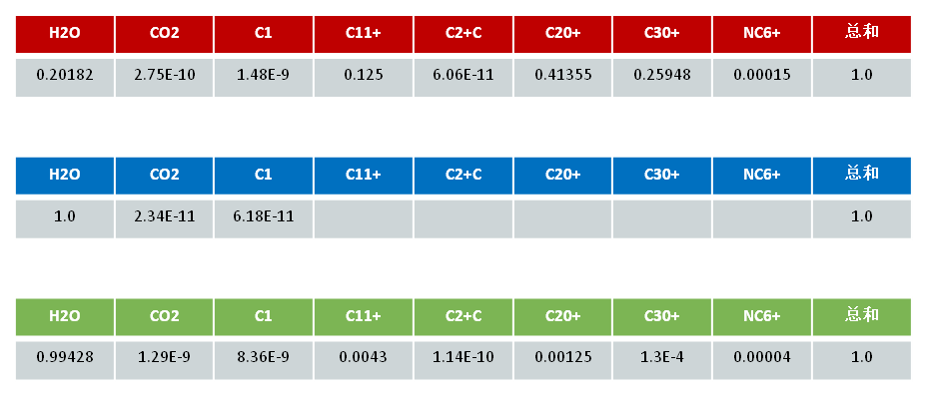
Unique Cases
Thermal Model
Case 1
Purpose: To demonstrate the thermodynamic process of the steam entering the oil phase at the reservoir condition.
Sum
So
Sum
Sw
Sg
Sum
Notes:
With the unique case 1, we mainly want to use this model to understand thermodynamic process of steam entering the oil phase, and wrapped by in the oil phase.
Let's take a look at the leftmost map. The green cube is hexahedron, which is the saturation of oil. The blue hexahedron represents the water saturation, and the most green one is gas saturation. On the right- top, there are various components, water, carbon dioxide, methane and so on. Now let's see, the mole fraction of water component in the oil reaches 20% after 360 days, that is to say, the water has entered into the oil.
Then let's look at the water phase. The water component is almost equal to one in the water phase. At high temperature, carbon dioxide and methane are hardly solved in water, which is negligible.
So, if you look at the gas phase, at the moment, we clearly see that the steam accounted for more than 99% in the gas phase, then there are some other methane, there are some very small things, this shows that in high temperature light hydrocarbons is almost insoluble in gas phase.
In addition, the C20+ and C30+, for example, enter the gas phase, which is the understanding of the effect of thermal recovery on the increase of medium heavy oil production.
So the upper right corner, this diagram clearly shows that the mole fraction of the water components in the oil phase increases with the steam flooding.

Slide 14
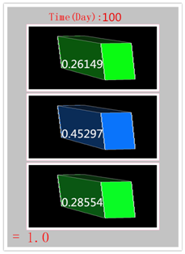
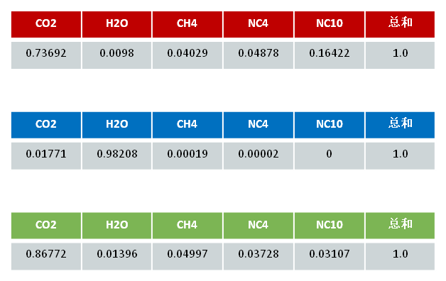
Unique Cases
CO2 Flooding
Case 2
Purpose: To demonstrate the process of CO2 dissolving in water at the reservoir condition, which reduces the efficiency of CO2 flooding.
Sum
So
Sum
Sw
Sg
Sum
Notes:
By the unique case 2, we illustrate the process of carbon dioxide flooding in reservoir condition. Because it dissolves in water, the displacement efficiency of carbon dioxide drive is reduced.
The same most regular hexahedron is oil saturation, the middle is water saturation, and the bottom is gas saturation. In this case, you can see clearly that carbon dioxide is also dissolved in water, oil and gas. You also clearly see that this water component can have very small mole fraction in the oil phase, and then it is still gasified, and there is a certain number of moles in the gas phase.
In the upper right corner, this diagram clearly shows the mole fraction of the carbon dioxide component in the water phase, with the change in the number of carbon dioxide injected into the day.

Slide 15
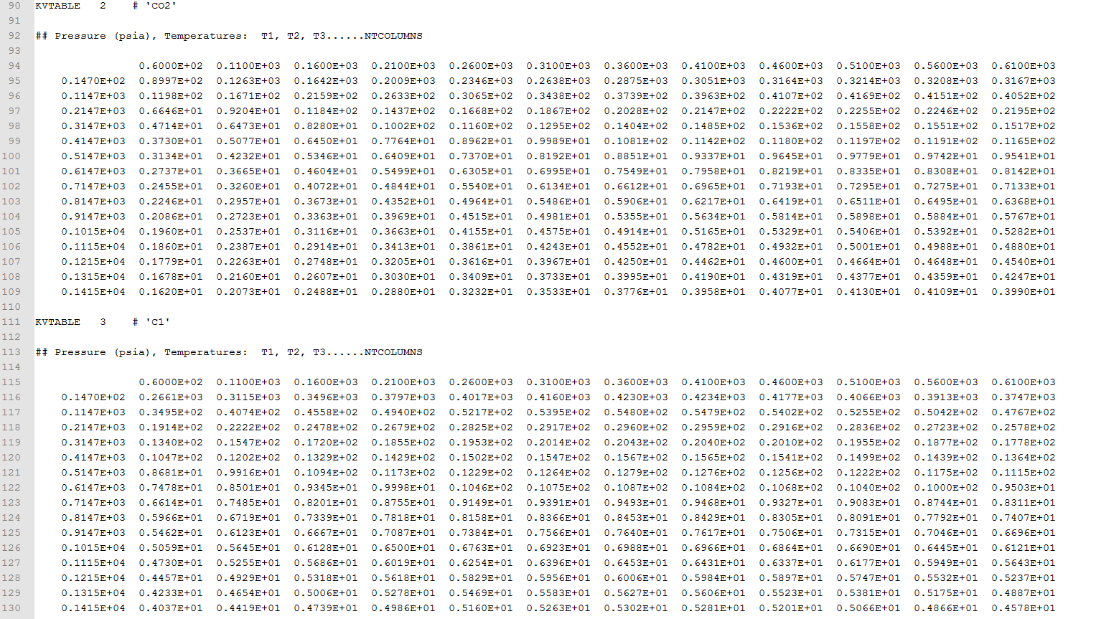
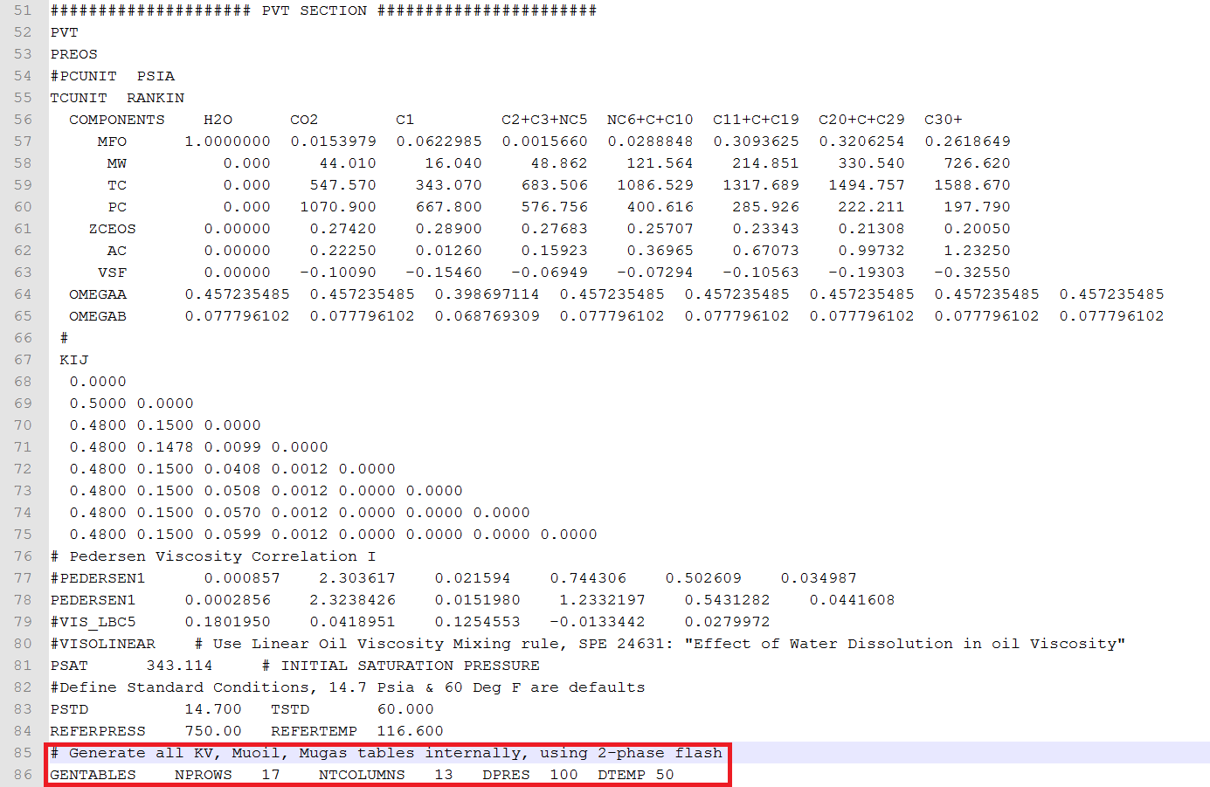
Unique Cases
Thermal Model
Case 3
Purpose: To compare two PVT modeling methods.
The K values are generated internally using characterized PR-EOS parameters
Traditional method, the tables of K-values and viscosities are explicitly input.
Must input K-Values and viscosity-temperature tables for each component
No need to input K-Values and viscosity-temperature tables
Notes:
The third unique example, this model is demonstrated in a thermal simulation, you can input a large number of K Value table, viscosity temperature table, in addition, you can also use the EoS of a good tune to generate these tables interiorlly, but you don't need any calculation. you can get the same effect.

Slide 16
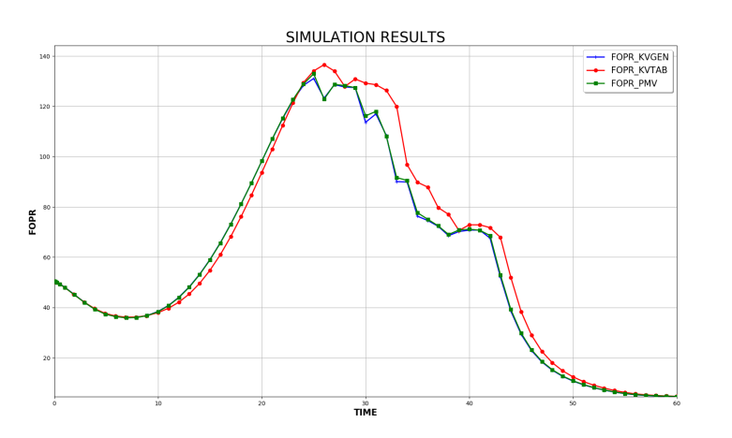
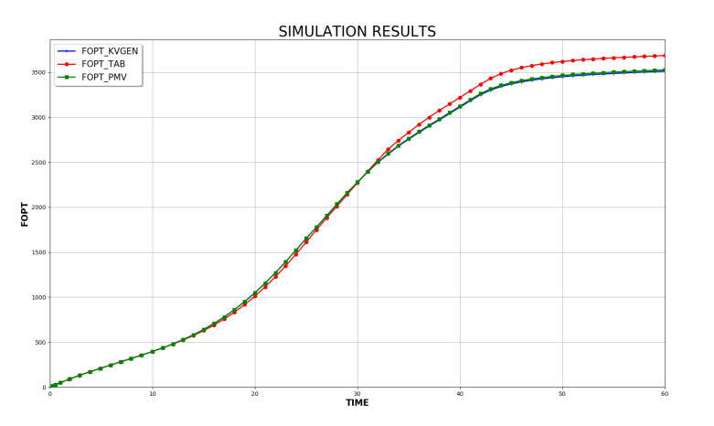
Unique Cases
Thermal Model
Case 3
Purpose: To compare two PVT modeling methods.
The K values are generated internally using characterized PR-EOS parameters
Traditional method, the tables of K-values and viscosities are explicitly input.
Comparison of FOPR | Comparison of FOPT
Notes:
The following is the comparison of this example, we see that this is a very simple model, we see the blue line and the green line are the two kinds of results, you can see that their results are very coupling.
The red line represents another manual input, without such an approximation of the density table, you can see that it is different. From this example, we can clearly see that the K value generated interiorlly is completely effective and accurate.

Slide 17
Classic Cases
Thermal Model
Compositional Model
Case 4
Case 5
A Radial steam cycling thermal model based on Spe4.
A compositional model with WAG process, Based on Spe5 paper
Compositional Model
Black Oil Model
Case 6
Case 7
A gas flood compositional model with finer cell size(20X20X6), modified from SPE5
Four black oil cases, based on Spe 1, 2, 7, 9 4.
Notes:
The following examples are the traditional models modified from SPE benchmarks. One thermal model, Two compositional models, and 4 black oil models.

Slide 18
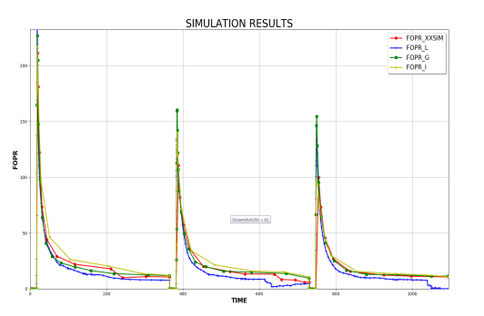
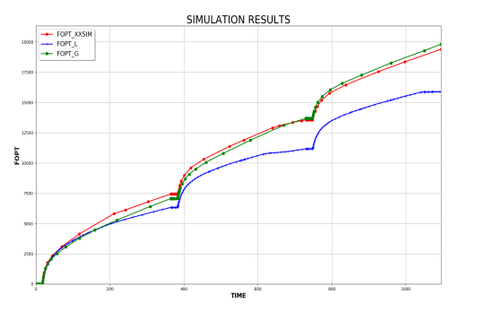
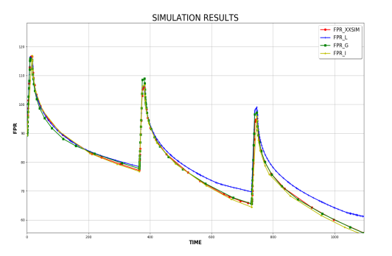
Classic Cases
Thermal Model
Case 4
Case Info: Based on Spe4, a thermal model with steam cycling.
Oil Rates (WOPR) | Cumulative Oil (WOPT) | Average Pressure (FPR)
Notes:
This is the steam huff and puff model from Spe4, Oil Rates, cumulative production and the average reservoir are compared with other commercial simulators. The result of XXSim are red solid lines.

Slide 19
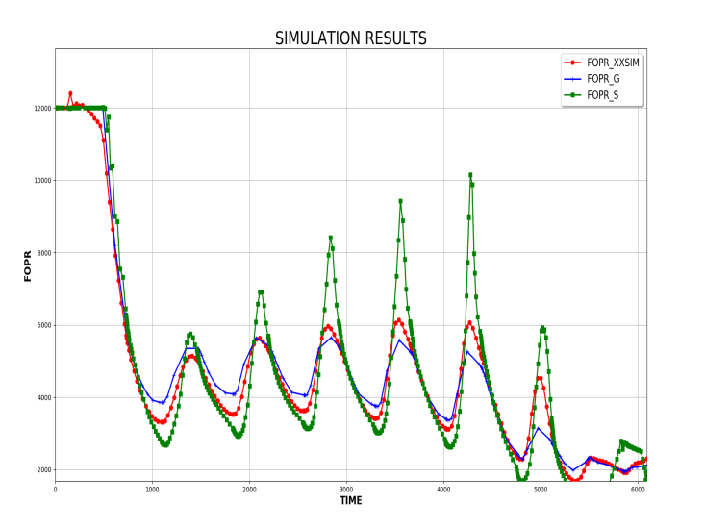
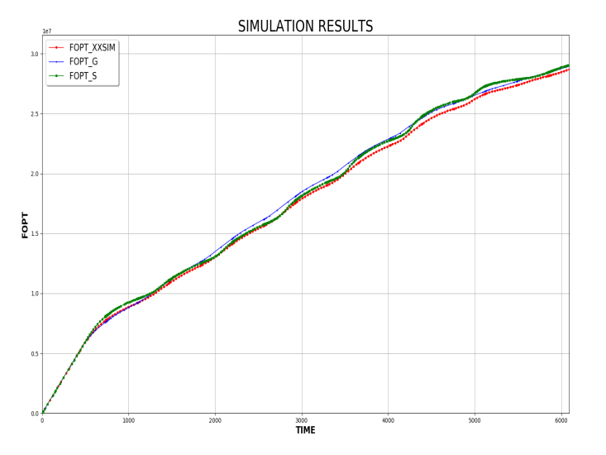
Classic Cases
Compositional Model
Case 5
Case Info: Based on Spe5 , a compositional model with WAG cycling.
Comparison of FOPR | Comparison of FOPT
Notes:
This is the model of SPE5's WAG model. Oil rate and cumulative productions are compared with two commercial simulators. The red lines are XXSIM’s result.

Slide 20
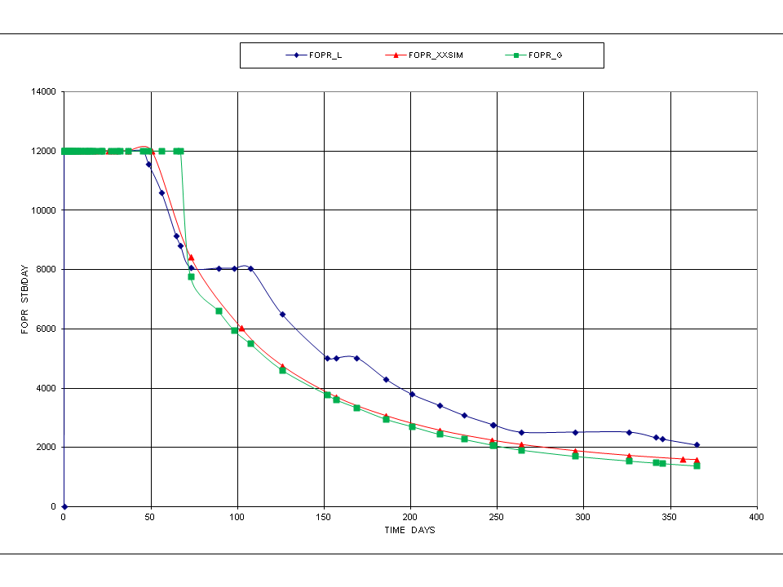
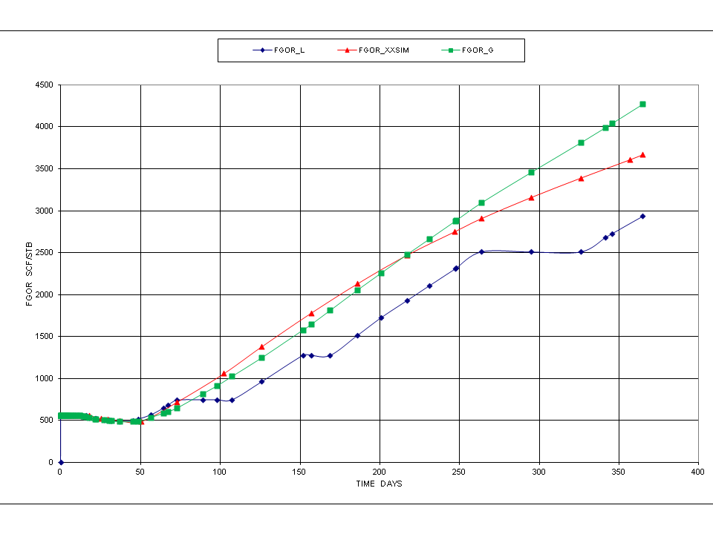
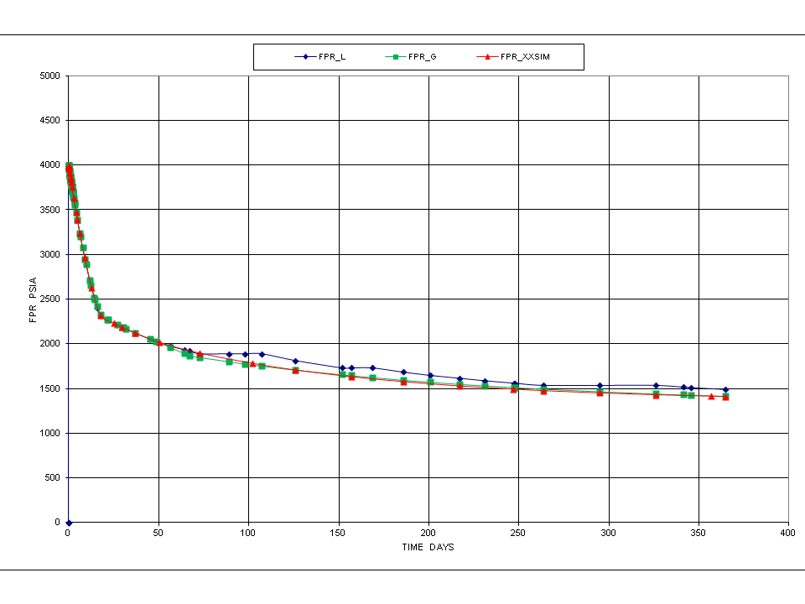
Classic Cases
Compositional Model
Case 6
Case Info: Modified case based on Spe5. It is a compositional model, gas drive in finer cell size.
Comparison of FOPR | Comparison of FGOR | Comparison of FPR
Notes:
Case 6 is a gas drive compositional model modified from SPE5's WAG model with exact EOS parameters, and different grid dimension (20x20x6) and sizes (50x50 ft) The red lines are XXSIM’s results, green and blue lines are the results of two commercial simulators. It is very clear that there is a commercial simulator, its results is not as same as others after grid refinement (results from (10x10x6) grid with 100x100ft are quite close for all three simulators)

Slide 21
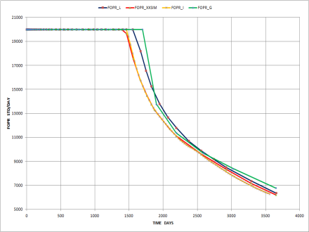
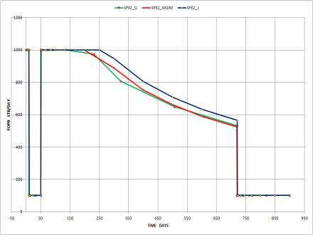
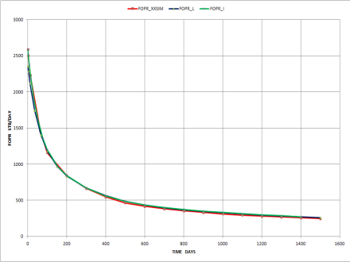
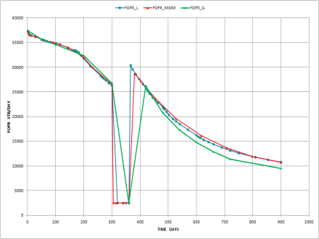
Classic Cases
Black Oil Model
Case 7
Case Info: Four black oil cases based on Spe 1, 2, 7, 9 4.
Comparison of FOPR SPE1 | Comparison of FOPR SPE2 | Comparison of FOPR SPE7 | Comparison of FOPR SPE9
Notes:
Case 7, 4 black oil models, modified from SPE 1, 2, 7, 9 are benchmarked with other commercial simulators. The red lines are XXSIM.

Slide 22

Thank You !
Contact Info:
+65 82395339
wt@peclouds.com
延时符

