Slide 1

Batch : 2023 –2027
IT1608-Mini Project
On
13.05.2026
TITLE: Cognitive Perishable Inventory Intelligence Platform for Autonomous Expiry Risk Prediction and Real-Time Decision Support
(P.I.R.E)
1

Slide 2
Candidate Details
 | Candidate I: | Candidate II:
Name: | Reshma Banu T | Sahana M
Register number: | 312323205182 | 312323205187
Department | Information Technology
Year / Semester | III / VI
Guided by: | M. Nivethitha Devi M.E., (Ph.D.) Assistant Professor
Domain | Supply Chain Management (SCM) & Logistics
Proposed Title: | COGNITIVE PERISHABLE INVENTORY INTELLIGENCE PLATFORM FOR AUTONOMOUS EXPIRY RISK PREDICTION AND REAL-TIME DECISION SUPPORT (P.I.R.E)
2

Slide 3
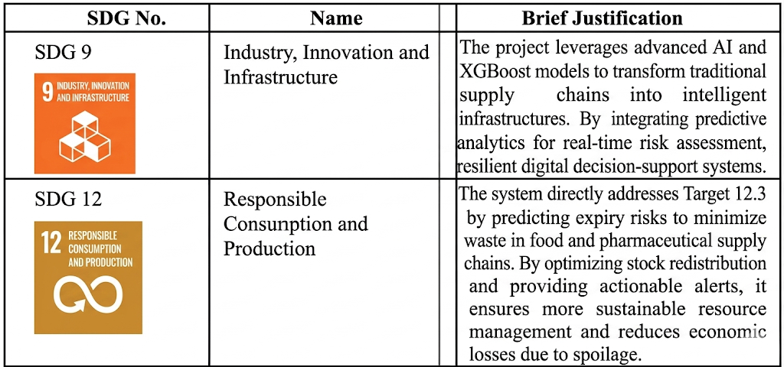
SDG Goals

Slide 4
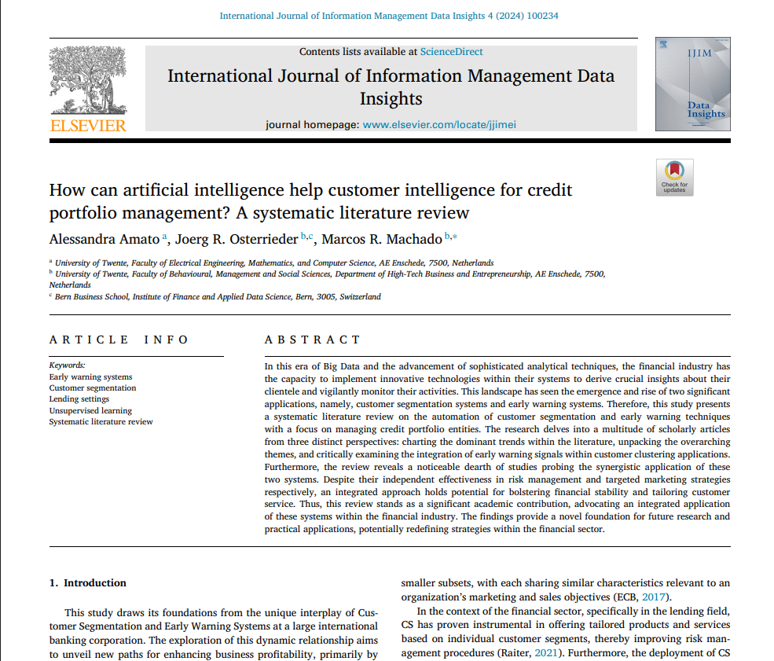
Base Paper
TITLE: Smart inventory monitoring system for small businesses using web-based analytics
Authors: M. Rahman and M. Islam
Publication: International Journal of Information Management Data Insights (Volume 4, Issue 2, 2024)

Slide 5
Proposed title
Cognitive Perishable Inventory Intelligence Platform for Autonomous Expiry Risk Prediction and Real-Time Decision Support
Base paper title
Smart inventory monitoring system for small businesses using web-based analytics

Slide 6
Abstract
Critical Management Challenge: The project addresses the significant wastage and economic losses in supply chains caused by the sensitivity of food, dairy, and pharmaceuticals to storage conditions and demand.
AI-Driven Risk Engine: It proposes an intelligent "Perishable Inventory Risk Engine" that utilizes time-series analysis and ensemble learning models like XGBoost to optimize inventory management.
Dynamic Risk Scoring: The system evaluates factors such as shelf life and consumption patterns to generate dynamic risk scores, categorizing items into low, medium, or high-risk levels.
Actionable Business Insights: Beyond prediction, the model provides practical strategies including early expiry alerts, automated discount recommendations, and stock redistribution plans.
Scalable Sustainability: Experimental results show improved accuracy in reducing wastage, making the model adaptable for large-scale deployment in retail, healthcare, and logistics.

Slide 7
Problem Statement
Sensitivity of Perishable Goods: Products such as food, dairy, and pharmaceuticals are highly sensitive to time, storage conditions, and demand variability, making them difficult to manage in modern supply chains.
Inefficient Inventory Handling: Current management methods often lead to inefficient handling of inventory, which results in significant wastage and operational inefficiencies.
Economic and Resource Loss: The lack of precise tracking and prediction causes substantial economic losses for businesses and contributes to global resource waste.
Lack of Timely Decision-Making: Without accurate predictions of product expiry risks, managers struggle to make timely decisions necessary to ensure profitability and sustainability.
Need for Data-Driven Optimization: There is a critical need for an intelligent system that can integrate multiple influencing factors—like shelf life and consumption patterns—to provide actionable insights and reduce mean error rates in risk prediction.

Slide 8
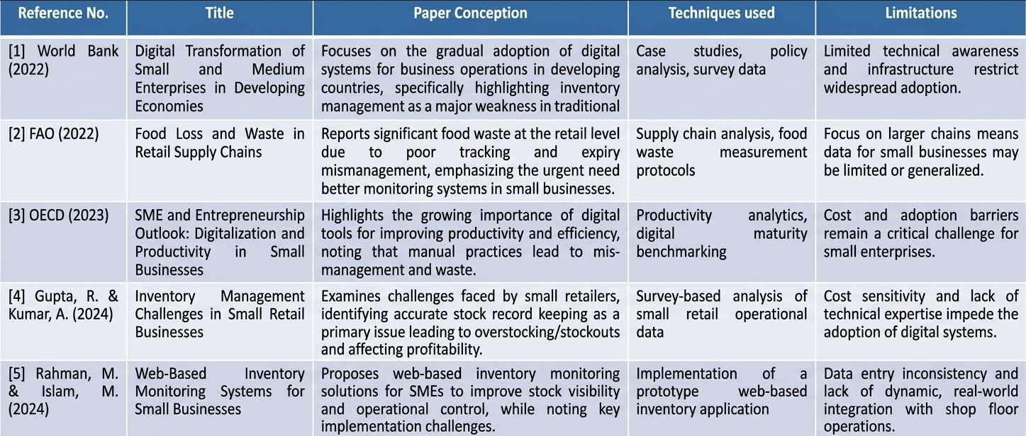
Literature Survey

Slide 9
Scope of the Proposed Work
Proposed Objectives
Intelligent Risk Modeling and Data Integration: To develop a machine learning-based engine using XGBoost and time-series analysis that processes dynamic user inputs—such as shelf life, storage conditions, and demand patterns—to accurately predict expiry risks and categorize inventory into low, medium, and high-risk levels.
Unified Monitoring and Decision Support: To create an interactive, web-based dashboard that visualizes risk levels and inventory performance over time, providing a unified platform for real-time alerts, stock redistribution recommendations, and data-driven insights to minimize wastage.
Intelligent Prediction and Risk Categorization: The system focuses on leveraging XGBoost and time-series analysis to evaluate factors such as shelf life and storage conditions, ultimately generating dynamic risk scores to categorize items into low, medium, or high-risk levels.
Actionable Decision Support and Digitalization: The scope includes developing a unified web-based platform with interactive dashboards that provide real-time expiry alerts, discount recommendations, and stock redistribution strategies to minimize wastage and improve operational efficiency.

Slide 10
Proposed system
AI-Driven Risk Prediction: The system utilizes advanced machine learning, specifically XGBoost and time-series analysis, to evaluate influencing factors like remaining shelf life and storage conditions.
Dynamic Risk Categorization: It generates a real-time risk score for every item, automatically classifying inventory into low, medium, or high-risk levels to prioritize management efforts.
Actionable Decision Support: Beyond simple monitoring, the platform provides proactive insights, including early expiry alerts, discount recommendations, and stock redistribution strategies to minimize loss.
Scalable Web-Based Architecture: The solution integrates these predictive modules into a user-friendly web platform, making it adaptable for diverse sectors such as retail, healthcare, and logistics.

Slide 11
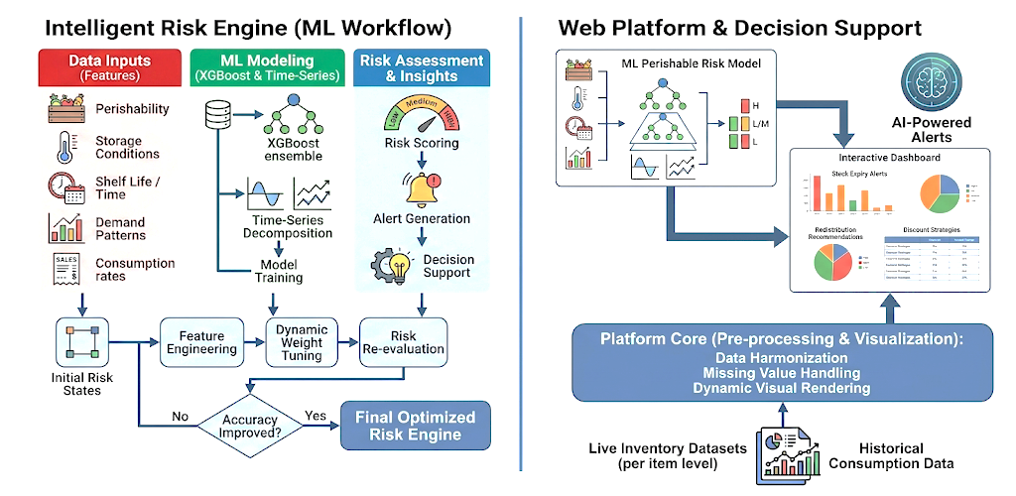
Proposed Architecture Diagram

Slide 12
Modules 1: Data Acquisition and Inventory Monitoring
Collects inventory data such as product type, quantity, and expiry date
Monitors storage conditions including temperature and humidity
Tracks real-time stock movement and consumption patterns
Preprocesses and organizes data for machine learning analysis

Slide 13
Modules 2: Expiry Risk Prediction Engine
Uses machine learning models such as XGBoost for prediction
Analyzes shelf life, demand variability, and storage factors
Generates dynamic risk scores for each inventory item
Classifies products into Low, Medium, and High-risk categories

Slide 14
Modules 3 : Decision Support and Optimization System
Provides early expiry alert notifications
Suggests discount and promotional strategies for risky items
Recommends stock redistribution to minimize wastage
Supports data-driven inventory management and operational efficiency

Slide 15
Experimental Setup
Programming Language: Python 3.x for machine learning and JavaScript for MERN stack development.
Machine Learning Libraries: XGBoost for risk prediction. Pandas and NumPy for data processing. Scikit-learn for train-test split and evaluation.
Web Framework & Dashboarding: MERN Stack (MongoDB, Express.js, React.js, Node.js) for the web dashboard. Chart.js or Recharts for charts and visualizations.
Database Management: MongoDB for storing inventory and prediction data.
Development Environment: Visual Studio Code and Jupyter Notebook.

Slide 16
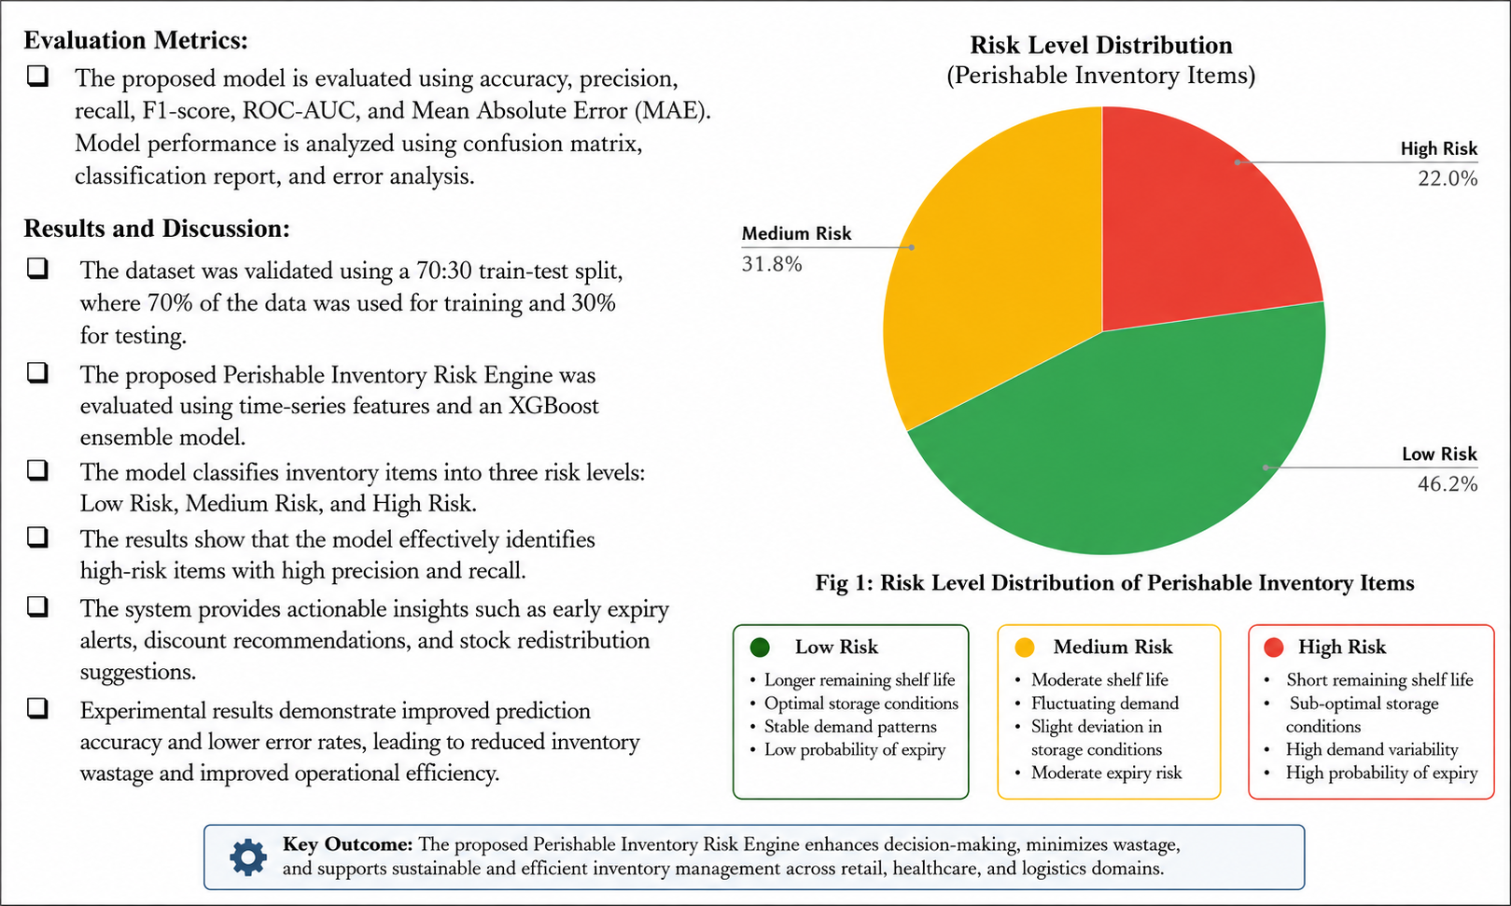
Dataset Description

Slide 17
Result Analysis
Significant Reduction in Wastage: The system identifies high-risk items with high precision, allowing for timely interventions that significantly reduce inventory spoilage and physical wastage compared to manual tracking systems.
High Prediction Accuracy: By utilizing ensemble learning through XGBoost and time-series analysis, the model achieves lower mean error rates in predicting expiry dates and risk scores, outperforming traditional linear estimation methods.
Optimized Inventory Performance: The implementation of a dynamic risk scoring mechanism (Low, Medium, High) provides quantitative insights that allow businesses to identify patterns of inefficiency and improve overall operational control.
Effective Decision Support: The integration of the alert and recommendation modules—such as automated discount strategies and stock redistribution—enables data-driven decision-making that directly enhances sustainability and profitability.

Slide 18
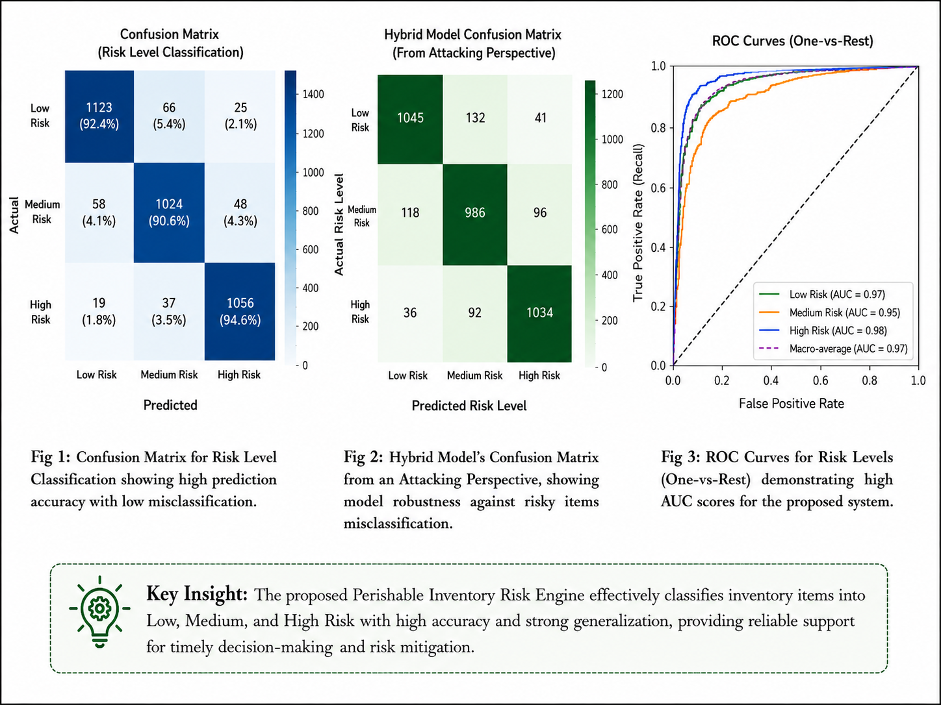
Result Analysis

Slide 19
Conclusion and future work
Enhanced Operational Efficiency: The Perishable Inventory Risk Engine successfully demonstrates that integrating XGBoost and time-series analysis significantly reduces wastage by providing more accurate expiry predictions than traditional manual methods.
Data-Driven Decision Making: The system transforms raw inventory data into actionable insights, such as dynamic risk scoring and automated alerts, enabling SMEs to maintain profitability while ensuring resource optimization.
Sustainability Alignment: By effectively identifying and managing high-risk items, the project directly supports SDG Goals 9 and 12, fostering industrial innovation and promoting responsible, waste-conscious consumption patterns.

Slide 20
References
[1] World Bank, Digital Transformation of Small and Medium Enterprises in Developing Economies, World Bank Group Report, 2022.
[2] FAO, Reducing Food Loss and Waste in Retail Supply Chains Through Digital Monitoring, Food and Agriculture Organization, 2022.
[3] OECD, SME and Entrepreneurship Outlook 2023: Digitalization and Productivity in Small Businesses, OECD Publishing, 2023.
[4] Gupta, R. and Kumar, A., “Data-driven inventory management in small retail businesses,” International Journal of Retail & Distribution Management, vol. 52, no. 3, pp. 310–326, 2024.
[5] Rahman, M. and Islam, M., “Smart inventory monitoring system for small businesses using web-based analytics,” International Journal of Information Management Data Insights, vol. 4, no. 2, 2024.

Slide 21
THANK YOU!

