Slide 1

WORLDWIDE ENERGY CONSUMPTION ANALYSIS

Slide 2
Agenda
Project Overview
ER Diagram and schema explanation
Key analysis questions (USE CASES)
SQL query results with summaries
Final Business Insights
Conclusion

Slide 3
PROJECT OVERVIEW
To analyze energy consumption patterns across different time intervals and identify periods of high and low usage.
To evaluate which segments - such as appliances, regions, or user groups - contribute most to overall energy consumption.
To detect anomalies or unusual spikes in usage that may indicate inefficiencies or abnormal behavior.
To convert raw SQL results into meaningful insights that support decision-making for optimizing energy usage and reducing wastage.

Slide 4
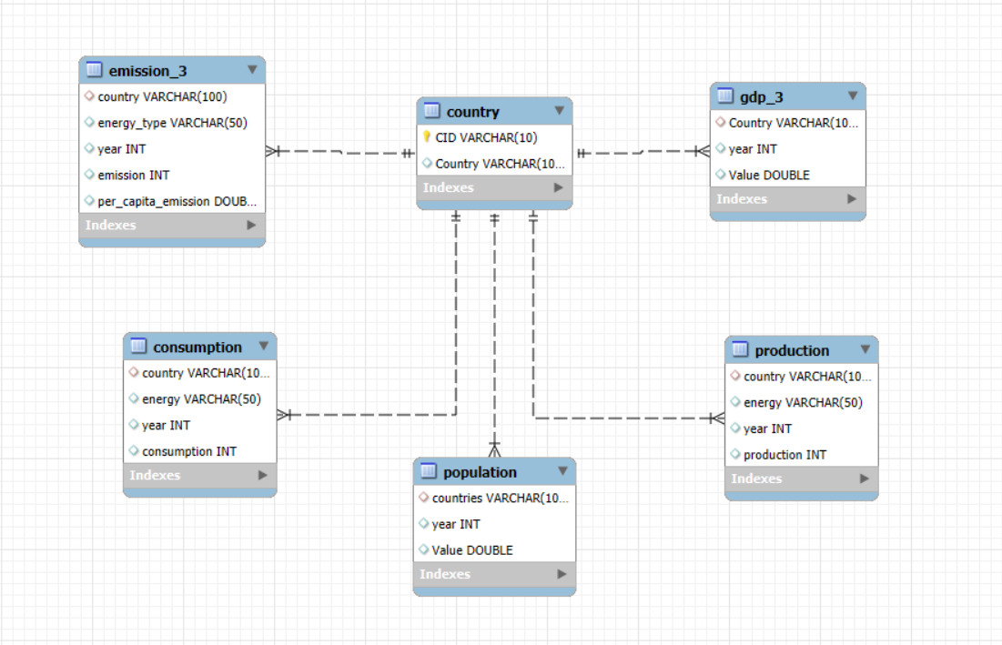
ER DIAGRAM
One-to-Many from country to emission_3
One-to-Many from country to consumption
One-to-Many from country to production
One-to-Many from country to gdp_3
One-to-Many from country to population

Slide 5
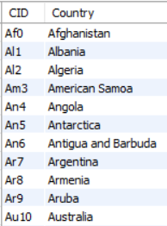
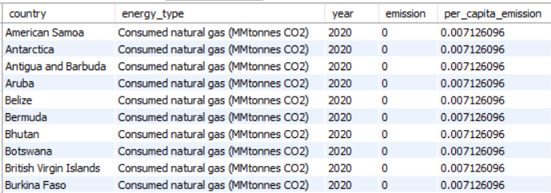
TABLES
1. COUNTRY 2. EMISSION_3

Slide 6
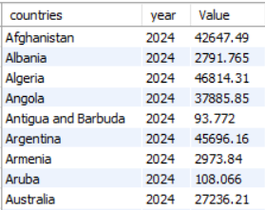
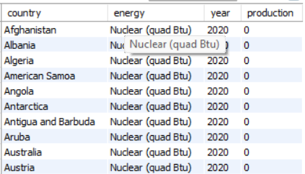
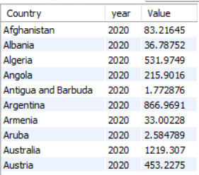
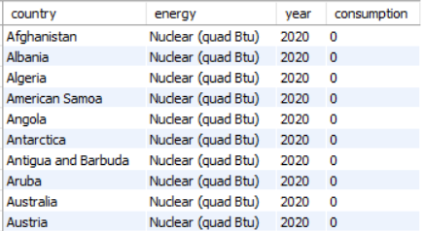
3. POPULATION
4. PRODUCTION
5. GDP_3
6. CONSUMPTION

Slide 7

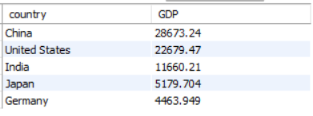
USE CASES
What are the top 5 countries by GDP in the most recent year?
QUERY
OUTPUT

Slide 8
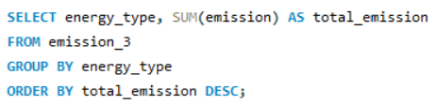
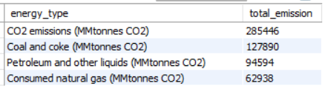
Which energy types contribute most to emissions across all countries ?
QUERY
OUTPUT

Slide 9
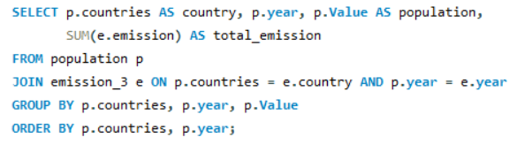
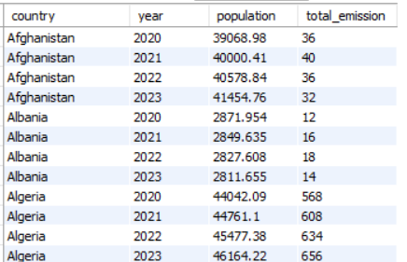
How has population growth affected total emissions in each country ?
QUERY
OUTPUT

Slide 10
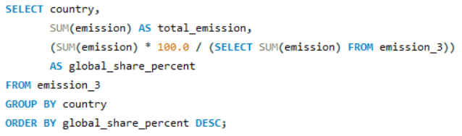
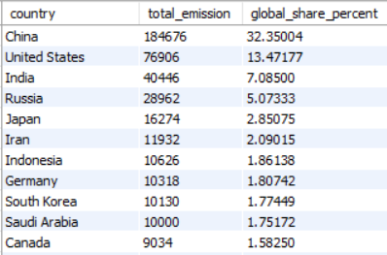
What is the global share (%) of emissions by country?
QUERY
OUTPUT

Slide 11
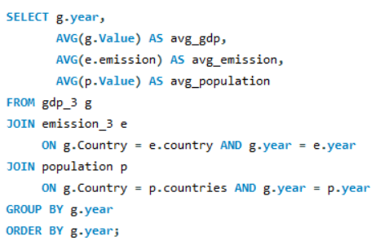
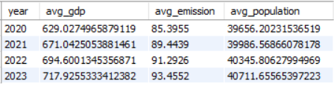
Global average GDP, emission, and population by year
QUERY
OUTPUT

Slide 12
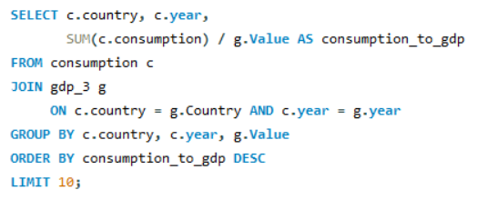
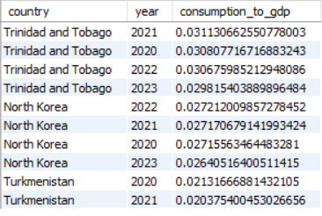
Countries with highest energy consumption relative to GDP
QUERY OUTPUT

Slide 13
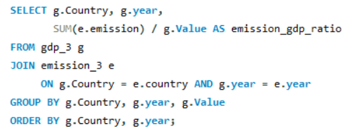

Emission-to-GDP ratio per country by year
QUERY
OUTPUT

Slide 14
FINAL BUSINESS INSIGHTS
1. Economic Growth Drives Energy Demand
Countries with higher GDP consistently show higher energy consumption and emissions, indicating that economic expansion is closely tied to energy dependence.
2. Global Emissions Continue to Rise
Year-over-year trends reveal a steady increase in global emissions, highlighting the growing environmental burden across major economies.
3. Fossil Fuels Dominate Emission Contribution
Coal and oil-based energy types contribute the highest share of emissions, making them the major drivers of global carbon output.
4. Population Growth Directly Influences Emissions
Countries with rapidly increasing populations show corresponding rises in total emissions, reinforcing the link between demographic expansion and environmental impact.

Slide 15
CONCLUSION
Economic growth, population growth, and energy use are causing emissions to rise, so countries need to plan sustainably.
Big economies have a major role in moving to cleaner energy.
Energy demand is increasing everywhere, so efficient use and balanced production are important.
Different countries emit differently because of lifestyles and resources.
To ensure long-term environmental and economic stability, reducing emissions and using more renewable energy is essential.

Slide 16

THANK YOU

