Slide 1

Music Store Data Analysis USING MySQL
Name : Reshma Sappa
Batch no : 543
ID : 81010206326

Slide 2
About Me:
Background: I completed my Bachelor's degree in Electronics and Communication Engineering (ECE) from Vignana Bharathi Institute of Technology (VBIT) in the year 2026.
Why do you want to learn Data Science: Every organization generates data, but the real value lies in asking the right questions and extracting actionable insights. I want to develop the ability to solve business problems systematically using data rather than relying on assumptions. That combination of analytical thinking and business impact is what motivates me to pursue Data Science.
Proile URLs :
      LinkedIn : http://www.linkedin.com/in/reshma-sappa17
      Github : https://github.com/Reshma-2517

Slide 3
Agenda:
Business Problem
Business Statement
Introduction
Data Description
Key analysis questions and insights
Recommendations
Conclusion
Experience & challenges while working
Q&A Slide

Slide 4
Business Problem:
The music store generates large volumes of data across customers, invoices, tracks, artists, and genres.
However, raw transaction data does not clearly show where revenue comes from or what drives customer purchases.
The business needs to identify high-value customers, profitable markets, and popular music preferences.
These insights can help improve promotional targeting, customer engagement, and sales decisions.

Slide 5
Business Statement:
Analyze the available sales and customer data to uncover revenue patterns, customer value, geographic performance, and music preferences, providing management with evidence-based insights for targeted business actions.
Design and implement a structured relational database with appropriate keys and relationships.
Import and validate the music store data across related tables.
Analyze customer purchases, invoices, artists, tracks, and genres using SQL queries.
Apply SQL techniques such as joins, aggregations, subqueries, views, CTEs and filtering to derive meaningful insights.

Slide 6
Introduction:
This project presents a SQL-driven analysis of a music store’s business data.
It examines the database from multiple perspectives to understand how the store operates and how its transactions are distributed.
The project connects different business entities to provide a complete view of the store’s data ecosystem.
The analysis concludes with key findings, business recommendations, and opportunities for further improvement.

Slide 7
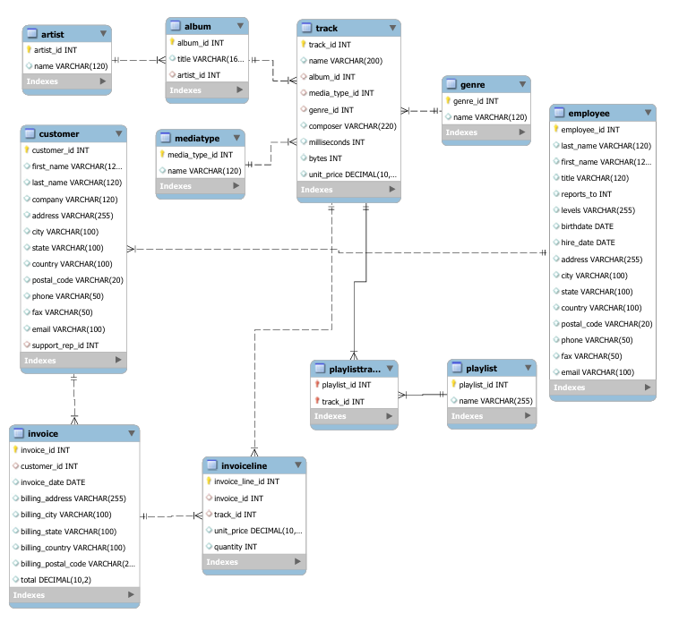
Data Description:
1. ER Diagram:

Slide 8
2. Cardinalities:
Relationship | Cardinality | Why
Employee → Employee (reports_to) | 1 : N | One manager can report many employees
Employee → Customer (support_rep_id) | 1 : N | One employee can support many customers
Customer → Invoice (customer_id) | 1 : N | One customer can have many invoices
Invoice → InvoiceLine (invoice_id) | 1 : N | One invoice contains many line items
Track → InvoiceLine (track_id) | 1 : N | One track can appear in many invoice lines
Playlist → PlaylistTrack (playlist_id) | 1 : N | One playlist contains many playlist-track records
Track → PlaylistTrack (track_id) | 1 : N | One track can belong to many playlists
Artist → Album (artist_id) | 1 : N | One artist can have many albums
Album → Track (album_id) | 1 : N | One album can contain many tracks
MediaType → Track (media_type_id) | 1 : N | One media type can apply to many tracks
Genre → Track (genre_id) | 1 : N | One genre can contain many tracks

Slide 9
3. Database Schema Overview:
Table Name | Description | Columns it Contains
Employee | Stores employee details, job roles, levels, and reporting relationships. | employee_id,last_name, first_name, title, reports_to, birthdate, hire_date, address, city, state, country, postal_code, phone, fax, email
Customer | Stores customer information and assigned support representative. | customer_id, first_name, last_name, company, address, city, state, country, postal_code, phone, fax, email,support_rep_id
Invoice | Records customer transactions, billing details, dates, and purchase totals. | invoice_id, customer_id, invoice_date, billing_address, billing_city, billing_state, billing_country, billing_postal_code, total
InvoiceLine | Stores individual tracks purchased within each invoice. | invoice_line_id, invoice_id, track_id, unit_price, quantity
Track | Stores individual music tracks and their associated metadata. | track_id, name, album_id, media_type_id, genre_id, composer, milliseconds, bytes, unit_price
Artist | Stores information about music artists. | artist_id, name
Album | Stores album information and its associated artist. | album_id, title, artist_id
Genre | Stores available music genre categories. | genre_id, name
MediaType | Stores the media types associated with tracks. | media_type_id, name
Playlist | Stores playlist information. | playlist_id, name
PlaylistTrack | Connects playlists with their associated tracks. | playlist_id, track_id

Slide 10

Key Analysis Questions:
1. Who is the senior most employee based on job title?
SELECT
employee_id,
CONCAT(first_name, ' ', last_name) AS employee_name,
title,
levels
FROM Employee
ORDER BY levels DESC
LIMIT 1;
Output:
Insight:
Identifies the employee with the highest organizational level, showing who holds the most senior position. This helps understand the company’s leadership structure and reporting hierarchy

Slide 11
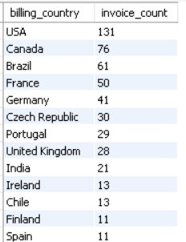
2. Which countries have the most Invoices?
Output:
CREATE VIEW invoice_count_by_country AS
SELECT
billing_country,
COUNT(invoice_id) AS invoice_count
FROM Invoice
GROUP BY billing_country
ORDER BY invoice_count DESC;
SELECT *
FROM invoice_count_by_country;
Insight:
Shows which countries generate the highest number of customer transactions. These markets have stronger purchasing activity and can be important targets for regional marketing.

Slide 12

3. What are the top 3 values of total invoice?
SELECT invoice_id, total
FROM (
SELECT
invoice_id,
total,
ROW_NUMBER() OVER (ORDER BY total DESC) AS rn
FROM Invoice
) AS ranked_invoices
WHERE rn <= 3;
Output:
Insight:
Highlights the three largest individual invoices in the business. These transactions represent high-value purchases and can help identify unusually large customer orders.

Slide 13

4. Write a query that returns one city that has the highest sum of invoice totals. Return both the city name & sum of all invoice totals
WITH city_revenue AS (
SELECT
billing_city,
SUM(total) AS total_revenue
FROM Invoice
GROUP BY billing_city
)
SELECT
billing_city,
total_revenue
FROM city_revenue
ORDER BY total_revenue DESC
LIMIT 1;
Output:
Insight:
Identifies the city contributing the most total invoice revenue. This city represents a strong revenue market and could be considered when planning promotional events.

Slide 14
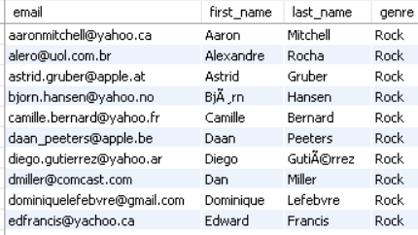
5. Write a query to return the email, first name, last name, & Genre of all Rock Music listeners. Return your list ordered alphabetically by email starting with A
SELECT DISTINCT
c.email,
c.first_name,
c.last_name,
g.name AS genre
FROM Customer AS c
INNER JOIN Invoice AS i
ON c.customer_id = i.customer_id
INNER JOIN InvoiceLine AS il
ON i.invoice_id = il.invoice_id
INNER JOIN Track AS t
ON il.track_id = t.track_id
INNER JOIN Genre AS g
ON t.genre_id = g.genre_id
WHERE g.name = 'Rock'
ORDER BY c.email;
Output:
Insight:
Identifies the customer who has generated the greatest total spending. This customer represents a high-value relationship and could be important for customer-retention strategies.

Slide 15
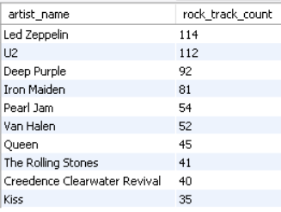
6. Let's invite the artists who have written the most rock music in our dataset. Write a query that returns the Artist name and total track count of the top 10 rock bands
SELECT
artist_name,
COUNT(track_id) AS rock_track_count
FROM (
SELECT
ar.artist_id,
ar.name AS artist_name,
t.track_id
FROM Artist AS ar
INNER JOIN Album AS al
ON ar.artist_id = al.artist_id
INNER JOIN Track AS t
ON al.album_id = t.album_id
INNER JOIN Genre AS g
ON t.genre_id = g.genre_id
WHERE g.name = 'Rock'
) AS rock_tracks
GROUP BY artist_id, artist_name
ORDER BY rock_track_count DESC
LIMIT 10;
Output:
Insight:
Shows which artists have the largest number of Rock tracks in the catalog.These artists have strong representation in the Rock inventory and may be useful for genre-focused promotions.

Slide 16
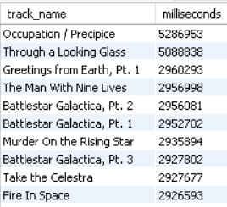
7. Return all the track names that have a song length longer than the average song length.- Return the Name and Milliseconds for each track. Order by the song length, with the longest songs listed first
SELECT
name AS track_name,
milliseconds
FROM Track
WHERE milliseconds > (
SELECT AVG(milliseconds)
FROM Track
)
ORDER BY milliseconds DESC;
Output:
Insight:
Identifies songs that are longer than the overall average track duration. Helps identify the longer songs in the music catalog for further analysis of customer listening patterns.

Slide 17
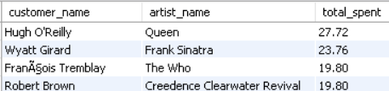
8. Find how much amount is spent by each customer on artists? Write a query to return customer name, artist name and total spent
CREATE VIEW customer_artist_purchases AS
SELECT
c.customer_id,
CONCAT(c.first_name, ' ', c.last_name) AS customer_name,
ar.artist_id,
ar.name AS artist_name,
il.unit_price * il.quantity AS amount
FROM Customer AS c
INNER JOIN Invoice AS i
ON c.customer_id = i.customer_id
INNER JOIN InvoiceLine AS il
ON i.invoice_id = il.invoice_id
INNER JOIN Track AS t
ON il.track_id = t.track_id
INNER JOIN Album AS al
ON t.album_id = al.album_id
INNER JOIN Artist AS ar
ON al.artist_id = ar.artist_id;
#view query ----------------------------
SELECT
customer_name,
artist_name,
SUM(amount) AS total_spent
FROM customer_artist_purchases
GROUP BY
customer_id,
customer_name,
artist_id,
artist_name
ORDER BY total_spent DESC;
Output:
Insight:
How much each customer spends on individual artists, revealing customer–artist purchasing patterns. This can support personalized recommendations and artist-specific marketing.

Slide 18
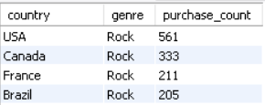
9. Write a query that returns each country along with the top Genre. For countries where the maximum number of purchases is shared, return all Genres . We determine the most popular genre as the genre with the highest amount of purchases.
WITH genre_purchases AS (
SELECT
i.billing_country AS country,
g.name AS genre,
COUNT(il.invoice_line_id) AS purchase_count
FROM Invoice AS i
JOIN InvoiceLine AS il
ON i.invoice_id = il.invoice_id
JOIN Track AS t
ON il.track_id = t.track_id
JOIN Genre AS g
ON t.genre_id = g.genre_id
GROUP BY
i.billing_country,
g.name
),
max_purchases AS (
SELECT
country,
MAX(purchase_count) AS max_purchase_count
FROM genre_purchases
GROUP BY country
)
SELECT
gp.country,
gp.genre,
gp.purchase_count
FROM genre_purchases AS gp
JOIN max_purchases AS mp
ON gp.country = mp.country
AND gp.purchase_count = mp.max_purchase_count
ORDER BY mp.max_purchase_count DESC;
Output:
Insight:
Identifies the most purchased genre in each country, revealing differences in music preferences across markets. Shared rankings also show where customer demand is distributed across multiple genres.

Slide 19
Recommendations:
Interactive Visualizations - Build dynamic dashboards with charts, maps, and filters for deeper insights.
Churn Prediction - detect customers whose purchasing activity is declining
Sales Forecasting to predict future revenue and demand.
Real-Time Analytics - connect the database to a live dashboard for continuously updated KPIs.

Slide 20
Conclusion:
This project transformed raw music-store data into meaningful business insights using SQL. By analyzing customers, invoices, artists, tracks, and genres, we identified important purchasing patterns and business opportunities. The analysis demonstrates how structured data and SQL can support data-driven decisions, targeted marketing, and improved customer engagement.

Slide 21
Experience & challenges :
Working on this project provided hands-on experience in data relationships, and SQL-based business analysis. The major challenges included understanding complex table relationships, applying the correct joins, handling aggregations across multiple tables, and translating business questions into efficient SQL queries. Overall, the project strengthened my ability to analyze real-world data and convert it into actionable insights.

Slide 22
Any Queries ?

Slide 23

THANK YOU

