Slide 1
Guess or perish…!!
M.Chithranjali-24EE01056
N.Reshma-24EE01050
Magic behind --
-the hangman challenge!!
{The Game}

Slide 2
The path we followed…
Exploring the codes of the given games
Finding the concepts which we could learn in the given time frame
Selecting the optimum project that we could do
Reading the syntax of the code from the reference
Writing the appropriate algorithm from the reference
Coding the code for the given project…..

Slide 3
Motivation:
Developing playable games can be fun , interesting and engaging way to learn C-Programming.
The project was supposed to solidify our understanding of the language in a more intriguing way . Hangman involves guessing and board thinking way , which transcribes well to the programming language . By building this project , we have gained prized practical experience ….!!

Slide 4
IMPORTANT HIGHLIGHTS OF PROJECT :
Engaging Gameplay Mechanics
Word Guessing Challenge: The player must guess the hidden word one letter at a time.
Limited Attempts: Adds suspense by giving a maximum of 6 incorrect guesses.
User-Friendly Features
Case-Insensitive Guessing: Players can enter letters in any case (e.g., ‘A’ or ‘a’).
Real-Time Feedback: Shows if a guess is correct or wrong and updates the remaining attempts.
Visual Word Progress: Displays the word with blanks for unguessed letters, making the game easy to follow.

Slide 5
CONCEPTS LEARNED DURING PROJECT:
During this project we have learned about many libraries and their functions.
We learned different ways to access Arrays and use them in an efficient manner to reduce the variables.
We used Functions to reduce the repetition of same code in the main function.
Even, we had a time, we faced time complexity problems.
Then, we learnt some functions, These functions helped to run the code more efficiently and reduced the time complexity problem.

Slide 6
AREAS FOR IMPROVEMENT:
Add validation to ensure that only letters are accepted.
Track guessed letters and notify the player if the letter was already guessed.
Implement random word selection from a predefined word list (stored in an array or read from a file).
Add colorful text using ANSI escape codes to highlight correct and incorrect guesses.
Use a graphical UI library like ncurses to create a more interactive interface.
Add a step-by-step ASCII drawing of the hangman based on the number of incorrect attempts.

Slide 7
FUTURE SCOPE :
• In the 21st century, Gaming is the most featured thing.
• We developed games in c without graphics in a simply way.
• We want to show that we can make games in c (where in present
situation, the game developers are using python, unity, etc …) .
CONTRIBUTIONS :
M . Chithranjali – logic for word input and set up , checking if the player as guessed the word or not and preparation of the the following ppt
N . Reshma – logic for displaying the word progress , handling player input’s , managing overall game scenarios and testing of the game…

Slide 8
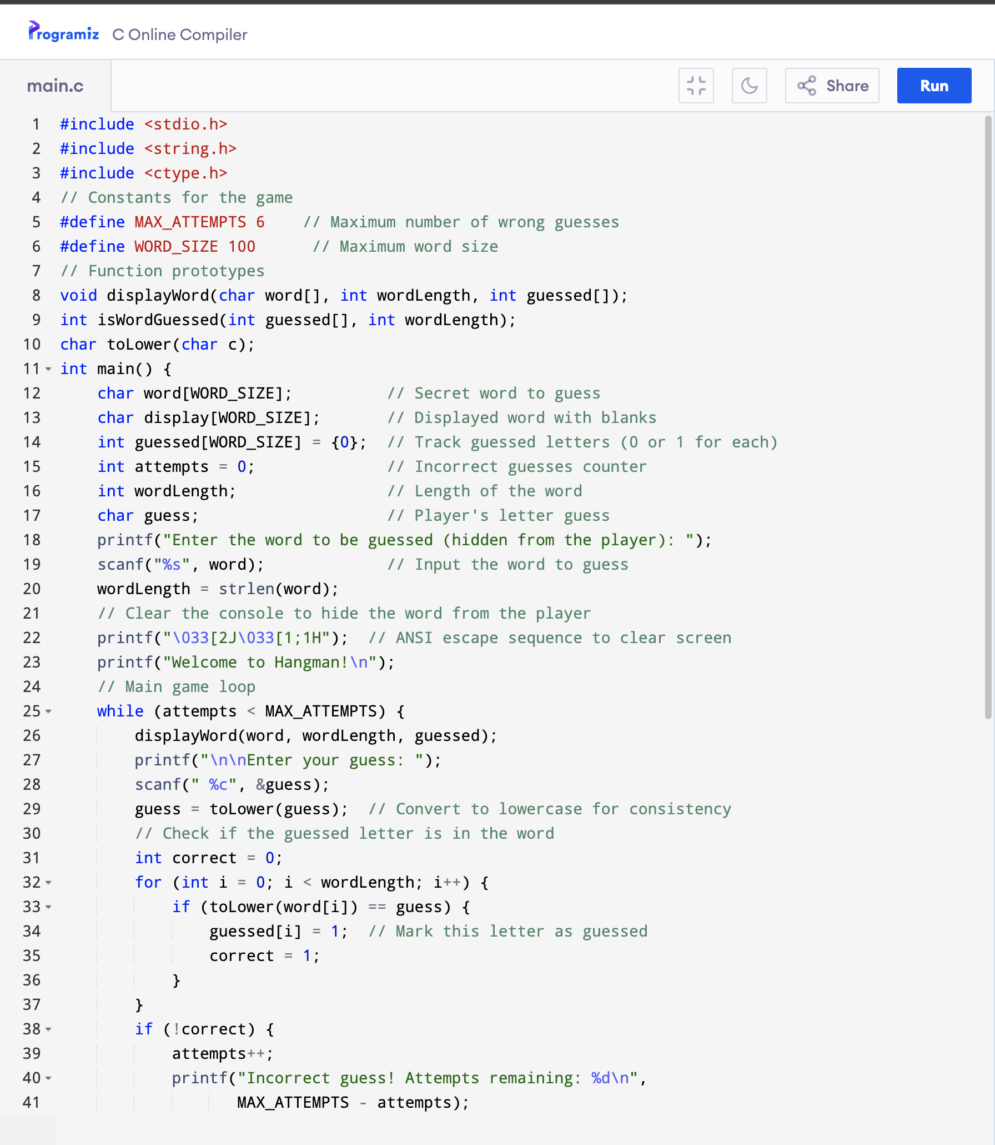
Code:

Slide 9
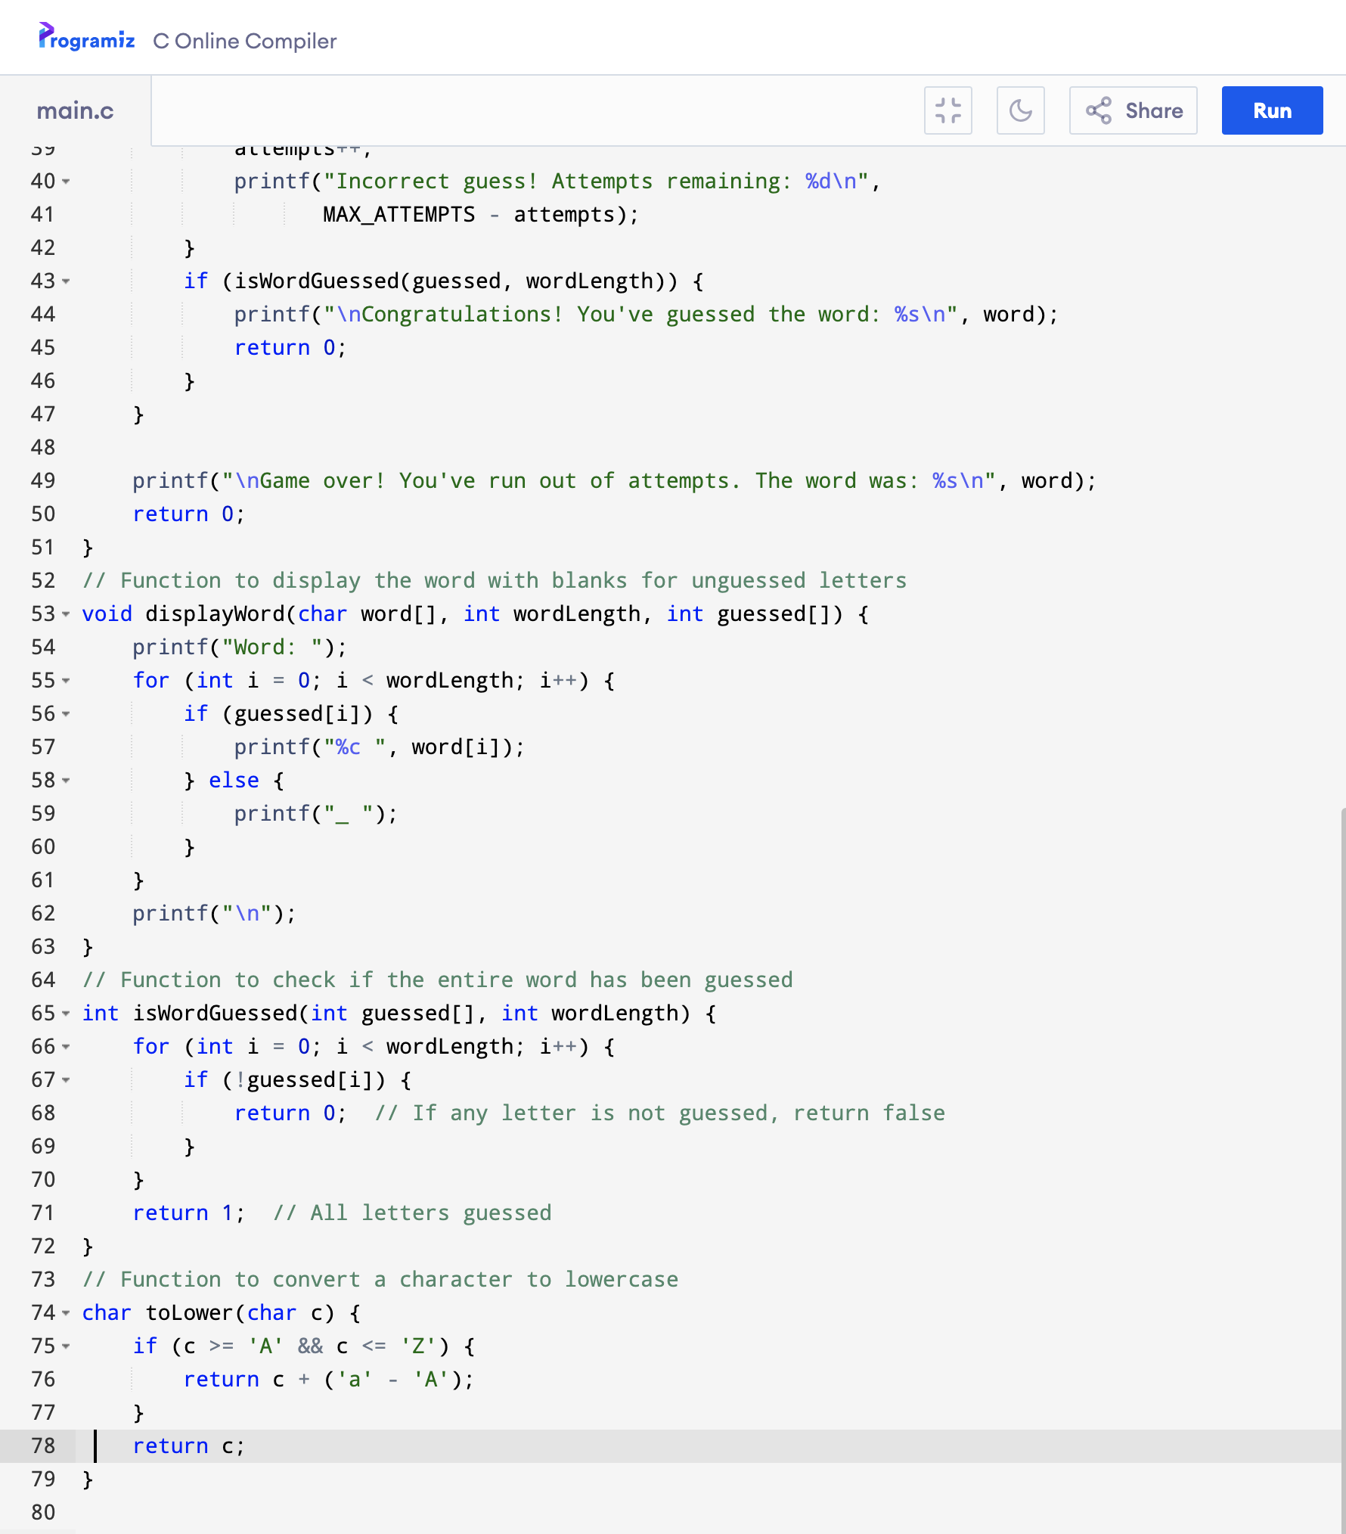

Slide 10
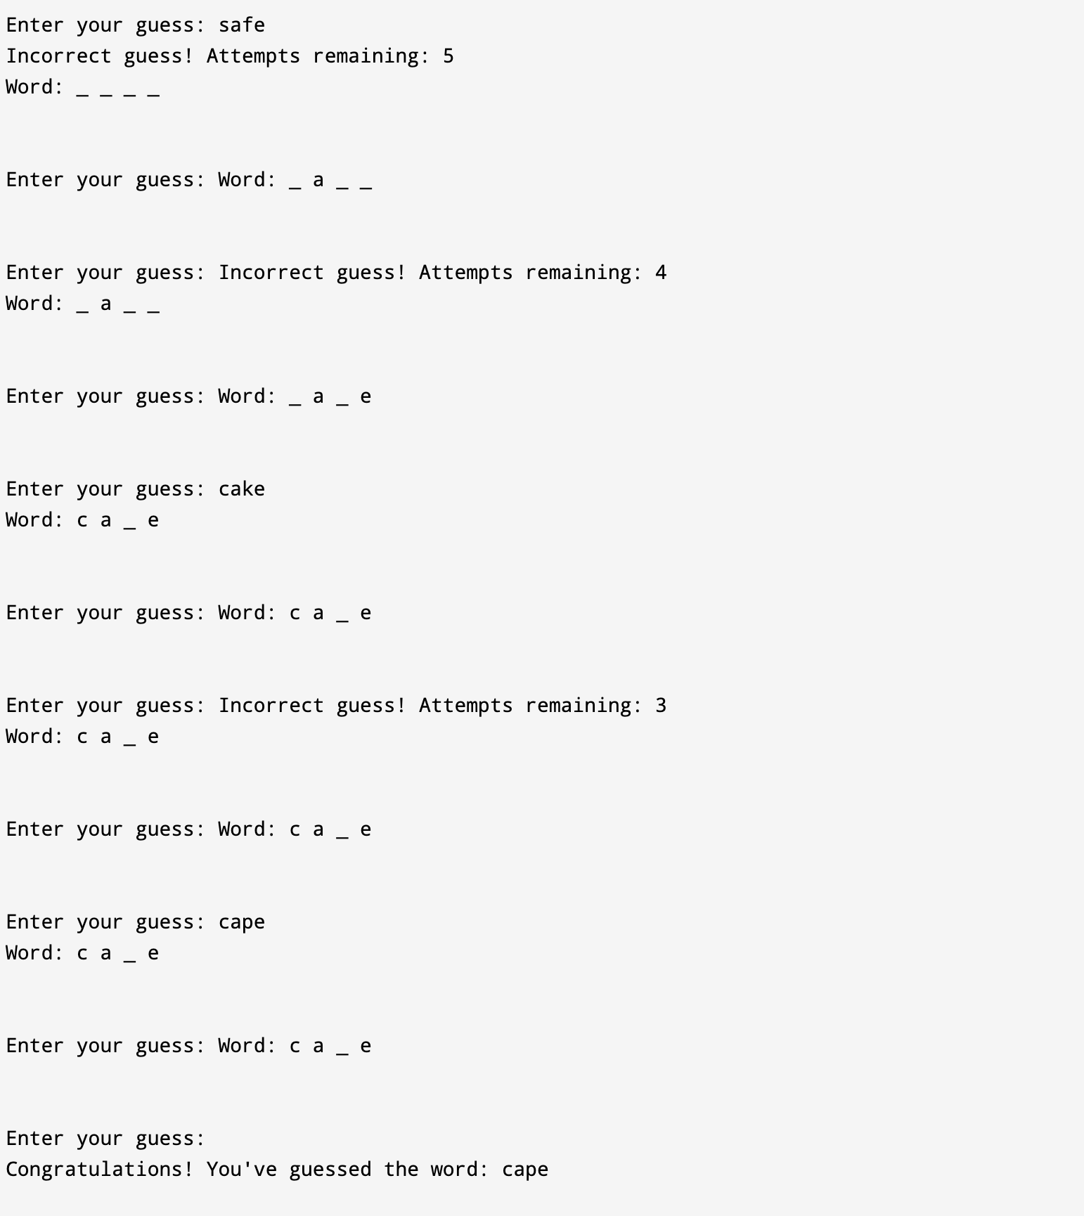
Output :

Slide 11
Thankyou....
The end…

