Slide 1
SWOT Analysis

Slide 2
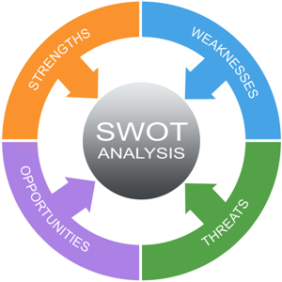
swot analysis summary
SWOT Analysis defined
What is it?
Why is it used?
What does it accomplish?
Breakdown of SWOT
Practical Walkthrough
Template Explained
Now It’s Your Turn
Student Exercise

Slide 3
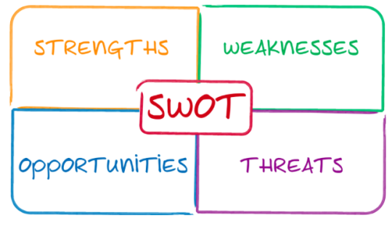
What is SWOT?

Slide 4

Why is SWOT used?
Identify Influencers

Slide 5
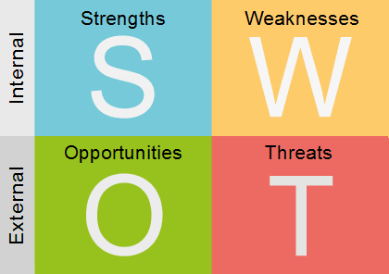
Why is SWOT used?
Identify Influencers

Slide 6

Why is SWOT used?
Identify Influencers
Uncover Opportunities

Slide 7

Why is SWOT used?
Identify Influencers
Uncover Opportunities
Raise Awareness

Slide 8

What does SWOT accomplish?

Slide 9
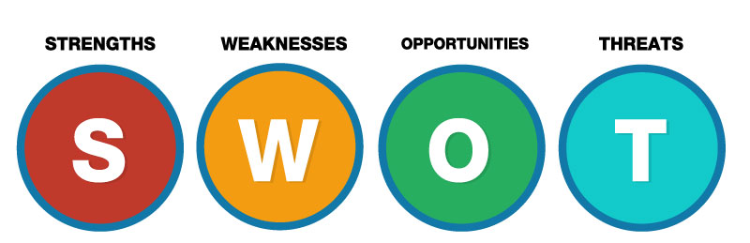
Breakdown of swot

Slide 10
Sources of the information
Internal
Customer Feedback
Employee Survey
Capabilities
Resources
Processes
External
Market Ecosystem
Industry
Technology
Third Parties
Competitors
Government

Slide 11
ORGANIZATION
What does your organization do well?
What are your unique resources?
What do others view as your strengths?
PERSONAL
What do you do well?
What are your unique skills?
What experience do you have?
What do you do better than others?

Slide 12
ORGANIZATION
What could you improve?
What resources do you lack?
What parts of the organization lack profitability?
PERSONAL
What factors lose you job offers?
In what areas do you need to improve?
Where do you need further education or experience?
What costs you time or money?

Slide 13
ORGANIZATION
How can you do more for your existing customers?
How can technology be used to enhance your business?
Any new target audiences you can potentially reach?
Are there new products or services that provide opportunity?
PERSONAL
What additional education would provide a boost?
How can you leverage technology to aid you?

Slide 14
ORGANIZATION
What obstacles do you face?
Are regulations or standards for your products or services changing?
Could any weaknesses seriously threaten your business?
PERSONAL
What obstacles do you face?
What are your job competitors doing?
Is changing technology threatening your strengths?

Slide 15
Focus on strengths

Slide 16
Focus on strengths
Shore up weaknesses

Slide 17
Focus on strengths
Shore up weaknesses
Capitalize on opportunities

Slide 18
Focus on strengths
Shore up weaknesses
Capitalize on opportunities
Recognize threats

Slide 19
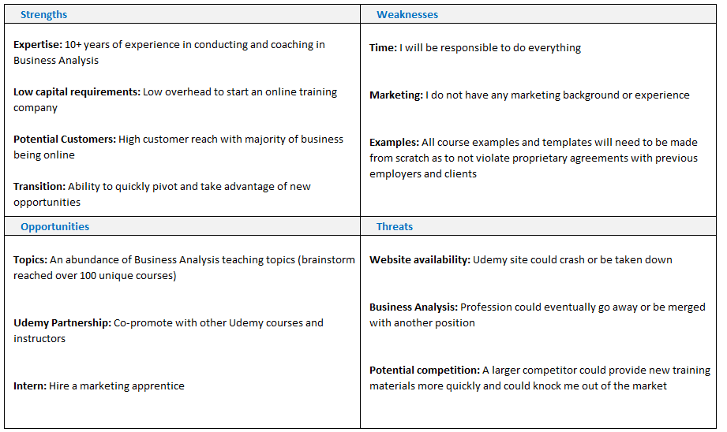
swot analysis: the ba guide

Slide 20
Swot analysis template
Provided by: The BA Guide

Slide 21

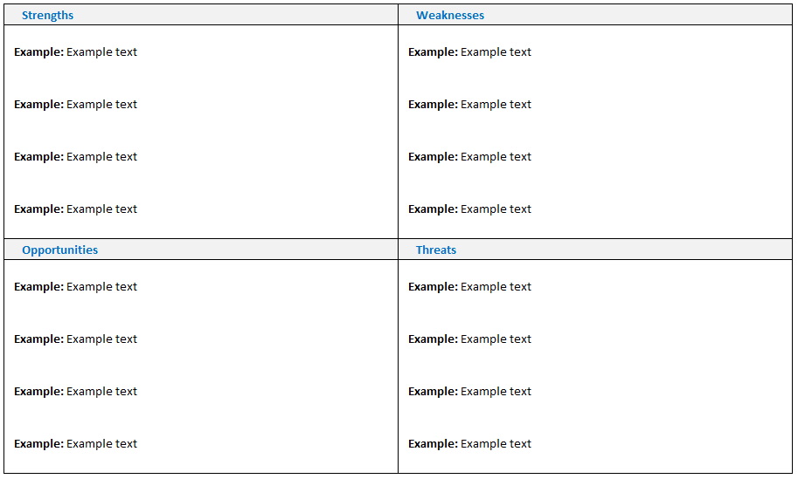

Slide 22
