Slide 1
What is Business Analysis?

Slide 2
What is Business Analysis?
“Business Analysis is the practice of enabling change in an organizational context, by defining needs and recommending solutions that deliver value to stakeholders.”
- IIBA BABOK

Slide 3
What is Business Analysis?
Business Analysis is the practice of enabling change in an organizational context, by defining needs and recommending solutions that deliver value to stakeholders.

Slide 4
What is a Business Analyst?
Someone that practices Business Analysis
Title is not always present
A high level problem solver

Slide 5

What is a Business Analyst?
The only constant in business is change picture

Slide 6
Value of the Business Analyst
Model the Organization
Understand Needed Capabilities
Find New Opportunities
Avoid Costs
Realize Benefits

Slide 7
High Level Tasks of a Business Analyst
Identify problems and opportunities
Determine and document the requirements
Define/design the solution that best achieves the requirements
Test the solution to verify the requirements have been met
Implement the solution
Validate the end result achieves the original problem

Slide 8
High Level Tasks of a Business Analyst
Identify problems and opportunities
Determine and document the requirements
Define/design the solution that best achieves the requirements
Implement the solution
Test the solution to verify the requirements have been met
Validate the end result achieves the original problem

Slide 9
High Level Tasks of a Business Analyst
Identify problems and opportunities
Determine and document the requirements
Define/design the solution that best achieves the requirements
Implement the solution
Test the solution to verify the requirements have been met
Validate the end result achieves the original problem

Slide 10
High Level Tasks of a Business Analyst
Identify problems and opportunities
Determine and document the requirements
Define/design the solution that best achieves the requirements
Implement the solution
Test the solution to verify the requirements have been met
Validate the end result achieves the original problem

Slide 11
High Level Tasks of a Business Analyst
Identify problems and opportunities
Determine and document the requirements
Define/design the solution that best achieves the requirements
Implement the solution
Test the solution to verify the requirements have been met
Validate the end result achieves the original problem

Slide 12
High Level Tasks of a Business Analyst
Identify problems and opportunities
Determine and document the requirements
Define/design the solution that best achieves the requirements
Implement the solution
Test the solution to verify the requirements have been met
Validate the end result achieves the original problem

Slide 13
High Level Tasks of a Business Analyst
Identify problems and opportunities
Determine and document the requirements
Define/design the solution that best achieves the requirements
Implement the solution
Test the solution to verify the requirements have been met
Validate the end result achieves the original problem

Slide 14
Asch Inc Example
Identify problems and opportunities
Determine and document the requirements
Define/design the solution that best achieves the requirements
Implement the solution
Test the solution to verify the requirements have been met
Validate the end result achieves the original problem

Slide 15
Asch Inc Example
Identify problems and opportunities
Determine and document the requirements
Define/design the solution that best achieves the requirements
Implement the solution
Test the solution to verify the requirements have been met
Validate the end result achieves the original problem

Slide 16
Asch Inc Example
Identify problems and opportunities
Determine and document the requirements
Define/design the solution that best achieves the requirements
Implement the solution
Test the solution to verify the requirements have been met
Validate the end result achieves the original problem

Slide 17
Asch Inc Example
Identify problems and opportunities
Determine and document the requirements
Define/design the solution that best achieves the requirements
Implement the solution
Test the solution to verify the requirements have been met
Validate the end result achieves the original problem

Slide 18
Asch Inc Example
Identify problems and opportunities
Determine and document the requirements
Define/design the solution that best achieves the requirements
Implement the solution
Test the solution to verify the requirements have been met
Validate the end result achieves the original problem

Slide 19
Asch Inc Example
Identify problems and opportunities
Determine and document the requirements
Define/design the solution that best achieves the requirements
Implement the solution
Test the solution to verify the requirements have been met
Validate the end result achieves the original problem

Slide 20
Types of Business Analyst Roles
Business Process Analyst
Requirements Analyst
Systems Analyst
Data Analyst
User Experience Analyst

Slide 21
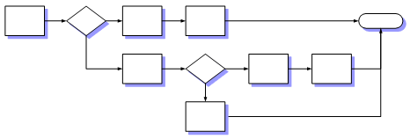
Types of Business Analyst Roles
Business Process Analyst
Requirements Analyst
Systems Analyst
Data Analyst
User Experience Analyst
Models business processes
Compares “as-is” and “to-be” models
Uses workflow and process engines

Slide 22
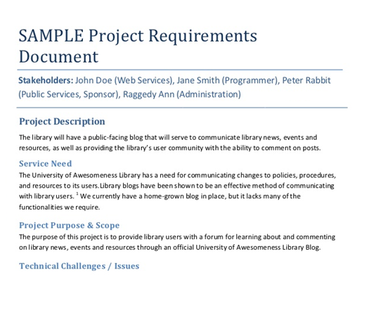
Types of Business Analyst Roles
Business Process Analyst
Requirements Analyst
Systems Analyst
Data Analyst
User Experience Analyst
Elicits/analyzes requirements
Bridges the gap between the business and IT
Solves problems with information technology solutions
Can be involved in functional design

Slide 23
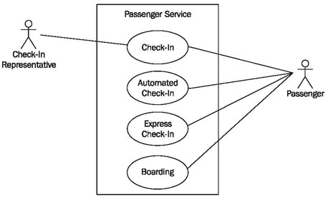
Types of Business Analyst Roles
Business Process Analyst
Requirements Analyst
Systems Analyst
Data Analyst
User Experience Analyst
Receives documented requirements
Creates functional specifications
Defines “how” a system will do the “what”
Works with the technical team

Slide 24

Types of Business Analyst Roles
Business Process Analyst
Requirements Analyst
Systems Analyst
Data Analyst
User Experience Analyst
Performs logical data modeling
Identifies patterns in data
Designs and creates reports

Slide 25
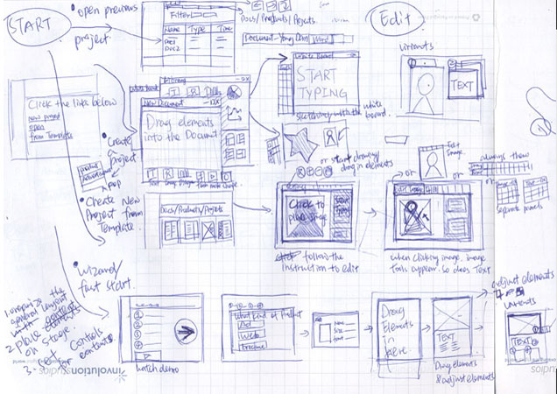
Types of Business Analyst Roles
Business Process Analyst
Requirements Analyst
Systems Analyst
Data Analyst
User Experience Analyst
Designs the user interface look and interaction
Focuses on efficiency and ease of use
Understands the end-user’s behavior

