Slide 1
Converting Legacy Content e-learning to m-learning
Kiranmayee Pamarthy

Slide 2
Agenda
Tracing Back...
Research Phases
Know your Learner
Case Study – A school in Tanzania
Learning Models and Pedagogy
Research Outcomes
Why Mobile Learning?
m-Learning - Highlights
m-Learning Strategy and Designing
Content creation
Performance Support Tools (PSTs)
Cognitive Learning – An Imagery

Slide 3
Abstract
The statisticians state that a mobile user uses the device 9 times per hour! Interspersed with small intervals of non-activity. Engaging such users for learning will be a challenge if we adopt old methodologies of learning. The strategy for learning and content for training has to be revisited, revised to adapt for mobile learning. What are the challenges, risks, in converting existing content, and the content strategy? A few use cases will be added to emphasize the need for new ways to publish content on mobile devices, it is just not about responsive design!

Slide 4
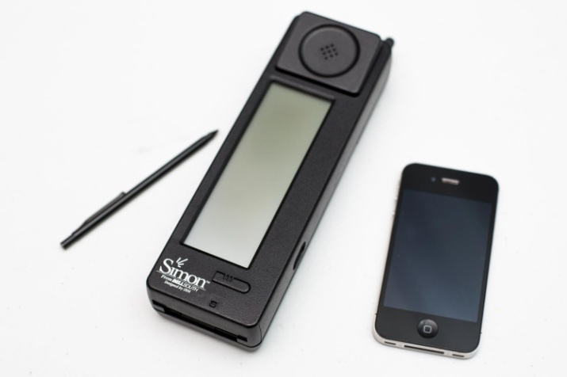
Tracing back…
Concepts of m-learning was given by Alan Kay in 1970's.
He joined Xerox Corporation's Palo Alto Research Center.
Formed a group to develop "Dynabook", which is a portable and hands on personal computer.
It aimed to let children have access to the digital world.
This project failed eventually due to the lack of technological support at that time.
1994, first smart phone, IBM Simon, was created by Mitsubishi Electric Corp. First handheld device.

Slide 5
Research Phases
3 phases
first phase - focus upon devices
second phase - focus on learning outside the classroom
third phase - focus on the mobility of the learner.
Knowing your learner is very important…..

Slide 6
Know your Learner
Model of Learning Styles – Dr. Richard Felder and Dr. Linda K Silverman
Eight different learning styles
Learner | Key Characteristic
Active Learners | Absorb material best by applying it in some fashion or explaining it to others.
Reflective Learners | Prefer to consider the material before doing anything with it.
Sensing Learners | Like learning facts and tend to be good with details.
Intuitive Learners | Like to identify the relationships between things and are comfortable with abstract concepts.
Visual Learners | Remember best what they see
Verbal Learners | Do better with written and spoken explanations.
Sequential Learners | Like to learn by following a process from one logical step to the next
Global Learners | Tend to make cognitive leaps, continuously taking in information until they get it.

Slide 7
Know your Learner
http://www4.ncsu.edu/unity/lockers/users/f/felder/public/ILSdir/styles.htm - Learning Styles and Strategies
Index of Learning Styles (ILS) – Dr. Richard Felder and Dr. Barbara A. Soloman
http://www4.ncsu.edu/unity/lockers/users/f/felder/public/ILSpage.html - ILS Analysis Test
ILS Test – is used by millions all over the world by trainers
Very effective analysis but is not the boundary

Slide 8
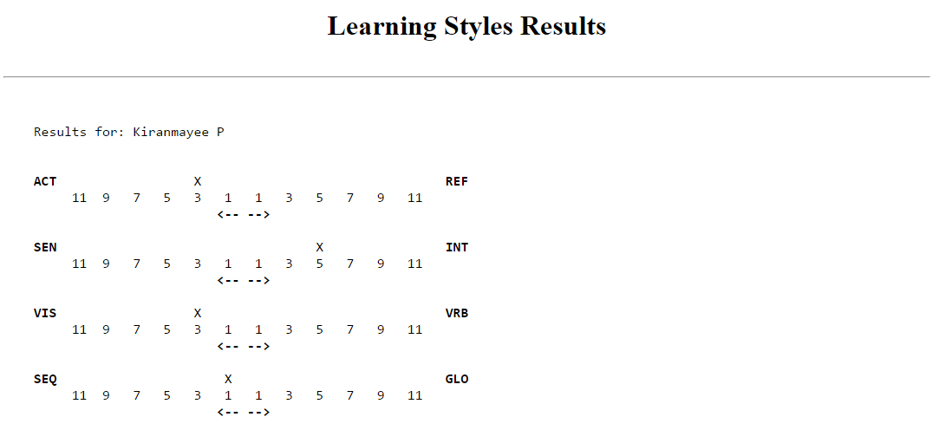
Know your Learner
My test results

Slide 9
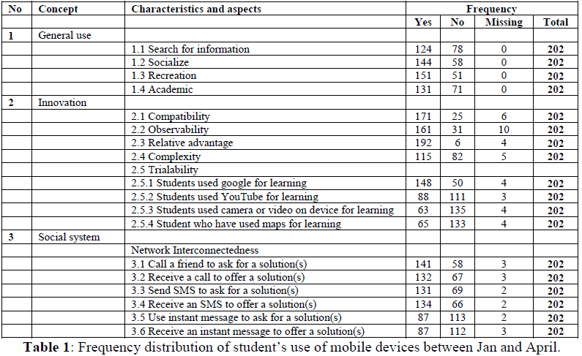
Case Study – A school in Tanzania

Slide 10
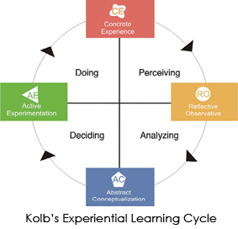

Learning Models and Pedagogy
David Kolb’s Experiential Learning Theory (ELT)

Slide 11
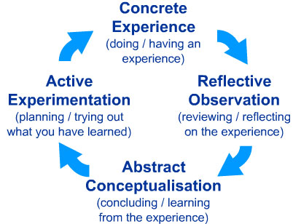
Learning Models and Pedagogy
David Kolb’s Experiential Learning Theory (ELT)

Slide 12
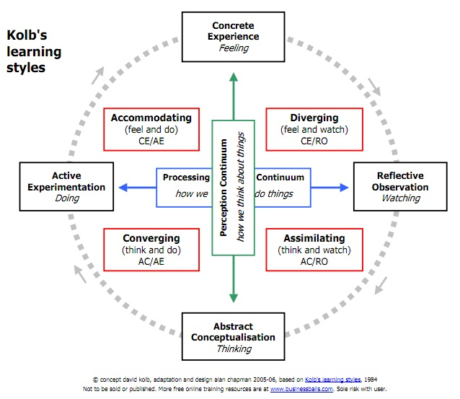
Learning Models and Pedagogy
David Kolb’s Experiential Learning Theory (ELT)

Slide 13
Learning Models and Pedagogy
David Kolb’s Experiential Learning Theory (ELT)
Teaching activities that support different aspects of the learning cycle
Concrete experience | Reflective observation | Abstract conceptualization | Active experimentation
readings examples fieldwork laboratories problem sets trigger films observations simulations/games text reading | logs journals discussion brainstorming thought questions rhetorical questions | lecture papers projects analogies model building | projects fieldwork homework laboratory case study simulations

Slide 14

Learning Models and Pedagogy
James Kadirire (2009), exposes how mLearning is related to the conductist and constructivist paradigms:
Conductist: delivery of content through the use of text messages or stimuli-response based activities in which a reinforcement message is sent by the system after the student sends his answer.
Constructivist: students become builders of their own knowledge through the active participation and the collaboration through their mobile devices and the communication support tools that they offer.

Slide 15
Research - Outcomes
Statistics
67% - learn on mobile devices
70% - user their own SmartPhone
52% - access at the point of need
47% - evenings and weekends
27% - during commuting to work

Slide 16
Why Mobile Learning?
Mobile learning is not elearning, it is sometimes complementary or supplementary in nature.
One size does not fit all
Global mobility of the workforce
Millennials demand for training and development
Constantly evolving technologies – leading to High-Skill job creation

Slide 17
Why Mobile Learning?
Remote working and on-the-go working force is increasing
Performance support (employees need support in the moment they need it, not to interrupt workflow). Directly proportional to technology changes
Employee experience – in terms of work-life balance is increasing
Integrated blended approach to learning

Slide 18
m-learning - Highlights
Low cost and high portability
Flexi time
Anytime-Anywhere
Easy accessibility
Micro learning or bite sized learning
Self Paced learning
On-Demand learning
BYOD (Bring Your Own Device)

Slide 19
m-learning - Highlights
Just In Time (Learning at work or through work)
Just In Case (Learning for work)
People Tagging (assigning tasks, skills, topics to people)
Cross-contextual learning (reconciliation of work settings and formal education formats)
Mobile-Assisted Language Learning (MALL) [Self-Learning]

Slide 20
m-learning Strategy
Flexibility for learners (anytime-anywhere, formats)
Micro learning modules or bite sized modules
Skill based learning (audience analysis) or Learning path
Consider Learner preferences
Attention Span – less is more; Low Information Density (LID)
Age – younger generation like learning through social media
Contextual learning – in-the-moment learning or information gathering (pharmaceutical sales rep, field diagnostics etc.)

Slide 21
m-learning Strategy
Higher retention (various methods of streaming information)
Performance Support Tools or PSTs (for learners) – Mobile apps, interactive videos and pdfs, short videos, infographics, podcasts, animations, whiteboard animations, flash cards, memory nuggets
Situated learning support
Multi-device support
Mobile friendly (Adaptive) approach to Mobile first (Responsive)

Slide 22

m-learning Strategy
Screen Size approach should be bottom up – Smartphones→Tablets→Laptops/PCs
Content creation – rule of the thumb – information presented to the size of an index card.
Intuitive learning methodology (Branching tree method)
Inclusive learning (by receiving constant feedback and contributions from the learners)

Slide 23
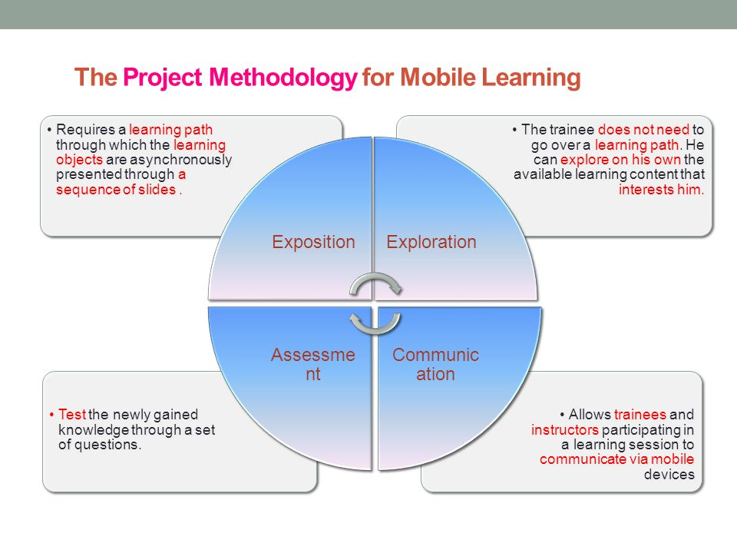
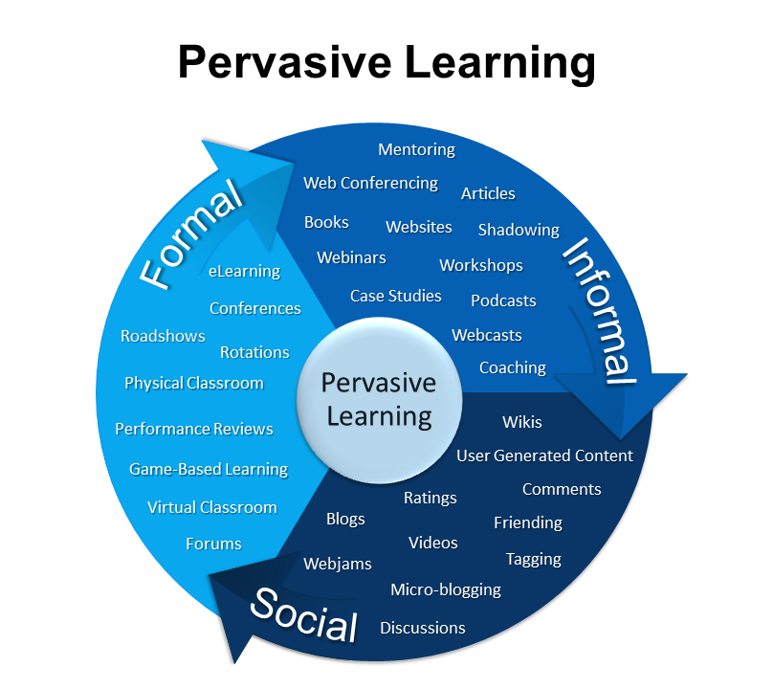
m-learning Strategy

Slide 24
m-learning Designing
Learning is the same, the delivery methods are different. Learners may be rushed but the design should not be; it should be a well thought, planned, and executed seamlessly.
Navigation – must be simple and at the top of the screen
Scrolling – to bare minimum
Orientation – design using the landscape mode
Bite-sized video clips – 2 mins or less
Access times – short and quick
Duration - 10 to 15 minutes learning modules

Slide 25
m-learning Designing
Size – video and audio download sizes should be less
Assessment – simple flash cards, quizzes, questionnaire (objective type with no more than 3 answers)
Bandwidth – Internet considerations; involve the IT department at the early phase; non-stop fast streaming of content
Processing Power of devices
Don’t force mobile learning on the audience – it should be a natural progression

Slide 26
Challenges
Battery Life
Internet connectivity and access
Distractions
Multitasking issues
Multiple devices, multiple operating systems
Cost of devices with advanced technology; limited memory
Obsolete content
Content security, intellectual property rights, copyright issues
Reworking existing e-learning content to mobile platforms

Slide 27
Content Strategy – receive and retain
Two-forked approach
  Systemic and Systematic – first is deeply ingrained in the system, leverage this aspect, second is the procedural steps.
Chunking of Content – modular approach
Organize content – brief, relevant, engaging
KISS principle – Keep It Simple, Stupid
Readability – lower verbose, increase readable content
Break it down – less cognitive load
Searchable content –easy to use TOC, index, and menu
Robust feedback and review mechanism

Slide 28
Content Strategy – receive and retain
Visual clarity in material – Large font, short paragraphs with appropriate captions, icons, color, and symbols
Visual learning is important – relevant images and pop up texts to enhance the learning experience
Images should be consistent in delivery and approach (for higher retention, rememberance and to avoid confusion).
Training material preparation = Training cycles on the mobile; 15 minutes maximum. The cycle will include to login, search, read, learn, answer, send feedback, and exit.
Room for paced learning by the user

Slide 29
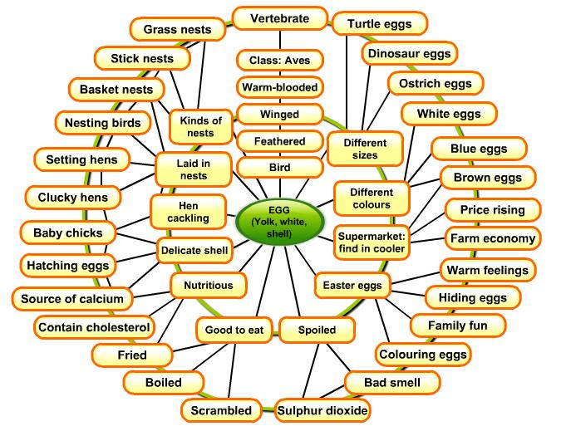
Cognitive Learning – An Imagery example

Slide 30
Performance Support Tools (PSTs)
Mobile Apps
5 moments of Need model (by Dr. Conrad Gottfredson) can be used to find when learners seek learning support.
NMASC (New, More, Apply, Solve, Change)

Slide 31
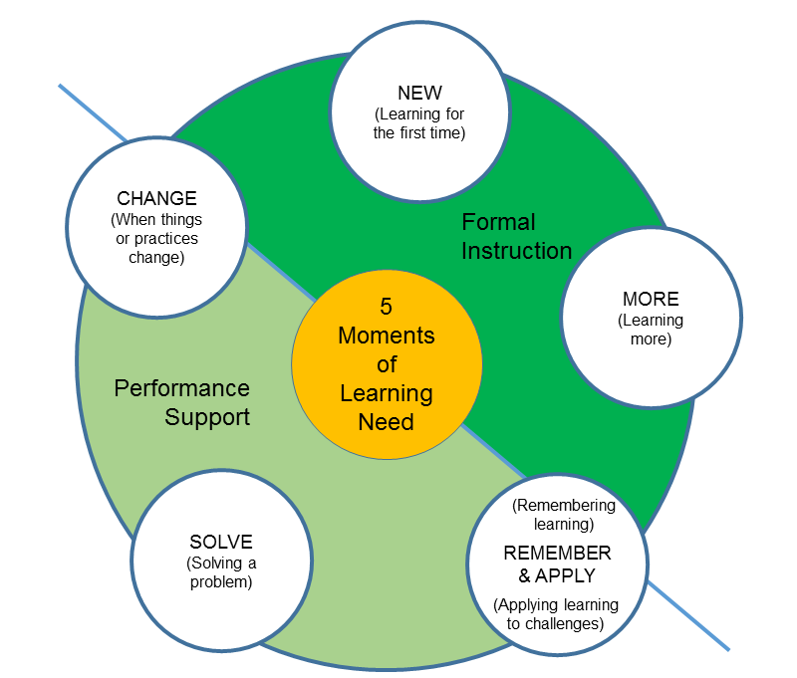
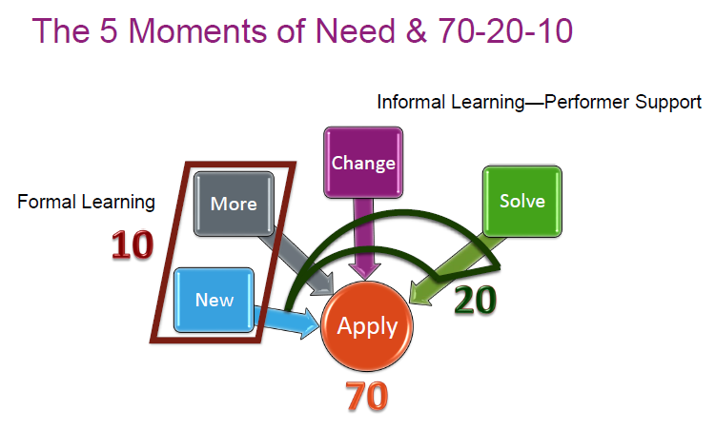
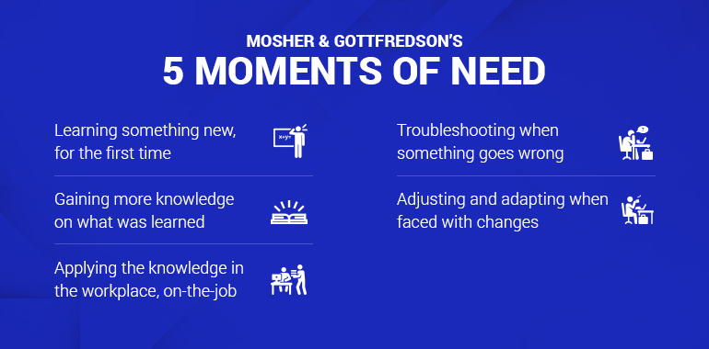
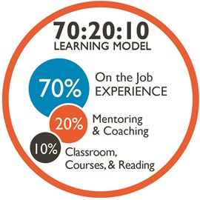
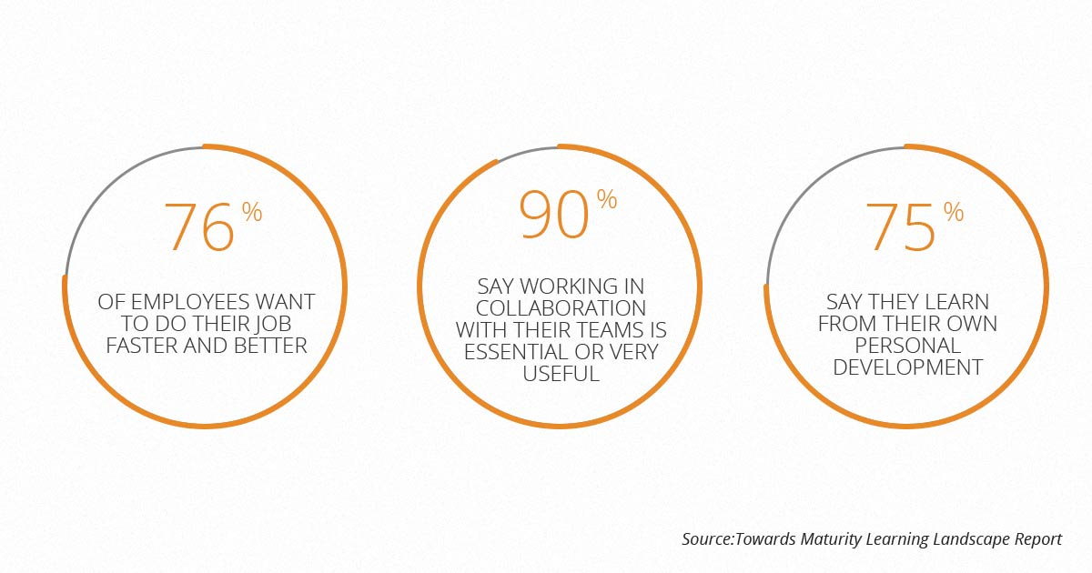
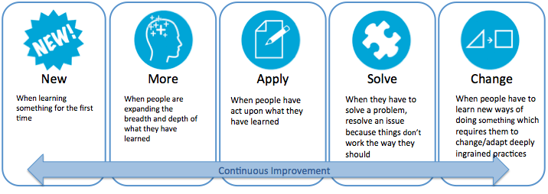
5 Moments of Need and 70:20:10 concept

Slide 32
Augmented Reality and m-learning
m-learning uses Augmented Reality extensively in education and corporate training.
Definition : AR superimposes virtual elements over the image of real elements through the combination of the screen and camera of the devices, thus permitting the interaction between these elements and the students.

Slide 33
Augmented Reality and m-learning
ARIS (http://arisgames.org)
Aurasma (http://aurasma.com)
Junaio (http://junaio.com)
Layar (http://layar.com)
Metaio (http://metaio.com)
Vuforia (http://vuforia.com)
Wikitude (http://wikitude.com) – Code free Augmented reality editor.

Slide 34


pkiranmayee@yahoo.com
34

Slide 35
Thank You
35

