Slide 1

GitHub in documentation
Write, store, review, publish

Slide 2
GitHub

Slide 3

GitHub
Git

Slide 4
GitHub
Hub

Slide 5
GitHub
Lock
Commit
Label
Merge
Tag
Baseline

Slide 6
DDLC

Slide 7
DDLC
Store
Write
Review
Publish

Slide 8
Write

Slide 9

Write

Slide 10
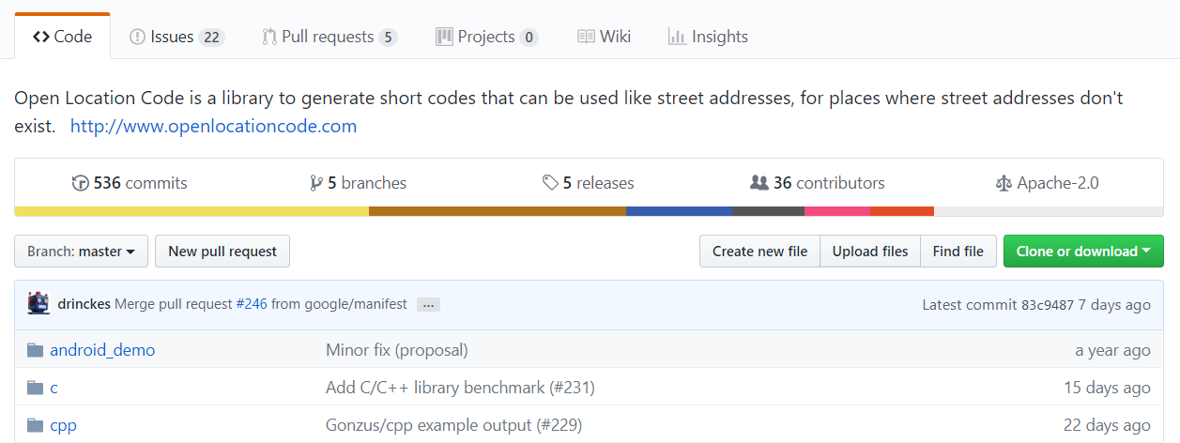
Write

Slide 11
Write

Slide 12
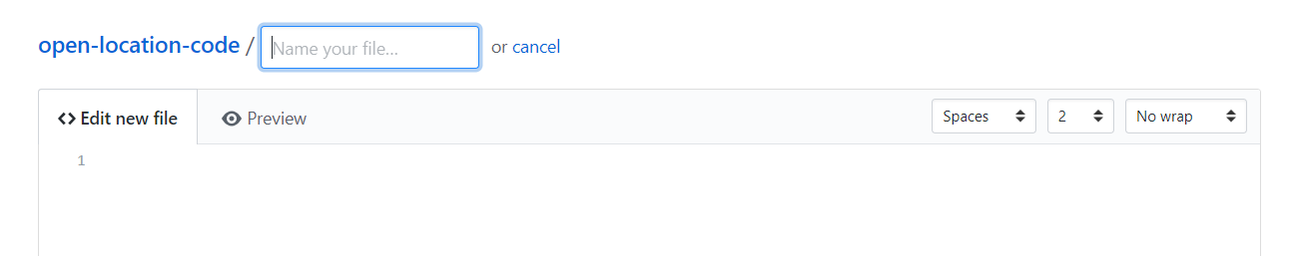
Write

Slide 13
Store

Slide 14

Store

Slide 15
Store

Slide 16
Store

Slide 17
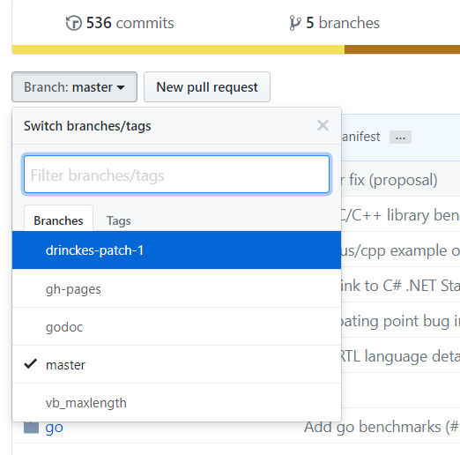
Store

Slide 18
Store

Slide 19
Store
Commit
Merge

Slide 20

Store
Commit
Merge

Slide 21
Store
Commit
Merge

Slide 22

Store
Commit
Merge

Slide 23
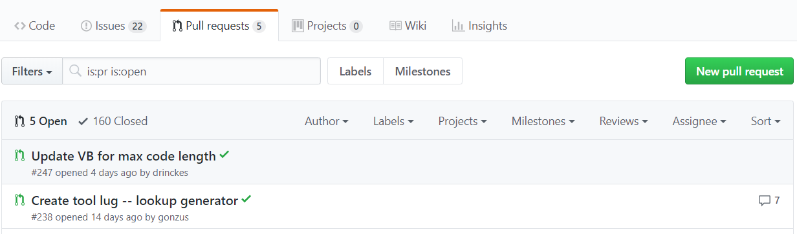
Store
Commit
Merge

Slide 24
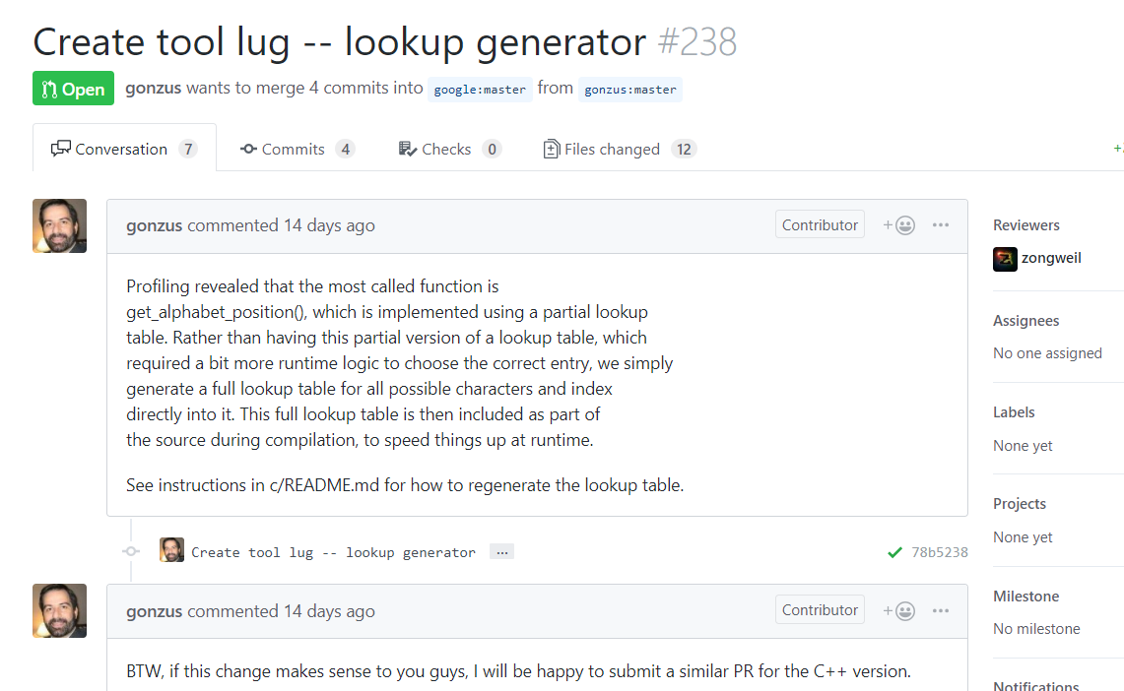
Store
Commit
Merge

Slide 25
Store
Commit
Merge

Slide 26
Review

Slide 27
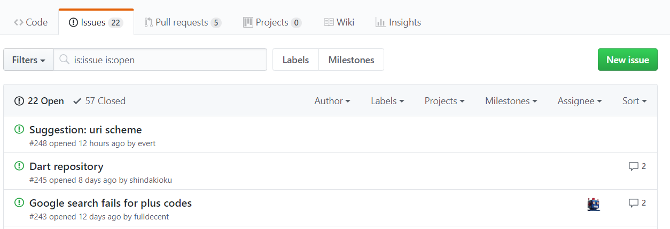
Review

Slide 28
Review

Slide 29
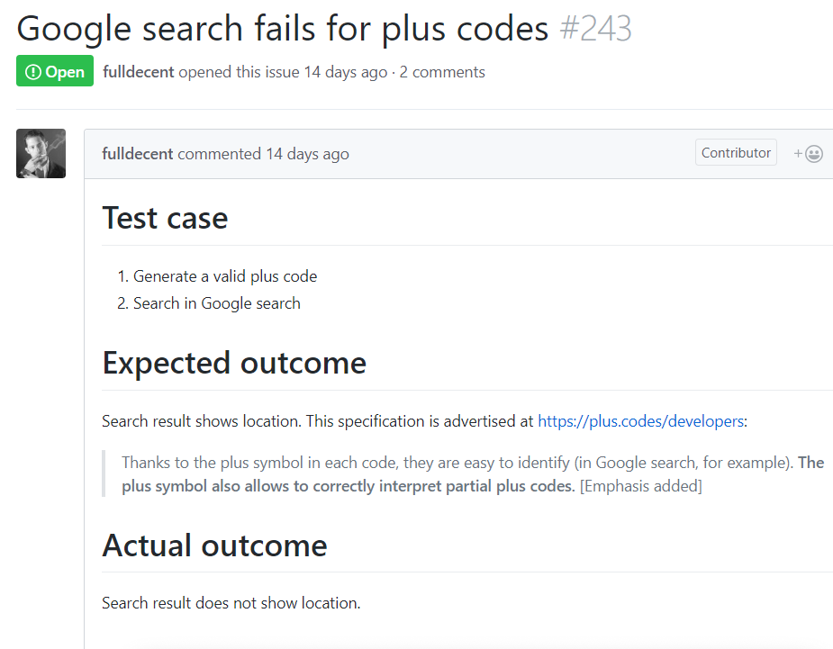
Review

Slide 30
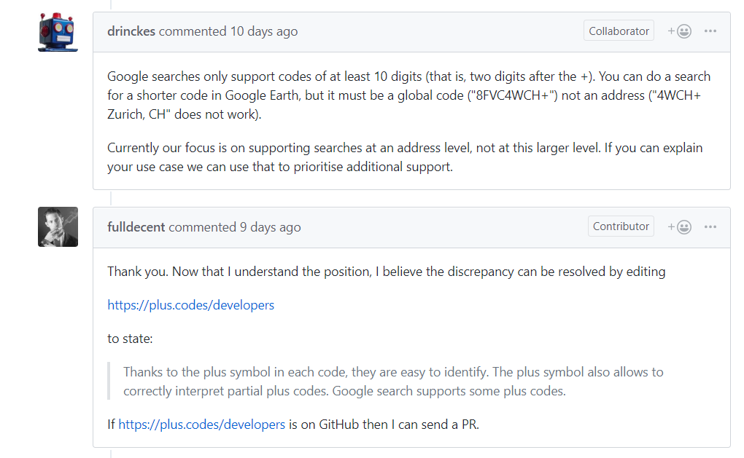
Review

Slide 31
Review

Slide 32
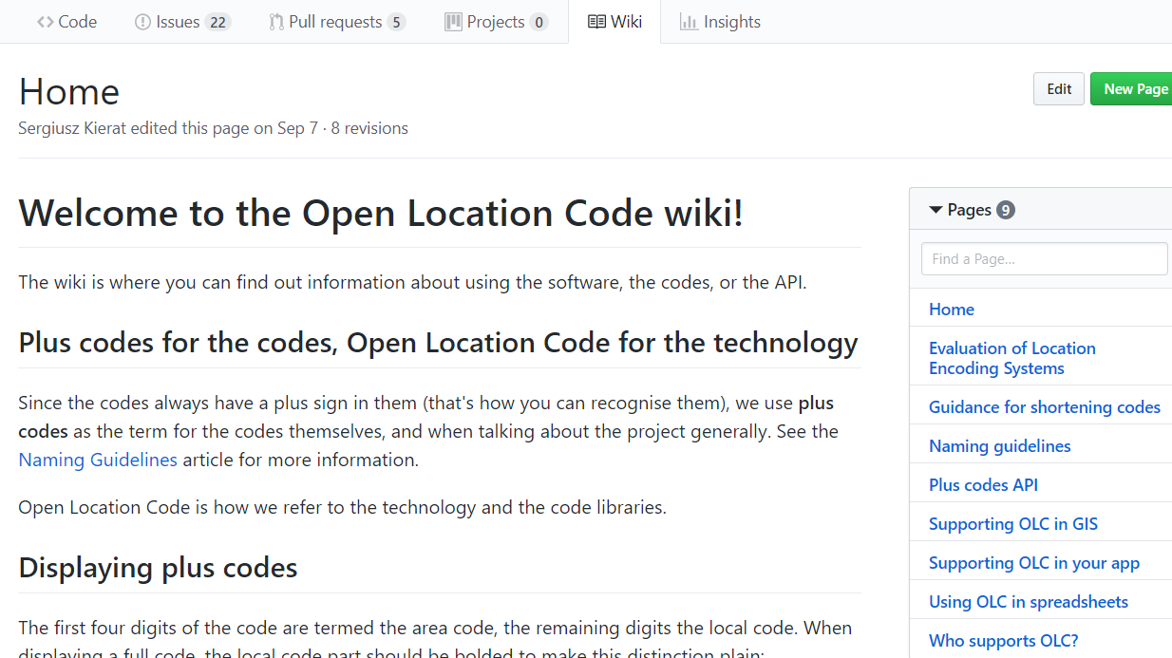
Review

Slide 33
Publish

Slide 34
Publish

Slide 35
Publish
https://<username>.github.io/<projectname>

Slide 36
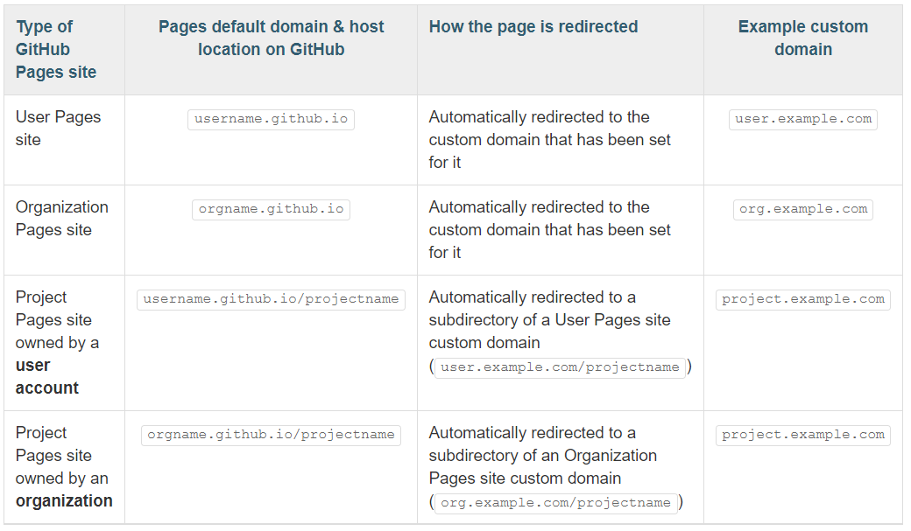
Publish
https://<username>.github.io/<projectname>

Slide 37
Publish

Slide 38
Example

Slide 39
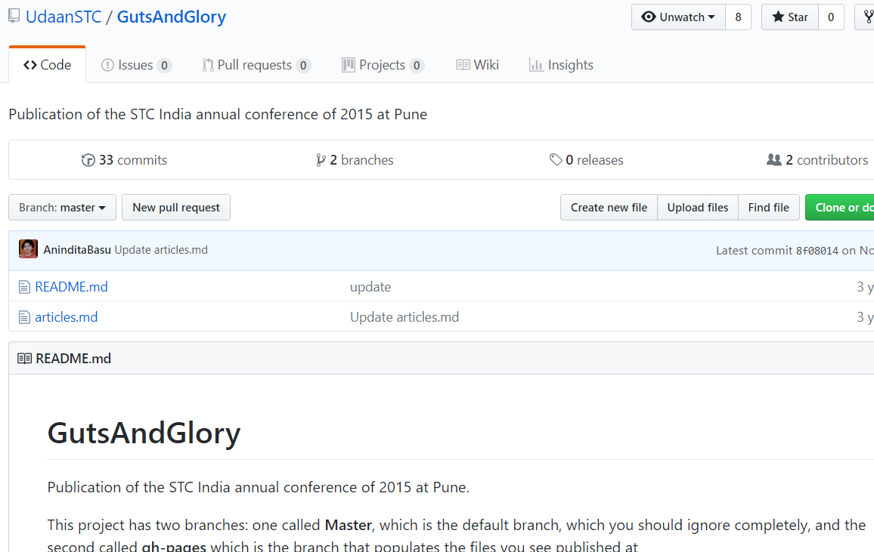
Example

Slide 40

Example

Slide 41
Example
http://udaanstc.github.io/GutsAndGlory/index.html

Slide 42


Wrap
https://www.slideshare.net/AninditaBasu7/github-for-technical-documentation
anindita.basu@oracle.com @anindita_basu
https://www.amazon.in/dp/B07KDV8YQF

