Slide 1
Minimalism Works
Does It, Really?
Urmilla Chandran from Zenoti
for STC India
Hyderabad Session
30th March 2019

Slide 2
Minimalism – Examples from the World Around Us

Slide 3
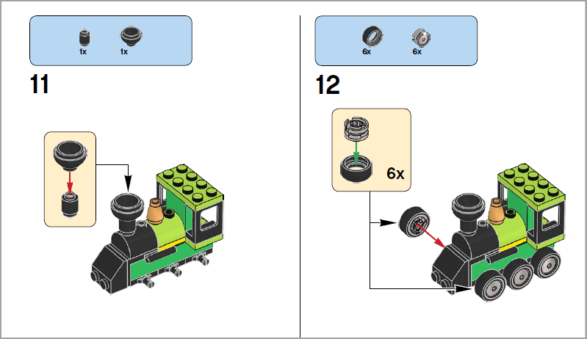
Minimalism Works - Examples
Lego
Notes:
DIY – Assembly instructions (children)

Slide 4
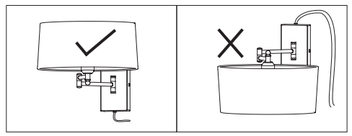
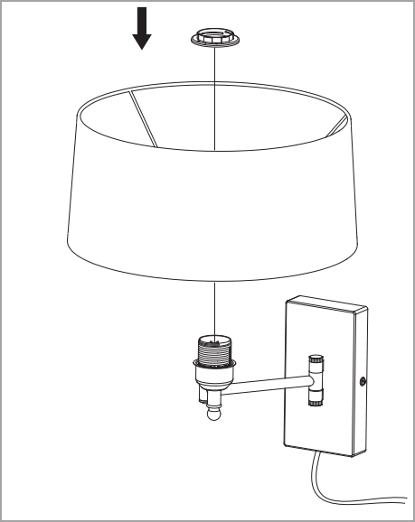
Minimalism Works - Examples
Ikea
Notes:
DIY – Assembly instructions (Adults)

Slide 5
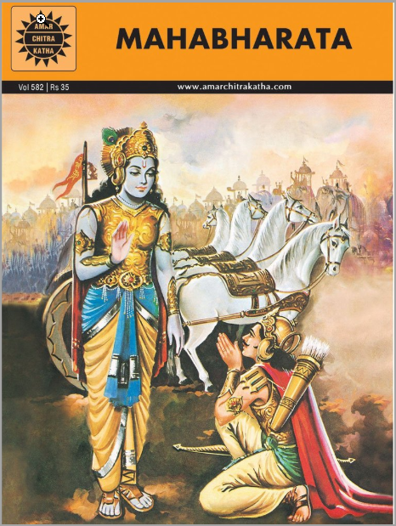
Minimalism Works - Examples
In 31 pages
Notes:
Brevity
Focus only on the main points

Slide 6
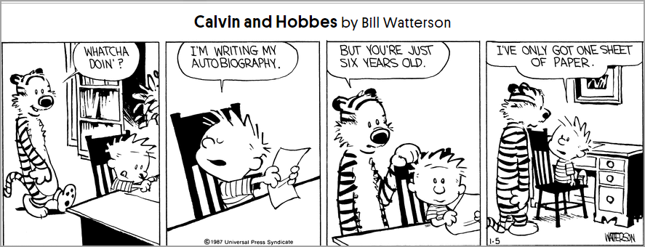
Minimalism Works - Examples
Notes:
Comic strips
Endear the characters to the reader
Push everything in 4 frames
Bring a smile
Lend perspective
Peanuts, Dilbert, Dennis the Menace

Slide 7
Minimalism in Technical Writing

Slide 8
Minimalism – The 3 W’s
When: 1980’s in technical communication, IBM
Who: Professor of Information Sciences and Technology, Penn State, John M. Carroll
What: 4 principles
  Action oriented
  Write in user’s perspective
  Solve user’s problem
  Findability
Notes:
Action orientation = focus on procedures – what the user wants to get done
Write in user’s perspective = chuck out jargon and developer lingo
Solve a user’s problem = that’s our job! That’s why the user will go to your Help Center
Findability = How will a user find what she’s looking for - clear titles, ToC, Index, Search

Slide 9
Minimalism – Ground Realities and Challenges
Complex products
Complex set ups
Interdependent modules
Roles and Permissions
Different end users for the same topic/article

Slide 10
Minimalism – Ground Realities:
What We Can Do
Focus on procedures
Focus on user’s need and solve a user’s problem
Make it easier for the user to find what we write
(ToC, Search, Chunk, Titles)
Make more visual (GIFs, Videos, Flow charts, Swim lanes)
Write conversationally (New trend)
Notes:
What: 4 principles
Action oriented (focus on procedures)
Write in user’s perspective
Solve user’s problem
Findability (clear titles, ToC, Index, Search)

Slide 11
Minimalism – Ground Realities:
What We Can’t Do
Fit everything in 4 frames
Oversimplify
Get away with sketchy details
Leave the user confused, dazed, irritable, resigned
Notes:
What: 4 principles
Action oriented (focus on procedures)
Write in user’s perspective
Solve user’s problem
Findability (clear titles, ToC, Index, Search)

Slide 12
Minimalism Redefined

Slide 13
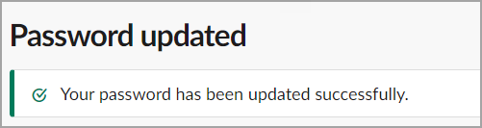
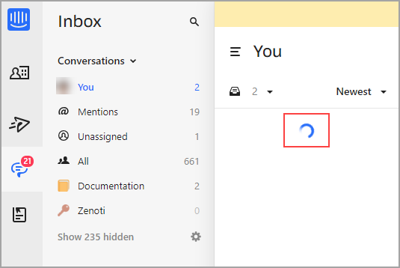
Minimalism – Examples
Notes:
Loading page icon – that doesn’t need any explanation

Slide 14
Minimalism and Conversational Style
New trend
Keep the reader informed … in an engaging way.
Notes:
Thought behind a layered approach to help
Putting everything together
Getting organized
This will take a few moments
Embedded help: Text in the UI, Embedded help as Smart ToolTips, Cool Walkthrus, ShoutOuts to get attention)

Slide 15
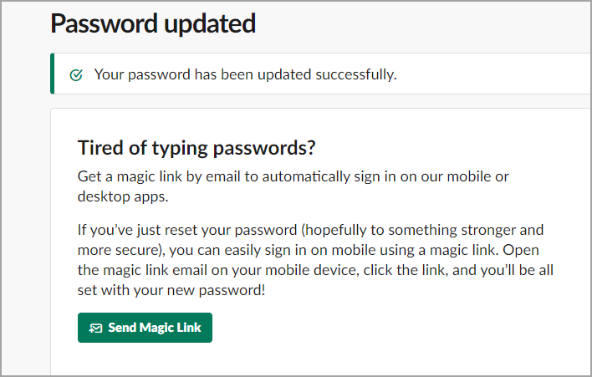
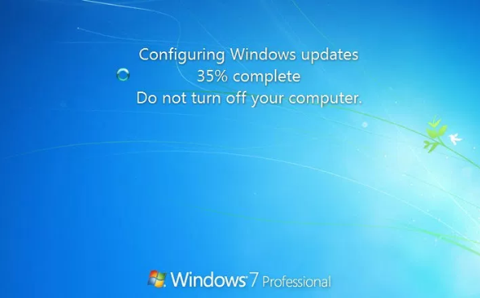
Minimalism and Conversational Style
Notes:
Loading page icon – that doesn’t need any explanation

Slide 16
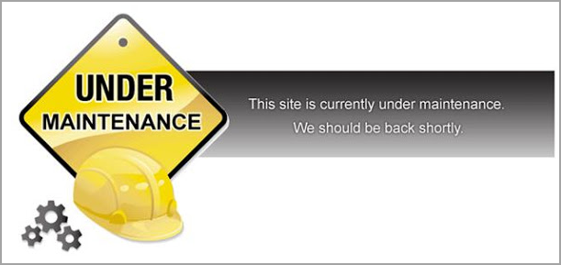
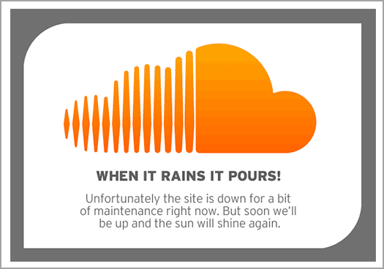
Minimalism – Examples – Site Downtime
Notes:
Site down time – new twist

Slide 17
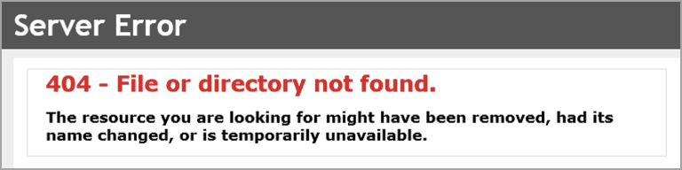
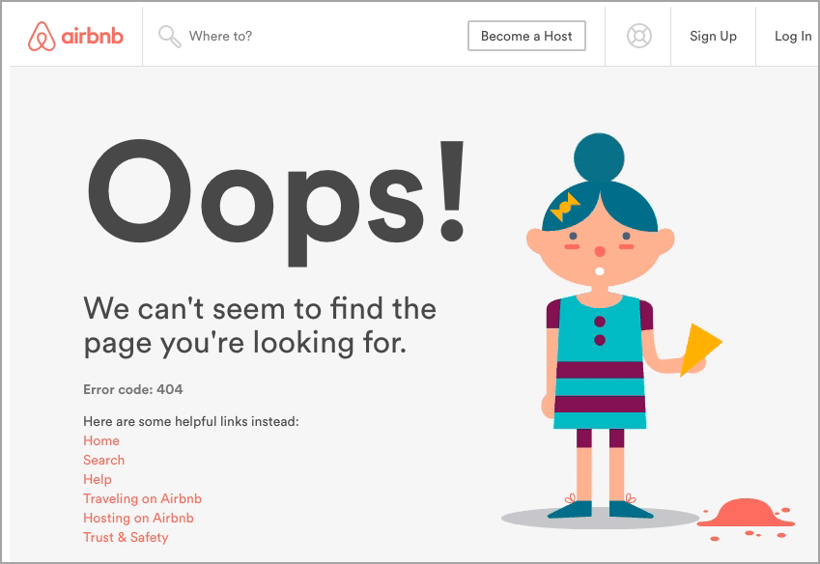
Minimalism – Examples – Page Not Found
Notes:
Loading page icon – that doesn’t need any explanation

Slide 18
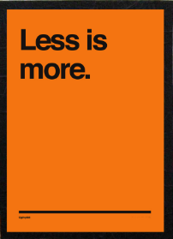
Minimalism – ‘Old’ Definition

Slide 19


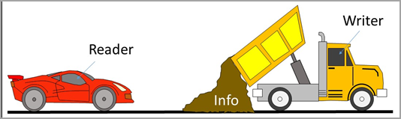
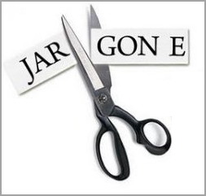
Minimalism – New Definition
Less of what?
Notes:
Less of:
Tech speak
Info dumps
Endless PDFs

Slide 20


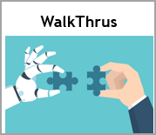



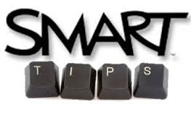



Minimalism – New Definition
More of what?
Notes:
Minimalism is now more of:
Layered approach to help
Smaller chunks of info
Embedded help: Text in the UI, Smart ToolTips, Cool Walkthrus, ShoutOuts, Videos
Non-embedded help – Articles/Topics - Focus on headings, Searchability
Discoverability – for humans and BOTs alike!

Slide 21
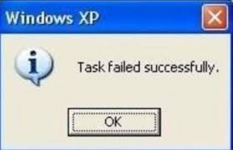
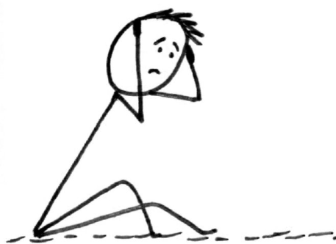
Whatever the Trends – Basic Principles Stay
Don’t leave the user dazed

Slide 22
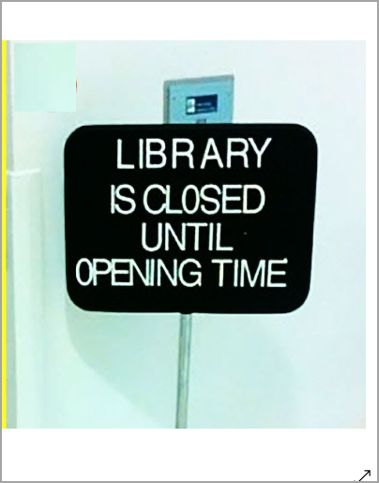
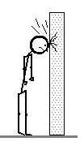
Whatever the Trends – Basic Principles Stay
Don’t leave the user confused

Slide 23
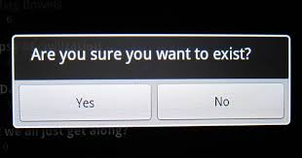

Whatever the Trends – Basic Principles Stay
And always read what
you write

Slide 24

Questions?

