Slide 1

Aspiring Minds(AMEO) 2015 Employment Outcome Data

Slide 2
About me:
I am Reshma Moturi.I completed my masters in Biotechnology
(MSc.Biotech) from bangalore university.And graduated in Computer applications from Osmania University
why DataScience is Because it interests me and has wide and very interesting applications across many disciplines.It plays a major role in understanding the business processes.
Work Experience:
Worked as a processs developer in general electric in the finance department.
https://www.linkedin.com/in/reshmamoturi

Slide 3
Objective:
The project aims to get usefull insights into the employment data that was released by
Aspiring Minds from the Aspiring Mind Employment Outcome 2015 (AMEO) to understand the current trend
at that time In the employement for various disciplines of engineering students
Summary:
The study is primarily limited only to students with engineering disciplines.
The dataset contains the employment outcomes of engineering graduates as dependent
variables (Salary, Job Titles, and Job Locations) along with the standardized scores from three different areas – cognitive skills, technical skills and personality skills.
The dataset also contains demographic features. The dataset contains around 40 independent variables and 4000 data points. The independent variables are both continuous and categorical in nature. The dataset contains a unique identifier for each candidate.

Slide 4
Exploratory Data Analysis:
Data Cleaning:
This includes clear understanding of the given data set regarding the employment details of all the employees .Data cleaning process includes :
Checking the shape of the dataset
Null values
Duplicates
Datatypes of each column
Data Manipulation:
Here int his dataset DOB ,DOJ,DOL are the date columns that required type convertion to datetime.and Age and Experience columns are derived out of these columns so they could be usefull for the Analysis
Few other categorical columns like JOBCITY and SPECIALIZATION needed some cleaning to handle the null values that are represented by -1.under specialization few records needed to be merged .

Slide 5
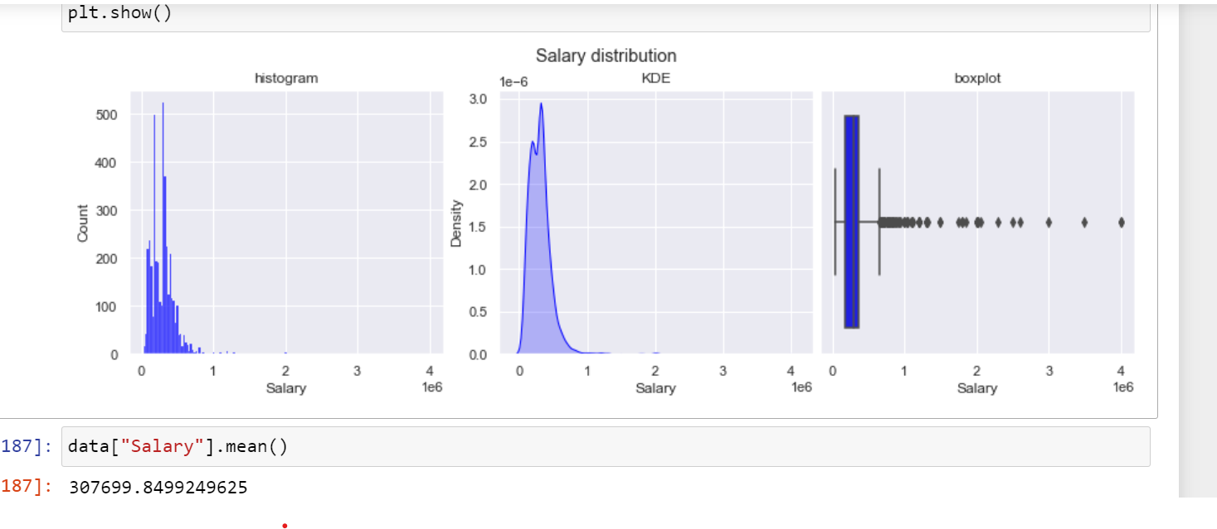
UNIVARIATE ANALYSIS:
Salary:
Histplot and kde plot showing the distribution of the salary values
And box plot showing the outliers in salary

Slide 6
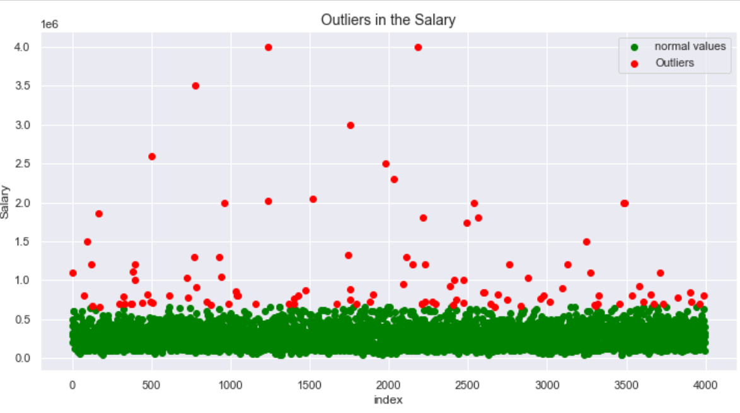
Scatter plot showing the outliers in the salary:
We Have 109 Outliers in Salary variable ranging from 6.6 to 40 lakh CTC
And the average salary is 3.07 lakh

Slide 7
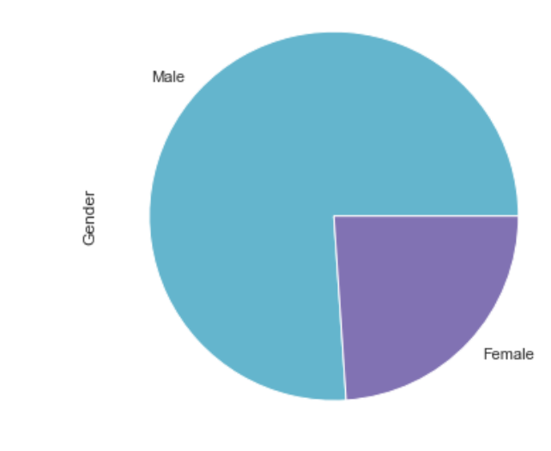
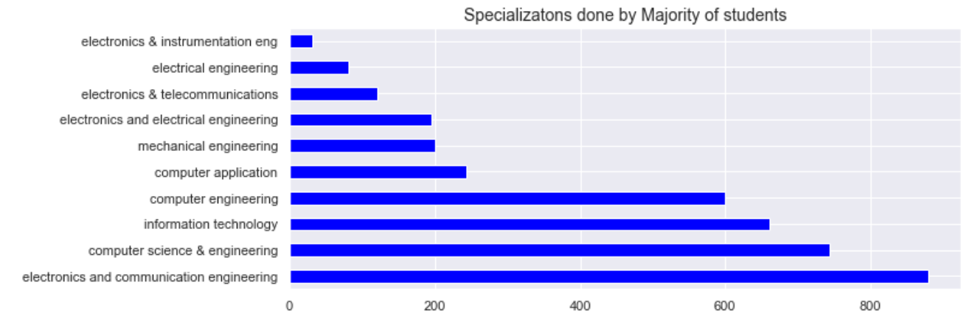
GENDER:
Specialization:
Majority Eployees are Male 76%
and Female 23%
The data shows 45 different specialisations ..Majority of students have done specializations in the field of
1:electronics and communication engineering
2:computer science & engineering
3: information technology
4: computer engineering

Slide 8
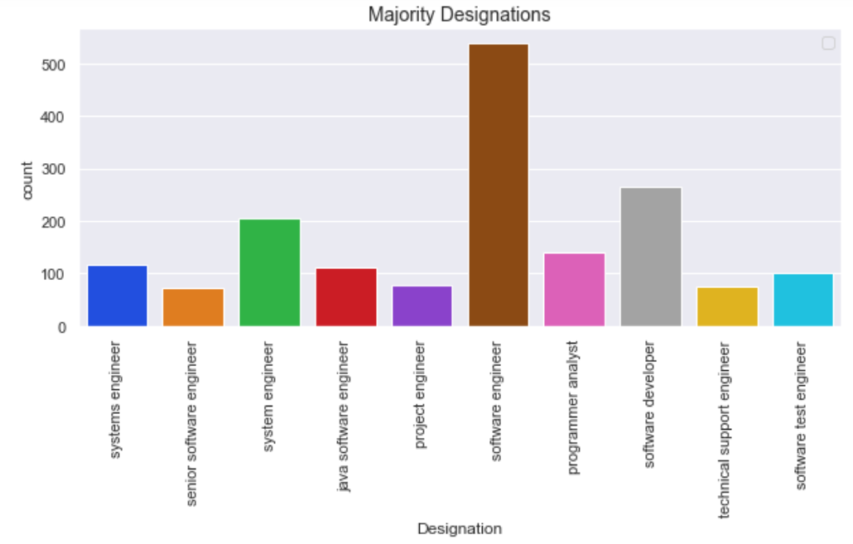
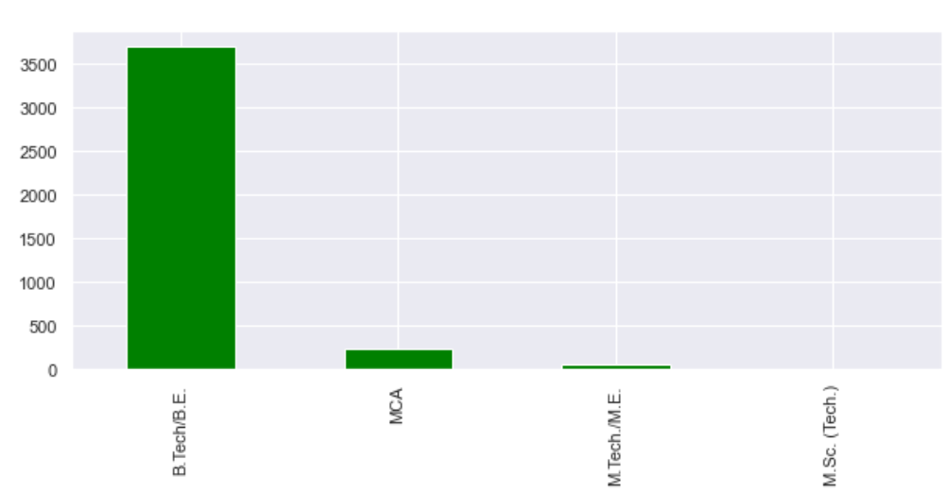
Designation:
Degree:
Majority Job Designations are Software engineer,followed by software developer and
system engineer
92% of the employees are from B.Tech,6% are from MCA,1% are from M.Tech/M.E

Slide 9
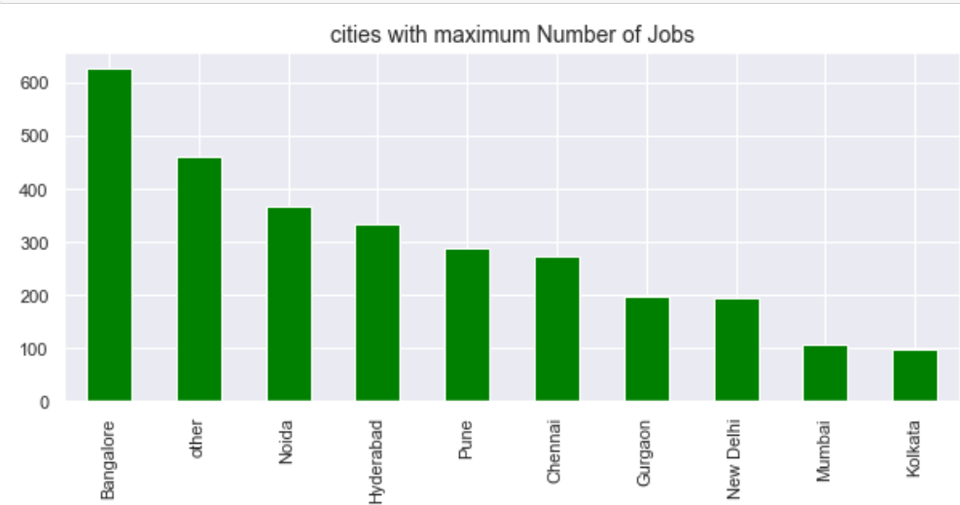
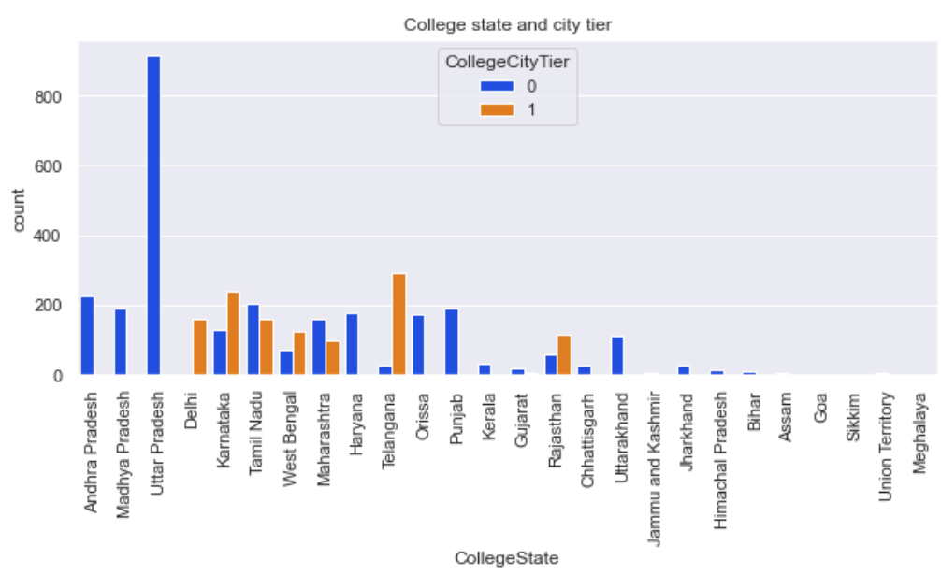
JOBCITY:
College State and City Tier:
Banglore city Has most Number of jobs followed by Noida and Hyderabad

Slide 10
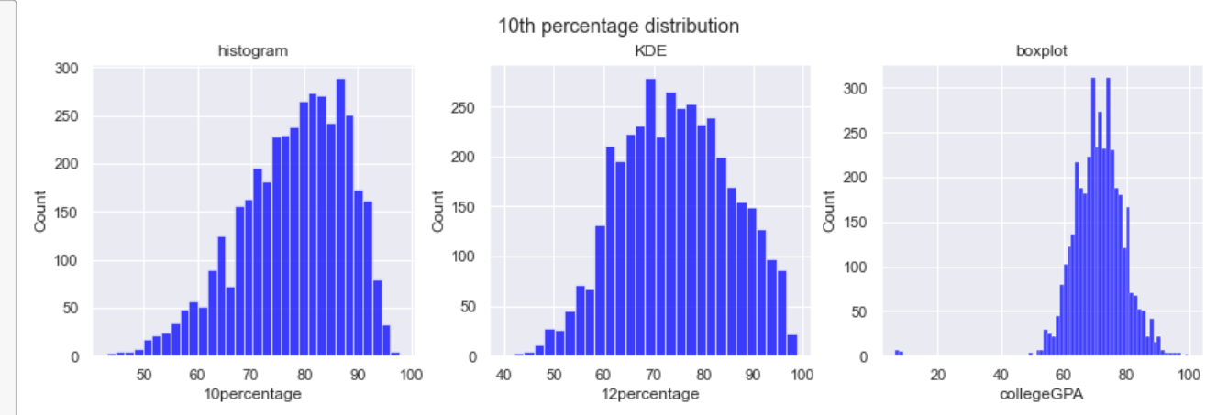
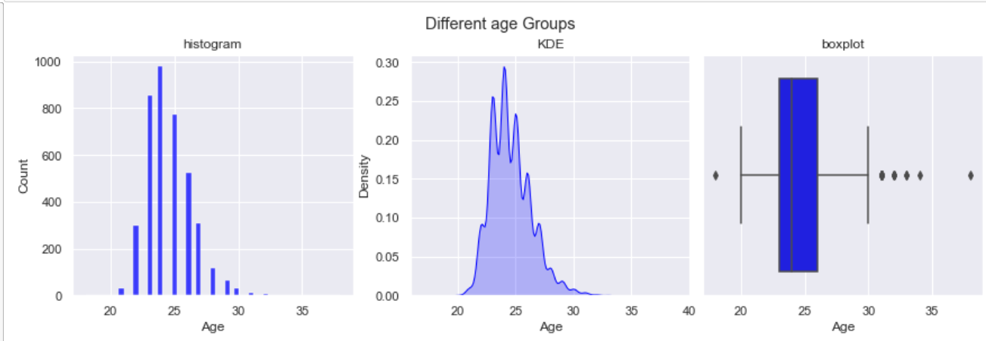
Scores in 10th,12th and CollegeGPA: And Ages Of Employeees:
Scores:
Most of the Employees Performed better in 10th grade and collegeGPA shows less performance comparitively
Ages:
Majority Employess are in the age of 20 to 30 years.one outlier below 20 and few above 30

Slide 11
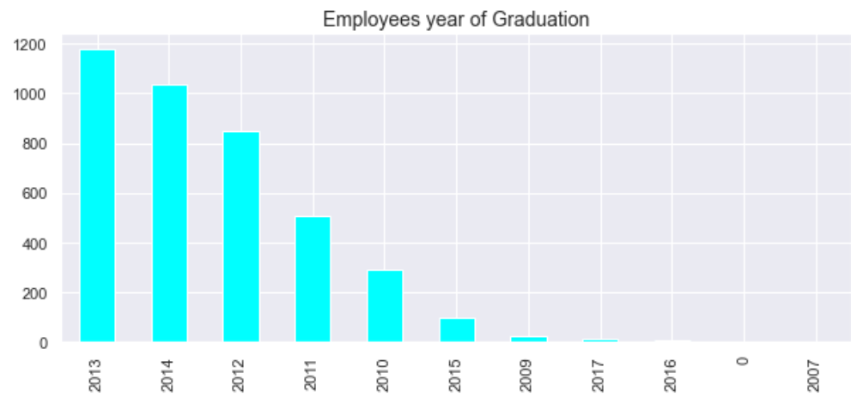
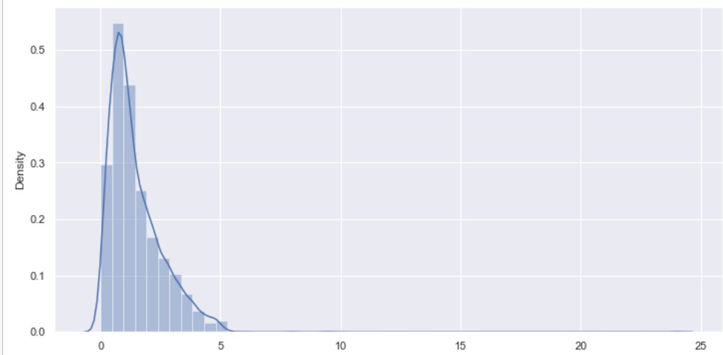
Graduation Year:
Experience:
Majority Employees are 2013 Graduates followed by 2014 and 2012
Experience on a density plot showing the distribution pattern

Slide 12
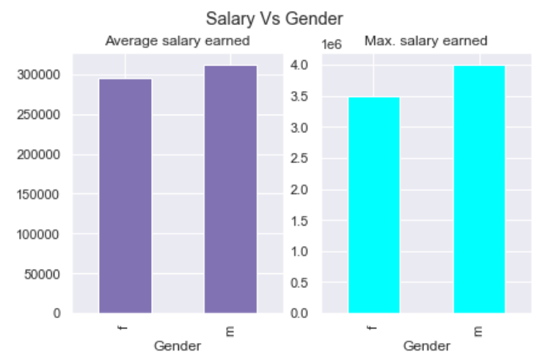
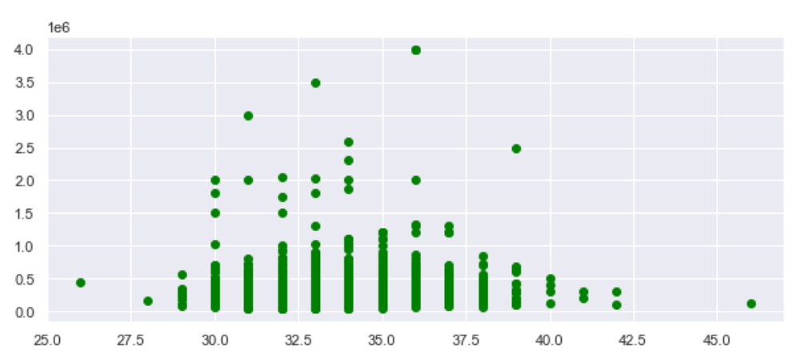
BIVARIATE ANALYSIS:
Salary by Gender:
Salary by Age:
Average salary earned by Male is little
higher than female
Age doesnot show a direct relation to salary

Slide 13
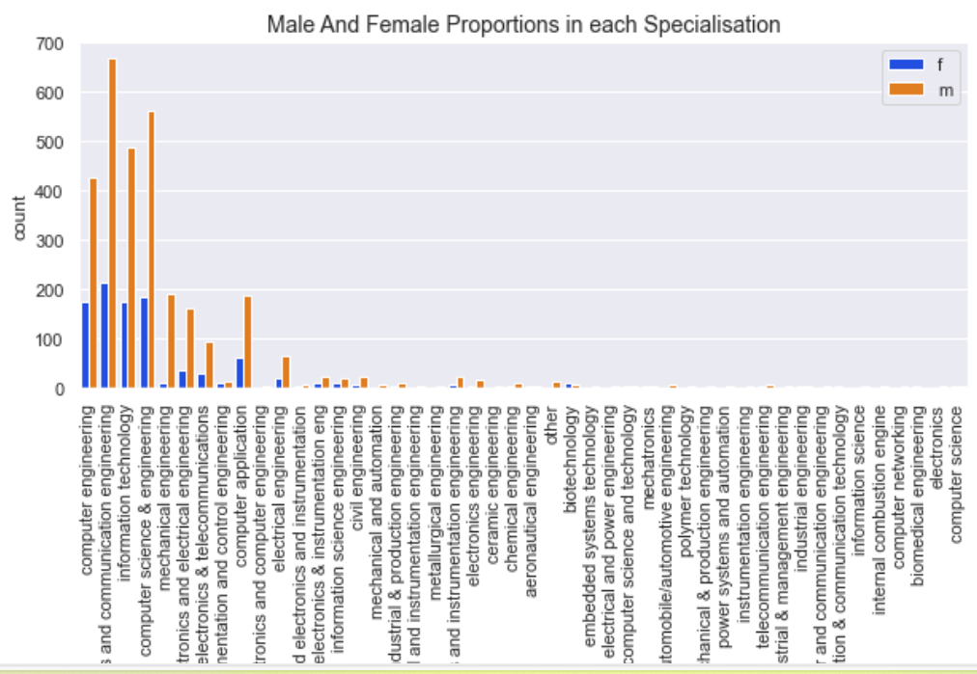
Specialization by Gender:
This shows female proportion is considerably less in every specialisation .
And in few like Mechanical engineering ,automobile/automotive engineering females are very scarce.

Slide 14
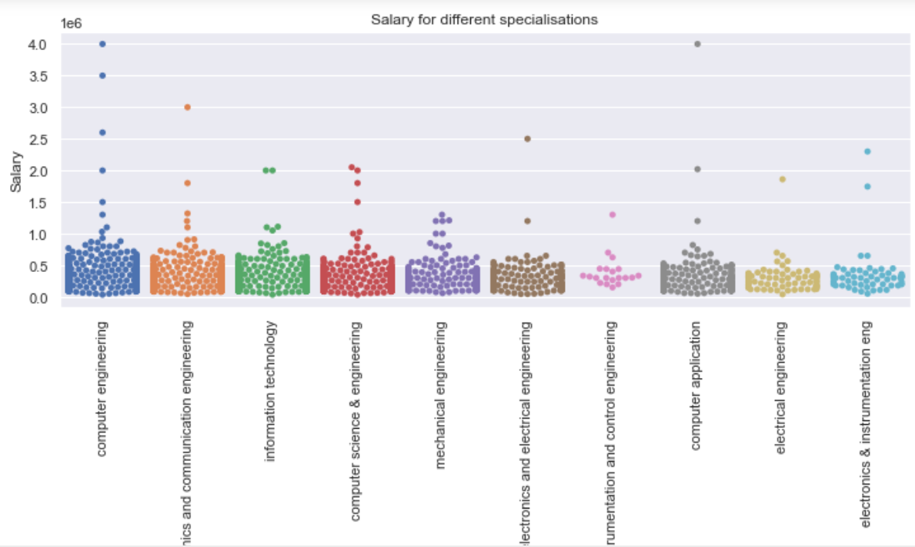
Swarm Plot showing the outliers in each specialisation
This shows the maximum salary outliers of 40 lakh CTC are from Computer Engineering and computer application

Slide 15
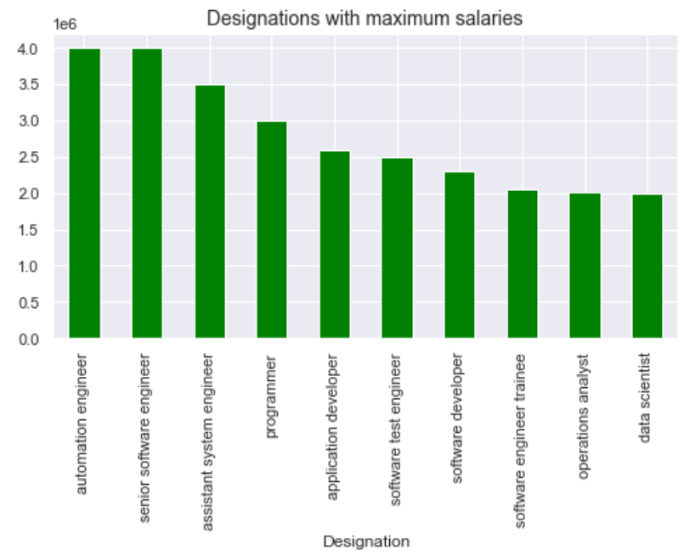
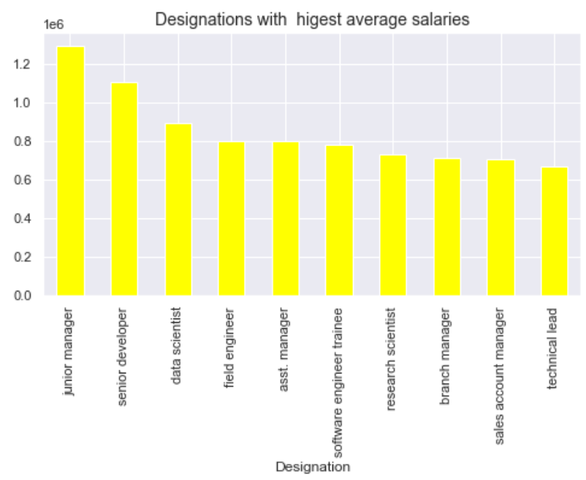
Salary By Designation:
Average Salaries in each Designation:

Slide 16
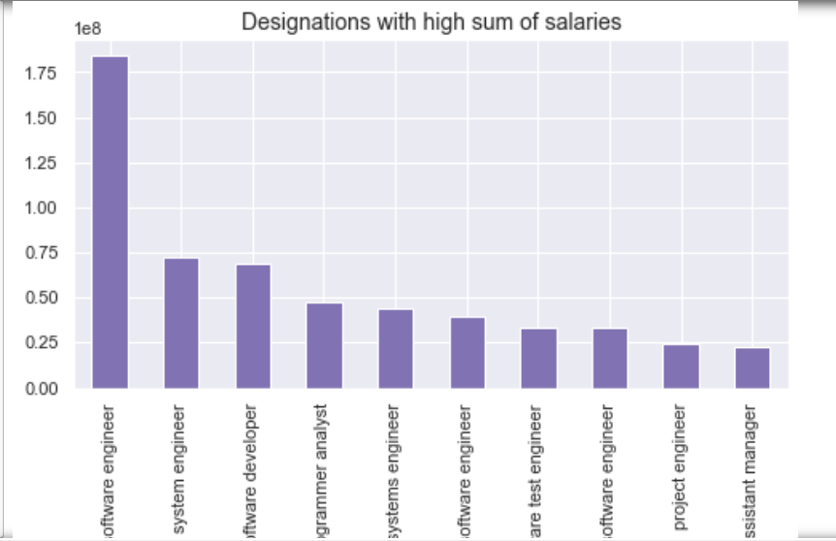
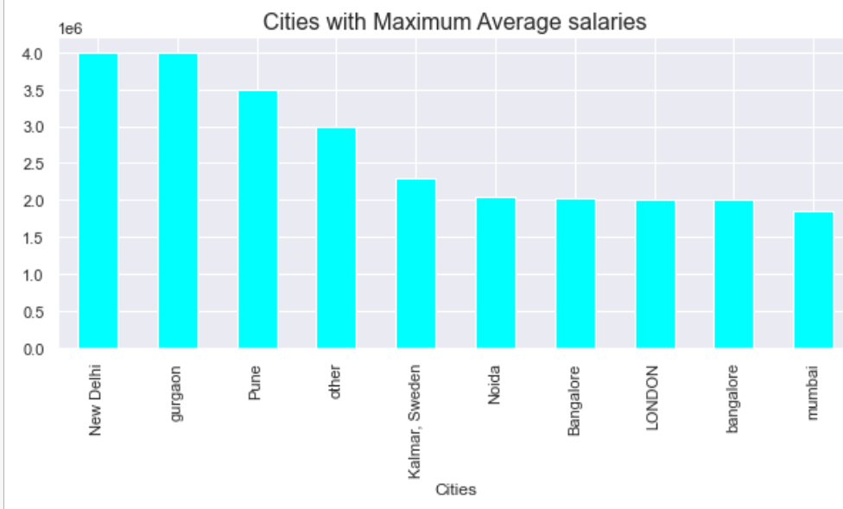
Designation by Sum of salaries:
Cities With Maximum Salaries:
Maximum salaries are drawn by senior software engineers n automation engineer
Total maximum sum of salaries are taken by software engineer and system engineer
FInding relation between salary and the specialization of the students
Cities with maximum salaried jobs are Gurgaon,New delhi,pune

Slide 17
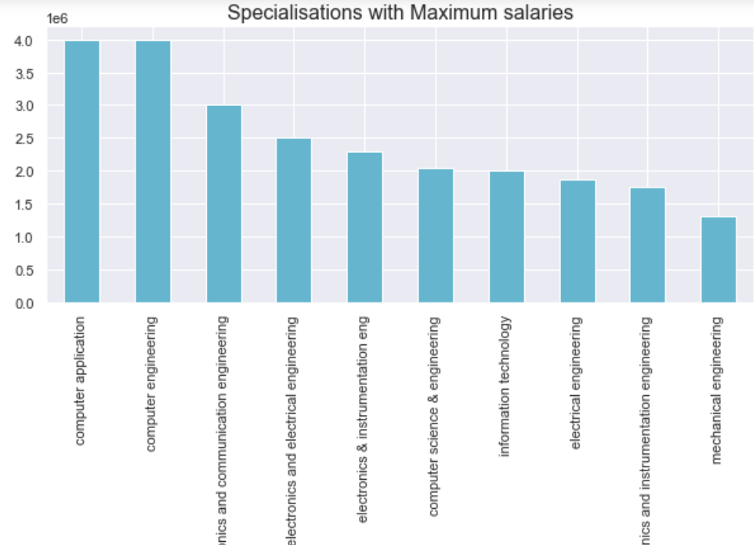
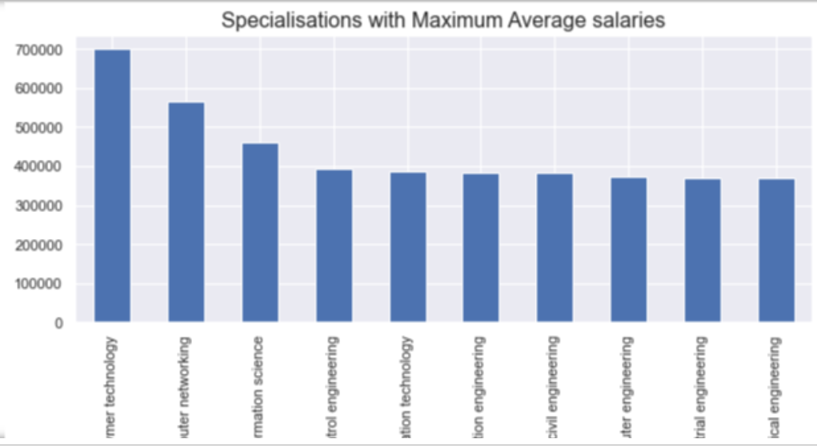
Specialization with maximum Salary:
Specialization with maximum Avg Salary:
Specialisations with maximum salaries are computer engineering,computer application,electronics and communication engineering
Specialisations with Maximum average salaries are polymer technology,computer networking and information science

Slide 18
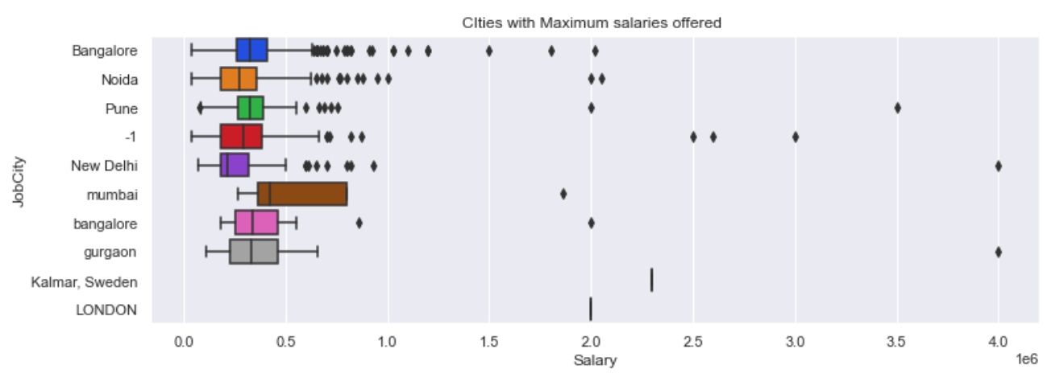
Salaries by city showing the outliers:

Slide 19
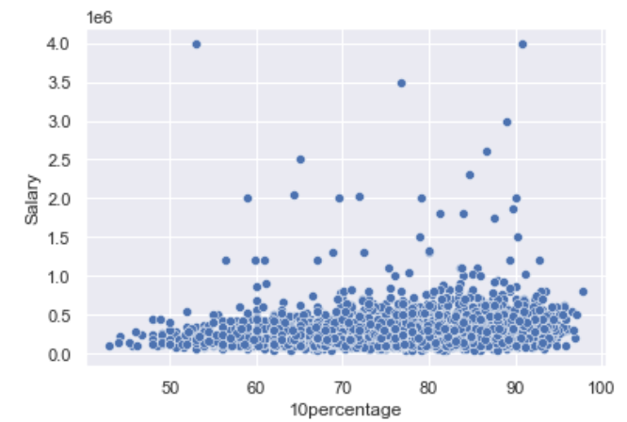
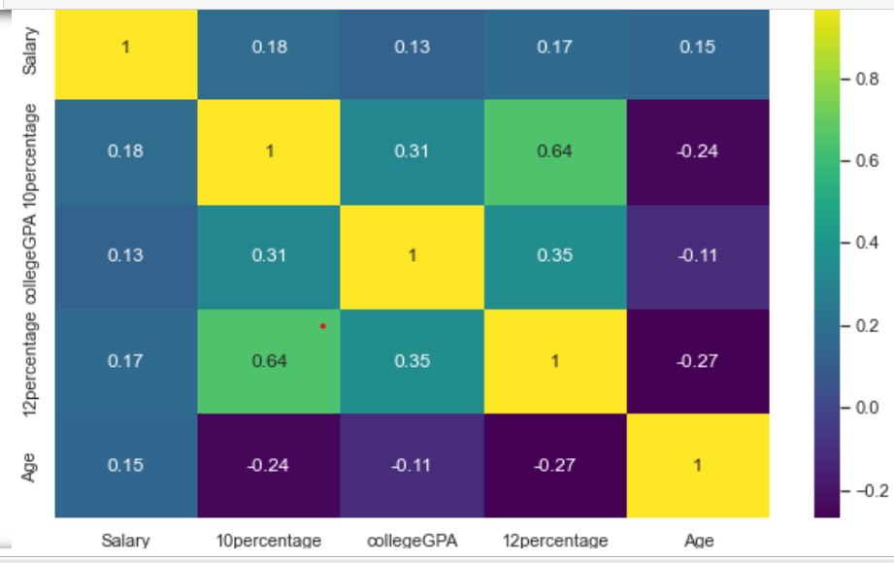
Multivariate Analysis:
Salary by 10percentage:
Salary by Scores of students in 10th,12th,collegeGPA:
Salary does not show directly proportional relation to 10thscore
Salary does not show directly proportional relationship with 10th,12th,or collegeGPA scores of employees¶

Slide 20
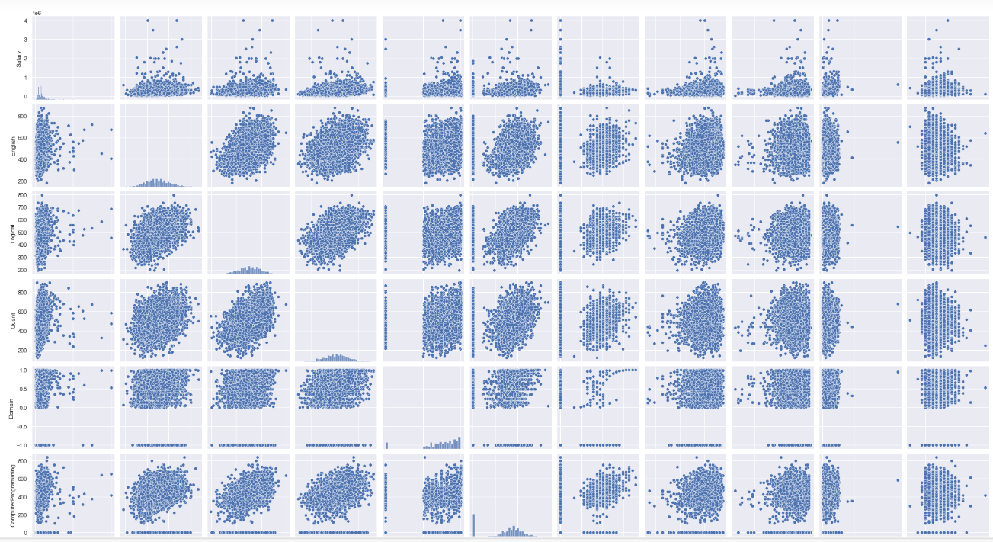
Pair plot Showing the relation between Salary and various AMCAT Scores:Multivariate
The first line of graph shows that salary has no relation with all these AMCAT Scores:

Slide 21
Conclusion:
All These visuals indicate the relationship between the Variables And the Salary that is drawn by the employee indicate the following:
Avrearge Salary of employees is 3.07 Lakh CTC With outliers form 6.6 to 40 lakh CTC
Majority of Students are Male in Specialisations as well as in job Designations.And There is gender specific selection in specialization where females are very scarce in
Mechanical,automobile and automotive engineering
Age has no relation to the Salary
Experience does show relation,with higher experience the salaries are more
Major cities with maximum jobs are Bangalore,Noida and Hyderabad
Most of the Employees are from the B.Tech/B.E ,and few from MCA and others
Most students are 2013 Graduates followed by 2014 and 2012

Slide 22
Most students are 2013 Graduates followed by 2014 and 2012
All the Scores including 10th ,12th,college and Various AMCAT scores does not show any relation to the salary earned
Major Designations Earning Average high salaries are Senior Developer ,junior manager and data scientist.whereas highest salaried designation is Senior software engineer,automation engineer ,And assistant system engineer
Major Specialisations with highest average salary are polymer technology,computer networking and information science whereas highest salaries are from Computer Engineering,Computer Application and Electronics and communication engineering

Slide 23

Thank you
THANK YOU

