Slide 1
python_flask code
# from flask import Flask,request,render_template
#
# app=Flask(__name__)
#
# notes=[]
#
# @app.route('/',methods=["GET","POST"])
#
# def index():
# if request.method == 'POST':
# note = request.form.get("note")
# if note:
# notes.append(note)
# return render_template("home.html",notes=notes)
# if __name__ == '__main__':
# app.run(debug=True)

Slide 2
HTML page
#
# <!DOCTYPE html>
# <html lang="en">
# <head>
# <meta charset="UTF-8">
# <meta name="viewport" content="width=device-width, initial-scale=1.0">
# <title>Document</title>
# </head>
# <body>
# <h1>Please make your Notes here</h1>
#
# <form action="/" method="POST">
# <label for="note">Add Note:</label>
# <input type="text" name="note" id="note">
# <button type="submit">Submit</button>
# </form>
#
# <h2>List of your Notes:</h2>
# <ul>
# {% for note in notes %}
# <li>{{ note }}</li>
# {% endfor %}
# </ul>
# </body>
# </html> """
HTML Code

Slide 3
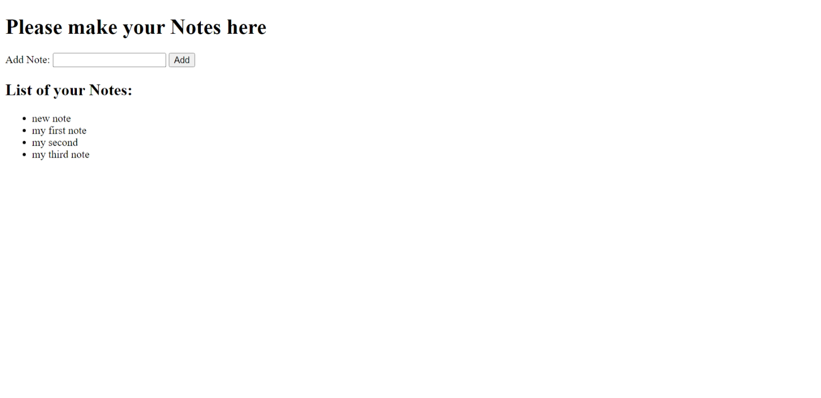

Slide 4
Report on code refactoring:
In the Given Code, @app.route('/', methods=["POST"]) , the route’/’ is using the method POST. So to take the input data from the client we should use note = request.form.get("note").POST is used so we could have data security where it will not show clients input as query parameter .
Made an html page in a templates folder that would help the user to easily enter the notes and all
Input is wrapped in a form that directs to the route ‘/’ that is mentioned in its action attribute,where it is taken by note variable.and all notes entered are strored as list in notes variable. form tag also should use POST Method
Also used jinja templating and also used some loop code to print the list of all the notes entered
by the user,displaying all his notes at one place.used <ul> unordered list tag to display all the notes
entered by the user as a list.
As we have not used any database .we can only see the list of notes entered for that time.to view the previously entered notes we can store them in a database so everytime we login we can see our old notes aswell
(

