Slide 1

Predicting Brain Stroke Occurrence Using Machine Learning Models for Early Prevention and Intervention
Reshma Parchuri, Biraj Shah, Selome Tefera, Thomas Xuan

Slide 2
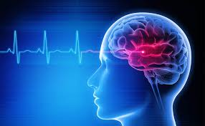
Introduction
A brain stroke is a serious medical condition that occurs when the blood supply to a part of the brain is interrupted or reduced, preventing brain tissue from getting enough oxygen and nutrients. Without oxygen, brain cells begin to die within minutes, making stroke a medical emergency that requires immediate treatment.

Slide 3
Data Source
Data set was originally created from real medical records of 5,110 patients in Bangladesh, collected by McKinsey & Company.
Only 30 percent of the full dataset was released publicly; the remaining 70 percent is private.
The dataset was later analyzed and referenced in a 2024 Scientific Reports study on stroke prediction (Hassan et al., 2024).

Slide 4
Research Question
Among adults aged 50–80 in Bangladesh, what is the combined effect of age, gender, marital status, residence type, work type, smoking status, hypertension, heart disease, BMI, and average glucose levels on predicting brain stroke occurrence, and which of these factors contributes most strongly to stroke risk?

Slide 5
Hypothesis
Null Hypothesis (H₀)
There is no statistically significant association between age, gender, marital status, residence type, work type, smoking status, hypertension, heart disease, body mass index, and average glucose level and the occurrence of stroke among adults aged 50 to 80.
Alternative Hypothesis (H₁)
There is a statistically significant association between one or more of the following variables age, gender, marital status, residence type, work type, smoking status, hypertension, heart disease, body mass index, and average glucose level and the occurrence of stroke among adults aged 50 to 80.

Slide 6
Project Goal
Workflow
Define Research Question
SQL + Python Data Cleaning (remove outliers, handle missing values)
Exploratory Analysis
Statistical Tests (t-tests, chi-square, normality tests)
Train/Test Split (70/30)
SMOTE Oversampling (Training Only)
Modeling: Logistic Regression & Random Forest
Evaluation: Confusion matrices, ROC curves

Slide 7
Research Design
Population & Outcome
Adults age 50–80
Outcome: Stroke vs. No Stroke
Predictors
Age, BMI, Avg Glucose, Hypertension, Heart Disease, Smoking, Gender, Work Type, Residence
Key Design Choices
Highly imbalanced dataset → Needed oversampling
All predictors non-normal (Shapiro–Wilk p < 10⁻²⁸) → ML methods appropriate
SMOTE applied only to training set
Test set left unchanged to preserve real-world distribution

Slide 8
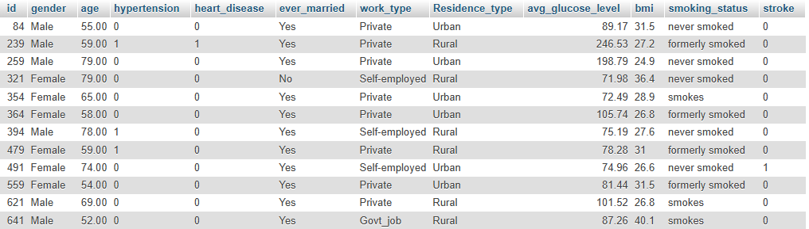



SQL Data Cleaning
SQL Data Cleaning (Screenshot Slide) (Shown Above)
SQL Cleaning Steps Performed
• Removed age outliers (kept ages 50–80)
• Removed NULL BMI values
• Deduplicated rows (SELECT DISTINCT)
• Created cleaned table: stroke_final

Slide 9
Data Structure
Each row represents a single patient
Each column represents a variable (feature)
Features (X) include age, hypertension, glucose, BMI, etc.
The target variable (Y) is stroke (yes or no)

Slide 10
Case Group and Control Group Update
Original imbalance:
1888 non-stroke vs. 206 stroke
Oversampling used to balance the dataset
Stroke and non-stroke counts matched for later modeling
Ensures minority group is not underrepresented

Slide 11
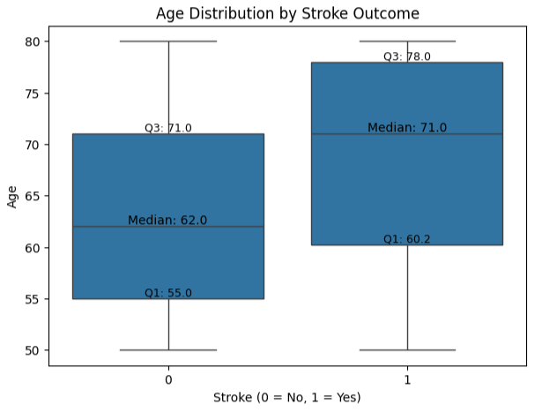

Age
Stroke patients are older on average.
Median age: 71 (stroke) vs 62 (no stroke)
Stroke cases have a higher overall age range and start at older ages.
T-Test Result:

Slide 12
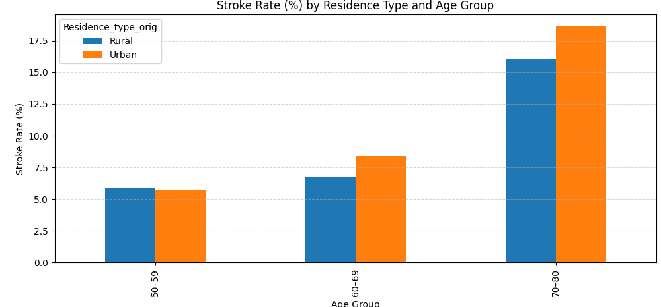
Gender
Stroke rates remain similar across genders
No clear association within any age group
Gender not a strong differentiator of stroke risk
Chi-Square Test Result:

Slide 13
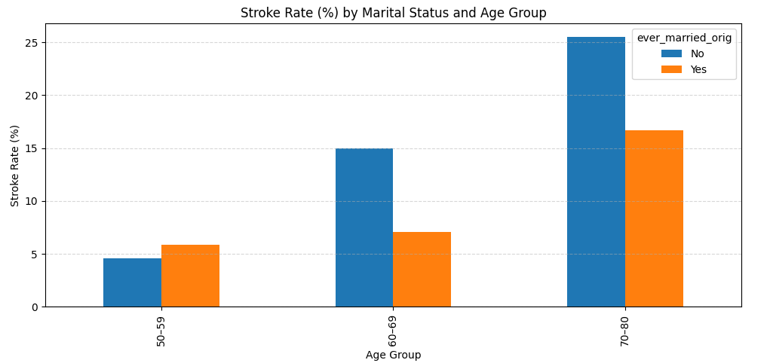
Marital Status (Ever Married)
Small difference between groups
Slightly higher stroke rates in unmarried individuals
May be influenced by age distribution
Chi-Square Test Result:

Slide 14
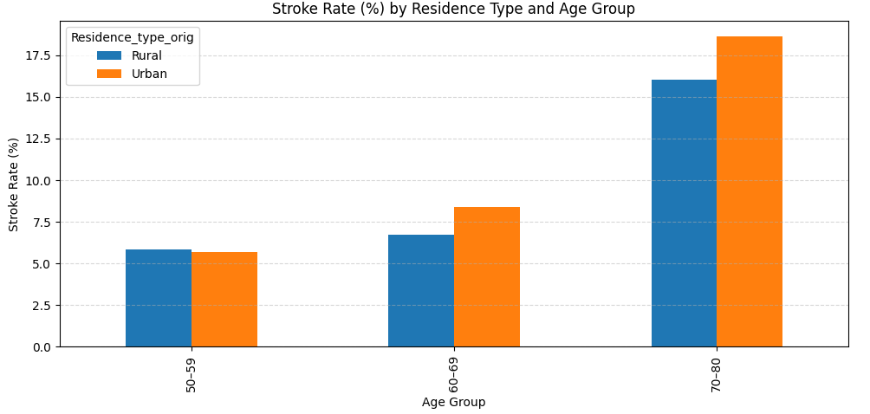
Residence Type
Urban vs rural groups show similar stroke rates
No major variation across age categories
Location not a strong predictor in this dataset
Chi-Square Test Result:

Slide 15
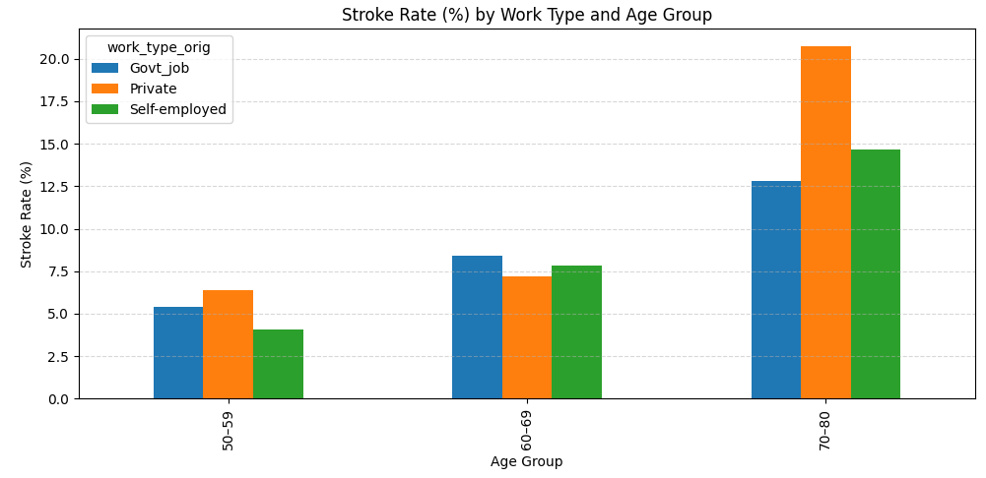
Work Type
Stroke rates similar across employment categories
Private, self-employed, and government roles show minimal differences
Not a strong differentiating factor
Chi-Square Test Result:

Slide 16
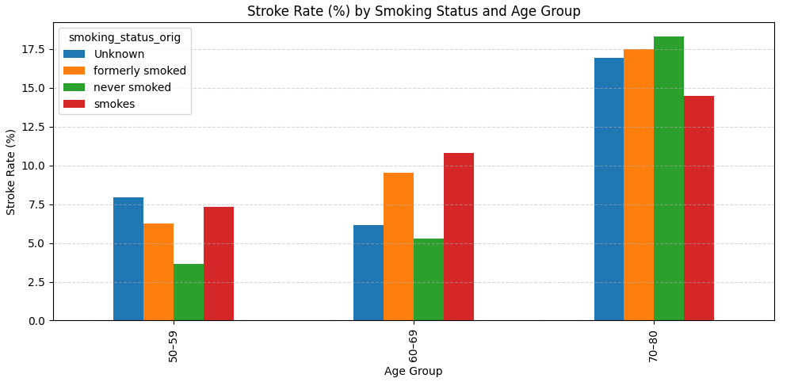
Smoking Status
“Smokes,” “Formerly smoked,” and “Never smoked” show comparable stroke rates
No strong association within any age group
Smoking not a predictive factor in this dataset
Chi-Square Test Result:

Slide 17
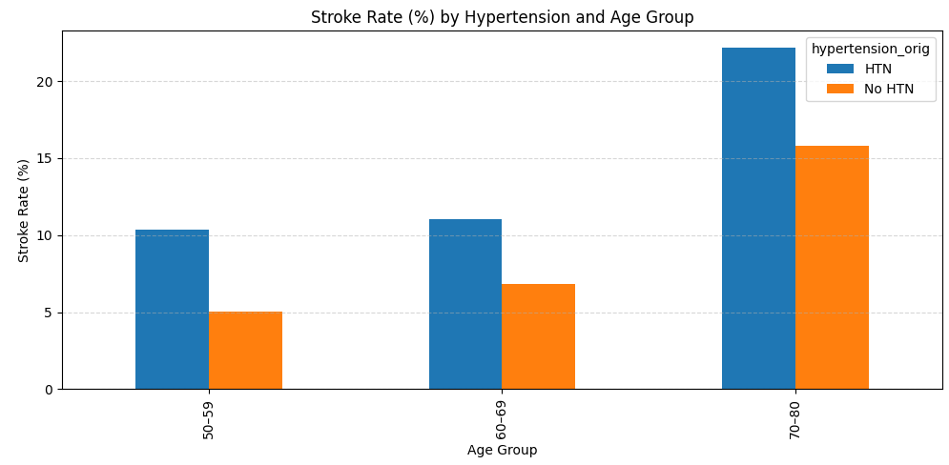
Hypertension
Clear increase in stroke rates among hypertensive individuals
Effect consistent across all age groups
Strong health-related risk factor in this dataset
Chi-Square Test Result:

Slide 18
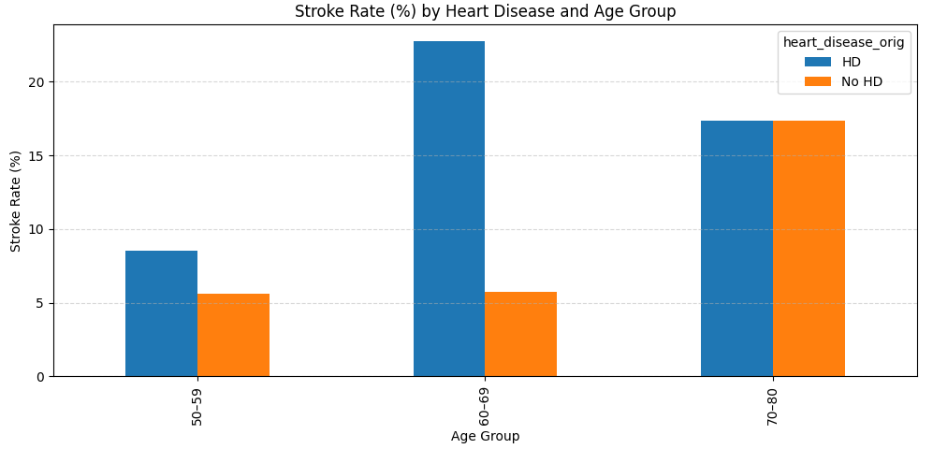
Heart Disease
Stroke rates significantly higher when heart disease is present
Consistent across age categories
Strong indicator of elevated stroke risk
Chi-Square Test Result:

Slide 19
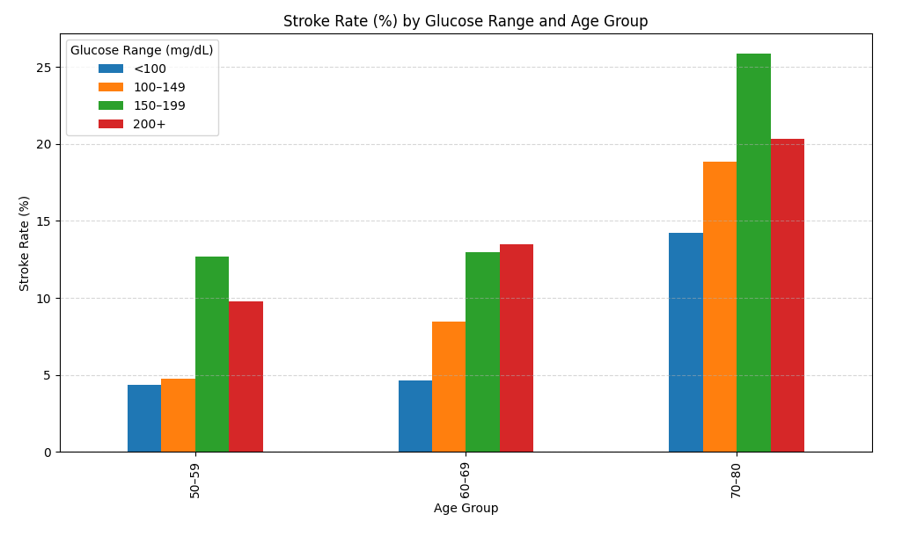

Glucose
Combined effect strongly differentiates stroke risk
Older adults with higher glucose show elevated risk
Interaction feature adds valuable insight into severity
T-Test Result:

Slide 20
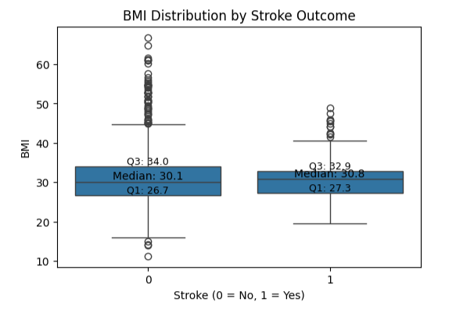

BMI
BMI is nearly identical between stroke and non-stroke groups.
Medians and IQRs overlap heavily.
Outliers appear in both groups.
T-Test Result:

Slide 21
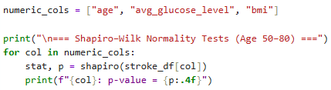
Shapiro-Wilk Normality Test
Feature | p-value | Interpretation
Age | 2.46 × 10⁻²⁹ | Not normal
Avg Glucose Level | 1.05 × 10⁻⁴² | Not normal
BMI | 8.19 × 10⁻²⁸ | Not normal
Conclusion:
Predictors violate normality assumptions (p < 0.05 across all variables)
Non-normal, skewed data + class imbalance warrant the use of SMOTE
SMOTE is appropriate because it does not rely on normality and prevents majority-class dominance
Notes:
“We applied the Shapiro–Wilk test to evaluate the normality assumption
null hypothesis of this test is that the data is normally distributed.”
The p-value tells us the probability of observing this data if normality were true.”
0.05 is a conventional significance level that balances false positives and false negatives in hypothesis testing.
We tested normality to justify method selection a
“The p-values from the Shapiro–Wilk test provide strong statistical evidence that normality assumptions are violated, directly informing our choice of resampling

Slide 22
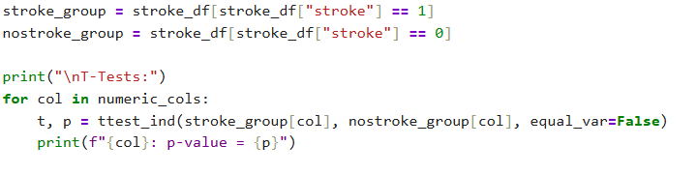

T-Test Results (Numeric Features)
Age: highly significant (p ≈ 1.46e-15)
Avg glucose: highly significant (p ≈ 9.58e-06)
BMI: not significant (p ≈ 0.9)
Interpretation: Older age and higher glucose levels strongly relate to stroke occurrence.
Notes:
independent two-sample t-tests to check whether the mean values of numeric features differ significantly between the stroke and no-stroke groups.
Mean BMI is similar in both groups
“BMI does not meaningfully differentiate stroke risk in this dataset
The t-test results validate that age and glucose differ significantly between stroke and non-stroke patients, while BMI does not, which aligns with the model performance.
Age and glucose show statistically significant mean differences between groups stroke and no stroke; BMI does not.

Slide 23
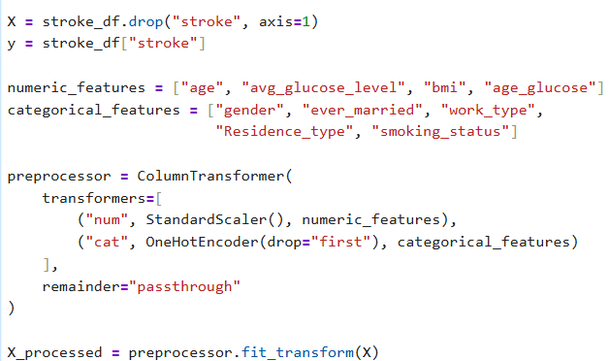
Categorical Features using One Hot Encoding
Our code converts all non-numeric categories into numeric 0/1 columns and scales the numeric features so the machine learning models can use them properly.
gender_Male: 0=Female, 1=Male
ever_married_Yes: 0=No, 1=Yes
work_type_Private: 0=Not Private, 1=Private
work_type_Self-employed: 0=Not SE, 1=SE
work_type_Govt_job: 0=Not Govt, 1=Govt
work_type_children: 0=Not Child, 1=Child
Residence_type_Urban: 0=Rural, 1=Urban
smoking_status_formerly smoked: 0=No, 1=Former
smoking_status_never smoked: 0=No, 1=Never
smoking_status_smokes: 0=No, 1=Smoker
Notes:
This slide explains how categorical (non-numeric) variables were converted into numeric 0/1 columns so that machine-learning models can process them correctly.
Machine-learning models require numeric inputs, so we transformed all categorical variables using one-hot encoding.”
“One-hot encoding converts each category into a separate binary column indicating presence or absence.”
Because correlated features like age and glucose are clinically meaningful, and their interaction improves prediction.

Slide 24
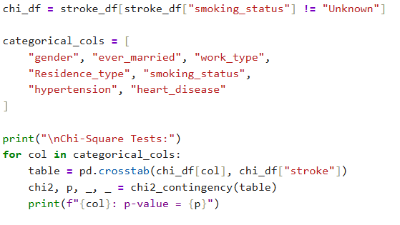
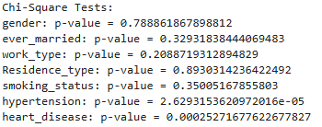
Chi-Square Results (Categorical Features)
Hypertension: significant (p ≈ 2.63e-05)
Heart disease: significant (p ≈ 2.53e-04)
Non-significant variables: gender, work type, smoking status, residence type
Interpretation: Cardiovascular conditions (hypertension, heart disease) show meaningful association with stroke risk.
Notes:
It tests whether two categorical variables are independent or associated.
p > 0.05 → “These variables do not show a statistically significant association with stroke in this dataset.”

Slide 25
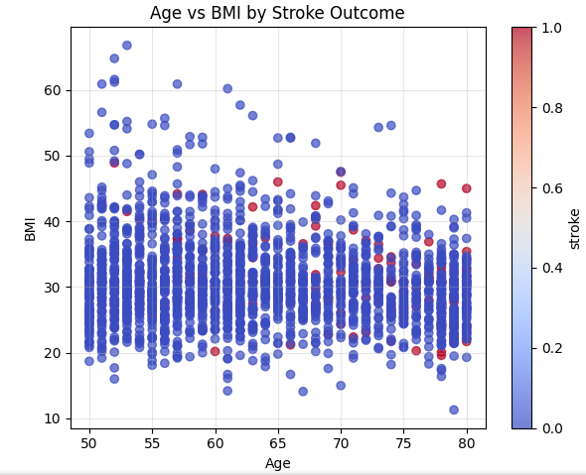
Scatter Plots of Key Health Factors (Age vs BMI)
Stroke cases appear across all BMI values, showing no clear BMI pattern.
Stroke cases are more common at older ages, not higher BMI.
BMI varies widely in both groups, matching the statistical result that BMI is not significant.
Takeaway:
Age is a much stronger indicator of stroke risk than BMI in this dataset.
Notes:
We used a scatter plot to visually examine the relationship between two continuous variables (age and BMI) and to see how stroke cases are distributed across them.
By coloring points by stroke outcome, we can visually assess whether stroke cases concentrate in specific regions.”
“This plot shows that stroke cases occur across all BMI values but are more common at older ages.”

Slide 26
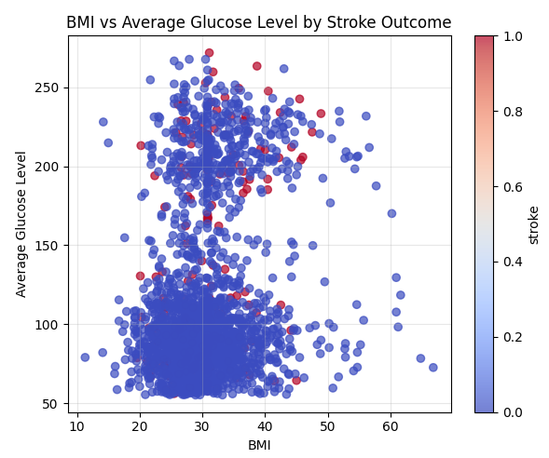
BMI vs Average Glucose Level
Stroke cases appear at higher glucose levels, regardless of BMI.
BMI does not clearly separate stroke and non-stroke groups.
Most stroke cases cluster where glucose is above ~150 mg/dL.
This supports glucose as a stronger predictor than BMI.
Takeaway:
Glucose level shows a clearer relationship with stroke risk than BMI, consistent with statistical tests and model feature importance.

Slide 27
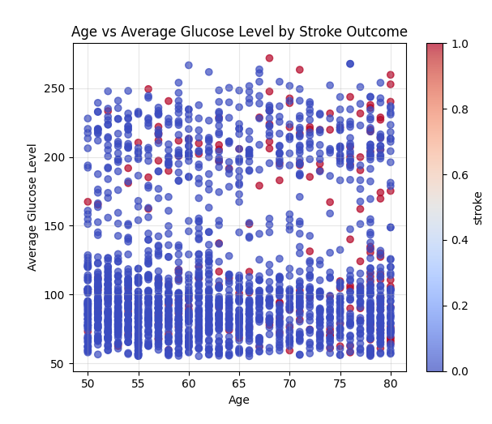
Age vs Average Glucose Level
Stroke cases tend to occur at higher glucose levels, across many ages.
Glucose appears more strongly linked to stroke than age in this plot.
Stroke points are more frequent above ~150 mg/dL glucose, regardless of age.
Age still shows some concentration of strokes at older ages, but glucose is the clearer separator.
Takeaway:
High glucose levels show a noticeable association with stroke, supporting glucose as one of the strongest predictors in the dataset.

Slide 28
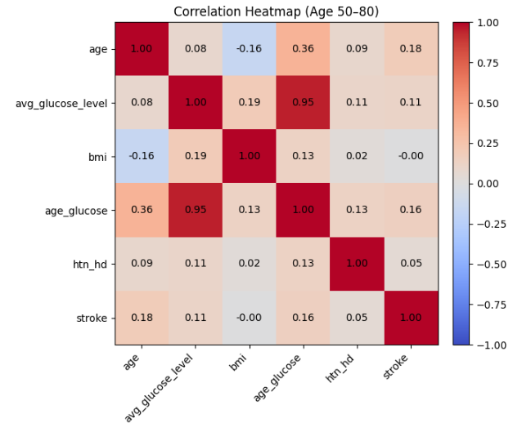
Correlation Heatmap
Age and glucose show strong positive correlation, and the age_glucose interaction captures this relationship.
Age and average glucose both have meaningful positive correlations with stroke, aligning with statistical tests.
BMI shows no meaningful correlation with stroke.
Hypertension + heart disease (htn_hd) has only a weak association with stroke.
Overall:
Strongest predictors of stroke in this group are age, glucose, and their interaction.
Notes:
The correlation heatmap is a visual representation of the Pearson r-values shown in the previous slide. Both are based on the same Pearson correlation calculations.
Focuses mainly on:
Correlation between each variable and stroke
Strength of individual linear relationships
Shows:
Variable ↔ variable correlations
Variable ↔ stroke correlations
Multicollinearity
Multicollinearity occurs when predictor variables are highly correlated, making it difficult to estimate their individual effects accurately.

Slide 29
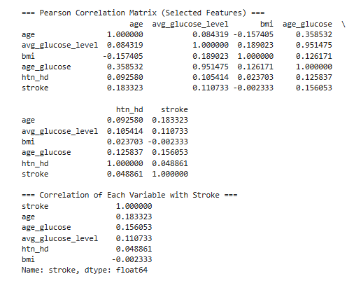
Pearson r-Values vs Stroke
Age (r ≈ 0.18) and Avg Glucose (r ≈ 0.11)
show the strongest positive correlations with stroke.
Age × Glucose interaction (r ≈ 0.16)
provides additional predictive strength.
Hypertension × Heart Disease (r ≈ 0.05)
shows only a weak association.
BMI (r ≈ –0.00)
has virtually no correlation with stroke risk.

Slide 30
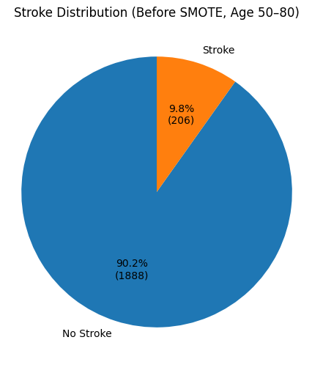
Class Imbalance, Normality Testing & Motivation for SMOTE
Stroke Case Imbalance (Ages 50–80)
No Stroke: 1888
Stroke: 206
Dataset is highly imbalanced, causing bias toward “No Stroke.”
Training/Test Split
70% Training Set (used for SMOTE)
30% Testing Set (kept unchanged for real-world evaluation)
Training Set BEFORE SMOTE
No Stroke: 1321
Stroke: 144

Slide 31
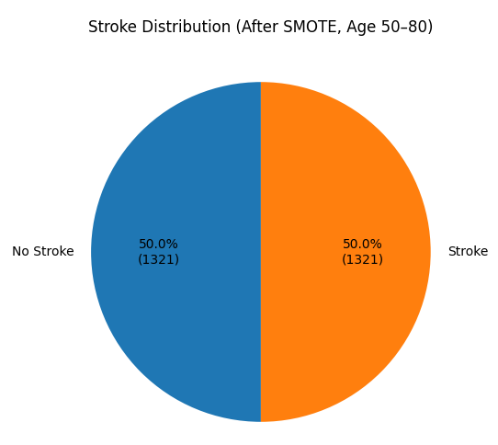
SMOTE Balancing (Training Set Only)
Applied SMOTE to balance the minority class in the training data
Training Set AFTER SMOTE
No Stroke: 1321
Stroke: 1321
Purpose of SMOTE
Reduce bias toward majority class
Improve detection of stroke cases (recall/sensitivity)
Keep test set unchanged to maintain real-world distribution
Avoid artificially inflating evaluation results
SMOTE generated synthetic stroke cases using a k nearest neighbor approach applied to the training data.

Slide 32

Train vs Test Dataset
Dataset | Stroke | No STroke
Train (Before SMOTE) | 144 | 1321
Train (After SMOTE) | 1321 | 1321
Test Set | 62 | 567
The training set initially showed a strong class imbalance
(144 stroke vs. 1321 non-stroke).
SMOTE was applied only to the training set, creating a balanced dataset
(1321 stroke vs. 1321 non-stroke).
The test set was left unchanged to preserve real-world conditions
(62 stroke vs. 567 non-stroke).
Random Sampling and Data Split
The dataset was split into training and testing sets using random stratified sampling.
Seventy percent of the data was randomly assigned to the training set and thirty percent to the test set.
Stratification ensured that stroke and non-stroke cases were proportionally represented in both sets.
Balancing only the training data improves the model’s ability to detect stroke cases while ensuring that evaluation on the test set remains realistic and unbiased.

Slide 33
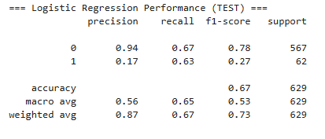
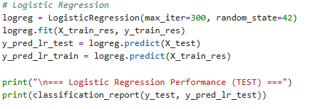
Logistic Regression
Accuracy: 67%
Stroke recall: 63% (correctly finds most stroke cases)
Stroke precision: 17% (but makes many false positives)
Non-stroke performance: strong (94% precision)
Interpretation: Model detects strokes but struggles to be precise due to small true-stroke sample.

Slide 34
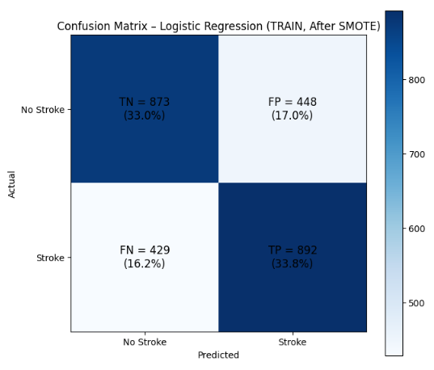
Logistic Regression Confusion Matrix - Trained Data
Model performs balanced classification due to the SMOTE-balanced training set.
True Positives (892, 33.8%) and True Negatives (873, 33.0%) are both strong, showing the model is learning patterns for both classes.
False Negatives (429, 16.2%) indicate some stroke cases are still being missed.
False Positives (448, 17.0%) reflect moderate over-prediction of stroke.
Overall Insight:
The logistic regression model fits the balanced training data reasonably well, showing good recognition of both stroke and non-stroke cases. Performance here is expected to be stronger than on the test set because SMOTE reduces class imbalance during training.

Slide 35
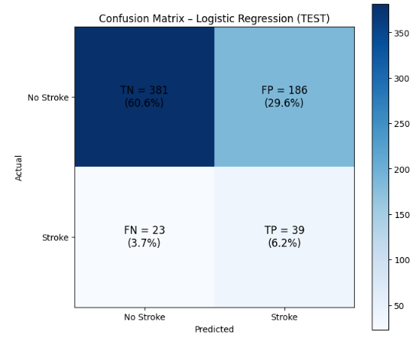
Logistic Regression Confusion Matrix - Test Data
True Negatives (381, 60.6%) show the model is strong at correctly identifying non-stroke cases.
True Positives (39, 6.2%) indicate the model successfully detects some stroke cases, though sensitivity is moderate.
False Positives (186, 29.6%) are relatively high, meaning many non-stroke cases are incorrectly predicted as stroke.
False Negatives (23, 3.7%) are comparatively low, which is good because missing stroke cases is clinically more harmful.
Overall Insight:
Logistic Regression performs reasonably well on the test set, maintaining meaningful stroke detection (TP = 39) despite the heavily imbalanced real-world distribution. Performance drops compared to training data, which is expected since SMOTE was not applied to the test set.

Slide 36
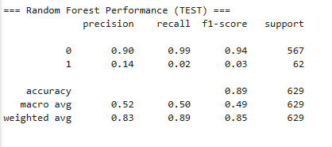
Random Forest Results
Model Summary
Accuracy: 89%
Performs extremely well for the majority class (No Stroke)
Performs very poorly for the minority class (Stroke) despite SMOTE
High overall accuracy is misleading due to severe class imbalance
Confusion Matrix Interpretation
True Negatives (TN = 561): Correctly identified most non-stroke patients
False Positives (FP = 6): Rarely predicts stroke when there is none
False Negatives (FN = 61): Missed almost all actual stroke cases
True Positives (TP = 1): Correctly detected only 1 stroke
Takeaway
Random Forest learns majority-class patterns extremely well but fails to detect stroke cases reliably, even after oversampling.
It is not appropriate for predicting rare events like stroke without additional techniques (threshold tuning, cost-sensitive learning, or alternative algorithms).

Slide 37
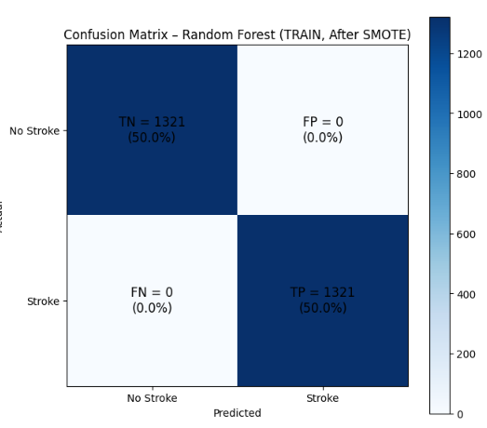
Random Forest Confusion Matrix - Trained Data
Perfect classification on the balanced training set:
True Negatives (1321, 50%)
True Positives (1321, 50%)
Zero False Positives and Zero False Negatives
This level of performance is not realistic and indicates the model has likely overfit to the SMOTE-generated training data.
Random Forest memorized the training patterns extremely well but may not generalize to real-world stroke cases.
Overall Insight:
Random Forest appears extremely accurate on training data, but this is a red flag for overfitting — especially because the test results do not match this level of performance.

Slide 38
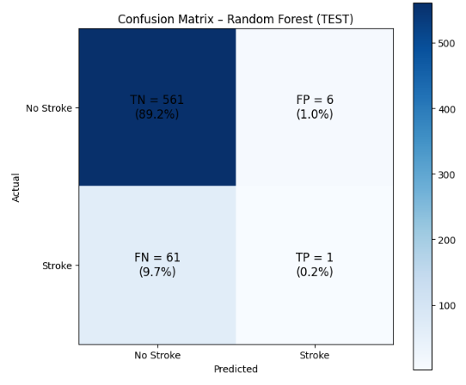
Random Forest Confusion Matrix - Test Data
True Negatives (561, 89.2%)
Model is very strong at correctly identifying non-stroke cases.
True Positives (1, 0.2%)
Random Forest detects almost no actual stroke cases.
False Negatives (61, 9.7%)
The model misses the vast majority of stroke patients, which is dangerous in a clinical context.
False Positives (6, 1.0%)
Very low — the model rarely predicts stroke incorrectly.
Overall Insight:
Despite excellent accuracy for the majority class, the Random Forest model fails almost completely at detecting strokes in real-world (imbalanced) test data.
This demonstrates severe overfitting and makes the model clinically unsuitable for stroke prediction.

Slide 39
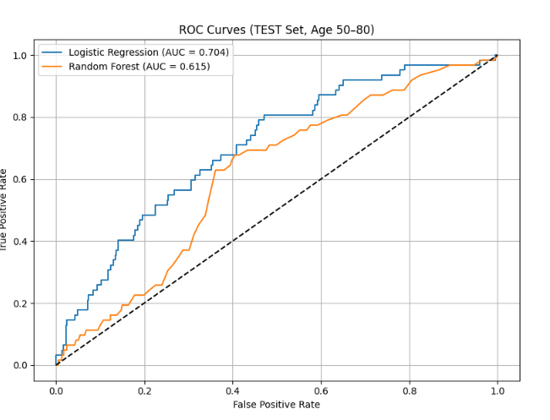
ROC Curve Comparison
LR AUC ≈ 0.70 — moderate discriminatory ability
RF AUC ≈ 0.61 — worse at distinguishing stroke vs non-stroke
LR outperforms RF for minority-class detection

Slide 40
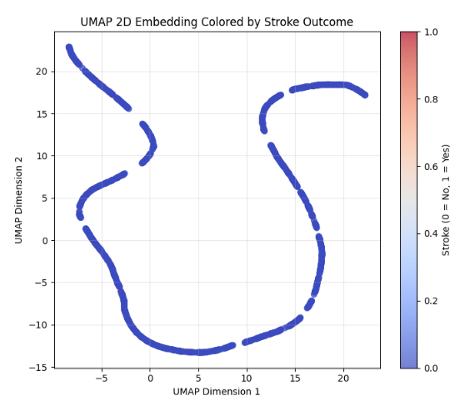
UMAP 2D Embedding
The UMAP projection does not show distinct clusters separating stroke vs. non-stroke individuals.
Stroke cases appear scattered throughout the space, indicating that stroke risk is not explained by any single feature or simple combination.
This supports the idea that stroke prediction requires multivariate machine learning models, not linear or single-variable decision rules.
The lack of clear grouping also reflects the complexity of clinical stroke risk, which depends on interactions among age, glucose, hypertension, heart disease, and other factors.
Overall Insight:
UMAP reveals that stroke outcomes do not form natural clusters in feature space — reinforcing the need for machine learning models capable of capturing subtle, nonlinear patterns rather than relying on visual group separation.

Slide 41
Conclusions
• Age, glucose, hypertension, and heart disease were the strongest predictors of stroke.
• Gender, marital status, work type, and residence type showed no significant difference.
• Logistic Regression performed moderately well in detecting stroke cases (higher recall).
• Random Forest achieved high accuracy but failed to detect stroke cases, producing many false negatives.
• Non-normality of predictors + heavy class imbalance justified the use of SMOTE and ML techniques.
Clinical Interpretation
A model that misses most stroke cases has limited clinical use, future work must focus on improving recall and sensitivity.

Slide 42
References
Stroke Prediction Dataset. (2021, January 26). Kaggle. https://www.kaggle.com/datasets/fedesoriano/stroke-prediction-dataset/data?select=healthcare-dataset-stroke-data.csv
Hassan, A., Gulzar Ahmad, S., Ullah Munir, E., Ali Khan, I., & Ramzan, N. (2024). Predictive modelling and identification of key risk factors for stroke using machine learning. Scientific reports, 14(1), 11498. https://doi.org/10.1038/s41598-024-61665-4

