Slide 1
Employee Data Analysis using Excel
STUDENT NAME: Reshma.k
REGISTER NO: 122204032
DEPARTMENT: Bcom cs
COLLEGE Shri Krishnaswamy college for women

Slide 2
PROJECT TITLE
Employee Gender Analysis using Excel

Slide 3


AGENDA
Problem Statement
Project Overview
End Users
Our Solution and Proposition
Dataset Description
Modelling Approach
Results and Discussion
Conclusion
3/21/2024 Annual Review

Slide 4

PROBLEM STATEMENT
Data Collection: Gather data on employee demographics, including gender, job titles, departments, compensation, years of service, performance evaluations, and promotion history.
Data Analysis: Perform statistical analysis to determine the gender distribution across different departments, job levels, and other dimensions.
Impact Assessment: Evaluate the potential impact of observed gender imbalances on organizational performance, employee satisfaction, and career advancement opportunities
Trend Identification: Identify trends and patterns in gender distribution, such as underrepresentation in certain roles or departments.

Slide 5

PROJECT OVERVIEW
Scope: This project focuses on:
Collecting and analyzing data related to employee gender, including distribution by department, job level, and tenure.
.
Deliverables:
A comprehensive report detailing the findings of the gender analysis.
Visualizations (e.g., charts, graphs) to illustrate key insights and trends.
Expected Outcome: The project aims to provide a clear understanding of the current gender distribution within the organization, highlight any areas of concern, and offer strategic recommendations to promote a more balanced and inclusive workplace.

Slide 6

WHO ARE THE END USERS?
HR Department:
Purpose: To use the findings to inform diversity and inclusion strategies, recruitment practices, and employee development programs.
Senior Management and Executives:
Purpose: To understand the implications of gender distribution on organizational performance, and to make informed decisions about policies and initiatives.
Department Heads and Managers:
Purpose: To gain insights into gender representation within their teams and departments and to support efforts to achieve greater gender balance.

Slide 7

OUR SOLUTION AND ITS VALUE PROPOSITION
Data Collection and Preparation:
Gather detailed data on employees, including gender, department, job level, tenure, and other relevant metrics.
Ensure data accuracy and completeness.
Analysis and Reporting:
Perform statistical analysis to assess gender distribution across various departments, job levels, and tenure.
Identify trends, patterns, and potential imbalances.
Visualization and Communication:
Create visualizations (charts, graphs) to clearly convey findings and trends.
Present findings in a user-friendly format for stakeholders.

Slide 8
Dataset Description
Dataset Overview:
The dataset contains information on employees within the organization, with a focus on attributes related to gender and its impact on various organizational factors.
Attributes:
Employee ID: A unique identifier for each employee.
Gender: The gender of the employee (e.g., Male, Female, Non-binary, Prefer not to say).
Department: The department in which the employee works (e.g., Sales, HR, IT).
Data Quality:
Completeness: Ensure all records have complete information, with no missing values for critical attributes.
Accuracy: Verify that gender information and other attributes are recorded correctly and consistently.

Slide 9

THE "WOW" IN OUR SOLUTION
Comprehensive Insights:
Deep Dive Analysis: Offers a granular analysis of gender distribution across multiple dimensions (departments, job levels, tenure), providing a detailed view of organizational dynamics.
Actionable Recommendations:
Tailored Strategies: Provides customized recommendations based on specific findings, such as targeted diversity programs and policy adjustments.
Predictive Analytics:
Trend Forecasting: Utilizes predictive models to forecast future gender distribution trends and potential impacts on organizational performance, enabling proactive planning.
3/21/2024 Annual Review
9

Slide 10
MODELLING
Objective:
To create models that help analyze and predict gender distribution trends, identify patterns, and assess the impact of gender diversity on various organizational outcomes.
Model Selection:
Choose appropriate modeling techniques based on the analysis objectives and data characteristics.
Validate models using cross-validation and other techniques to ensure accuracy and reliability.
Data Preparation:
Clean and preprocess the dataset to handle missing values, outliers, and ensure consistency.
Feature engineering to create relevant variables for modeling (e.g., tenure categories, job level indicators).
10

Slide 11
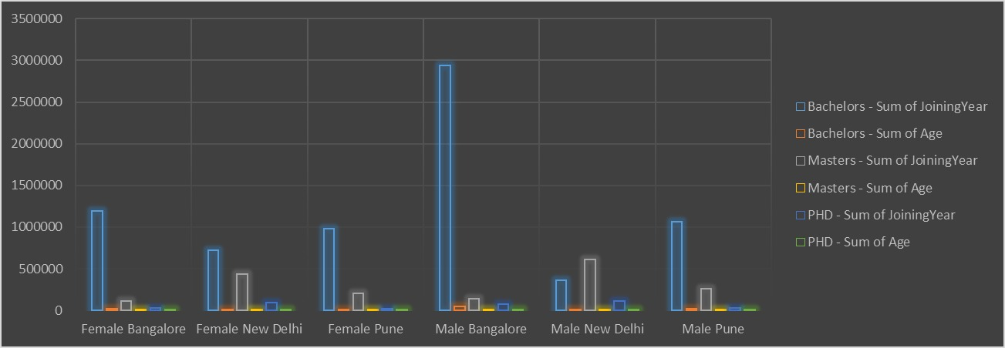
RESULTS
11

Slide 12
conclusion
The Employee Gender Analysis has provided valuable insights into the gender distribution within the organization, highlighting key areas of imbalance and potential opportunities for improvement. By analyzing gender representation across different departments and job levels, we have identified specific trends and disparities that could impact organizational performance and employee satisfaction.
Overall, this analysis equips the organization with a clear understanding of its current gender dynamics and actionable steps to foster a more inclusive and balanced environment, ultimately contributing to a more effective and supportive workplace culture.

