Slide 1


Security Attacks, Threats, Risks and Their Impact on Security Goals
Course Code : CSA5112
Course Name: Cryptography And Network Security
Presented by :
Name : Reshma S
Reg.no :192421229
Dept : Btech IT
Guided by :
Sivasankar chandrasekaran

Slide 2
Agenda
Introduction
Security Attacks and Threats
Security Risks and Their Impact
Security Goals
Prevention
Conclusion

Slide 3
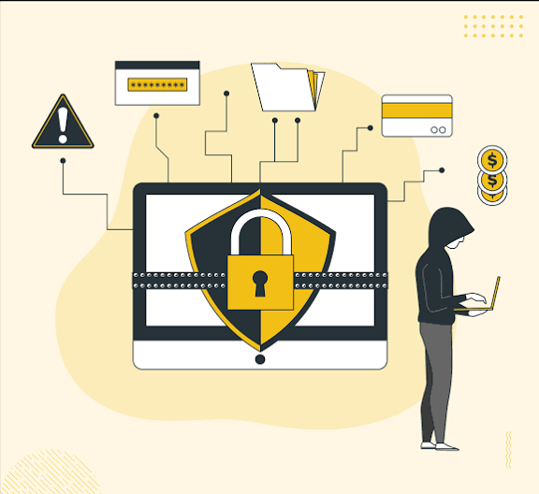
Introduction
To understand security attacks, threats, risks, and their impact on information security.
Information security protects data from unauthorized access and damage.
Security attacks try to steal, change, or destroy information.
Security threats are possible dangers to computer systems.
Security risks are the chances of a threat causing damage.
Security goals help keep information safe and secure.
Example: Protecting student’s personal details stored in a college database.

Slide 4
Security Attacks and Threats
Security Attack: An action performed to steal, modify, or damage information.
Examples:
Phishing: Fake emails or websites used to steal passwords.
Malware: Harmful software that damages a computer.
Password Attack: Trying to discover someone's password.
Security Threat: Anything that could cause harm to a computer system or its data.
Examples:
Hackers trying to access a system.
Viruses infecting a computer.
Employees accidentally sharing confidential data.
VS

Slide 5
Security Risks and Their Impact
Security Risk:
The possibility of losing data, money, or privacy because of a security threat.
Examples:
Weak passwords can lead to account hacking.
Clicking suspicious links can expose personal information.
Poor security can cause data theft or financial loss.
Impact of Security Risks:
Loss of confidential information.
Damage to computer systems.
Financial loss
Loss of user trust.
Example: If a hacker steals a student's login password, they may access personal details and misuse the account.
Example: If a hacker steals a student's login password, they may access personal details and misuse the account.

Slide 6
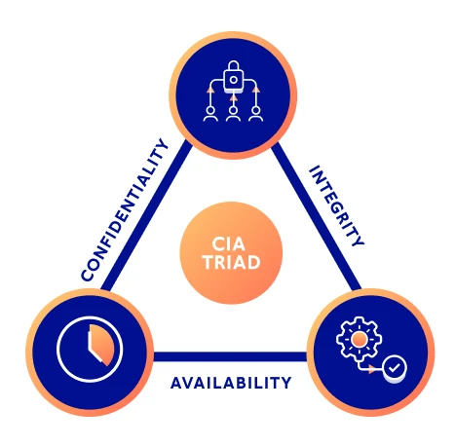
Security Goals
The three main security goals are Confidentiality, Integrity, and Availability (CIA).
1. Confidentiality
Information should be accessible only to authorized people.
Example: Only authorized students can view their personal records.
2. Integrity
Information should remain accurate and unchanged by unauthorized people.
Example: Nobody should be able to change a student's marks without permission.
3. Availability
Information and services should be accessible when needed.
Example: Students should be able to access the college website during exam registration.

Slide 7
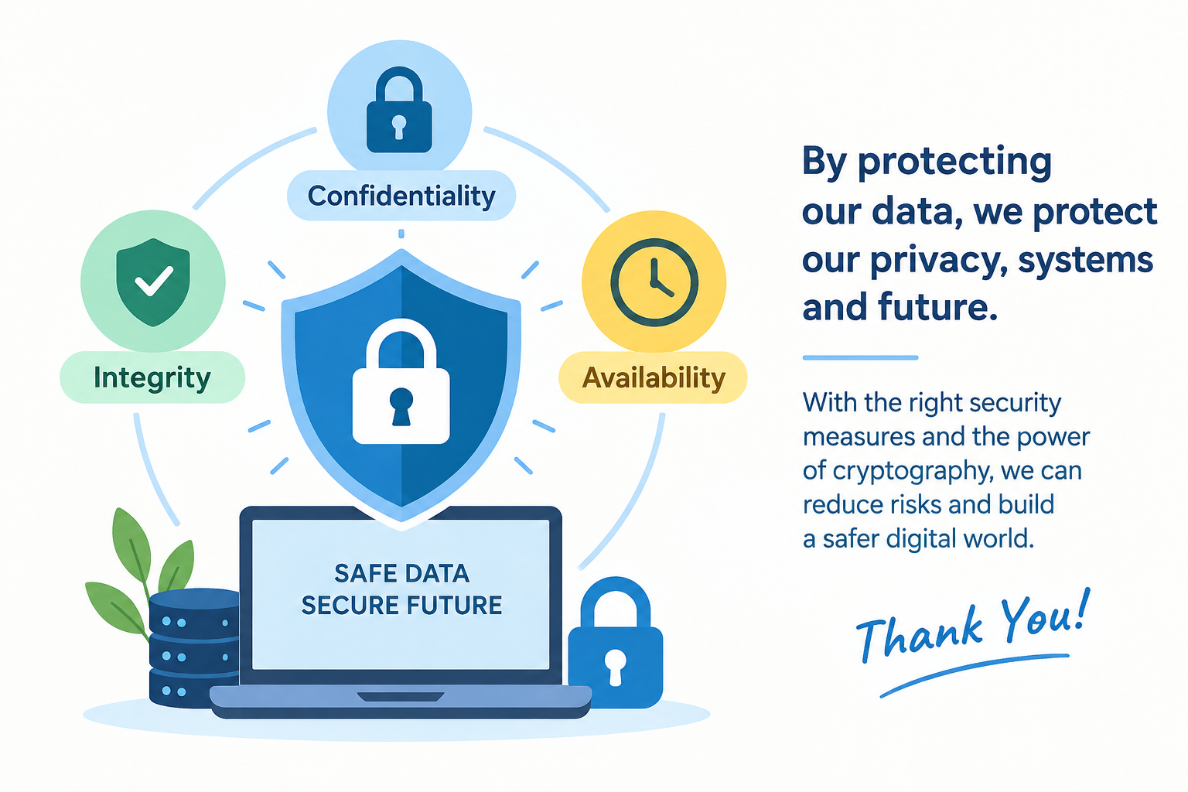
Prevention & Conclusion
How to Prevent Security Attacks
Use strong passwords and multi-factor authentication.
Encrypt sensitive information.
Install antivirus software and update systems regularly.
Avoid suspicious emails and links.
Back up important data regularly.
Conclusion:
Security attacks, threats, and risks can affect the confidentiality, integrity, and availability of information. By using cryptography, strong passwords, encryption, and proper security practices, we can protect data and reduce security risks.

Slide 8
Thank you

