Slide 1



CNN Model to Classify Images of Plastic Waste

Slide 2

Learning Objectives
1)Understand the fundamentals of Convolutional Neural Networks (CNN).
2)Learn how to develop a CNN model using TensorFlow for image classification.
3)Measure model performance using accuracy, precision, recall, and loss functions.
4)Utilize various plots and visualizations to validate and interpret model results.
5)Explore the application of CNNs in waste classification and future improvements.
GOAL
Source :
www.freepik.com/

Slide 3
Tools and Technology used
Programming Languages:
Python (TensorFlow, Keras, NumPy, Matplotlib)
Frameworks and Libraries:
TensorFlow/Keras for Deep Learning
OpenCV for Image Processing
Development Tools:
Jupyter Notebook for Code Implementation
Google Notebook,Kaggle Notebok
Visual Studio Code for Script Writing
Data Source:
Kaggle Waste Classification Dataset

Slide 4
Methodology
Step 1: Data Collection and Preparation
Collected waste classification dataset from Kaggle.
Preprocessed images: resized, normalized, and augmented to enhance model generalization.
Step 2: Model Design
Built a CNN architecture using TensorFlow/Keras.
Used layers: Convolutional, MaxPooling, and Fully Connected.
Step 3: Model Training
Defined loss function: Categorical Cross-Entropy.
Optimized using Adam optimizer with a learning rate of 0.001.
Split data into training and validation sets.
Step 4: Performance Evaluation
Monitored metrics: accuracy, precision, recall, F1-score.
Visualized results using plots (accuracy, loss, and confusion matrix).
Step 5: Results Interpretation
Analyzed model predictions on test data.
Highlighted areas for improvement and future refinements.

Slide 5
Problem Statement:
Issue: Waste management is a critical environmental challenge, and improper waste segregation leads to environmental hazards and inefficient recycling.
Need: Automating the waste classification process can significantly improve recycling efficiency and reduce human intervention.
Objective: To design and implement a Convolutional Neural Network (CNN) model for classifying waste into categories such as recyclable and organic, ensuring an efficient and scalable solution for waste management

Slide 6
Solution:
Proposed Approach: Develop a Convolutional Neural Network (CNN) model to automate the classification of waste into categories such as recyclable and organic.
Key Features of the Solution:
Automated Waste Segregation: Reduces human effort and errors in waste sorting.
High Accuracy: Uses TensorFlow-based CNN for precise classification.
Scalable and Flexible: Can be extended to classify additional waste types.
Visualization and Interpretability: Leverages performance plots and confusion matrices for better understanding.
Outcome: A robust, efficient, and scalable system for waste classification that improves recycling processes and environmental impact.

Slide 7
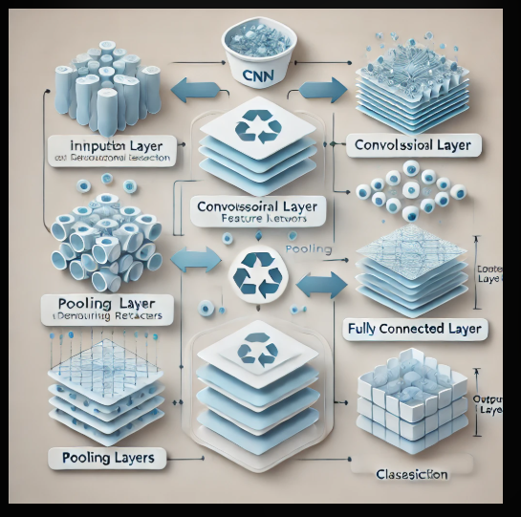
Algorithm:

Slide 8
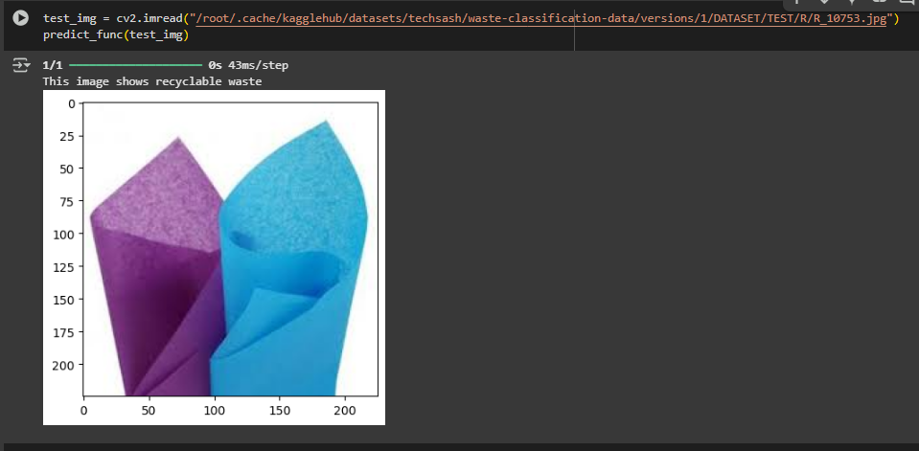
Screenshot of Output:

Slide 9
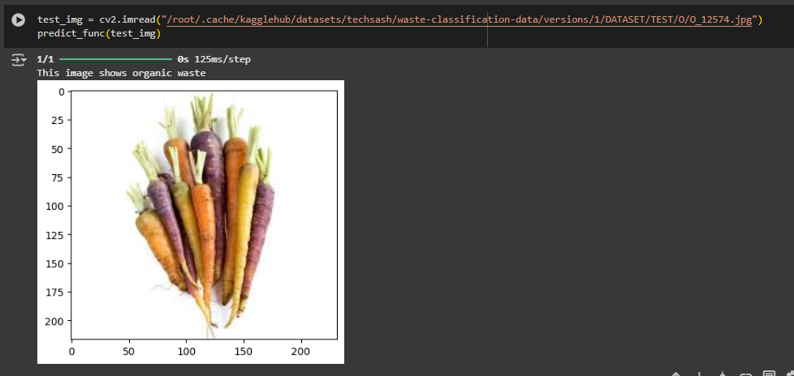
Screenshot of Output:

Slide 10
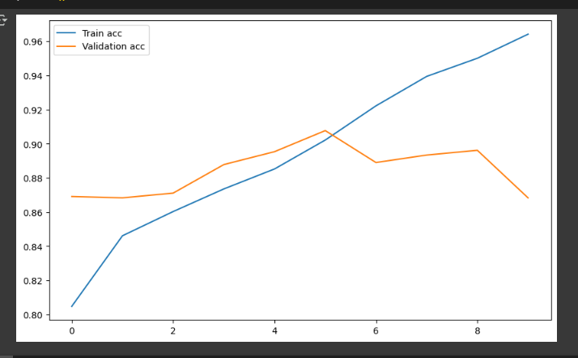
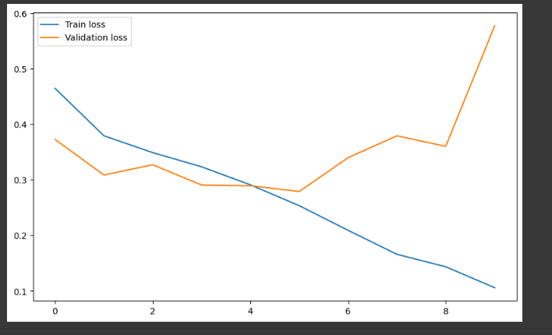
Model Accuracy, Loss plots:

Slide 11
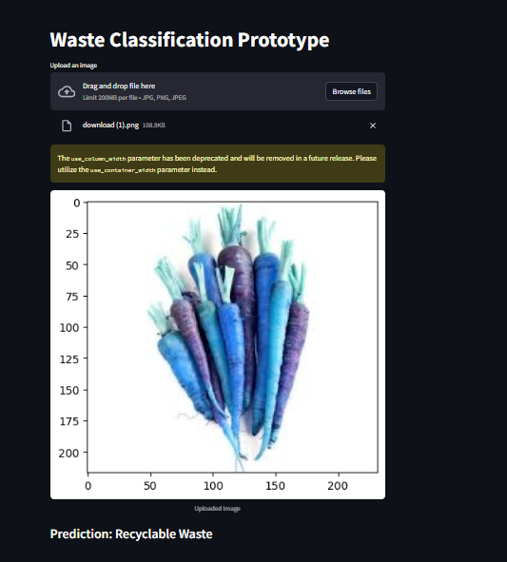
Advancements done by Me:
Objective: To provide an interactive and user-friendly platform for waste classification using the trained CNN model.
Features of the Web Interface:
Image Upload: Users can upload images of waste items for classification.
Real-time Predictions: Displays whether the waste is recyclable or organic instantly.
Visual Feedback: Shows the uploaded image alongside the prediction for better user understanding.
Performance Metrics Display: Option to display the model’s confidence score for each prediction.
Technology Used:
Streamlit: For building the web interface and integrating the trained CNN model.

Slide 12
Conclusion:
Summary of Achievements:
Successfully developed and trained a Convolutional Neural Network (CNN) model for waste classification.
Achieved high accuracy in classifying waste into recyclable and organic categories.
Built an interactive web interface using Streamlit, allowing users to easily upload images and get real-time predictions.
Impact:
Promotes effective waste management and recycling.
Reduces manual errors in waste classification.
Contributes to environmental sustainability through automation.
Future Scope:
Extend the system to classify more waste categories.
Optimize the model for better accuracy and faster predictions.
Takeaway: A practical solution leveraging AI and deep learning to address environmental challenges through automation.

Slide 13
References:
Git Repo Link:https://github.com/Vishnu917vj/EDUNET_PROJECT
Dataset Link :https://www.kaggle.com/datasets/techsash/waste-classification-data/data

