Slide 1
Revolutionizing Scheduling: Our Appointment Booking System
A sleek, modern platform that streamlines booking, reduces no‑shows, and scales with your business. Built for clarity, speed, and delightful user experiences.

Slide 2
The Problem with Traditional Booking Methods
Fragmented channels
Poor visibility
High no‑show rates
Calls, emails, and spreadsheets create manual work and double bookings.
Teams lack a single calendar view — leading to conflicts and missed opportunities.
Limited reminders and friction during rescheduling increase cancellations.

Slide 3
Introducing Our Intuitive Booking System
One place for scheduling
Fast bookings
Unified calendar, client database, and automation — all on brand and mobile friendly.
Two‑click scheduling from web, social, or chat.
Secure & compliant
Encrypted data, role-based access, and audit logs.
Responsive design
Optimized experience on phones, tablets, and desktops.

Slide 4
Key Features: Seamless Scheduling & Management
Smart availability
Automated reminders
Payments & deposits
Auto-blocking for travel, buffer times, and multi‑staff rules.
Custom SMS / email reminders and follow‑ups to cut no‑shows.
Secure checkout, partial payments, and refund management.
Client profiles
Analytics & reporting
History, notes, and preferences for personalized service.
Track bookings, revenue, staff utilization, and conversions.

Slide 5
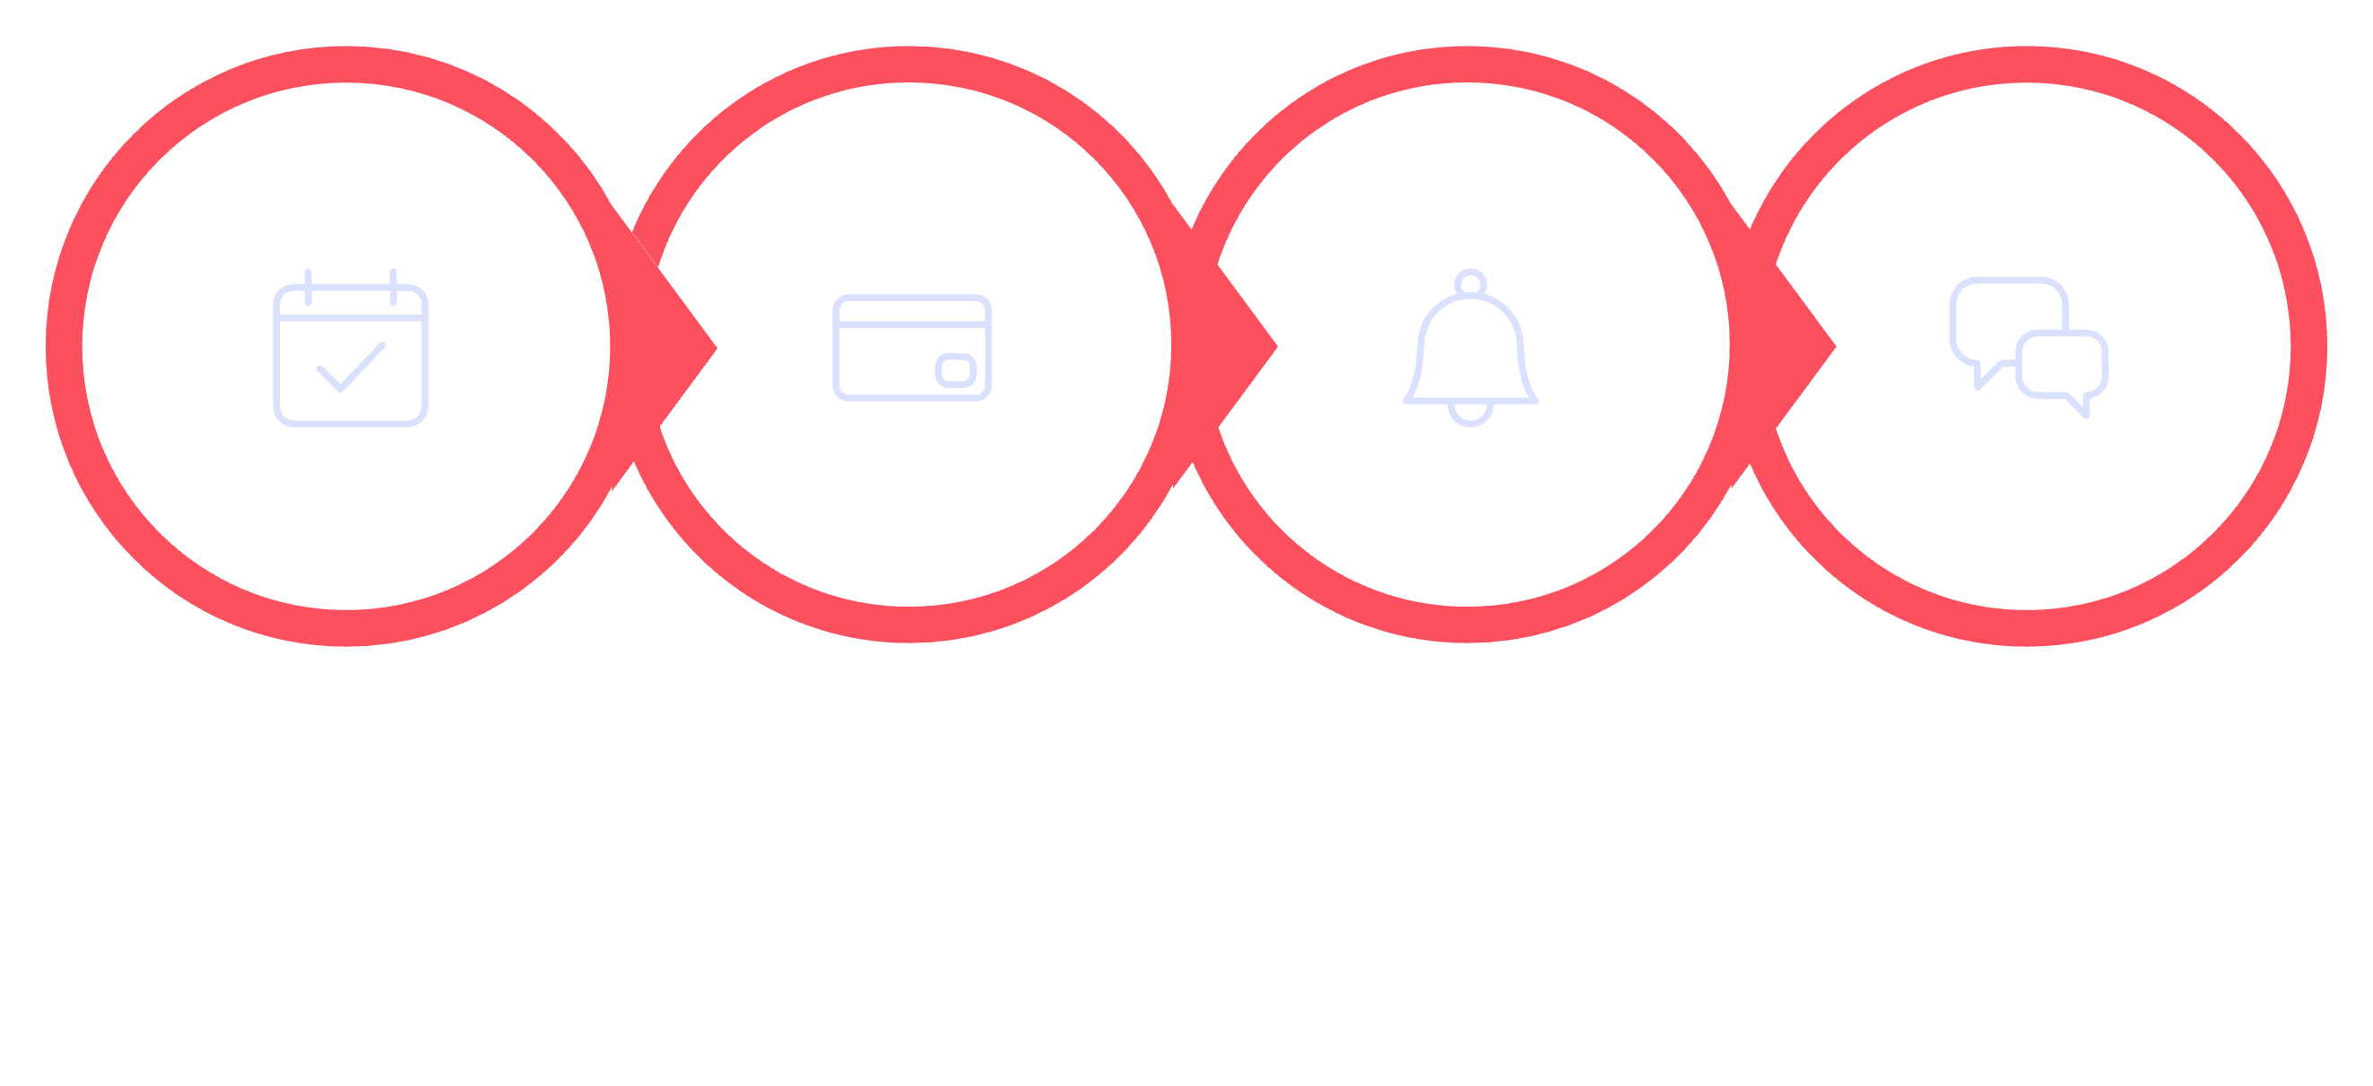
How It Works: A Step-by-Step Walkthrough
Confirm & Charge
Send Reminders
Feedback & Notes
Select Service
From discovery to feedback, the system automates each handoff so staff focus on service — not logistics.

Slide 6
Benefits for Businesses
Operational efficiency
Data-driven decisions
Fewer manual tasks, centralized scheduling, and reduced staff conflict.
Utilization dashboards help optimize hours, staffing, and promotions.
Revenue growth
Higher booking capacity, prepaid deposits, and upsell prompts increase income.

Slide 7



Benefits for Customers
Instant availability — book within seconds
Clear appointment details and reminders
Easy reschedule or cancel from mobile
Choice of payment and contact channels
Flexible times
Live support
Personalized experience

Slide 8
Use Cases: Who Can Benefit?
Healthcare
Salons & Wellness
Manage clinics, telehealth slots, and intake forms with secure patient flows.
Staggered services, multi‑staff bookings, and client preferences remembered.
Professional Services
Education & Training
Consultants, legal, and finance teams streamline appointments and billing.
Schedule classes, office hours, and 1:1 tutoring with capacity controls.

Slide 9

Future Enhancements & Roadmap
Smart suggestions: AI-based slot optimization and pricing recommendations
Advanced integrations: Bi-directional sync with major CRMs and ERPs
Group bookings & resource management for rooms/equipment
Multilingual UI and expanded global payment providers
Q2
1
AI suggestions & improved analytics
2
Q3
Major integrations and group booking
Planned timeline: MVP enhancements in 3 months; integrations and AI features rolled out over the next 9–12 months.
Q4
3
Global payments and language expansion

Slide 10

Q&A and Next Steps: Start Your Journey to Smarter Scheduling
Ready to reduce no‑shows, free staff time, and deliver a modern booking experience? Next steps:
Schedule a demo — see the system with your calendar and rules
Run a 30‑day pilot with dedicated onboarding
Measure: bookings, utilization, and customer satisfaction
Contact our team to book a personalized demo and implementation plan.

