Slide 1

Android Market Analysis
Google Play Store
Data Analysts:
Duy Nguyen | Reshma Hegde | Sneha Kundra | Srinivasa

Slide 2
About Google Play
Google's official store and portal for Android apps, books, magazines, music, games, movies and other contents.
Pre-installed on Android-powered phones, tablets or Android TV devices.

Slide 3
Hypothesis
Our friend “Apu” is a Software Developer.
He intends to develop an app on “Quantum Mechanics and Atomic Physics”. Although unsubstantiated, he believes that educational and gaming apps are widely downloaded and top ranked categories in google world. We decided to help our friend to find some answers.
“Are educational and gaming apps widely downloaded and top ranked categories on Google play store(Android market)?”

Slide 4


Data source
https://www.kaggle.com/lava18/google-play-store-apps
https://github.com/JeroSik/Google-Play-Store-App-Data-Analysis
https://www.schemecolor.com/

Slide 5


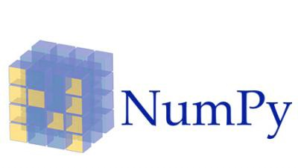
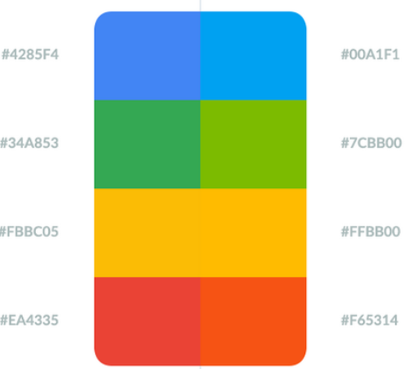
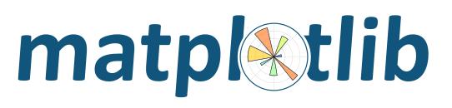
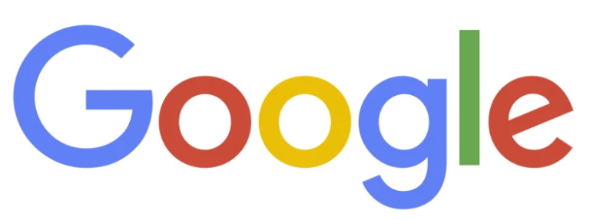
Tools

Slide 6
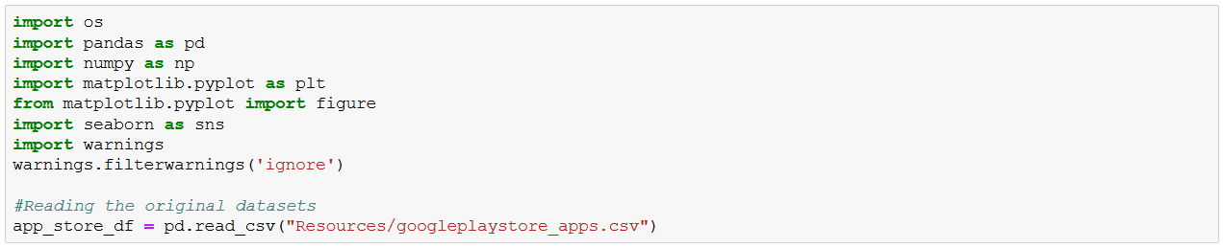
Data source details

Slide 7
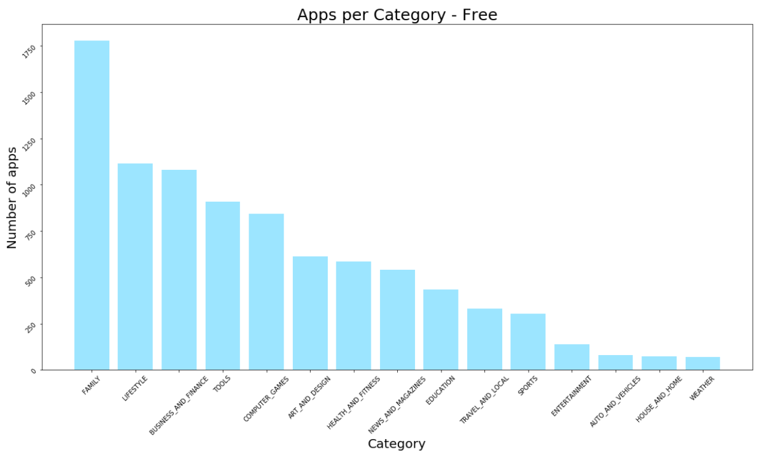
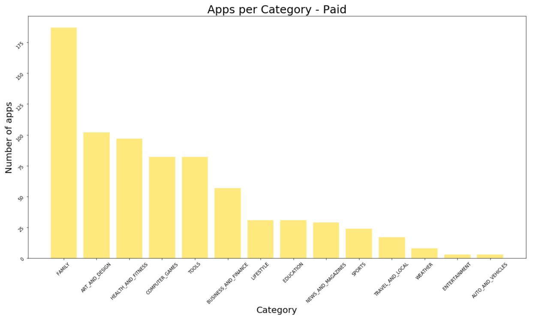
Comparison - By Count
Category Vs Count (Free Apps)
Category Vs Count (Paid Apps)

Slide 8
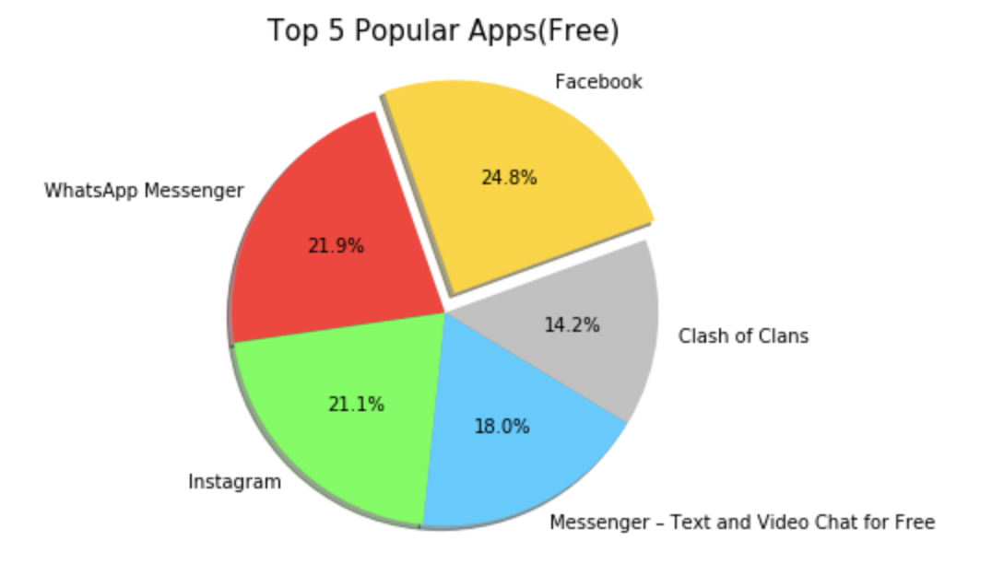
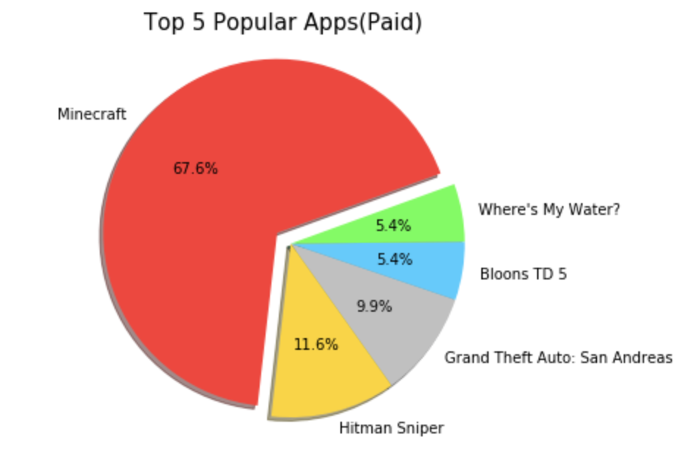
Comparison – By Popularity
% of Top 5 Popular Apps(Free Apps)
% of Top 5 Popular Apps(Paid Apps)

Slide 9
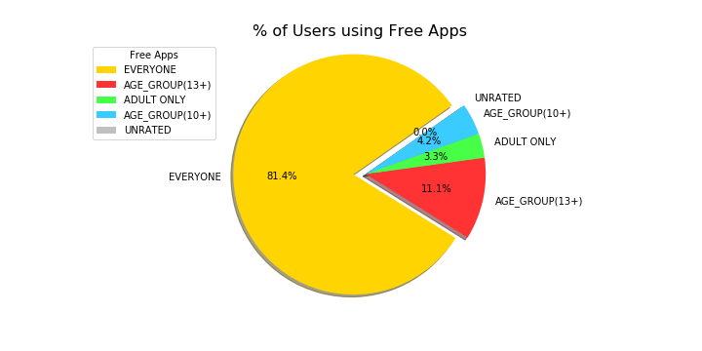
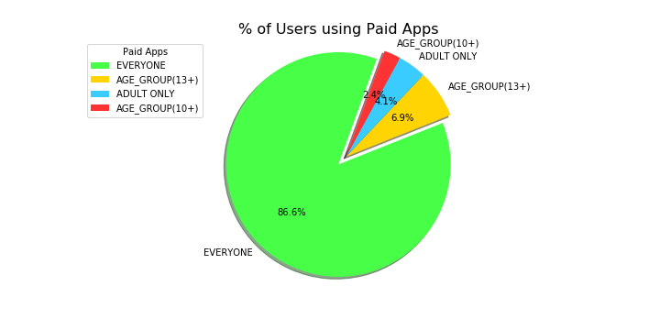
Comparison – By Content Rating
% of Target Group using Free Apps
% of Target Group using Paid Apps

Slide 10
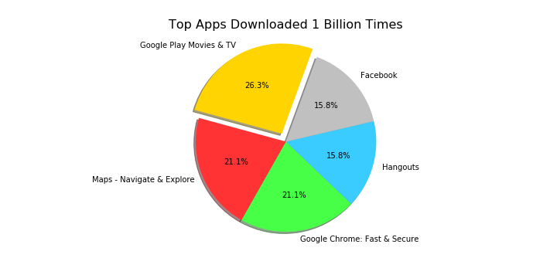
1 Billion Downloads(Top 5)

Slide 11
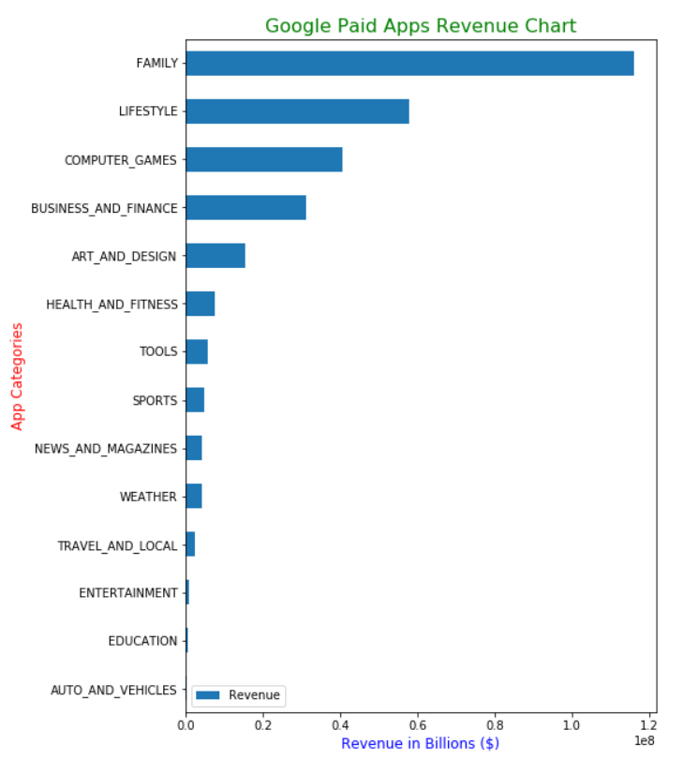
Revenue – By Category Based on purchase counts(Paid Apps only)

Slide 12
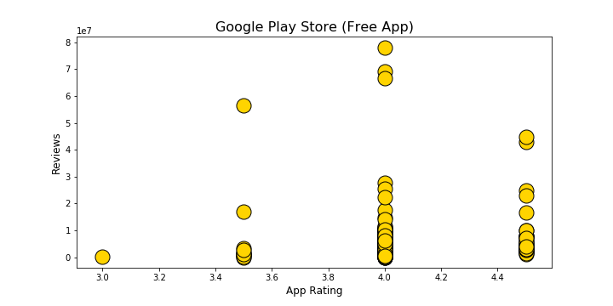
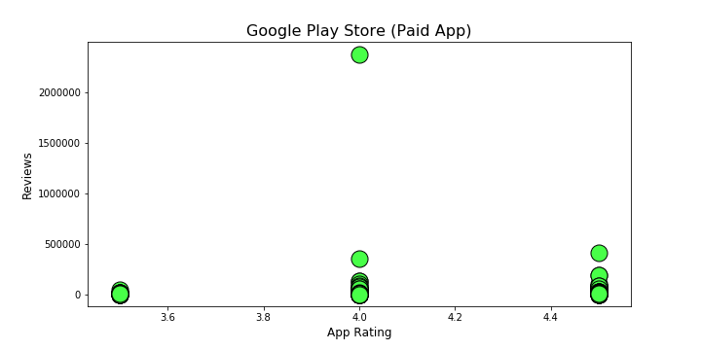
Comparison - Reviews Vs Rating

Slide 13
Assumptions & Limitations
Measurability – The comparisons made may change over time, population, cost for in-app purchases and better versions of an app.
Authenticity – Data like reviews may be biased, meaning we cannot verify who actually wrote it or was it authentic.
Data source – We have to trust that the source of the dataset must be true. Since we did not collect the data, we have no control of what is in the dataset and we are limited to analyze on what is available.
Time limit – Given the time, we tried to derive the most we could. There are many other parameters like Android version, App updated dates, specific genres etc, which can provide more depth to the analysis. There is scope for improving the analysis in future.

Slide 14
Here we go.. Our Jupyter Notebook

Slide 15
Observations and Conclusions
Over 92% of the total apps were Free to download on the Google Play Store, of which Categories "Family" and “Lifestyle” were the most popular and profitable.
While Facebook(24.8%), Whatsapp (21.9%) and Instagram(21.1%) are closely competing as top free apps, Minecraft(67.6%) emerges as single largest paid app.
It can be noticed that significant number of people prefer to purchase the apps which are related to Art and Design and Health and Fitness.
Top downloaded free apps are mainly of Social media and Communication genre.
Top downloaded paid apps mainly belong to Action/Adventure, Strategy and Puzzles genre.
It can be noted that most developers find success when they prefer to limit the complexity of their app to make it available for everyone and publish them mostly under the categories of “Family” and “Lifestyle”.
Ratings are better indicator of app quality than review count. App developers could use ratings as their key performance indicator (KPI) to measure quality and success.
After this analysis, we can arrive at a conclusion that our hypothesis is partially true. App developers mostly find success in the areas pertaining to “Family” and “Lifestyle”. Evidence show that, to a larger extend even gaming applications are also successful. But it is clear to us that “Educational” Apps are still considerably less popular as of now.

Slide 16

Thank you ..

