Slide 1
Git

Slide 2
Common coding scenarios
I’ve Made A Change I Didn’t Mean To Make …
I’ve Made Some Changes, But I Don’t Remember What They Were…
My Computer Crashed And Now I Don’t Have Access To My Code…
We Can’t All Work On The Same File, Can We?
I’m Not Sure What I Accomplished Today…
I Want To Try Something, But I’m Scared I’ll Break Something Else…

Slide 3

Single stop solution to your problems?
VCS
VERSION CONTROL SYSTEM

Slide 4
How does it help?
I’ve Made A Change I Didn’t Mean To Make…
VCS creates versions of your code over time and can revert to an old version of your code and undo changes that have been made.
I’ve Made Some Changes, But I Don’t Remember What They Were…
VCS allows you to easily see the changes you have made since the last time you have committed (saved) your code to the VCS repository.
My Computer Crashed And Now I Don’t Have Access To My Code…
VCS can run on a server, so your changes can be tracked and backed up remotely.

Slide 5
How does it help?
We Can’t All Work On The Same File, Can We?
You can set up a remote Version Control System, where developers can fetch a copy of the code onto their machine and work independently from other developers. Once everyone is done with their work, it is easy to merge all the different versions into a common file that incorporates everyone’s modifications.
I’m Not Sure What I Accomplished Today…
VCS lets you see a log of all your commits (saves) and thus gives a good overview of what you’ve accomplished for a given period of time. This history also allows you to track down changes to specific lines of code, so you can source why a change was made, or how a bug first appeared.

Slide 6
So, what is a version control system?
A version control system (VCS) allows you to track the history of a collection of files.
It supports creating different versions of this collection.
Each version captures a snapshot of the files at a certain point in time and the VCS allows you to switch between these versions.
These versions are stored in a specific place, typically called a repository.

Slide 7
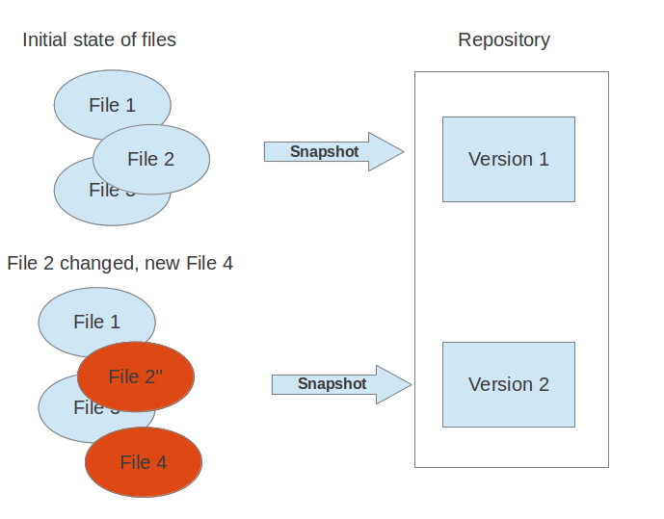

Slide 8
Localized and centralized version control systems
A localized version control system keeps local copies of the files. This approach can be as simple as creating a manual copy of the relevant files.
A centralized version control system provides a server software component which stores and manages the different versions of the files. A developer can copy a certain version from the central sever onto their individual computer.
Both approaches have the drawback that they have one single point of failure. In a localized version control systems it is the individual computer and in a centralized version control systems it is the server machine. Both system makes it also harder to work in parallel on different features.

Slide 9
What is a distributed version control system?
In a distributed version control system each user has a complete local copy of a repository on his individual computer. The user can copy (also called cloning) an existing repository and the resulting repository can be referred to as a clone .
Every clone contains the full history of the collection of files and a cloned repository has the same functionality as the original repository.
Every repository can exchange versions of the files with other repositories by transporting these changes.
This is typically done via a repository running on a server which is, unlike the local machine of a developer, always online.
Typically, there is a central server for keeping a repository but each cloned repository is a full copy of this repository. The decision which of the copies is considered to be the central server repository is pure convention.

Slide 10
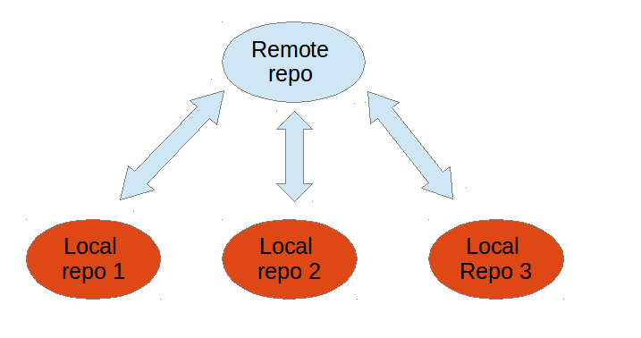
Distributed version control system

Slide 11
What is Git?
Git is a popular implementation of a distributed version control system.
Git originates from the Linux kernel development and was founded in 2005 by Linus Torvalds.
Nowadays it is used by many popular open source projects, e.g., the Android or the Eclipse developer teams, as well as many commercial organizations.
The core of Git was originally written in the programming language C , but Git has also been re-implemented in other languages, e.g., Java, Ruby and Python.

Slide 12
Git repositories
A Git repository contains the history of a collection of files starting from a certain directory.
The process of copying an existing Git repository via the Git tooling is called cloning.
After cloning a repository the user has the complete repository with its history on his local machine.
Of course, Git also supports the creation of new repositories.
If you want to delete a Git repository, you can simply delete the folder which contains the repository.

Slide 13
Types of Repositories
Bare repositories
Supposed to be used on a server for sharing changes coming from different developers.
Such repositories do not allow the user to modify locally files and to create new versions for the repository based on these modifications.
Non-bare repositories
Target the user and allows user to create new changes through modification of files and to create new versions in the repository.
This is the default type which is created if you do not specify any parameter during the clone operation.

Slide 14
Working tree
A file in the working tree of a Git repository can have different states. These states are the following:
untracked: the file is not tracked by the Git repository. This means that the file never staged nor committed.
tracked: committed and not staged
staged: staged to be included in the next commit
dirty / modified: the file has changed but the change is not staged
committed: change done in local copy pushed to the main git repository
After doing changes in the working tree, the user can add these changes to the Git repository or revert these changes.
Notes:
A local repository provides at least one collection of files which originate from a certain version of the repository. This collection of files is called the working tree.

Slide 15
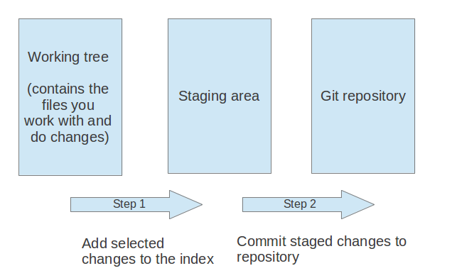
Adding to a Git repository

Slide 16
Adding to a Git repository
The git add command stores a snapshot of the specified files in the staging area. It allows you to incrementally modify files, stage them, modify and stage them again until you are satisfied with your changes.
After adding the selected files to the staging area, you can commit these files to add them permanently to the Git repository. Committing creates a new persistent snapshot (called commit or commit object) of the staging area in the Git repository.

Slide 17
Let’s get started
Create a new folder.
Go to the folder from command prompt and type the following
$ git init
Clone the repository
$ git clone /full path to folder
Now let’s add a folder to it. First place the folder inside the repository. Then type
$ git add /path to folder
$ git add *

Slide 18
Now we have to commit the changes. But before we do that we have to add a few details
$ git config user.name "reshma“
$ git config user.email reshma@gmail.com
Now we are ready to commit using the following command
$ git commit -m “add some comment here“
For remote login we have to ‘push’ the changes to the original repository using the following command
$ git remote add origin /path to your original git folder
$ git push origin master

Slide 19
You can see the changes done using the following command
$ git log
In case of multiple repositories changes made to a single repository can be seen using the following command
$ git log --author=reshma
To see summary of changes
$ git log --pretty=oneline
Now, go to the folder and change any file.
Once done save and type the following in the command prompt
$ git diff

Slide 20
To add the changes to the repository the steps to be followed are same as the steps followed while adding a folder
$ git add folder/file [path to file]
$ git add * //optional
$ git commit -m “comment“
$ git push origin master //for remote
Now suppose you have made a change but do not want to commit it. Instead, you want to revert it to it’s previous state.
First, after you make the changes, check the changes using the git diff command explained before.
To revert the change type the following
$ git checkout /path to file
Re- check with the git diff command.

Slide 21
BRANCHING
I Want To Try Something, But I’m Scared I’ll Break Something Else…
VCS branching allows you to create a “master branch”, which usually coincides with the code that is in production. Different versions of the code, named branches, shoot off this master branch for every change in functionality you want to implement.
It is a great way to isolate changes to your code and allows for easy reversing of problematic code.
The master branch continues to evolve independently of whichever branch you are working on.
When you are done with your changes, you can merge your branch back into the “master branch”, which will apply both the changes in your branch and the changes that have occurred on the “master branch” in the meantime.

Slide 22
Branches
Git supports branching which means that you can work on different versions of your collection of files. A branch allows the user to switch between these versions so that he can work on different changes independently from each other.
For example, if you want to develop a new feature, you can create a branch and make the changes in this branch. This does not affect the state of your files in other branches. For example, you can work independently on a branch called production for bug fixes and on another branch called feature_123 for implementing a new feature.
Branches in Git are local to the repository. A branch created in a local repository does not need to have a counterpart in a remote repository.
Git supports the combination of changes from different branches.

Slide 23
Branch
Lets now create a new branch
$ git checkout -b newbranch
Make changes to a file and do
$git diff
To add the changes to the parent repository
$ git add folder/file [path to file]
$ git add * //optional
$ git commit -m “comment"
To merge the changes of a branch with original repository first traverse back to the original repository
$ git checkout master
At this point if you open the file you will not see the changes made in branch.
Now merge the changes in branch with master
$ git merge newbranch
If the branch is no longer needed then delete the branch
$ git branch -d newbranch

Slide 24


