Slide 1

ROAD ACCIDENT PREDICTION USING MACHINE LEARNING
SESHADRI RAO GUDLAVALLERU ENGINEERING COLLEGE
(An Autonomous Institute with Permanent Affiliation to JNTUK, Kakinada)
Department of Electronics and Communication Engineering
UNDER THE GUIDANCE OF : PRESENTED BY : Batch – D14
Ms. RAMYA P V. RESHMA PRIYA - 20481A04O2
(Assistant Professor) SK. BB AYESHA - 20481A04K9
V. VENKATA VAMSI - 20481A04O1

Slide 2
OBJECTIVE:
Utilize machine learning to predict the risk of road accidents based on various factors such as weather conditions, traffic patterns, and historical accident data.
To carry out the SVM, K-NN, Random Forest, Decision Tree, Naïve Bayes algorithms to predict the performance and accuracy of each.
To conclude the fastest algorithm.
To understand the effect of each feature on the accident and conclude how much is it responsible for the accident.

Slide 3
ABSTRACT:
Due to the exponentially increasing number of vehicles on the road, the number of accidents occurring on a daily basis is also increasing at an alarming rate. With the high number of traffic accidents and deaths these days, the ability to forecast the number of traffic accidents over a given time is important for the transportation department to make scientific decisions. In this scenario, it will be good to analyze the occurrence of accidents so that this can be further used to help us in coming up with techniques to reduce them. Even though uncertainty is a characteristic trait of majority of the accidents, over a period of time, there is a level of regularity that is perceived on observing the accidents occurring in a particular area. This regularity can be made use of making well informed predictions on accident occurrences in an area and developing accident prediction models. We will analyze the inter relationships between road accidents, condition of a road and the role of environmental factors in the occurrence of an accident. We will make use of machine learning techniques in developing an accident prediction model using K-NN Algorithm, Support Vector Machines, Random Forest Algorithm, Naive Bayes Algorithm, Decision Tree Algorithm.

Slide 4
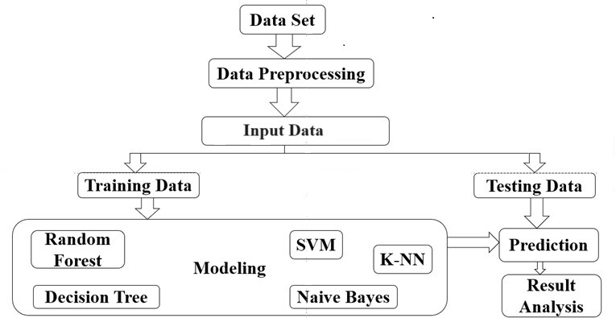
FLOW CHART:

Slide 5
PROCEDURE:
Consider a dataset.
Apply pre-processing on the dataset.
Split the dataset into train and test.
Apply machine learning algorithms to train data.
Save the machine learning model using pickle.
Use the saved model to make predictions.

Slide 6
SOFTWARE TOOLS REQUIRED :
Operating System: Windows 11
Programming Language: Python , HTML
IDE : Python 3.6.7, Jupyter

Slide 7
IMPLEMENTATION:
A machine learning model is implemented by using algorithms (KNN, SVM, Naïve Bayes, Decision Tree, Random Forest) to predict the accident probability.
A Web page is created by using HTML to predict the probability of accidents based on input parameters. It loads a pre-trained machine learning model from a file.
This model takes in various factors like vehicle type, weather conditions, road types etc., to predict the probability of an accident.
Factors such as vehicle type, road type, light conditions, and weather conditions collectively contribute to safer driving conditions, minimizing the risk of accidents.

Slide 8
ACCURACY OF PROPOSED ALGORITHMS:
Algorithm | Accuracy | Precision | f1-score | Recall
Random Forest | 0.85 | 0.76 | 0.78 | 0.85
Decision Tree | 0.84 | 0.75 | 0.78 | 0.84
SVM | 0.85 | 0.72 | 0.78 | 0.85
KNN | 0.84 | 0.74 | 0.78 | 0.84
Naive Bayes | 0.84 | 0.72 | 0.78 | 0.84

Slide 9
We have chosen the Random Forest Algorithm for our model, which has the highest accuracy (85%).
Input taken from the user is sent to the backend flask server which feeds the parameters to the ML model and returns the result.

Slide 10
Vehicle Types:
Automobile – 0
Lorry(41?100Q) – 5
Other – 7
Pick up upto 10Q – 8
Public(12 Seats) – 9
Stationwages – 14
Lorry(11?40Q) – 4
Public(13?45 Seats) – 10
Public(>45 Seats) – 11
Long Lorry – 3
Taxi – 15
Motorcycle – 6
Special Vehicle – 13
Ridden Horse – 12
Turbo – 16
Bajaj – 1
Bicycle - 2
Road Types:
Asphalt Roads – 0
Earth Roads – 2
Gravel Roads – 3
Other – 4
Asphalt Roads with some distress - 1
Weather Conditions:
Normal – 2
Raining – 4
Other – 3
Unknown – 7
Cloudy – 0
Windy – 8
Snow – 6
Raining & Windy – 5
Fog or Mist – 1
Light Conditions:
Daylight – 1
Darkness – 0

Slide 11
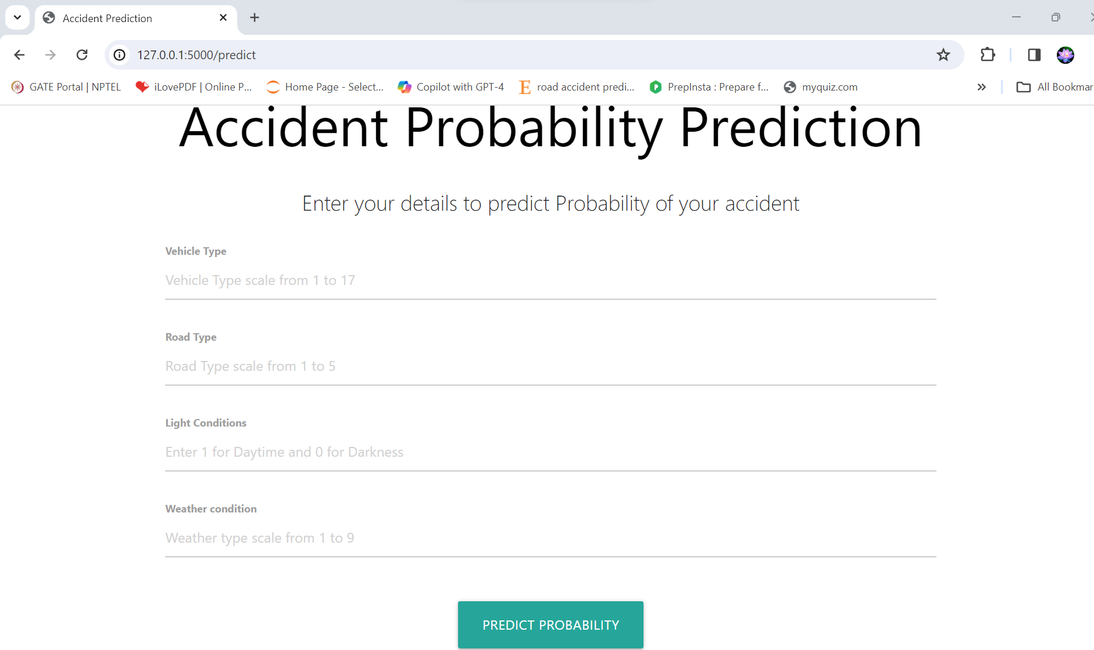

Slide 12
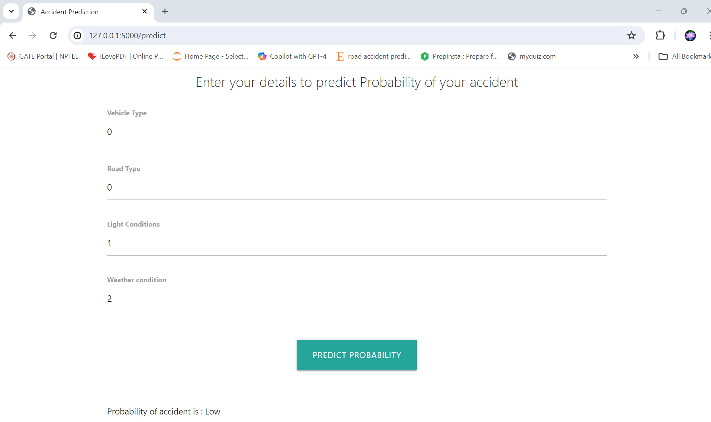

Slide 13
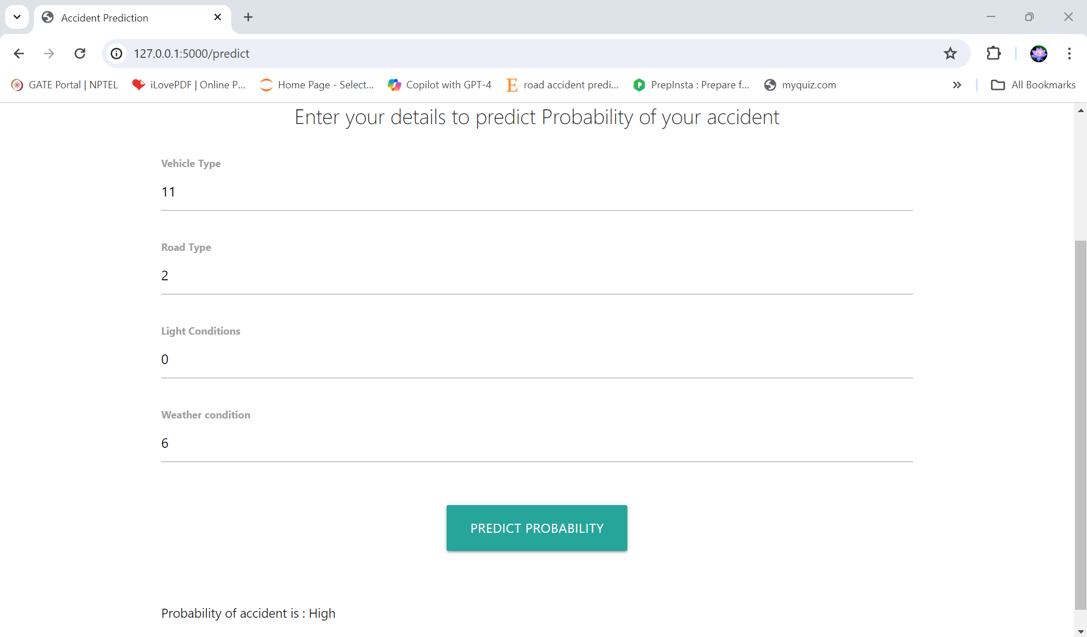

Slide 14
OBSERVATIONS:
The observation of our project aligns with the broader understanding that road accidents tend to occur more frequently under adverse conditions, encompassing factors such as darkness, snow, and the presence of less-maintained earth roads. These conditions pose increased challenges to drivers, reducing visibility and traction, thereby elevating the risk of accidents. Furthermore, our analysis highlights a notable correlation between the likelihood of accidents and the involvement of larger public vehicles, which often require longer stopping distances and may have limited maneuverability in challenging road conditions. Conversely, favorable conditions such as daylight, normal weather, and well-maintained asphalt roads are associated with a decreased probability of accidents, particularly for smaller and more agile automobiles. Such environments offer improved visibility, better road grip, and enhanced control for drivers. These findings underscore the critical role that environmental and infrastructural factors play in shaping road safety outcomes.

Slide 15
CONCLUSION:
Road accidents have a profound impact on individuals and communities, highlighting the importance of proactive measures to reduce their occurrence. While it is each individual's responsibility to adopt safe driving practices, the role of road development authorities and automobile industries in creating safer infrastructure and vehicles cannot be understated. However, addressing the multifaceted nature of accidents requires a comprehensive approach that includes predictive modeling based on historical data and regulatory compliance. Our project successfully developed an application capable of efficiently predicting road accidents by leveraging machine learning algorithms. By analyzing factors such as vehicle types, light and weather conditions, and road types, our model can assess the risk probability of accidents in different areas with a high degree of accuracy.

Slide 16
REFERENCES:
Chen ZY, Chen CC. (2015). Identifying the stances of topic persons using a model-based expectationmaximization method. J. Inf. Sci. Eng 31(2): 573-595.http://dx.doi.org/10.1504/IJASM.2015.068609.
Williams T, Betak J, Findley B. (2016). Text mining analysis of railroad accident investigation reports. In 2016 Joint Rail Conference. American Society of Mechanical Engineers V001T06A009 V001T06A009. http://dx.doi.org/10.14299/ijser.2013.01.
Sarkar S, Pateshwari V, Maiti J. (2017). Predictive model for incident occurrences in steel plant in India. In ICCCNT 2017, IEEE, pp. 1-5. http://dx.doi.org/10.14299/ijser.2013.01.
Zheng CT, Liu C, Wong HS. (2018). Corpus based topic diffusion for short clustering. Neurocomputing http://dx.doi.org/10.1504/IJIT.2018.090859.
Tessa KA. Kernel density estimation and K-means clustering to profile road accident hotspots. Elsevier. Accident Analysis and Prevention. 2009; 41:359–364.

Slide 17
A. Briz-Redon, F. Martinez-Ruiz, and F. Montes. Estimating the occurrence of traffic accidents near school locations: A case study from Valencia (Spain) including several approaches. Elsevier. Accident Analysis & Prevention. 2019;132.
De Ona. J, Lopez. G, Mujalli. R, Calvo.F. J. Analysis of traffic accidents on rural highways using latent class clustering and bayesian networks. Elsevier. Accident Analysis and Prevention. 2013;51:1-10.
Mahendra G, Dayananda R B. Vehicle rash drive control system. International Journal for Research in Engineering Application and Management. 2018;04(03):676-681.
Jamal Raiyn, Tomer Toledo. Real-time road traffic anomaly detection. Journal of Transportation Technologies. 2014; 4(3):256-266.
X. Gao, J. Wen, C Zhang. An improved random forest algorithm for predicting employee turnover. Hindawi. 2019; 4140707:12 p.
World Health Organization. Road Traffic Injuries. Available online: https://www.who.int/news-room/fact-sheets/detail/road traffic-injuries (accessed on 20 June 2021).

Slide 18
THANK YOU

