Slide 1
Project
-Reshma r & Sathyamurthy r

Slide 2

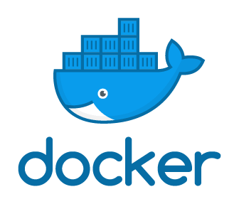


Existing Code
Install Docker
Build a docker image
Monitoring through datadog
Infrastructure monitoring
Container Monitoring
Process monitoring
Scaling using Docker Compose
Push to Docker Hub

Slide 3
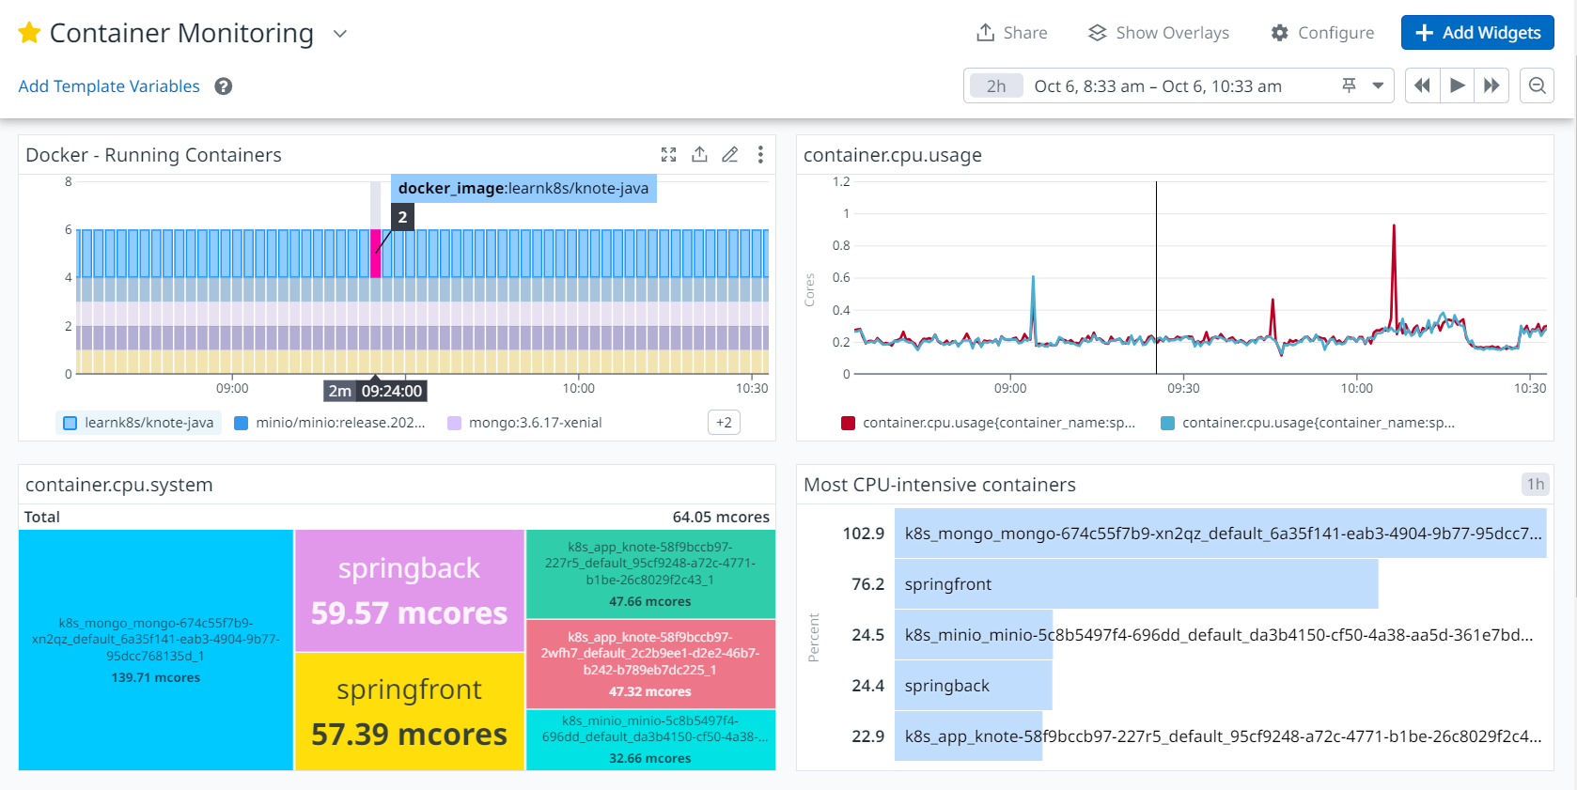

Slide 4
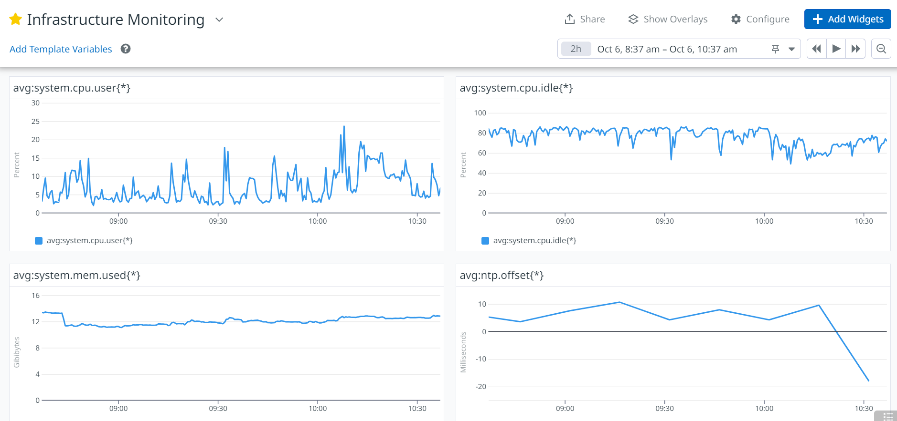

Slide 5
Thank you

