Slide 1
Gradle

Slide 2
Contents
what is build tool?
what is gradle?
why gradle as build tool?
installation using sdkman
Simple gradle commands
importing gradle in idea project
gradle window to see tasks
writing simple tasks
Dependency between tasks
applying plugins
Dependency
Gradle wrapper
Buildscript

Slide 3
What is a build tool?
Anything that is needed to get a piece of software setup but is not needed after that.
But depending on your project complexity, you may need to compile, copy files somewhere, pull some code from a Git repository, replace some text in a file, etc.
The build tool could handle all these things automatically once you set it up.

Slide 4
What is Gradle ?
A general purpose build automation tool. It can automate-
Building
Testing
Deployment
Publishing
Generate static websites
Generate documentation
Indeed anything else
Designed to take advantage of convention over configuration
Combines the power and flexibility of Ant with the dependency management and conventions of Maven into a more effective way to automate build.

Slide 5
Why Gradle as build tool?
Powerful and expressive Groovy DSL instead of XML.
Adaptable to nonconventional project structures.
Works well for java as well as non java projects.
Extensible (plugins!).
Multi project builds are hassle free.
Powerful dependency management.
Reduced start up cost using Gradle daemon.
Caching of task input output.
Introduced to Android with Android Studio.
Grails 3.0 build system is updated to use Gradle.

Slide 6
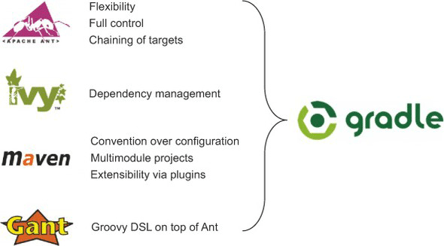
Combines best features from other build tools

Slide 7
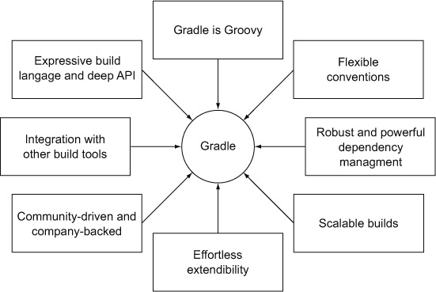
Features of Gradle

Slide 8
Installation (using sdkman)
Install sdkman from following link if not already done: https://sdkman.io/install
To list available versions of gradle: sdk list gradle
Install selected version: sdk install gradle 4.5.1 or Install latest version by simply using: sdk install gradle

Slide 9
Simple Gradle Commands
gradle -v : shows the current installed version of gradle
gradle init: initializes the gradle project.
gradle tasks : You can list all the tasks which belong to the multiple projects by using this.
gradle tasks --all : You can use the following command to display the information of all tasks.
gradle myTask: executes the user defined task myTask.

Slide 10
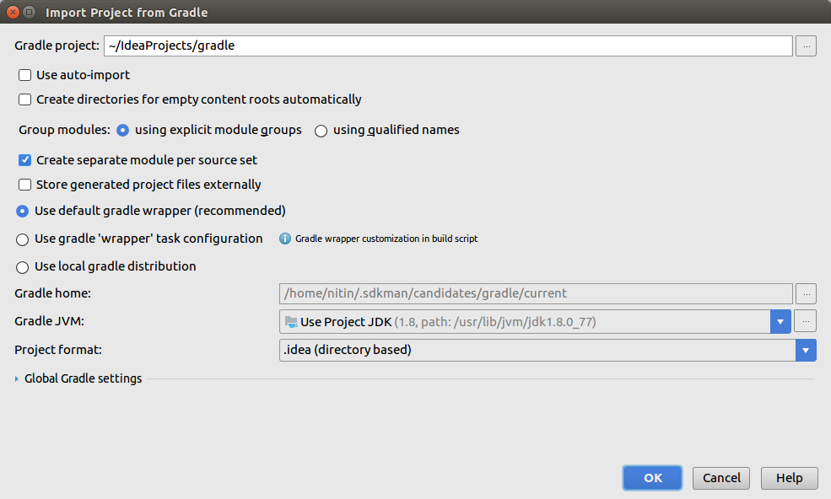
Importing a project in Idea

Slide 11
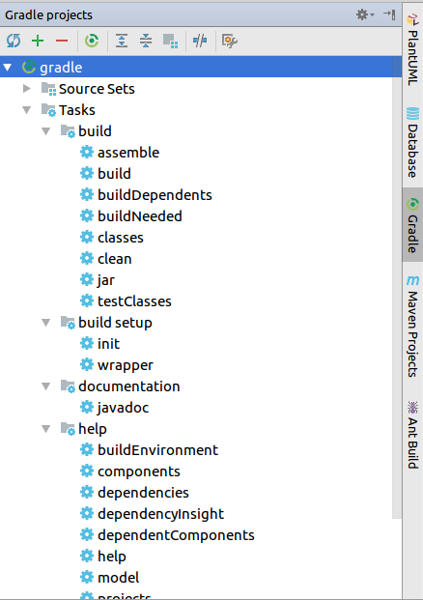
Gradle window to see tasks

Slide 12
Gradle Tasks
Each project is made up of one or more tasks.
A task is an atomic piece of work which a build performs.
The task might be compiling some classes, storing class files into separate target folder, creating JAR, generating Javadoc, or publishing some archives to repositories
Task is a keyword which is used to define a task into build script.

Slide 13
Gradle Tasks
Defines task 'hello' with groovy closure.
task hello << {
println "Hello !!!!"
}
task greet <<{
println "Welcome Mr. X"
}
task intro(dependsOn: hello) << {
println "I'm Gradle"
}
hello << { println "Hello extended!!!!" }
greet.dependsOn hello, intro
// gradle tasks :list all the available tasks
// gradle intro :executes intro task
// gradle -q greet :bare build output
// gradle --daemon hello :subsequent execution will be fast
Defines task 'intro' which
depends on 'hello' task
appends additional groovy closure to be
executed to existing 'hello' task
gradle tasks are groovy objects. You can
change dependency of existing tasks

Slide 14
Dependency between tasks
A task can be made dependent on another task, meaning that when one task is done only then the other task would execute.
Adds dependency from taskX to taskY
task taskX << { println 'taskX' } task taskY(dependsOn: 'taskX') << { println "taskY" }
task taskX << { println 'taskX' } taskX.dependsOn { tasks.findAll { task → task.name.startsWith('lib') } } task lib1 << { println 'lib1' } task lib2 << { println 'lib2' } task notALib << { println 'notALib' }
task taskY << { println 'taskY' } task taskX << { println 'taskX' } taskY.dependsOn taskX

Slide 15
Plugins
A plugin is nothing but a set of tasks, almost all useful tasks such as compiling tasks, setting domain objects, setting up source files, etc. are handled by plugins. Applying a plugin to a project, allows the plugin to extend the project’s capabilities.
Gradle core intentionally provides very little for automation.
All of the useful features are added by plugins. e.g. java compile.
Gradle plugins
add new tasks (e.g. JavaCompile)
add domain objects (e.g. SourceSet)
add conventions (e.g. Java source is located at src/main/java)
extends core objects and objects from other plugins
Plugin portal : http://plugins.gradle.org/

Slide 16
Applying Plugins
Script plugins
//from a script on the local filesystem or at a remote location.
apply from: 'other.gradle'
Binary plugins
// applying a binary plugin by type
apply plugin: 'java'
Using plugins DSL
//version is optional
plugins {
id "com.jfrog.bintray" version "0.4.1"
}
NOTE: The application of plugins is idempotent. That is, a plugin can be applied multiple times. If the plugin has previously been applied, any further applications will have no effect.

Slide 17
Using Java Plugin
New/modified tasks
clean, compileJava, classes, jar, uploadArchives, build etc.
Default project layout
src/main/java
src/main/resources
src/test/java
Dependency configurations
compile, runtime, testCompile, archives etc.
Convention properties
sourceSets, sourceCompatibility, archivesBaseName etc.

Slide 18
Changing project layout for Java Plugin
apply plugin: 'java'
sourceSets {
main {
java {
srcDirs = ['source/main/java']
}
}
test {
java {
srcDirs = ['source/test/java']
}
}
|-- build.gradle
|-- settings.gradle
`-- source
`-- main
`-- java
`-- com
`-- intelligrape
`-- gradle
`-- Application.java
package com.intelligrape.gradle.demo;
public class Application {
public static void main(String[] args) {
System.out.println("Hello Gradle!!!");
}
}

Slide 19
A Task to execute java class
apply plugin: 'java'
task runMe(type: JavaExec, dependsOn: 'classes') {
main = "com.intelligrape.gradle.demo.Application"
classpath = sourceSets.main.runtimeClasspath
}
Execute java class using 'runMe' task
$ gradle -q runMe
Hello Gradle!!!
Or execute using java command
$ gradle -q build
$java -cp build/classes/main com.intelligrape.gradle.demo.Application
Hello Gradle!!!

Slide 20
Dependency
Dependencies means the things that support to build your project such as required JAR file from other projects and external JARs like JDBC JAR or Eh-cache JAR in the class path.
Almost all the projects are not self-contained. They need files build by other projects to compile and test the source files.

Slide 21
Dependency
Dependency configuration is nothing but defines a set of dependencies. You can use this feature to declare external dependencies, which you want to download from the web. This defines the following different standard configurations.
Compile − The dependencies required to compile the production source of the project.
Runtime − The dependencies required by the production classes at runtime. By default, also includes the compile time dependencies.
Test Compile − The dependencies required to compile the test source of the project. By default, it includes compiled production classes and the compile time dependencies.
Test Runtime − The dependencies required to run the tests. By default, it includes runtime and test compile dependencies.

Slide 22
Dependency Management
apply plugin: 'java'
repositories {
//mavenLocal()
mavenCentral()
//maven { url "http://repo.mycompany.com/maven2"}
//flatDir { dirs 'lib1', 'lib2'}
}
dependencies {
compile "org.quartz-scheduler:quartz:2.1.5"
testCompile group: 'junit', name: 'junit', version: '4.11'
compile project(':shared') //project dependency
runtime files('libs/a.jar', 'libs/b.jar') //file dependency
}

Slide 23
Gradle Wrapper
The Gradle Wrapper consists of a few files in your project directory:
gradlew: The shell script Unix users can run to execute Gradle tasks
gradlew.bat : The bat script Windows users can run to execute Gradle tasks
gradle/wrapper/gradle-wrapper.jar The wrapper’s executable JAR; this is where the wrapper code resides
gradle/wrapper/gradle-wrapper.properties A properties file for configuring the wrapper
You should make sure all these are committed to version control. They are all small, system-independent, and critical to using the Gradle Wrapper.
Using the wrapper guarantees that every developer on your team is using the same version of Gradle and that they can run Gradle builds (even if they haven’t installed Gradle on their machine).

Slide 24
Gradle Wrapper
What the Gradle Wrapper does?
When you run the Gradle Wrapper it performs the following actions:
Parse the arguments passed to gradlew
Install the correct Gradle version
Invoke Gradle to run the specified tasks
Note: The Gradle Wrapper itself does not execute your tasks. All it does is ensure you have the desired Gradle distribution and then invoke it. The wrapper is a very thin layer to eliminate the need for devlelopers to manage distributions themselves.

Slide 25
BuildScript
build.gradle file in project root directory.
Its actually a groovy script.
This is where you define gradle tasks.
Every Gradle build is made up of one or more projects.

Slide 26
References
Book:
Gradle in Action by BENJAMIN MUSCHKO
Links:
https://medium.com/@bherbst/understanding-the-gradle-wrapper-a62f35662ab7
http://www.gradle.org/docs/current/userguide/userguide_single.html
http://www.gradle.org/docs/current/userguide/java_plugin.html

