Slide 1



Spring Security

Slide 2

Spring Security
a framework that focuses on providing both authentication and authorization to Java and Groovy applications
It makes it easy to use data access technologies, relational and non-relational databases, map-reduce frameworks, and cloud-based data services.

Slide 3
Spring Security
at an authentication level, Spring Security supports a wide range of authentication models, its own set of authentication features, and integration with technologies
Kerberos
JAAS
HTTP BASIC
SAML
LDAP
JOSSO
HTTP Digest
Federated
Providers
OpenID
AppFuse
HTTP X.509
Form Authentication

Slide 4
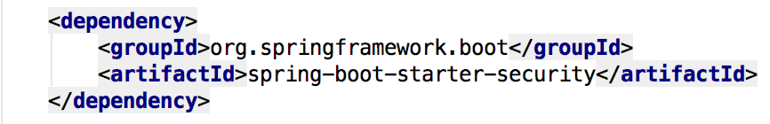
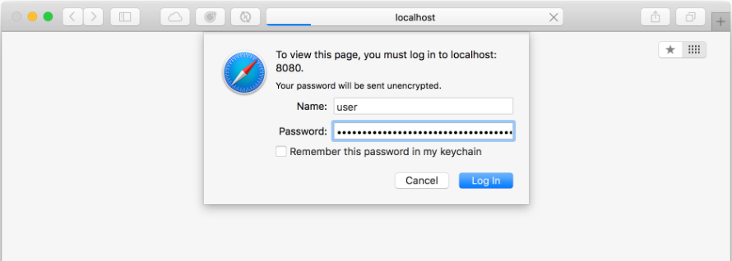
Spring Data JPA
Add the Spring Security starter to our pom.xml file
Generate password for two-factor authentication

Slide 5
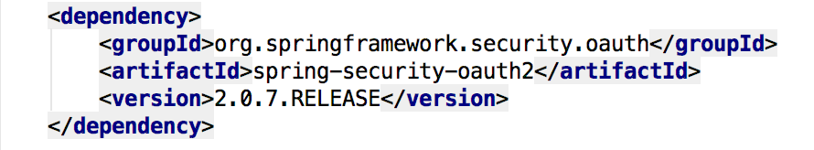
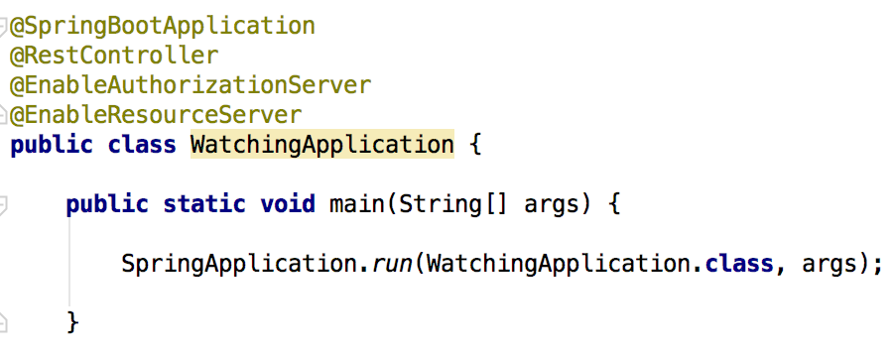
OAuth
OAuth provides support for using Spring Security with OAuth (1a) and OAuth2 using standard Spring and Spring Security programming models and configuration idioms
Add a dash of Spring OAuth into our pom.xml
Sprinkle in some annotations
@EnableAuthorizationServer
@EnableResourceServer
Notes:
Provide radically faster and widely accessible “getting started” experience for all Spring development
Opinionated out of the box, but get out of the way as quickly as possible
Provide a range of non-functional features (embedded servers, metrics, health checks, externalized config)

Slide 6
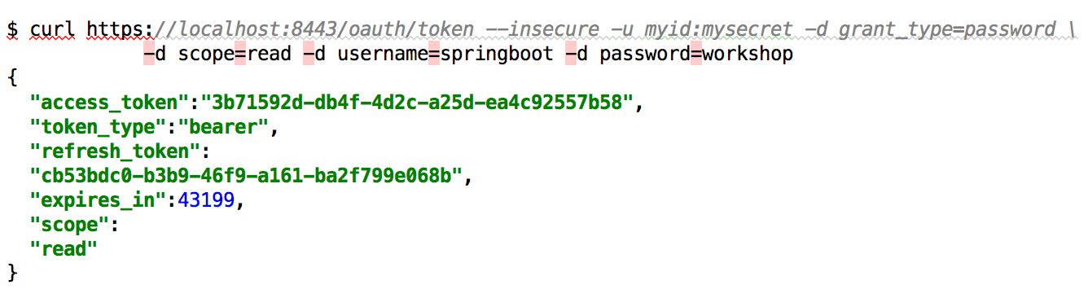
OAuth Bearer Token
We can use generate
clientId and secrets
Notes:
Provide radically faster and widely accessible “getting started” experience for all Spring development
Opinionated out of the box, but get out of the way as quickly as possible
Provide a range of non-functional features (embedded servers, metrics, health checks, externalized config)

Slide 7
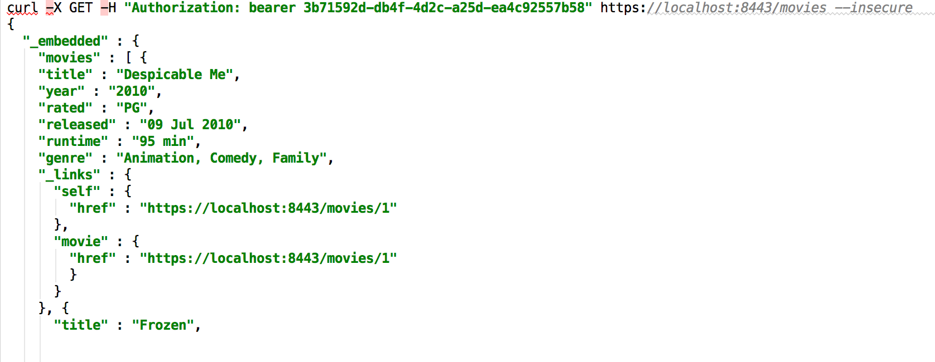
OAuth Bearer Token
Notes:
Provide radically faster and widely accessible “getting started” experience for all Spring development
Opinionated out of the box, but get out of the way as quickly as possible
Provide a range of non-functional features (embedded servers, metrics, health checks, externalized config)

Slide 8

Lab

