Slide 1

Bluestock Mutual Fund Analytics: Performance, Risk Analysis and Business Intelligence Dashboard
Submitted By: Reshma J
Technology: Python, SQL, Power BI
Capstone Project
Submission Date 15th June 2026

Slide 2

Problem Statement & Objectives
Problem Statement
Investors face challenges in evaluating mutual fund performance.
Large amounts of financial data make decision-making difficult.
Need for a centralized analytics and visualization solution.
Objectives
Build ETL pipeline.
Analyze mutual fund performance.
Calculate risk metrics.
Develop Power BI dashboard.
Generate actionable insights.

Slide 3
Data Sources
Dataset | Description
Fund Master | Fund details
NAV History | Historical NAV
AUM Data | Assets Under Management
SIP Inflows | Monthly SIP data
Transactions | Investor activity
Portfolio Holdings | Fund holdings
Benchmark Data | Market indices

Slide 4
ETL Pipeline Architecture
CSV Files
↓
Extract
↓
Data Cleaning
↓
Transformation
↓
SQLite Database
↓
Python Analytics
↓
Power BI Dashboard

Slide 5
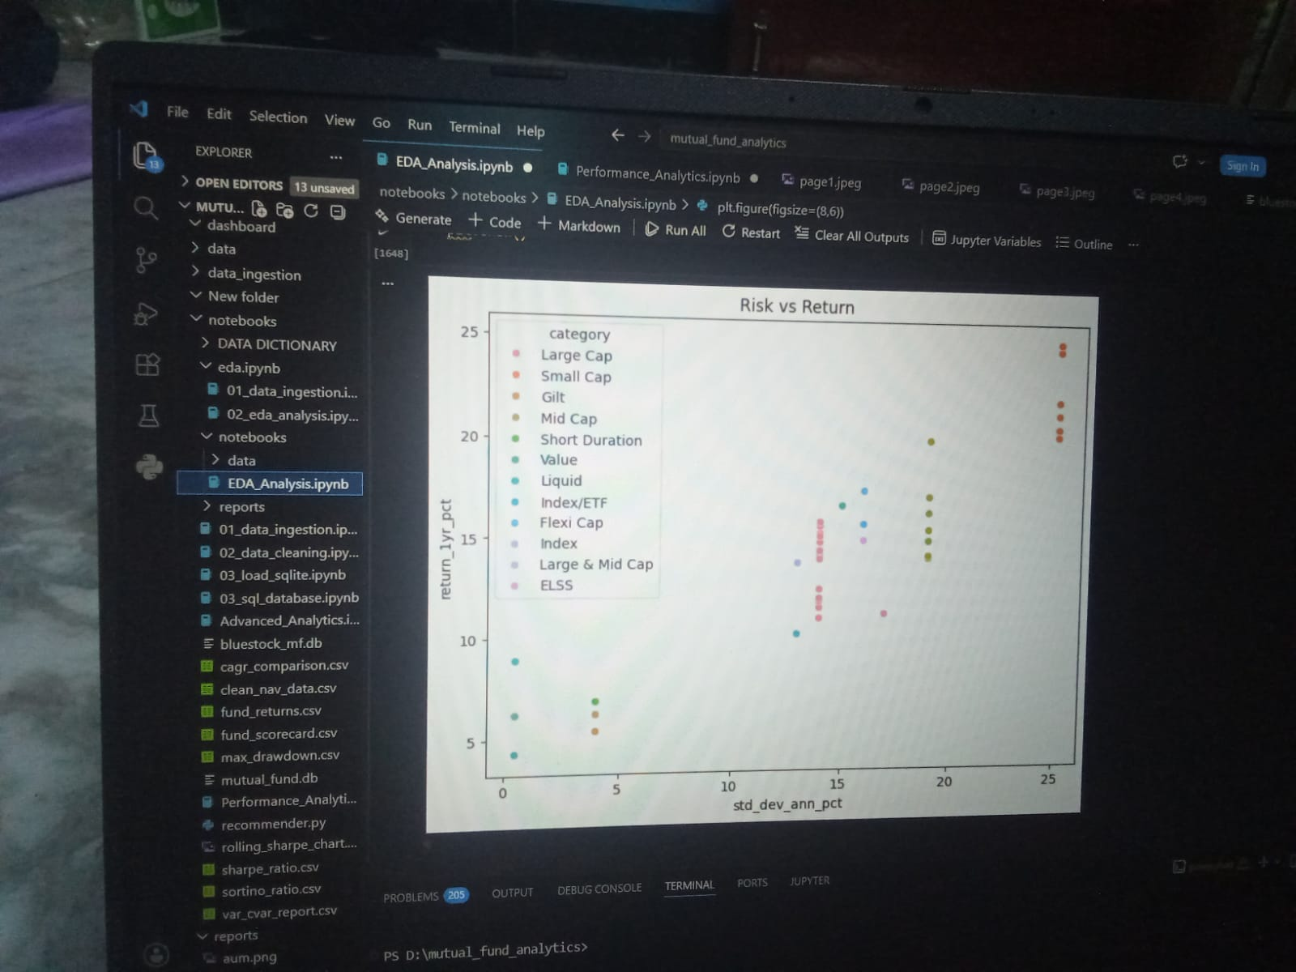
EDA Highlights – 1
Higher risk generated higher returns.
Small-cap funds exhibited greater volatility.
Debt funds showed lower risk.

Slide 6
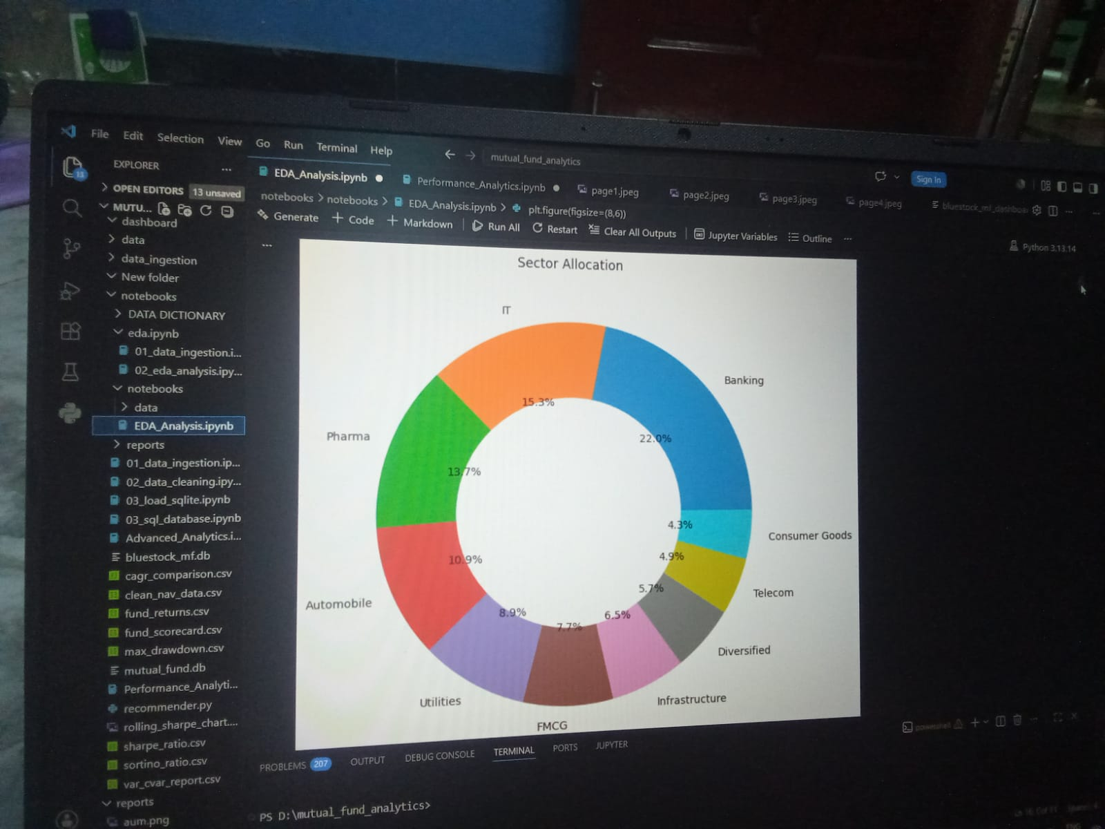
EDA Highlights – 2
Banking sector dominated allocations.
SIP inflows increased steadily.
Investor participation grew significantly.

Slide 7
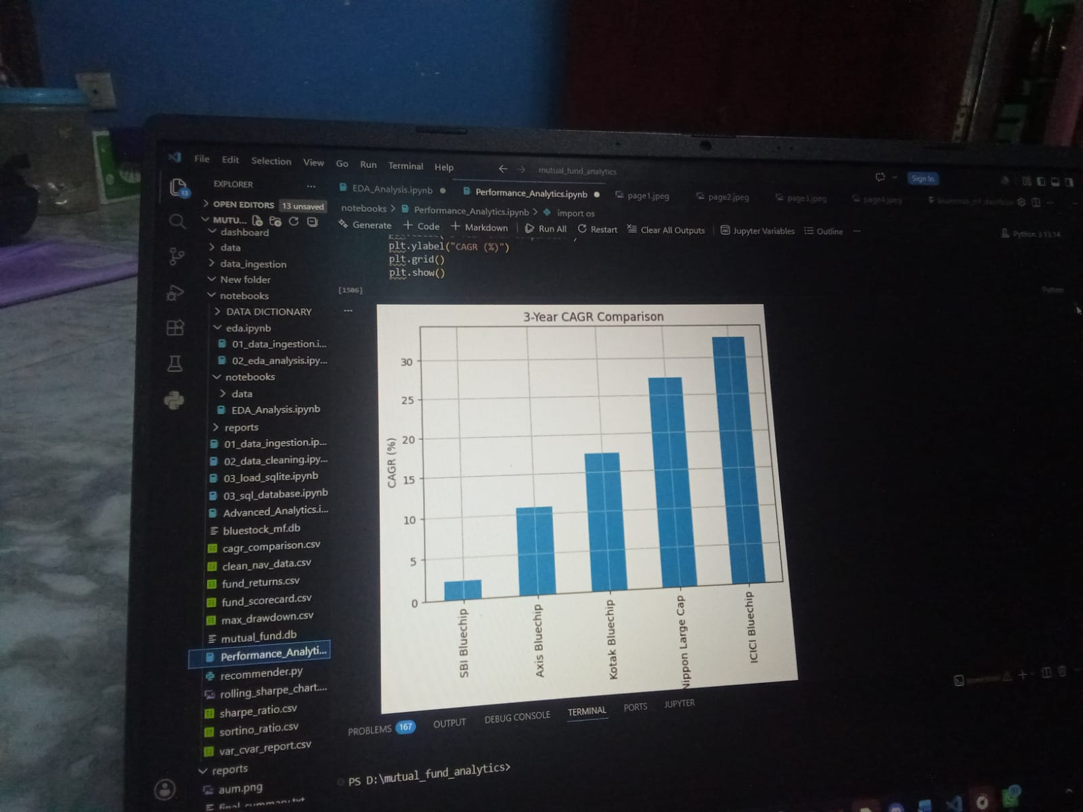
Performance Analytics – 1
ICICI Bluechip achieved highest CAGR.
Nippon Large Cap showed strong growth.
SBI Bluechip had comparatively lower returns.

Slide 8
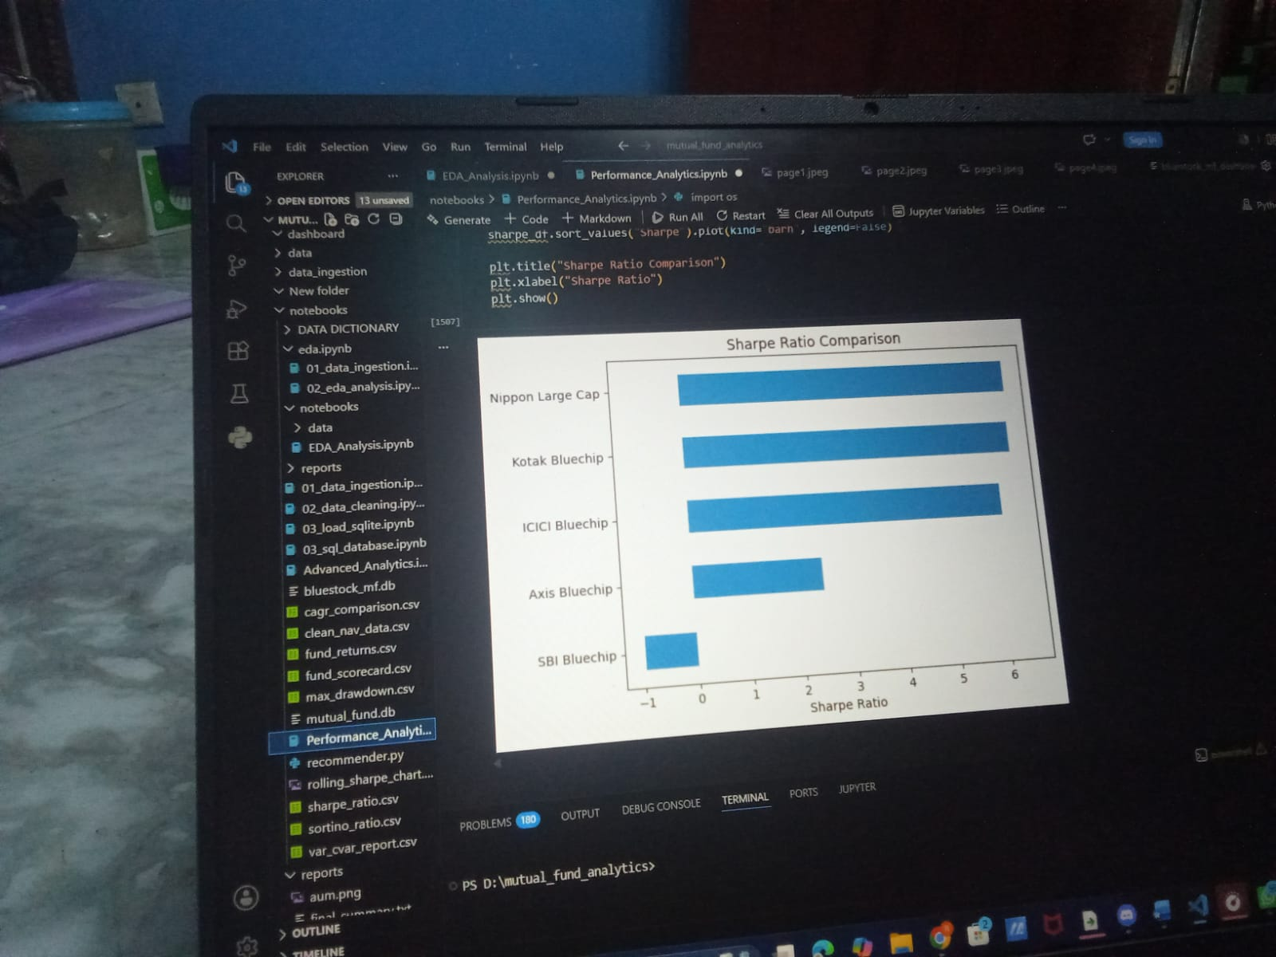
Performance Analytics – 2
Higher Sharpe Ratio indicates better risk-adjusted returns.
Drawdown analysis identifies downside risk.
Nippon Large Cap performed consistently.

Slide 9
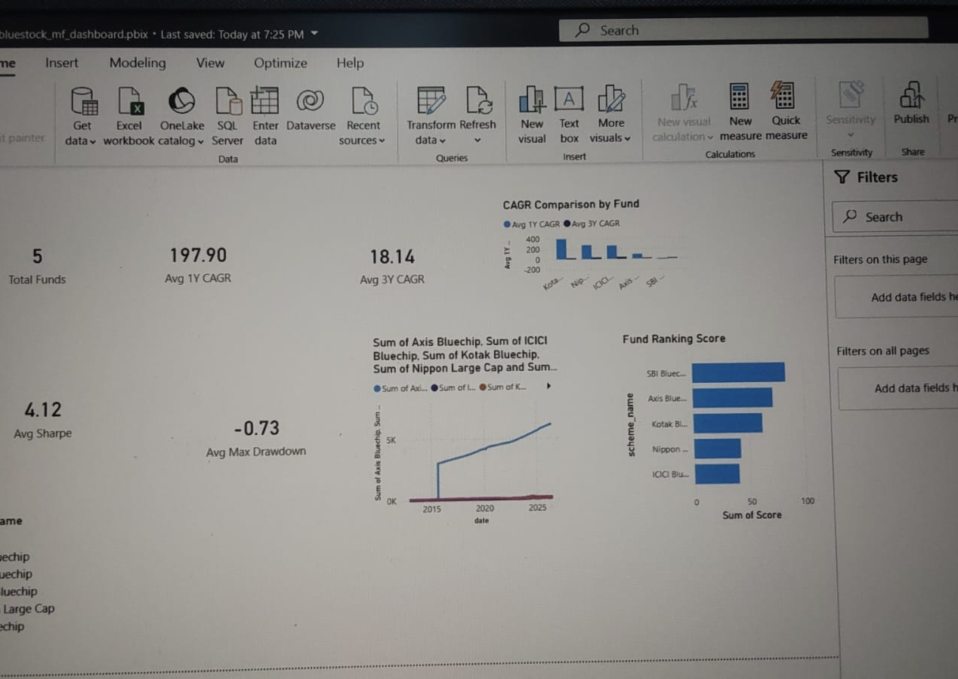
Dashboard Overview – 1
KPI Cards
CAGR Comparison
Fund Ranking
Performance Overview

Slide 10
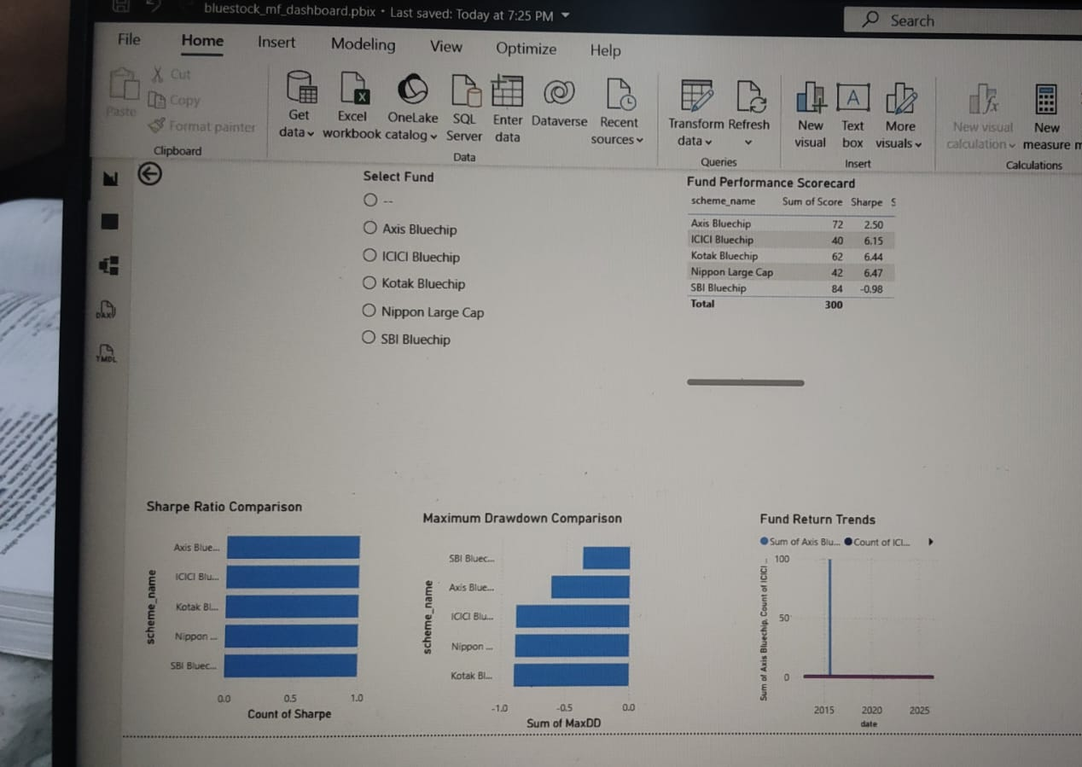
Dashboard Overview – 2
Sharpe Ratio Analysis
Drawdown Analysis
Return Trends
Fund Comparison

Slide 11
Key Findings & Recommendations
Key Findings
SIP investments increased steadily.
Banking and IT sectors dominated holdings.
ICICI Bluechip and Nippon Large Cap were top performers.
Risk-adjusted metrics improved fund evaluation.
Recommendations
Focus on long-term investing.
Diversify across categories.
Monitor risk-adjusted performance.
Use dashboard insights for decision-making.

Slide 12
Thank You

