Slide 1

FACE MASK DETECTION SYSTEM FOR COVID 19
Department of CSE Jyothi Engineering College
Thrissur
January 21, 2021

Slide 2
PROJECT TITLE | FACE MASK DETECTION SYSTEM FOR COVID 19
PROJECT GUIDE | Dr. SWAPNA B SASI ASSOCIATE PROFESSOR, JEC
TEENA JOY P J | JEC17CS101
RESHMA R | JEC17CS081
RONDY THOMAS | JEC17CS083
VISHNU V J | JEC17CS105
GROUP NUMBER | 26
01/06/21
CSE Department, JECC
2

Slide 3
Vision of the Department
Creating eminent and ethical leaders in the domain of Computational Sciences through quality professional education with a focus on holistic learning and excellence.
To create technically competent and ethically conscious graduates in the field of Computer Science and Engineering by encouraging holistic learning and excellence.
To prepare students for careers in Industry, Academia and the Government.
To instill Entrepreneurial Orientation and research motivation among the students of the department.
Mission of the Department
3

Slide 4
CONTENTS
INTRODUCTION
ABSTRACT
EXISTING SYSTEM
LITERATURE SURVEY
PROPOSED SYSTEM
APPLICATIONS
CONCLUSION
REFERENCE
4

Slide 5
INTRODUCTION
Recently, the outbreak of Coronavirus Disease (COVID-19) has spread rapidly across the world and thus wearing face mask has become one of mandatory preventive measures to control the virus spread
Putting on a face mask can restrict the spread of the virus. As it is rightly said, prevention is better than cure, one should wear a face mask while coming in contact with people.
5

Slide 6
ABSTRACT
The COVID - 19 pandemic is devastating mankind irrespective of caste, creed, gender, and religion. . Using a face mask can undoubtedly help in managing the spread of the virus. COVID - 19 face mask detector uses deep learning techniques to successfully test whether a person is with wearing a face mask or not. This real time face mask detector can be used in CCTV footages to detect whether a person is wearing a mask perfectly so that he does not pose any danger to others. Mass screening is possible and hence can be used in crowded places like railway stations, bus stops, markets, streets, mall entrances, schools, colleges, etc.
6

Slide 7
Literature Survey
Title | Year | Author | Concepts | Objective
Face detection system based on viola-jones algorithm | 2016 | Mehul K Dabhi and Bhavna K Pancholi | Face detection, Haar features, cascading | Object Detection Framework
Bluetooth Low Energy Technology(BLE) | 2012 | Bin Yu, Lisheng Xu, and Yongxu Li | Bluetooth Low Energy signals, Proximity sensing | Contact tracing
Social Distance Monitor with a Wearable Magnetic Field Proximity Sensor | 2019 | Sizhen Bian , Bo Zhou and Paul Lukowicz | proximity sensing system based on an oscillating magnetic field | Social distancing and contact tracing
7

Slide 8
Title | Year | Author | Concepts | Objective
Object Tracking using HOG and SVM | 2015 | Marti A. Hearst, Susan T Dumais, Edgar Osuna | Histogram of Oriented Gradients , Support Vector Machine | Object detection and tracking
Monitoring Social Distance by Smart Phone Application | 2020 | Dr.Neelavathy and Balaji Vasu | Image processing,Open-CV | Social Distance Monitoring
8

Slide 9
PROPOSED SYSTEM
A real time face mask detection system which detects whether the person on the webcam is wearing a face mask or not
The results are tested using a live video stream as an input to the face mask detector
By monitoring the placement of the face mask , we can make sure that an individual wears it in the right way and helps to curb the scope of the virus.
9

Slide 10
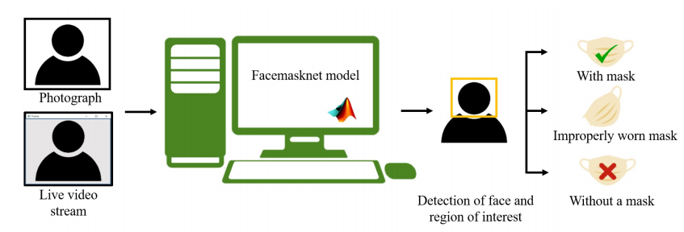
Fig. 1 Image or live video stream is given as an input to the Face mask detector model. Classification of an image takes place as with mask and without a mask.
10

Slide 11
DATA FLOW DIAGRAM
LEVEL 0
Face mask detector
Input images/videos
Output
mask or no mask

Slide 12
LEVEL 1
Input images/videos
Load face detection model
Detect faces in image
Apply mask detection model
Output
Mask / No mask

Slide 13
Level 2
Input images/videos
Videos/images
Image to Array conversion
Arrays
Comparison with face detection model
Detect faces
Output with mask
Apply mask detector
Extract ROI
Output with no mask

Slide 14
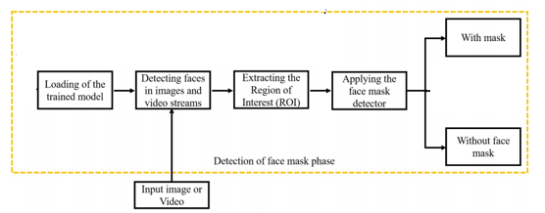
ARCHITECTURAL DIAGRAM

Slide 15
Modules
Module 1
Load pretrained CNN models to the system
MobileNetv2
Mask detection.model
ResNet101
Module 2
Real time video stream is given to webcam as input
Image to array conversion is performed to obtain pixel values as Numpy arrays
Loop over the frames to detect face and mask

Slide 16
Module 3
Generate bounding boxes around the face with Green and Red frames
Display probability of prediction
Send alert / notification to local authority if mask is not detected

Slide 17

Implementation
Load libraries
Specify the path of face_detector and mask_detector model
Load the face detector model from disk (MobileNetv2)
Load OpenCV to take live video streams
Load the mask detector model from disk
Loop over the frames from the video stream and detect faces in the frame to determine if they are wearing a face mask or not

Slide 18
Face Mask Detection with TensorFlow
Face detection is a computer vision problem that involves finding faces in photos
Locating a face in a photograph refers to finding the coordinate of the face in the image, whereas localization refers to demarcating the extent of the face, often via a bounding box around the face.
OpenCV uses machine learning algorithms to search for faces within a picture.

Slide 19
Keras Preprocessing provides utilities for working with image data, text data, and sequence data
MobileNetV2 is a convolutional neural network architecture that seeks to perform well on mobile devices. It is a very effective feature extractor for object detection and segmentation

Slide 20
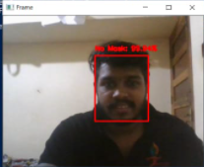
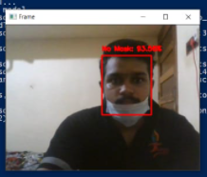
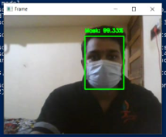
Result

Slide 21
APPLICATIONS
This system can be adopted by colleges and universities to conduct safe classes and exams
Installations in each and every public places like supermarkets, religious places, cross roads etc. are possible to detect face mask

Slide 22
CONCLUSIONS
Thus a real time Face Mask Detection System has been made with Open CV
In this dangerous pandemic situation of COVID 19 and it’s mutated strains, this project is of great help to police and local authorities.
In future this system can be integrated in each and every street cameras in public places such as religious halls, supermarkets, colleges in large scale for public safety

Slide 23
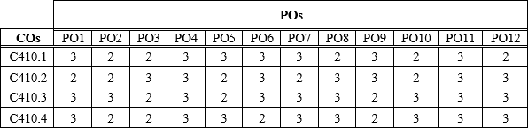
COURSE OUTCOME
Able to analyze a current topic of professional interest and present it before an audience
Gained thorough knowledge in design, implementations and execution of CS related projects
Became familiar with usage of latest technologies
Students will have ability to plan and work in a team
MAPPING OF CO TO PO

Slide 24
REFERENCE
Mehul K Dabhi and Bhavna K Pancholi. Face detection system based on viola-jones algorithm. International Journal of Science and Research (IJSR), 5(4):62–64, 2016.
Bin Yu, Lisheng Xu, and Yongxu Li. Bluetooth low energy (ble) based mobile electrocardiogram monitoring system. In 2012 IEEE International Conference on Information and Automation, pages 763–767. IEEE, 2012.
Social Distance Monitor with a Wearable Magnetic Field Proximity Sensor Sizhen Bian , Bo Zhou and Paul Lukowicz ,German Research Center for Artificial Intelligence (DFKI), 67663 Kaiserslautern, Germany; bo.zhou@dfki.de (B.Z.); paul.lukowicz@dfki.de (P.L.)
Marti A. Hearst, Susan T Dumais, Edgar Osuna, John Platt, and Bernhard Scholkopf. Support vector machines. IEEE Intelligent Systems and their applications, 13(4):18–28, 2015.
monitoring-social-distancing-by-smart-phone-app-in-the-effect-of-covid-19-IJERTV9IS090469%20 by Dr. Neelavathy Pari S and Balaji Vasu Department of Computer Technology Madras Institute of Technology Chennai, India.
Pai Chet Ng, Petros Spachos, and Konstantinos N. Plataniotis. COVID-19 and your smartphone: Ble-based smart contact tracing. CoRR, abs/2005.13754, 2020.
Deepak Sharma, Amol P Bhondekar, AK Shukla, and C Ghanshyam. A review on technological advancements in crowd management. Journal of Ambient Intelligence and Humanized Computing, 9(3):485–495, 2018.
Dongfang Yang, Ekim Yurtsever, Vishnu Renganathan, Keith A Redmill, and Ümit Özgüner. A vision-based social distancing and critical density detection system for covid19. arXiv preprint arXiv:2007.03578, pages 24–25, 2020.

Slide 25
Thank You

