Slide 1

SOCIAL DISTANCE MONITORING SYSTEM FOR COVID 19
Department of CSE Jyothi Engineering College
Thrissur
January 21, 2021

Slide 2
PROJECT TITLE | SOCIAL DISTANCE MONITORING SYSTEM FOR COVID 19
PROJECT GUIDE | Dr. SWAPNA B SASI ASSOCIATE PROFESSOR, JEC
TEENA JOY P J | JEC17CS101
RESHMA R | JEC17CS081
RONDY THOMAS | JEC17CS083
VISHNU V J | JEC17CS105
GROUP NUMBER | 26
20/01/21
CSE Department, JECC
2

Slide 3
Vision of the Department
Creating eminent and ethical leaders in the domain of Computational Sciences through quality professional education with a focus on holistic learning and excellence.
To create technically competent and ethically conscious graduates in the field of Computer Science and Engineering by encouraging holistic learning and excellence.
To prepare students for careers in Industry, Academia and the Government.
To instill Entrepreneurial Orientation and research motivation among the students of the department.
Mission of the Department
20/01/21 3

Slide 4
CONTENTS
INTRODUCTION
ABSTRACT
EXISTING SYSTEM
LITERATURE SURVEY
PROPOSED SYSTEM
APPLICATIONS
CONCLUSION
REFERENCE
4

Slide 5
INTRODUCTION
Recently, the outbreak of Coronavirus Disease (COVID-19) has spread rapidly across the world and thus social distancing has become one of mandatory preventive measures to avoid physical contact
Social distancing has proven to be a very effective measure to slow down the spread of the disease
5

Slide 6
Abstract
The pandemic situation has taken over the world and has made the conditions worst, as of now there is no vaccination developed for the contagious disease and hence social distancing emerged as one of the best methods to prevent the spread of COVID-19. As the name suggests, social distancing implies that people should maintain a distance themselves from one another. The main objective of this project is to develop a Social Distance Monitoring System which helps the people and police to follow Covid 19 protocols easily and efficiently with the help of Artificial Intelligence technology, mainly Image Processing.
6

Slide 7
Existing System
Most of the existing systems revolve around Human Tracking and Crowd Management.
Global positioning system(GPS) and Global system for mobile communication(GSM) feature is utilized to emulate the tracking and detection
Crowd management in real time is still a challenging problem
The existing system includes OpenCV-Python and classification using, Histogram,AdaBoost algorithm, etc.
Advantages
Human Tracking to manage the crowd by keeping track of the
people in a given location.
7

Slide 8
Advantages
Monitoring system that detects the human heads and provide a count of people in the region.
Crowd dynamics characteristics such as speed, density, flow of the crowd are determined.
Disadvantages
No Social distance calculation and alerts to control viral spread
Unavailability of face mask detection and alert
8

Slide 9
Literature Survey
Title | Year | Author | Concepts | Objective
Face detection system based on viola-jones algorithm | 2016 | Mehul K Dabhi and Bhavna K Pancholi | Face detection, Haar features, cascading | Object Detection Framework
Bluetooth Low Energy Technology(BLE) | 2012 | Bin Yu, Lisheng Xu, and Yongxu Li | Bluetooth Low Energy signals,Proximity sensing | Contact tracing
Social Distance Monitor with a Wearable Magnetic Field Proximity Sensor | 2019 | Sizhen Bian , Bo Zhou and Paul Lukowicz | proximity sensing system based on an oscillating magnetic field | Social distancing and contact tracing
9

Slide 10
Title | Year | Author | Concepts | Objective
Object Tracking using HOG and SVM | 2015 | Marti A. Hearst, Susan T Dumais, Edgar Osuna | Histogram of Oriented Gradients , Support Vector Machine | Object detection and tracking
Monitoring Social Distance by Smart Phone Application | 2020 | Dr.Neelavathy and Balaji Vasu | Image processing,Open-CV | Social Distance Monitoring
10

Slide 11
PROPOSED SYSTEM
The proposed system monitors the social distance among people and gives an alert to the officials if they are not followed
There is also a Face mask Recognition system which helps the people and higher officials to follow Covid19 protocols easily and efficiently
The goal is to help local authorities and police to reduce their ground efforts
11

Slide 12
Modules
Module 1:
Video inputs are captured from public places via CCTV, street cams, web cams etc.
These collected videos are used for both social distance monitoring and face mask detection
Module 2:
Feeding output of module 1 to Open CV and applying HOG on it.
The Numpy array obtained from HOG is given to SVM classifier to detect presence of humans and face masks in the frame

Slide 13
Module 3:
Calculating Euclidean distance ‘d’ between individuals to monitor the distance between them.
If d is less than 2 feet or face mask is absent, then give a notification/ alarm as warning signal and represent the corresponding person in Red frame on screen
Else, represent the corresponding person in Green frame on screen

Slide 14
SRS
FUNCTIONAL REQUIREMENTS
User interface
This is the user interface module where the user inputs the video
Social distancing is monitored followed by face mask detection and the corresponding results are shown as output here
Alert system
A warning alert or signal is provided, if social distancing is violated or face mask is absent

Slide 15
Non-Functional Requirements
Performance Requirements
Better design to get efficiency at peak time
Security Requirements
Keeping the data including location and privacy of people secure and confidential
Efficiency
The software shall minimize the use of Central Processing Unit (CPU),
Graphics Processing Unit and Memory resources in the operating system

Slide 16
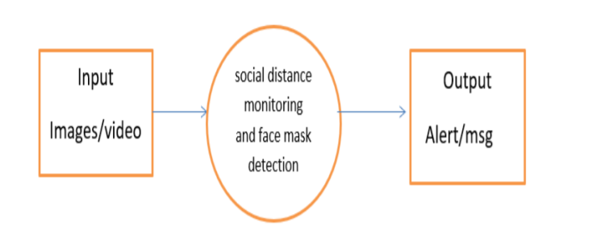
DATA FLOW DIAGRAM
Level 0

Slide 17

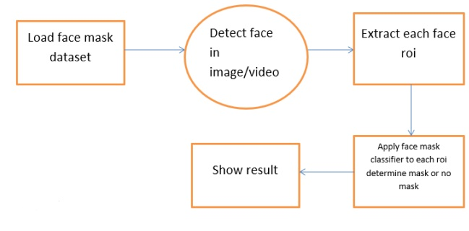
Distance monitoring
frames
Object detection(filter only people)
Level 1
Input
Images/video
Show result
Compute pairwise distance btwn centroid

Slide 18
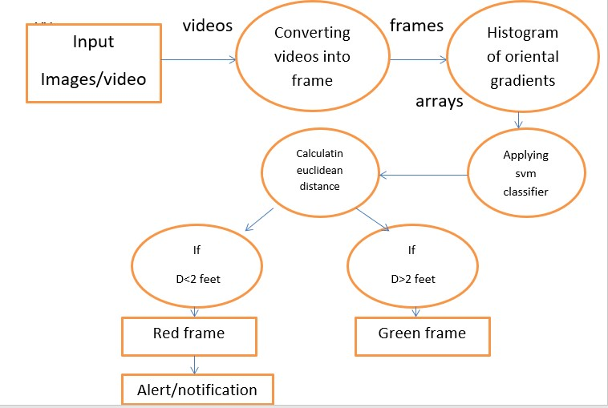
DATA FLOW DIAGRAM
Level 2

Slide 19
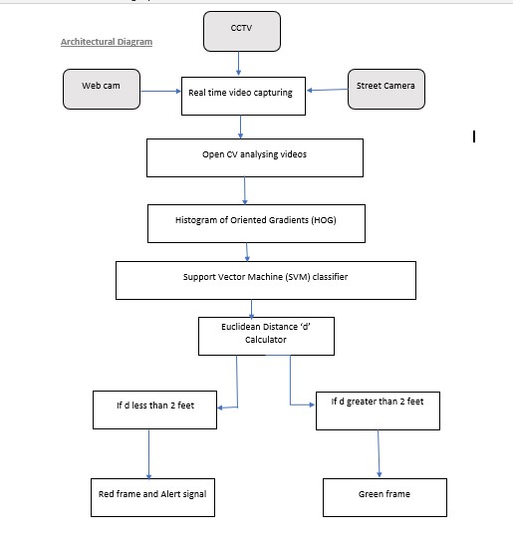
ARCHITECTURAL DIAGRAM

Slide 20
APPLICATIONS
This system can be adopted by colleges and universities to conduct safe classes and exams
Crowd management facilities can be provided at public places
Installations in each and every public places like supermarkets, religious places, cross roads etc. are possible to monitor social distancing

Slide 21
CONCLUSIONS
Thus a real time Social Distance Monitoring and Face Mask Detection System has been made with Open CV
In this dangerous pandemic situation of COVID 19 and it’s mutated strains, this project is of great help to police and local authorities.
In future this system can be integrated each and every street cameras in public places such as religious halls, supermarkets, colleges in large scale for public safety

Slide 22
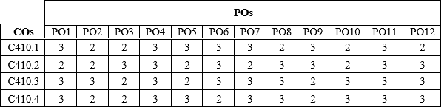
COURSE OUTCOME
Able to analyze a current topic of professional interest and present it before an audience
Gained thorough knowledge in design, implementations and execution of CS related projects
Became familiar with usage of latest technologies
Students will have ability to plan and work in a team
MAPPING OF CO TO PO

Slide 23
REFERENCE
Mehul K Dabhi and Bhavna K Pancholi. Face detection system based on viola-jones algorithm. International Journal of Science and Research (IJSR), 5(4):62–64, 2016.
Bin Yu, Lisheng Xu, and Yongxu Li. Bluetooth low energy (ble) based mobile electrocardiogram monitoring system. In 2012 IEEE International Conference on Information and Automation, pages 763–767. IEEE, 2012.
Social Distance Monitor with a Wearable Magnetic Field Proximity Sensor Sizhen Bian , Bo Zhou and Paul Lukowicz ,German Research Center for Artificial Intelligence (DFKI), 67663 Kaiserslautern, Germany; bo.zhou@dfki.de (B.Z.); paul.lukowicz@dfki.de (P.L.)
Marti A. Hearst, Susan T Dumais, Edgar Osuna, John Platt, and Bernhard Scholkopf. Support vector machines. IEEE Intelligent Systems and their applications, 13(4):18–28, 2015.
monitoring-social-distancing-by-smart-phone-app-in-the-effect-of-covid-19-IJERTV9IS090469%20 by Dr. Neelavathy Pari S and Balaji Vasu Department of Computer Technology Madras Institute of Technology Chennai, India.
Pai Chet Ng, Petros Spachos, and Konstantinos N. Plataniotis. COVID-19 and your smartphone: Ble-based smart contact tracing. CoRR, abs/2005.13754, 2020.
Deepak Sharma, Amol P Bhondekar, AK Shukla, and C Ghanshyam. A review on technological advancements in crowd management. Journal of Ambient Intelligence and Humanized Computing, 9(3):485–495, 2018.
Dongfang Yang, Ekim Yurtsever, Vishnu Renganathan, Keith A Redmill, and Ümit Özgüner. A vision-based social distancing and critical density detection system for covid19. arXiv preprint arXiv:2007.03578, pages 24–25, 2020.

Slide 24
Thank You

