Slide 1
Introduction to APIs: Enabling Modern Application Integration
Presented By,
Reshma T R,
Corporate IT Trainer(Full Stack)

Slide 2
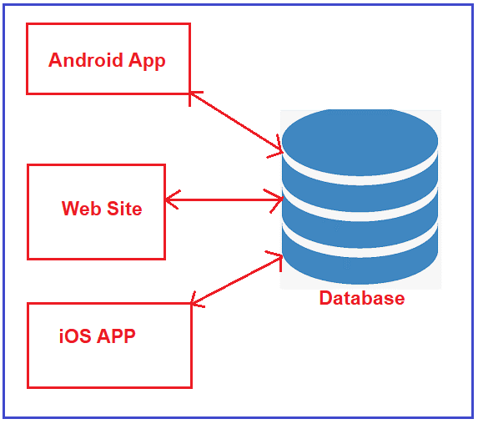
Problem: Direct Communication with Database

Slide 3
Issues with Direct DB Communication
Duplicate logic in each app
Error-prone multiple implementations
Some front-end tools can’t connect to DB
Hard to maintain with scattered logic

Slide 4

From Problem to Solution
Direct communication
between applications
and database leads to
duplicate logic, errors,
and maintenance
challenges.
Introduce a centralized
Web API to handle all
business logic and database
interactions, improving
scalability and maintainability.

Slide 5
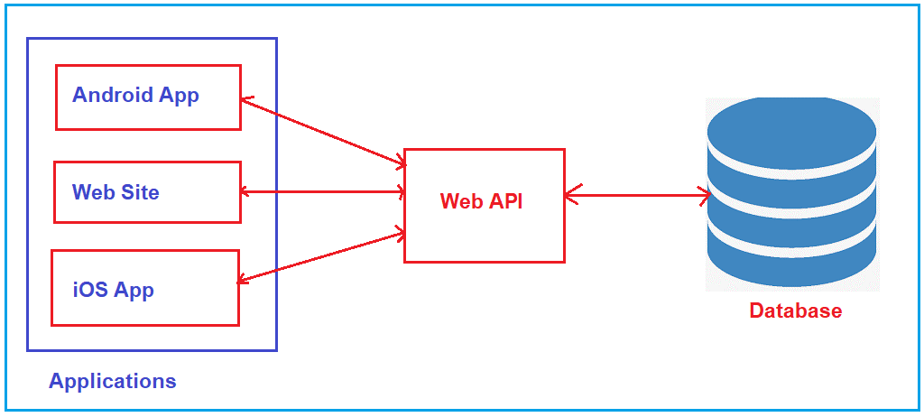
Solution: Introducing Web API

Slide 6
Key Characteristics of Web APIs
HTTP Communication (GET, POST, PUT, DELETE)
Data Formats: JSON, XML
RESTful Architecture
Auth & Access Control (API keys, OAuth, JWT)

Slide 7
Popular Frameworks for Creating APIs
ASP.NET Core (C#) – Cross-platform, high performance
Express.js (Node.js) – Minimal, flexible, RESTful
Django REST Framework (Python) – Powerful, flexible
Flask (Python) – Lightweight, quick REST API building
Ruby on Rails (Ruby) – Full-stack, REST support
Spring Boot (Java) – Simplified Java REST API creation

Slide 8
Advantages of APIs
Integration & Connectivity
Automation
Modularity & Reuse
Faster Development
Security & Control
Platform Independence
Scalability
Easy Updates

Slide 9
Conclusion
APIs connect different apps & services
Centralize logic for easy maintenance
Improve scalability, security, flexibility
APIs enable modern, efficient, connected systems

Slide 10
Thank You!
Questions & Discussion

