Slide 1

Coffee Sales Dashboard Summary
Reporting Period: [25-April-2025]
Prepared by: [Reshu Kumar Singh]

Slide 2
Executive Summary
- Strong sales observed in top products and regions
- Consistent performance across key locations
- Notable trends across time (e.g., peak sales months)
- Recommendations proposed for further growth

Slide 3
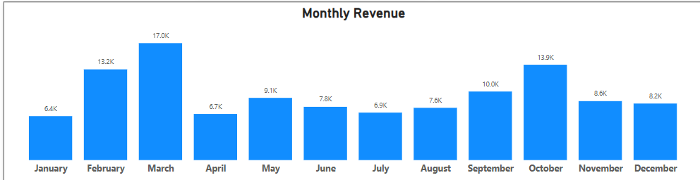
Overall Sales Performance
Total revenue, growth trends, and key performance indicators are highlighted here.

Slide 4
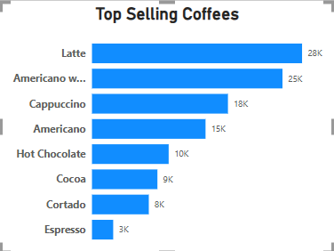
Top Products
Breakdown of product-wise sales.
- Highlight best-sellers
- Compare performance across categories

Slide 5
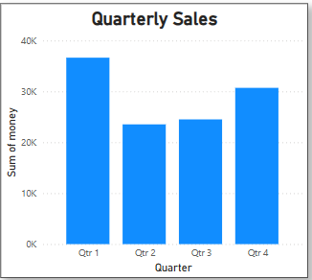
Sales Trends Over Time
Quarterly sales trends.
- Identify peak seasons
- Detect any declining patterns

Slide 6
Recommendations
- Promote high-performing products in new regions
- Address low sales in underperforming stores
- Optimize inventory and marketing efforts based on trends

Slide 7
Appendix / Data Notes
- Filters used in analysis: [e.g., Date Range, Product Categories]
- Data source: Power BI Dashboard – Coffee Sales
- Methodology: Aggregated and visualized sales data by region, product, and time

