Slide 1

Hadoop Overview
Reshu Vishwakarma
Oct 2020

Slide 2
CONTENT
MAJOR USERS OF HADOOP
INTRODUCTION
FEATURES OF HADOOP
BIG DATA
HADOOP ARCHITECTURE
WHY HADOOP
COMPONENTS OF HADOOP

Slide 3
Introduction
HADOOP is a technology used for storing and processing BIG DATA.
Hadoop was developed by Doug Cutting.
It is an open source Apache Project sponsored by the Apache Software Foundation.
The Hadoop framework itself is mostly written in the Java programming language,
with some native code in C and command line utilities written as shell scripts.
The top 6 vendors offering Big Data Hadoop solution are:
Cloudera.
HortonWorks.
Amazon Web Services Elastic MapReduce Hadoop Distribution.
Microsoft.
MapR.
IBM InfoSphere Insights.

Slide 4
Big Data
Big data is a term for data sets that are so large or complex that traditional
data processing application software is inadequate to deal with them.
BIG DATA poses 5 distinct dimensions:
VOLUME (TB, PB, EB)
VARIETY (Structure, Semi-structure, Un-structure)
VELOCITY (batch, periodic, near real-time, real-time)
VALUE
VERACITY (accuracy)

Slide 5
WHY HADOOP
Distributed cluster system
(Multiple nodes connected via network)
Enables parallel data processing
(Multiple processes running on a node)
Platform for massively scalable applications
(ETL, BI, RDBMS, etc.)

Slide 6






Major Users of Hadoop

Slide 7
Features of Hadoop
Hadoop spilt the data into blocks, with the default block size of 128 MB.
It stores the data with replication factor of 3.
NAME NODE
128 MB
Block 1
128 MB
BLK1
BLK2
Block 2
BLK1
BLK2
524 MB
DN 1
DN 1
DN 1
128 MB
File
Block 3
BLK1
BLK2
12 MB
DN m
Block 4
DN m
DN m
RACK 1
RACK K
RACK N

Slide 8
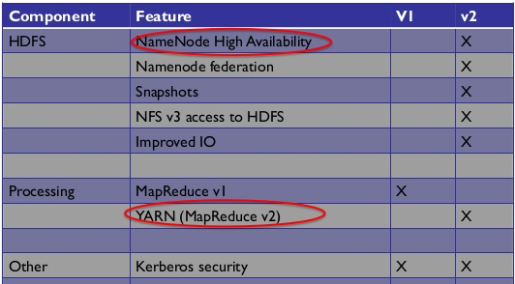
Hadoop Architecture
Hadoop uses MASTER-SLAVE architecture
HADOOP v1: DEC 2011
HADOOP v2: OCT 2013

Slide 9
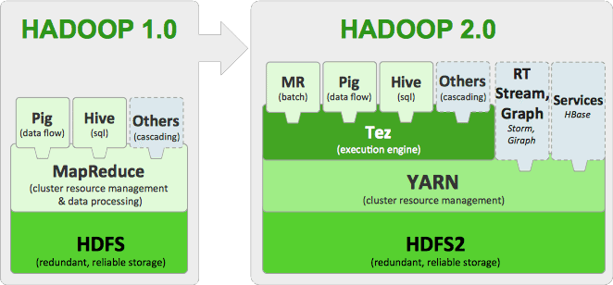
HADOOP ARCHITECTURE

Slide 10
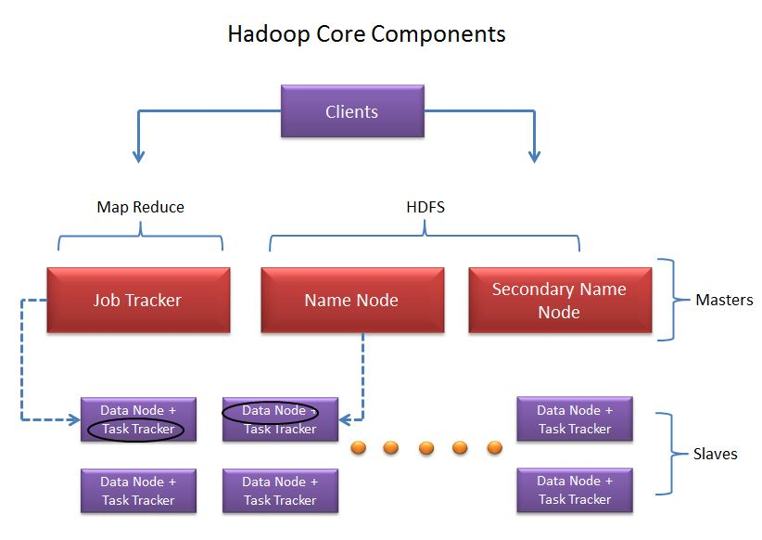
HADOOP v1

Slide 11
Hadoop V1 HDFS
NAME NODE
MASTER NODE
DATA NODE
DATA NODE
DATA NODE
SLAVE NODES
PITFALL: Single Point OF Failure (SPOF)

Slide 12
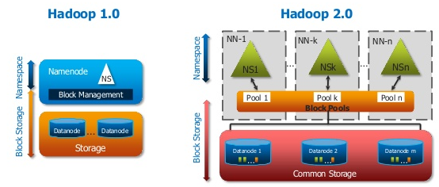
Hadoop v2 HDFS
Name node high availability
SHARED STORAGE
ACTIVE NAME NODE
PASSIVE NAME NODE
Uses Name node federation
NN1- /HBASE
NN2- /HIVE
NN3- /USER

Slide 13
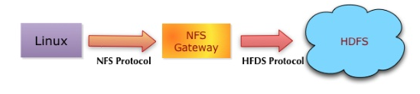
Hadoop v2
Snapshots
Support NFS protocol
Improved IO (v1: 264 MBs/sec, v2: 1395 MBs/sec)

Slide 14
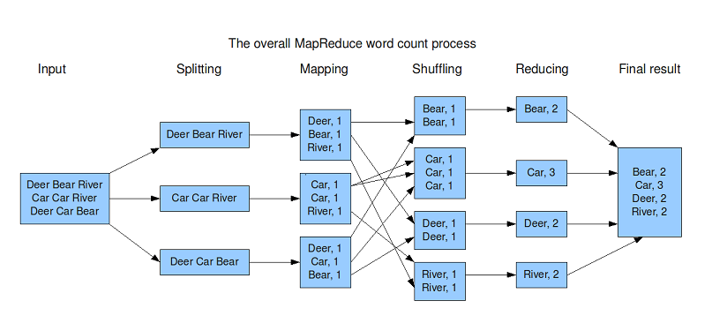
Hadoop v1 Map Reduce
Responsible for both Processing and Resource Management.

Slide 15
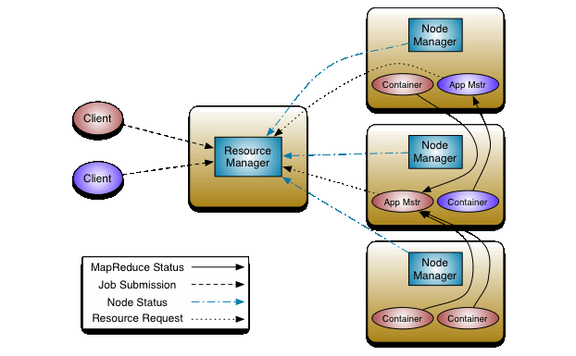
HADOOP v2 YARN (Yet Another Resource Negotiator)
So failure of one Application master causes only that job to fail

Slide 16
HADOOP v2
Functions of the JobTracker have been split between three services-
YARN
MapReduce Application Master
JobHistoryServer
TaskTracker is replaced by the Node Manager.

Slide 17
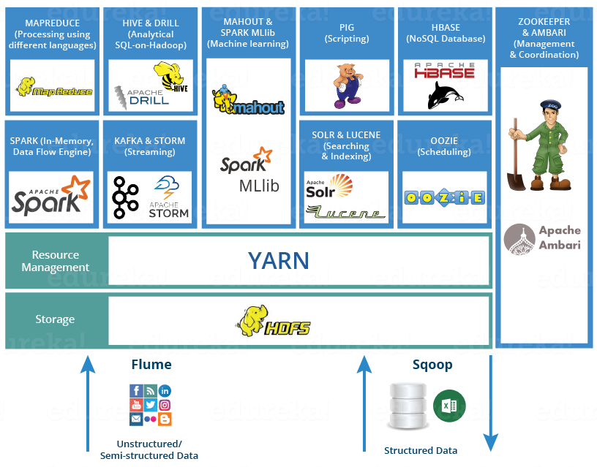
COMPONENTS OF HADOOP

Slide 18
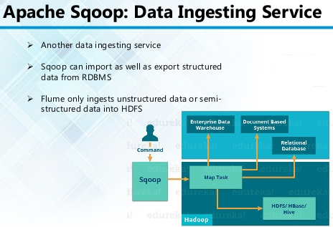
COMPONENTS OF HADOOP

Slide 19
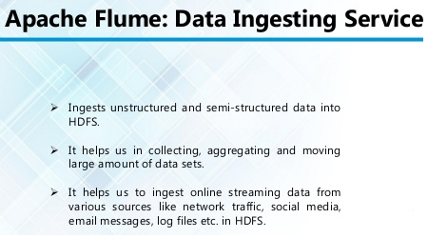
COMPONENTS OF HADOOP

Slide 20
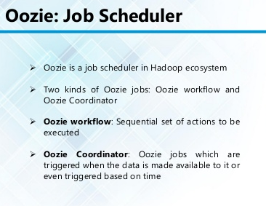
COMPONENTS OF HADOOP

Slide 21
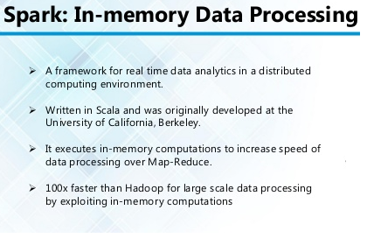
COMPONENTS OF HADOOP

Slide 22
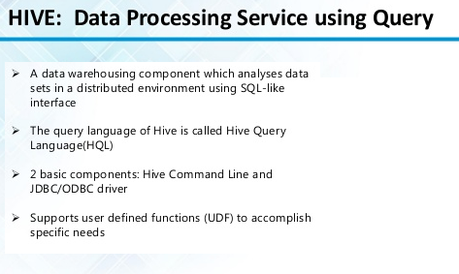
COMPONENTS OF HADOOP

Slide 23
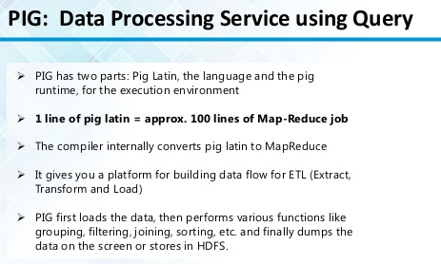
COMPONENTS OF HADOOP

Slide 24
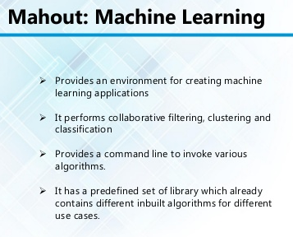
COMPONENTS OF HADOOP

Slide 25
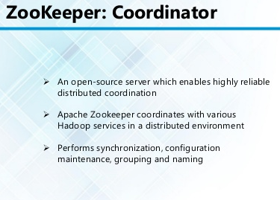
COMPONENTS OF HADOOP

Slide 26
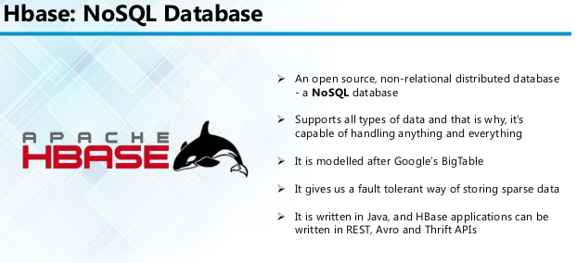
COMPONENTS OF HADOOP

Slide 27
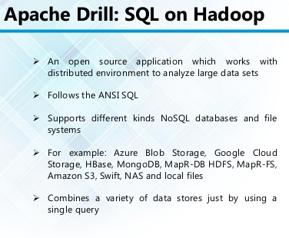
COMPONENTS OF HADOOP

Slide 28
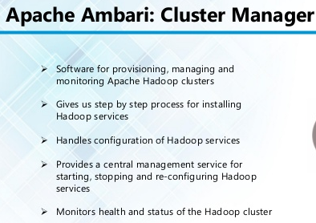
COMPONENTS OF HADOOP

Slide 29
Thank You

