Slide 1
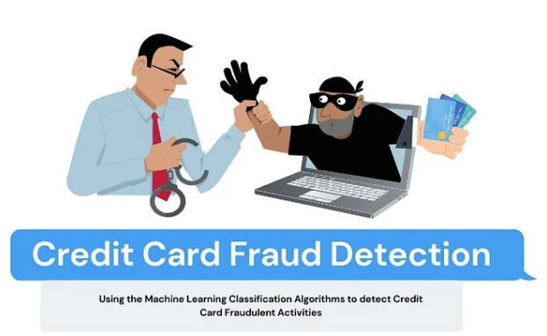
How Can Machine Learning (ML) Help Detect Fraudulent Transactions More Accurately and Efficiently?
Group 15
Reshum Zubair (91807925)
Jiahui Xu (5238857)
Bo Li (69549442)
Chloe Chen (47449814)
Jiaqi Qi (57762809)

Slide 2
Agenda
Project Overview
Data and Statistical Questions
Exploratory Data Analysis
Methodology
Insights and Recommendations
Reference

Slide 3
Context: In 2022
448,459
Credit card fraud reports
24%
Canadians reported credit card fraud
$530 million
Fraud and cybercrime losses reported by the Canadian Anti-Fraud Centre
How can machine learning detect fraudulent transactions in real-time?
Transaction features
ML Model & Training
Fraudulent transactions

Slide 4
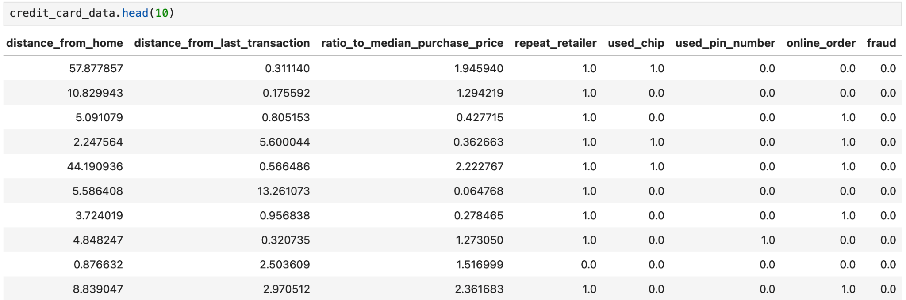
2. Data and Statistical Questions
The dataset is from Kaggle, with 1,000,000 simulated rows and 8 columns for features and label:
Statistical Question: Which machine learning algorithm achieves the highest performance in distinguishing between fraudulent and non-fraudulent transactions?
Usefulness: directly aligns with our business objective of selecting the optimal predictive model for fraud detection
Limitations: doesn't address the computational efficiency or the ease of integration into existing systems; requires ongoing monitoring and re-adjustments as performance vary over time

Slide 5
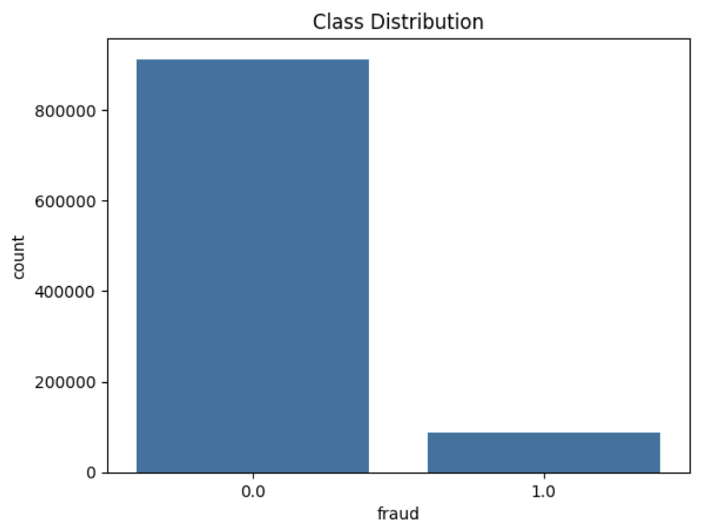
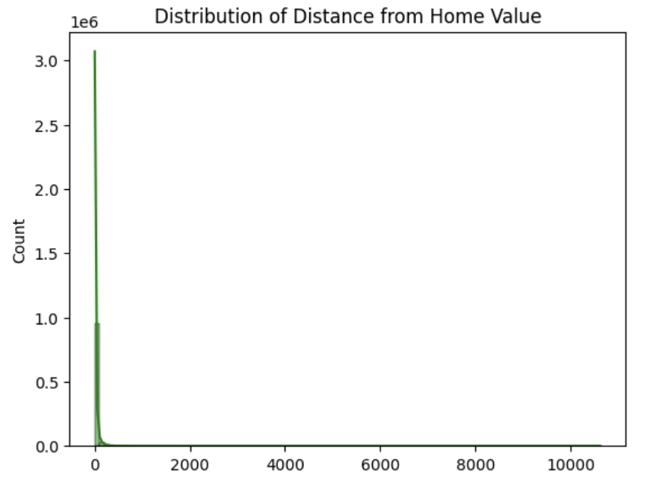
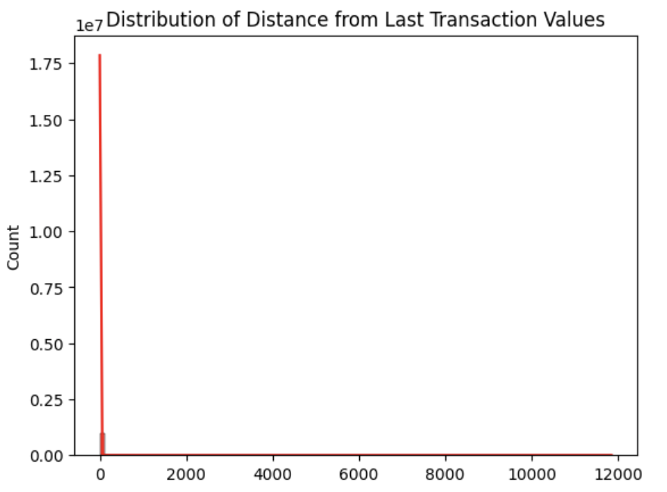
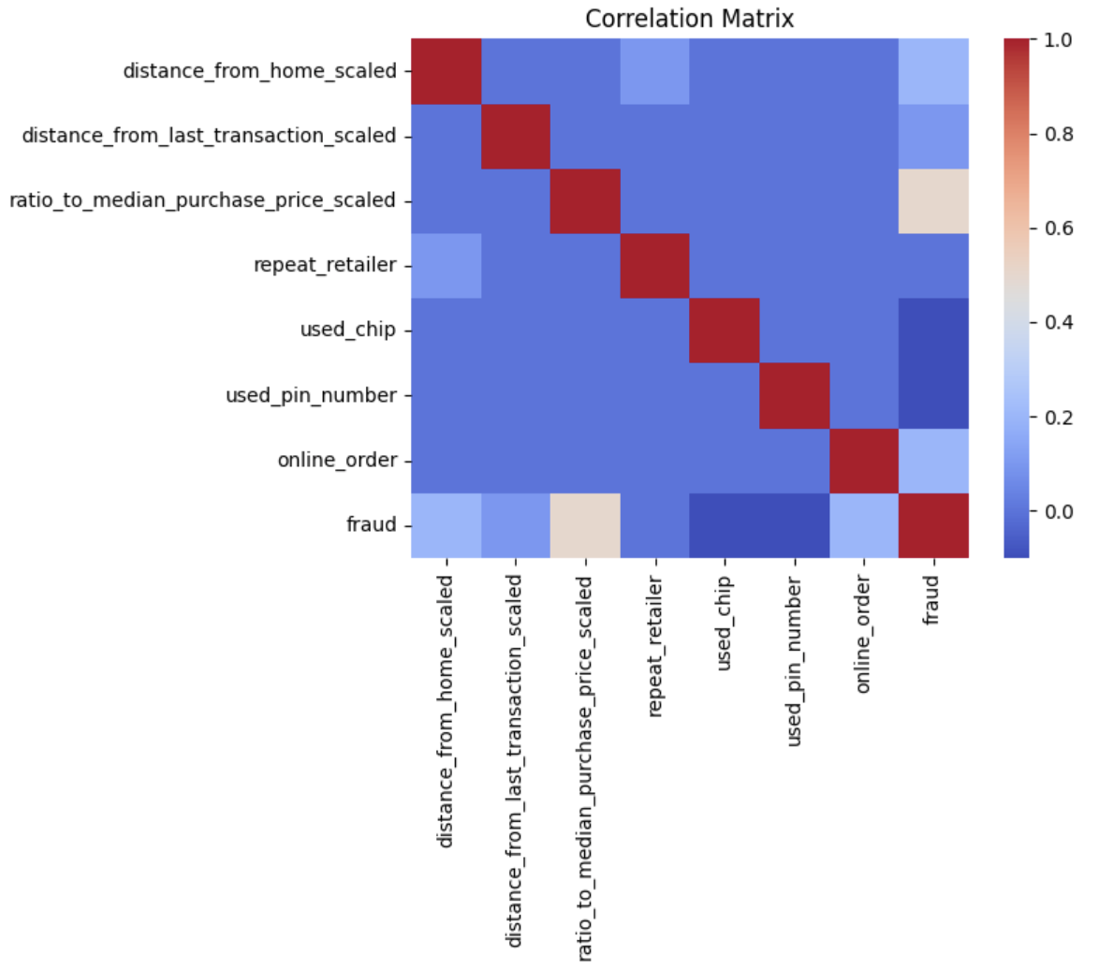
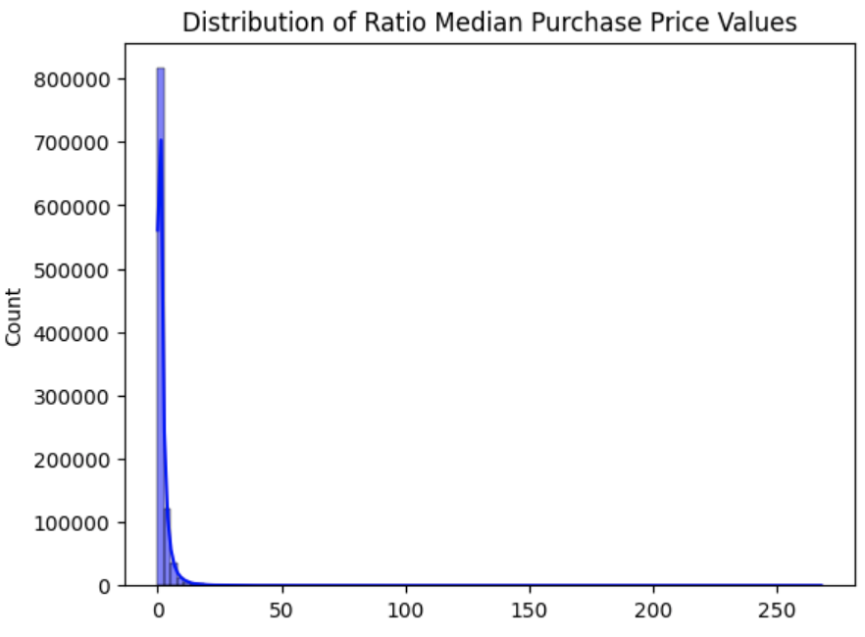
3. Exploratory Data Analysis
.head() and .info() shows:
The dataset is very clean
All dataset features are numerical
There are no null values to be handled
Measuring Class Imbalance
91.3% non-fraudulent (Class 0) Only 8.7% fraudulent (Class 1)
The 'fraud' feature is highly imbalanced
Need to implement sampling methods
Distribution of Non-boolean Features
Most transactions occur near the account holder's home
Transactions are in proximity to each other
Majority of transactions are small
Need to apply the standard scaler
Correlation Between Features
Clear diagonal line without grouping, the features don't strongly correlate with each other
ratio_to_median_purchase_price has a higher correlation with fraudulent transactions, highlighting its importance in fraud detection

Slide 6
Challenges & Limitations
High Class Imbalance: Fraud cases remain rare despite upsampling.
Trade-off between Precision & Recall:
Higher recall → More frauds detected but false positives increase.
Higher precision → Fewer false positives but some fraud cases may be missed.
Computational Cost: Random Forest is more resource-intensive.

Slide 7
4. Methodology
Data Cleaning: No missing values, standardized numerical features.
Addressing Class Imbalance:
Stratified K-Fold Cross-Validation
Random Upsampling
Random Downsampling
SMOTE for upsampling.
Models Tested: Logistic Regression, K-Nearest Neighbors (KNN), Random Forest.
Cross-validation applied to avoid overfitting.
Hyperparameter tuning performed with RandomizedSearchCV

Slide 8
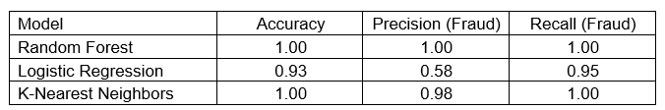
5. Insights and Recommendations
Model Performance and Key Findings
Model Comparison and Performance
Overall, Random Forest is the best choice for deployment due to its flawless classification accuracy.
Impact of Data Imbalance
SMOTE was used to balance the dataset by generating synthetic fraud cases, improving recall without significantly increasing false positives.
Precision was the most important evaluation metric because we want to minimize false positives as they would damage the client’s recommendation.
Notes:
Our analysis demonstrates that machine learning can significantly enhance fraud detection by identifying suspicious transaction patterns that indicate fraudulent activity.
To achieve this, we tested multiple machine learning models and found that the Random Forest classifier performed best, achieving 100% accuracy, precision, and recall in identifying fraudulent transactions. This means the model was able to correctly classify every transaction without misidentifying legitimate purchases as fraud or allowing fraudulent transactions to go undetected. The K-Nearest Neighbors (KNN) model also performed well, though it is computationally expensive, making it less ideal for real-time fraud detection. The Logistic Regression model, while achieving a strong recall rate (95%), struggled with precision (58%), meaning it flagged a higher number of legitimate transactions as fraudulent.

Slide 9
5. Insights and Recommendations
Business Implications and Practical Applications
Real-time fraud detection
Automated risk scoring
Hybrid fraud detection system
Customer notification system
Integration with external data sources
Recommendations for Future Improvements
Incorporating real-time behavioral analysis
Monitoring changes in spending patterns over time could improve fraud detection by adapting to customer habits. Deploy model as an API for real-time fraud detection.
Exploring More Advanced Models
More sophisticated models such as gradient boosting techniques (XGBoost, LightGBM) or deep learning models could potentially improve accuracy.
Enhancing Feature Engineering
Introducing time-based behavioral patterns, such as spending habits at different times of the day or week, could further refine fraud detection.
Notes:
•• Deploy model as an API for real-time fraud detection.

Slide 10
6. Reference
Data Source: www.kaggle.com. (n.d.). Credit Card Fraud. [online] Available at: https://www.kaggle.com/datasets/dhanushnarayananr/credit-card-fraud/data.

