Slide 1
JAVA FX

Slide 2

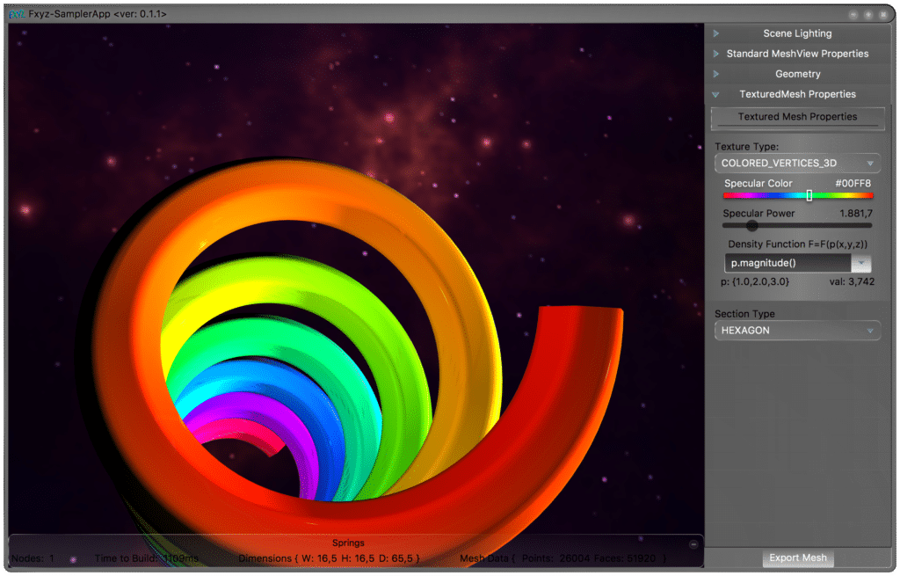
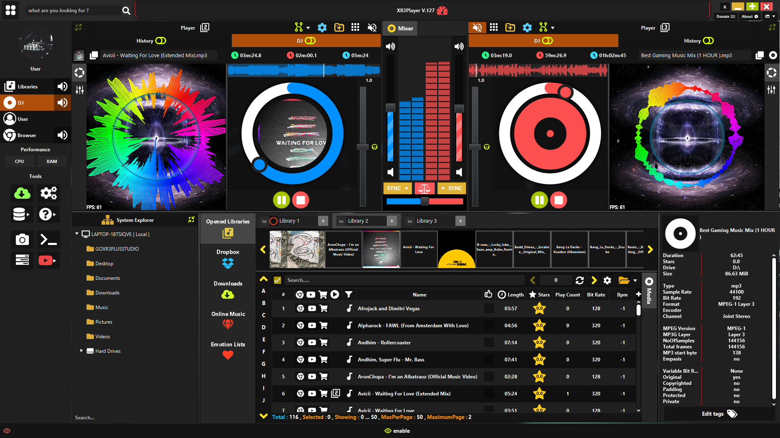
What is JavaFX?
Notes:
JavaFX is a Java library used to create modern graphical user interfaces. It was introduced by Oracle in 2008 as a successor to Swing. It provides tools to build desktop applications with controls, graphics, audio, and video.

Slide 3
JavaFX Pros
Set of UI controls
2D and 3D graphics
FXML
OS agnostic
CSS-like styling system
Notes:
Some of the main features are:
A wide set of UI controls, built-in charts, tables, and multimedia support.
Support for 2D and 3D graphics.
Styling system really similar to CSS, is not the same but is easy to understand once you already now CSS FXML, an XML-based language that separates design from logic, making the code cleaner, I'll show more about this later
And it is OS agnostic and runs : Windows, macOS, and Linux.

Slide 4
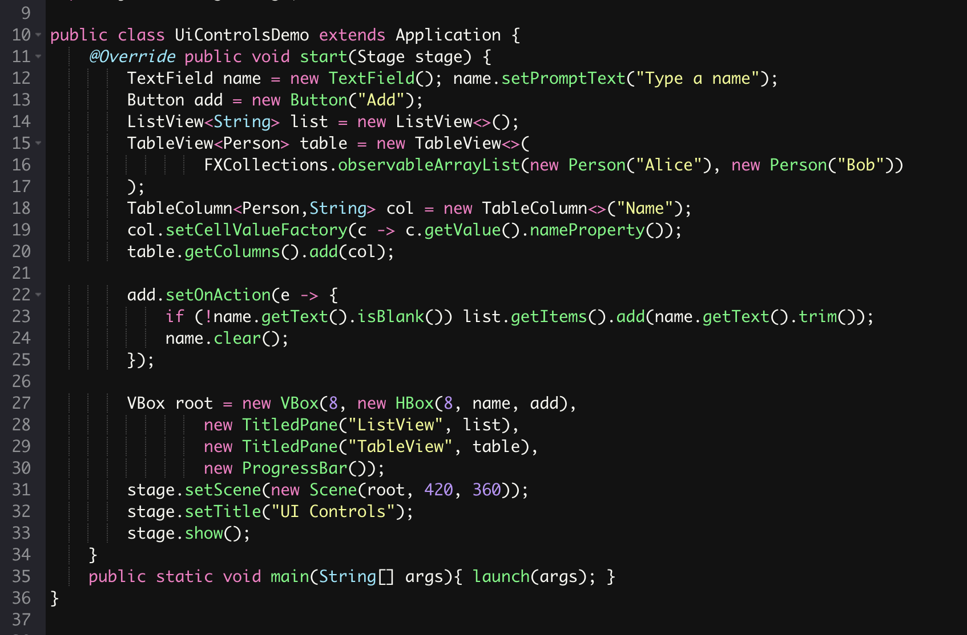
Set of UI controls
Notes:
Here is some example of

Slide 5
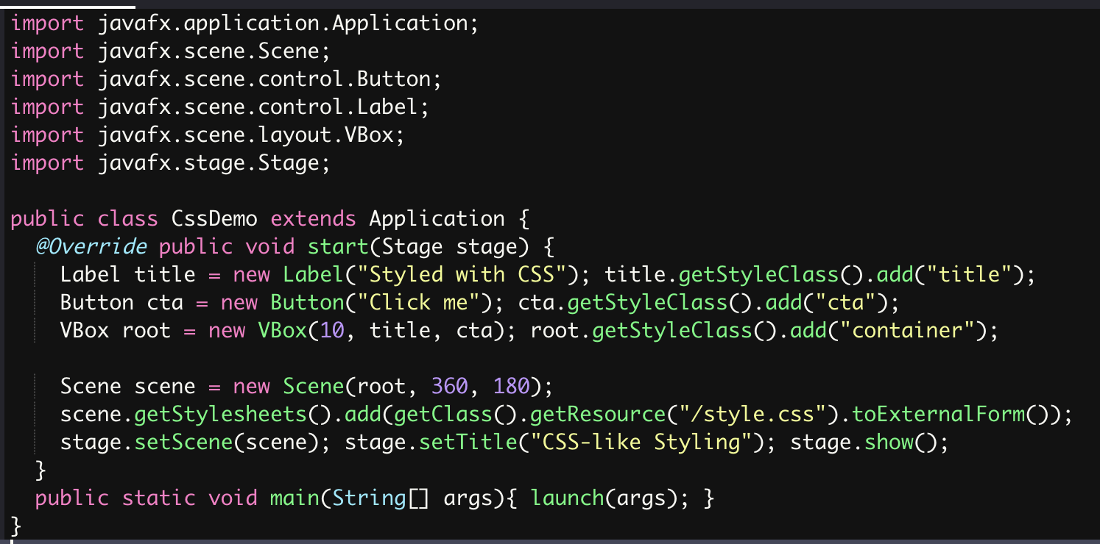
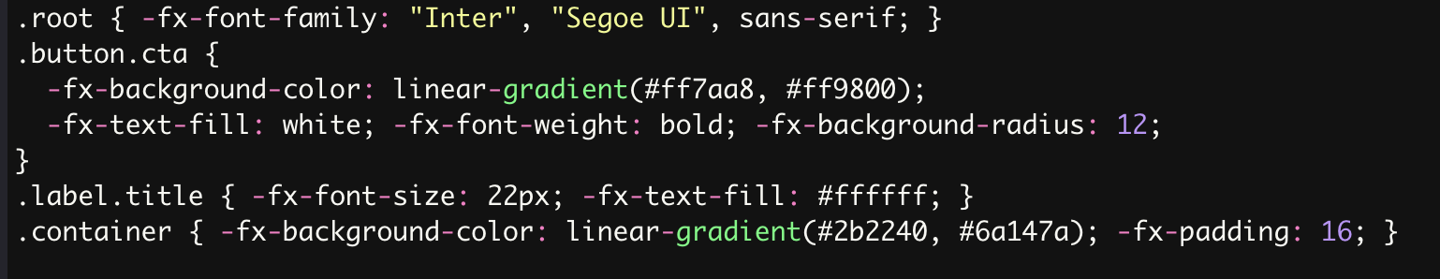
CSS-styling
Notes:
Some of the main features are:
A wide set of UI controls, built-in charts, tables, and multimedia support.
Support for 2D and 3D graphics.
Styling system really similar to CSS, is not the same but is easy to understand once you already now CSS FXML, an XML-based language that separates design from logic, making the code cleaner, I'll show more about this later
And it is OS agnostic and runs : Windows, macOS, and Linux.

Slide 6
Cons
Less community support
Desktop only
Limited OS interactivity
Notes:
Now, let’s look at some limitations of JavaFX. First, it is designed mainly for desktop, so it does not target mobile or web. Second, the community is smaller compared to web frameworks, so you may find fewer libraries or examples. And finally, it has limited integration with the operating system. Unlike Electron, for example, it doesn’t provide built-in APIs for notifications or native menus. You would need external libraries for that.

Slide 7
Let’s go to the code

