Slide 1
Perkinsus RNAseq analysis with 4 datasets
Are there biomarkers (DEGs) that overlap across studies?
Can we find these just looking at the data they already analyzed?
Are there more previously identified DEGs overlapping after we systematically reprocess and compare
Use their results short list
Are there new DEGs that come up?
Use this model for all datasets? Overview of R Package lfmm • lfmm; WGCNA; Deseq2; random forest
Gene groups to target after diff exp. Analysis
Immune gene set:
(find set of genes associated with oyster immunity)
E.g. Cytokines or use GO slim ‘immune response’
Compare gene set results tables in papers to our results
5 overlapping DEGs from their results table
20 overlapping DEGs from their results tables
100 overlapping DEGs from their results tables

Slide 2
Overall next steps
Expand Perkinsus meta-analysis to include other data types
Methylation (Johnson et al.; other studies?)
Proteomics
Metabolomics
Genomics (WGS, SNP arrays, etc)
If not enough perkinsus data available, expand disease meta-analysis to include data types from other disease experiments (QPX, MSX, etc)
RNAseq
Methylation
Proteomics
Metabolomics
Genomics
If not enough disease data available, can pivot to environmental factor studies (e.g. temp)

Slide 3
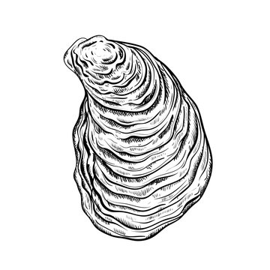
Disease dataset set #1: Proestou et al. 2023
Understanding Crassostrea virginica tolerance of Perkinsus marinus through global gene expression analysis
link: https://www.frontiersin.org/journals/genetics/articles/10.3389/fgene.2023.1054558/full
Oyster origin: Aquaculture Genetics and Breeding Technology Center (ABC) eastern oyster breeding program at the Virginia Institute of Marine Science (VIMS)
Two sensitive and two tolerant eastern oyster families experimentally challenged with distinct doses of P. marinus (0, 10⁶, 10⁷, and 10⁸ parasite spores per gram wet weight, n = 3–5 individuals per family per dose)
Phenotype metrics determined: Sensitive (90, 120) and Tolerant (84, 89)
Control (0 parasite spores g⁻¹)
Family 84
Family 120
Dose 10⁶ parasite spores g⁻¹)
Day 7
Day 50
Dose 10⁷ parasite spores g⁻¹)
Dose 10⁸ parasite spores g⁻¹)
Family 89
Family 90
TruSeq Stranded mRNA n=3 family⁻¹ treatment⁻¹
Mantle tissue

Slide 4
Disease dataset set #2: Johnson et al. 2020
Characterizing the Epigenetic and Transcriptomic Responses to Perkinsus marinus Infection in the Eastern Oyster Crassostrea virginica
link: https://www.frontiersin.org/journals/marine-science/articles/10.3389/fmars.2020.00598/full
Oyster origin: Vermilion Bay, Louisiana & Calcasieu Lake, Louisiana. 5 months acclimation at hatchery then spawned. Spat reared in upwelling system and outplanted to mesh bags. Monitored for mortality and cleaned every 3 months for 14-month period
Classified:
n=40
tagseq
Very-light (</=1,000 parasites g⁻¹) n=16
14 months out planted
Light (1,001 – 10,000 parasites g⁻¹) n=8
Moderate (10⁴ – 10⁵ parasites g⁻¹) n=8
Phys: shell height, wet weight, P. marinus hyponospores g⁻¹
Moderate-heavy (>10⁵ parasites g⁻¹) n=8

Slide 5
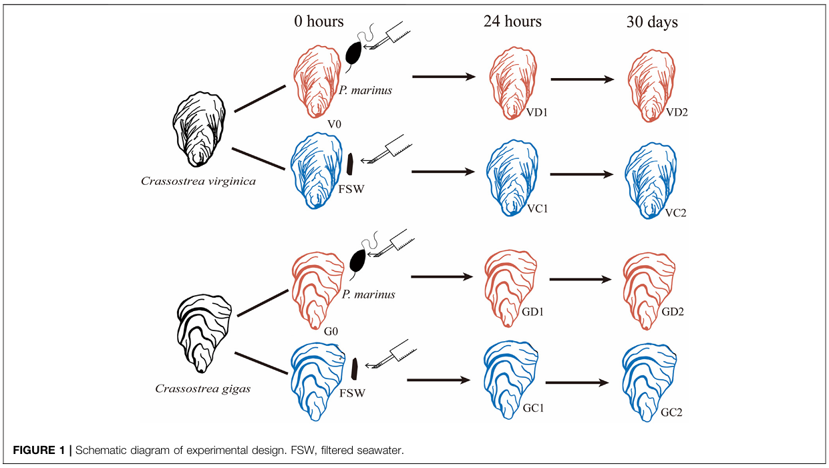
Disease dataset set #3: Chan et al. 2021
Transcriptomic Response to Perkinsus marinus in Two Crassostrea Oysters Reveals Evolutionary Dynamics of Host-Parasite Interactions
link: https://www.frontiersin.org/journals/genetics/articles/10.3389/fgene.2021.795706/full
Oyster origin: Maine and Washington oyster farms. Acclimated in lab for 24 hours then experimentally challenged
n=10
n=10
n=10
Challenge (1.2 x 10⁶ P. marinus)
Control (FSW)
Challenge (1.2 x 10⁶ P. marinus)
Control (FSW)

Slide 6
Disease dataset set #4: Sullivan and Proestou 2021
Survival and transcriptomic responses to different Perkinsus marinus exposure methods in an Eastern oyster family
link: https://doi.org/10.1016/j.aquaculture.2021.736831
Oyster origin: 1 year old from full sibling oyster family 286 from VIMS transported to USDA ARS NCWMAC in RI. Acclimated to lab conditions. All exposed oysters (n = 56 per group) received a dose of 5 × 10⁶ cultured P. marinus cells. Group 2 were fed P. marinus; Group 3 were injected with P. marinus. At 6 h, 36 h, 7 d, and 28 d post-exposure, six live oysters per group were censored and mantle and digestive tissues preserved. For 3-5 per group, measured global gene expression. Throughout, moribund oystered were removed and sampled. At completion at 42 d, remaining oysters were sampled. Samples were sequenced in two batches (fall 2015 and 2017) and expression profiles covaried with batch.
n=56
Group 1
Saline
n=3-5 per group per timepoint
6 h
36 h
7 d
28 d
Group 2
Fed 5 x 10⁶ P. marinus
Group 3
Injected 5 x 10⁶ P. marinus

Slide 7
Disease dataset set #5: Proestou and Sullivan 2020
Variation in global transcriptomic response to Perkinsus marinus infection among eastern oyster families highlights potential mechanisms of disease resistance
link: https://www.sciencedirect.com/science/article/pii/S1050464819311295?via=ihub#appsec1
Oyster origin: full sibling oyster families from the Aquaculture Genetics & Breeding Technology Center's (ABC) selective breeding program were challenged with either 5 × 10⁶ P. marinus cells g⁻¹ wet tissue weight (injected treatment) or artificial seawater (control treatment) via injection in adductor muscle tissue
gene expression analysis focused on mantle tissues collected from two families identified as susceptible (low survival and low parasite elimination rate, family 242) and resistant (high survival and moderate parasite elimination rate, family 266) to P. marinus infection in the laboratory disease challenge
n=62 total
Min n=5 per family per timepoint
Family 242
susceptible
Control (0 parasite spores g⁻¹)
36 h
7 d
28 d
Family 266
resilient
Dose 10⁵ parasite spores g⁻¹)

Slide 8
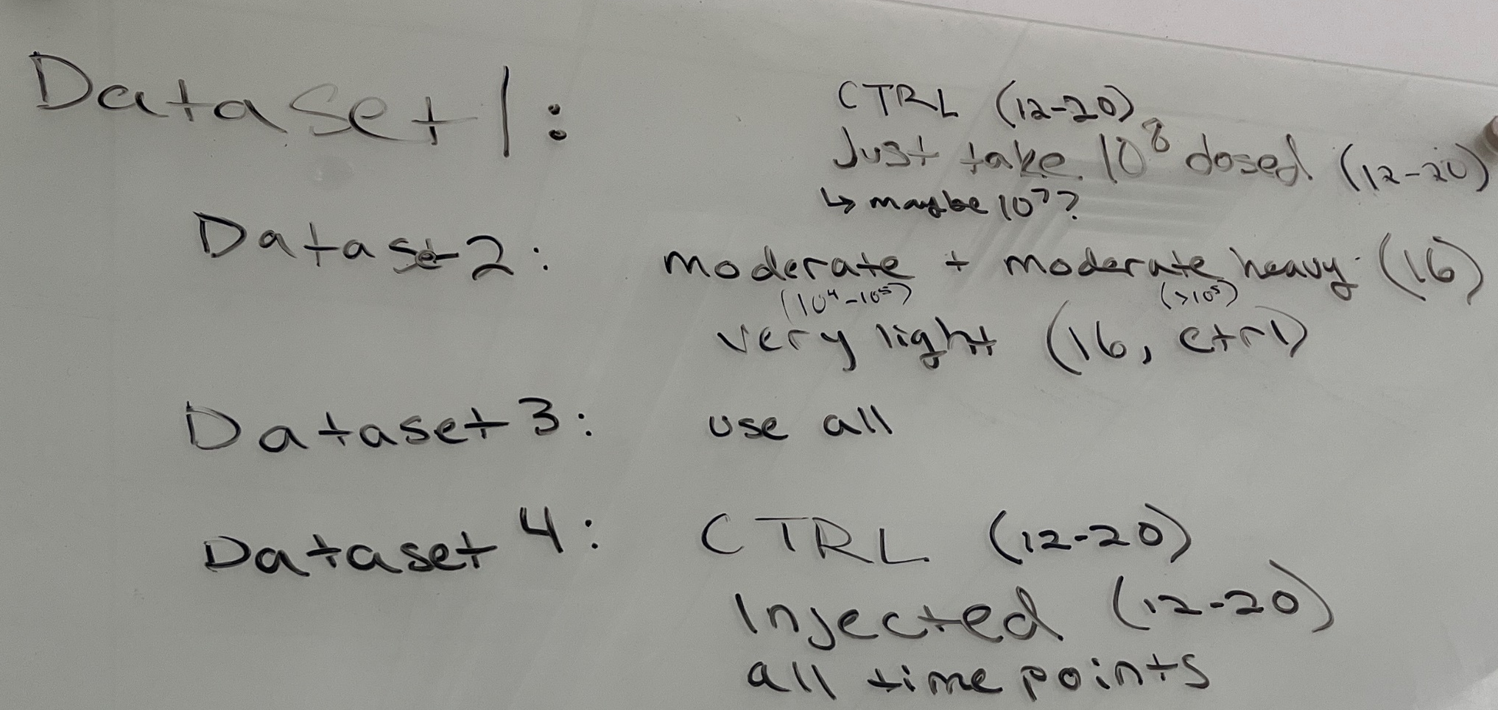
Subsetting the data
Dataset 1:
CTRL (n = 12-20)
10^8 dosed (n = 12-20)
10^7 dosed (n = 12-20)
Dataset 2:
CTRL (very light, n =16)
Moderate (10^4-10^5, n =16)
Moderate heavy (>10^5, n =16)
Dataset 3:
Dosed C. gigas (n = 5)
Dosed C. virginica (n=5)
Use all samples
Dataset 4:
CTRL (n = 12-20)
Injected (n = 12-20)
Use all time points
Dataset 5:
CTRL (n = 20)
10^5 dosed (n =20)
Exclude time point 36 h

