Slide 1
Perkinsus RNAseq analysis with 4 datasets
Are there biomarkers (DEGs) that overlap across studies?
Can we find these just looking at the data they already analyzed?
Are there more previously identified DEGs overlapping after we systematically reprocess and compare
Use their results short list
Are there new DEGs that come up?
Use this model for all datasets? Overview of R Package lfmm • lfmm; WGCNA; Deseq2; random forest
Gene groups to target after diff exp. Analysis
Immune gene set:
(find set of genes associated with oyster immunity)
E.g. Cytokines or use GO slim ‘immune response’
Compare gene set results tables in papers to our results
5 overlapping DEGs from their results table
20 overlapping DEGs from their results tables
100 overlapping DEGs from their results tables

Slide 2
Overall next steps
Expand Perkinsus meta-analysis to include other data types
Methylation (Johnson et al.; other studies?)
Proteomics
Metabolomics
Genomics (WGS, SNP arrays, etc)
If not enough perkinsus data available, expand disease meta-analysis to include data types from other disease experiments (QPX, MSX, etc)
RNAseq
Methylation
Proteomics
Metabolomics
Genomics
If not enough disease data available, can pivot to environmental factor studies (e.g. temp)

Slide 3
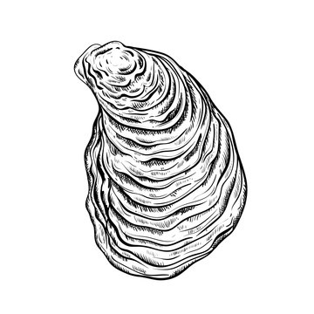
Disease dataset set #1: Proestou et al. 2023
Understanding Crassostrea virginica tolerance of Perkinsus marinus through global gene expression analysis
link: https://www.frontiersin.org/journals/genetics/articles/10.3389/fgene.2023.1054558/full
In this study we measured dermo tolerance and evaluated global expression patterns of two sensitive and two tolerant eastern oyster families experimentally challenged with distinct doses of P. marinus (0, 10^6, 10^7, and 10^8 parasite spores per gram wet weight, n = 3–5 individuals per family per dose)
Phenotype metrics determined: Sensitive (90, 120) and Tolerant (84, 89)
Control (0 parasite spores g⁻¹)
Family 84
Family 120
Dose 10^{^6} parasite spores g⁻¹)
Day 7
Day 50
Dose 10^{^7} parasite spores g⁻¹)
Dose 10^{^8} parasite spores g⁻¹)
Family 89
Family 90
TruSeq Stranded mRNA n=3 family⁻¹ treatment⁻¹
Mantle tissue

Slide 4
Disease dataset set #2: Johnson et al. 2020

Slide 5
Disease dataset set #3: Chan et al. 2021

Slide 6
Disease dataset set #4: Sullivan and Proestou 2021

