Slide 1
A better Example Domain homepage
Audit, concept redesign and delivery plan for Example Domain
Prepared 2026-10-25 · Samsung digital engineering

Slide 2
Your site today: 77/100 (C)
Measured on your live homepage, not a template
SPEED
100 · A
Main content shows in 0.2s; 0.0 MB over 2 requests.
MOBILE
100 · A
1 of 1 tap targets are too small on mobile.
A11Y
90 · A
3 accessibility rules failed (0 serious or critical).
UX
64 · D
Weakest area: visual hierarchy (2/5).
GEO
21 · F
No structured data; no llms.txt.

Slide 3
What is costing you customers
Top fixes, ranked by severity
No structured data for search and AI engines
AI assistants and rich results rely on structured data to name and recommend the brand.
No main headline (h1)
Visitors decide in seconds; unclear hierarchy and actions send them to a competitor.
Document should have one main landmark
Inaccessible sites exclude users, invite legal risk (ADA / EAA) and lose search visibility.
Page should contain a level-one heading
Inaccessible sites exclude users, invite legal risk (ADA / EAA) and lose search visibility.
No llms.txt guide for AI crawlers
A cheap, early signal that helps AI tools represent the brand accurately.

Slide 4
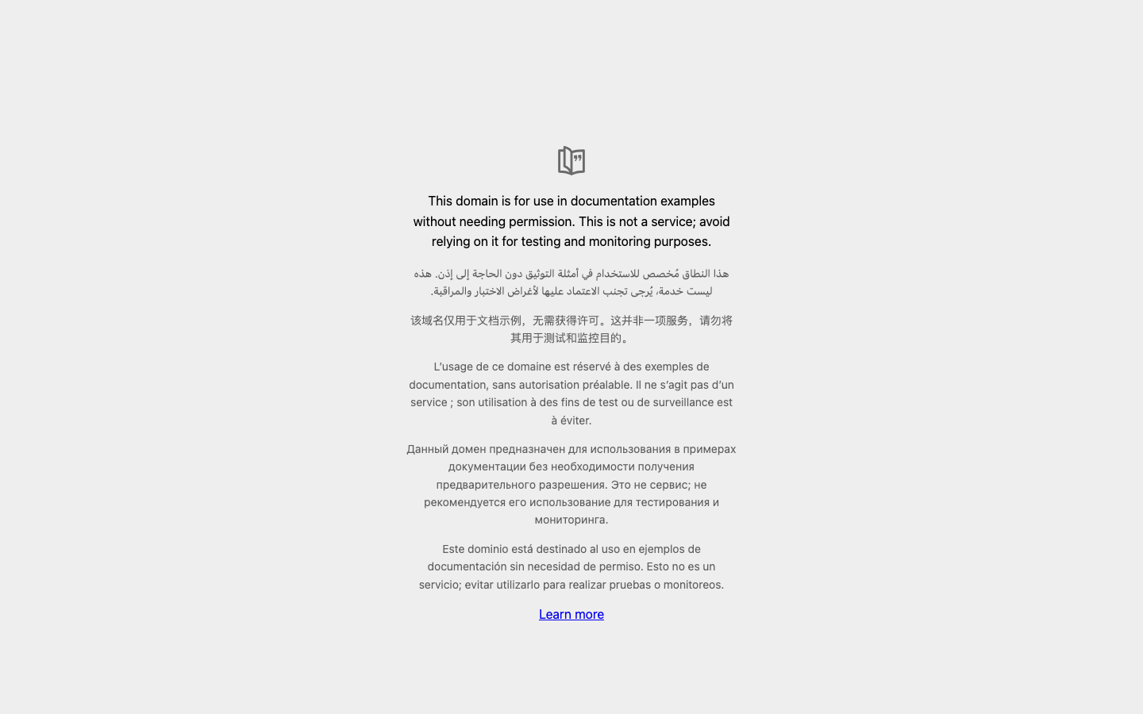
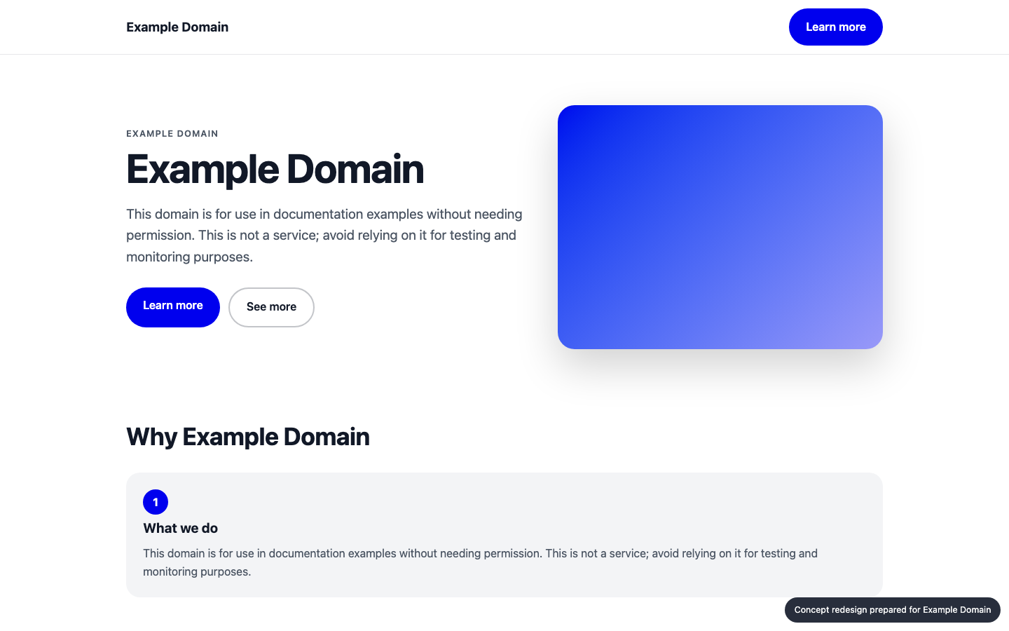
Your homepage, before and after
Concept built from your own brand colours, fonts and content
BEFORE
AFTER (concept)

Slide 5
What changed, and the proof
Same inspectors, run on the new prototype
A11Y
MOBILE
GEO
UX
90 → 98
100 → 100
21 → 36
64 → 64
No structured data for search and AI engines: Add Organization, WebSite and Product/Service JSON-LD.
No main headline (h1): Use exactly one clear headline stating the value proposition.
Document should have one main landmark: Fix the flagged elements and add automated a11y checks to CI.
Page should contain a level-one heading: Fix the flagged elements and add automated a11y checks to CI.

Slide 6
Plan: 2 weeks, 58 person-days
Effort by workstream
Homepage rebuild (design + front end)
15 d
Accessibility remediation
12 d
UX & conversion redesign
4 d
Structured data & AI-search
15 d
QA & launch
7 d
Delivery management
5 d

Slide 7
Why us: 87/100 organisation match
Named people, free to start soon
Aarav Mehta · Senior Frontend Engineer
fit 85%
nextjs, responsive-ui · free from 2026-11-02
Dev Malhotra · Senior Frontend Engineer
fit 85%
nextjs, responsive-ui · free from 2026-11-09
Isha Patel · QA Automation Engineer
fit 84%
qa-testing, a11y · free from 2026-11-09
Zoya Ali · Accessibility Specialist
fit 78%
a11y, qa-testing, responsive-ui · free from 2026-11-02
Kabir Singh · SEO / Schema Engineer
fit 67%
schema-seo, content-strategy · free from 2026-11-02
Ananya Rao · UX Designer
fit 65%
ux-design, design-systems · free from 2026-11-02
No skill gaps for this scope.

Slide 8
Investment
A range until discovery is complete
₹5,85,000 – ₹7,47,000
Homepage and key templates only; no new backend features
Client provides brand assets and timely feedback
Blended day rate 8000 with a 40% margin
Estimate is +/- range until discovery is complete

Slide 9
Next steps
30-minute walkthrough of the prototype with your team
Discovery week to confirm scope and price
Team starts 2026-11-02

