Slide 1











DIGITHON 2026
Nitro
Great developers, in front of every client.
Powering external business in a supercharged environment.
Manish Paul Digital CRM
Abhishek Kaushik · Rohan Kalra · Saurav Singh · Amrendra Kumar
Mentor: Mukul Jain
Notes:
Nitro, presented by Manish Paul (Digital CRM) with Abhishek Kaushik, Rohan Kalra, Saurav Singh and Amrendra Kumar; mentor Mukul Jain. Digithon 2026. Nitro is an AI pre-sales platform. Paste a prospect's website and a team of AI agents audits it, redesigns it, matches our available experts and writes a personalised pitch in minutes. A human approves everything before it is sent.

Slide 2
Pre-sales today
THE PROBLEM
01
02
03
Slow to propose
Expensive to create
Generic content
Days of research before a single proposal goes out.
Senior architects spend days on each pitch.
The same slides for every client.
04
05
06
Can't target customers
Demos take too long
Talent waiting
We don't know who to approach, or with what.
Built only when a deal is almost won.
Skilled developers sit between projects.
So conversion stays low.
Notes:
The six pain points of pre-sales today: proposals are slow, expensive to create and generic; we cannot target the right customers; demos take too long; and skilled developers wait between projects. So conversion stays low. In the live deck each point appears on a click.

Slide 3



Don't wait for RFPs. Reach the CTO first, at scale.
WHY CONVERSION IS LOW
PERSONALISED PITCHES WE CAN PREPARE
2.5 min
×
3
=
72
Waiting for RFPs
per analysis
in parallel
an hour
a few a month
$0.18
×
100
=
≈ $18
With Nitro
hundreds a month
per analysis
prospects
model cost
An RFP arrives late: the shortlist is set and every vendor answers it.
Measured on our saved runs: 103 to 150 s and $0.11 to $0.18 each.
Analyse hundreds
Pick the best fits
Talk to the CTO first
Every target account, 24x7
Clear problems + skills we have
Already knowing their stack, news and gaps
Notes:
Waiting for RFPs gives us a few chances a month, and an RFP arrives late: the shortlist is set and every vendor answers the same questions. Nitro prepares a personalised analysis in about 2.5 minutes, three at a time, so 72 an hour; at about 18 cents of model tokens each, 100 prospects cost about 18 dollars. These are measured on our saved runs (103 to 150 seconds, 11 to 18 cents). So we analyse hundreds, pick the best fits (clear problems on their platform and skills we have), and go to the CTO first, already knowing their stack, their news and their gaps.

Slide 4
The client never sees what we would do for them
THE PROBLEM
To: cmo@prospect.com · Subject: Proposal for your esteemed consideration
Inbox · cmo@prospect.com
Unread 6
Proposal for your esteemed consideration
Us
Dear Sir/Madam,
We are pleased to submit our proposal for your consideration.
We have 15+ years of experience and skilled professionals.
We look forward to a fruitful association. Regards.
Proposal for your consideration
Vendor A
Introducing our capabilities
Vendor B
Partnership opportunity
Vendor C
Following up on our proposal
Vendor D
Our services overview
Vendor E
SENT
One more proposal that looks like all the others.
Notes:
Generic proposals look like every other vendor. Nothing in them shows we looked at the client's own site, so ours lands in the client's inbox as one more unread proposal that looks like all the others.

Slide 5
Demos take days to build. Nitro builds one in minutes.
THE PROBLEM
TIME TO BUILD ONE PERSONALISED DEMO FOR A PROSPECT
By hand
Days of developer time
Days
With Nitro
1.5–3 min
Every prospect gets one
Always available · 24x7
Not only the deals that are almost won: a demo built on their own site, before the first meeting.
Agents keep working in the background, so a demo is ready whenever sales needs one.
Notes:
Building one personalised demo for a prospect takes days of developer time, so we build one only when a deal is almost won. Nitro builds one in about 1.5 to 3 minutes per run, so every prospect can get one, and the agents are always available, working 24x7 in the background.

Slide 6
WHAT IF…
What if the prospect could see their own website, improved, before they signed anything?
That is Nitro.
Notes:
The turning point of the story: show, do not tell. The client sees their own site improved before any contract.

Slide 7
Paste a URL. That's it.
THE SOLUTION
www.allbirds.com
Launch
…and a whole office of AI agents goes to work.
Notes:
One input: the prospect's website. The server checks it is a public address, then a whole office of AI agents goes to work.

Slide 8


Meet the 13 agents
THE TEAM
Coordinator
Market Researcher
Tender Scout
Site Auditor
Tech Detector
Speed Tester
Mobile Tester
Plans and runs the job
Latest news on the company
Triages government tenders
Checks the website
Finds the technologies
Measures page speed
Checks it on a phone
13 agents
12 in every run
1 finds tenders
Accessibility Checker
UX Reviewer
AI-Search Checker
Designer
Team Matcher
Deck Writer
Works for everyone?
Usability and design
Visible in AI search?
Builds the new homepage
Finds available experts
Writes deck and proposal
The Market Researcher runs first in every analysis; the Tender Scout triages government tenders. All are listed in the agent marketplace.
Notes:
Thirteen agents, each with one job. The Coordinator plans the run; the Market Researcher reads the latest news on the company first; the others audit, test, design, match people and write the pitch. The Tender Scout finds work in government tenders. Every tool call posts to a live feed.

Slide 9


One URL in. A personalised pitch out.
HOW IT WORKS
URL or tender
Plan
Research
Audit
Build
Write
Review
Site or govt tender
Coordinator agent
Latest news on the company
7 checks in parallel
Redesign + team
Deck + proposal
Human approves
✓
Tools measure: Lighthouse, axe-core, Playwright, Chrome DevTools Protocol
✓
The model (Claude) researches, plans, judges design and clarity, and designs
✓
Code guardrails keep the order, retries and step budget safe
✓
A human reviews everything before it is sent
A full run takes about 1.5 to 3 minutes. Every step streams live, and every run can be replayed.
Notes:
Paste a URL, or take a government tender the Tender Scout found; the Coordinator plans; the Market Researcher reads the latest news on the company; seven checks run in parallel; the Designer and Team Matcher build; the Deck Writer writes; a human approves. The checks find speed, mobile, accessibility, UX, AI-search visibility, the tech stack from front end to DevOps, third-party weight and the brand kit. A run takes about 1.5 to 3 minutes.

Slide 10


The Tender Scout finds the work. And decides if it fits.
GOVERNMENT TENDERS
WATCHING
Tender Scout
Website revamp and GIGW accessibility audit
GeM portal
Checks every tender, step by step
Ministry of Electronics and IT
CPPP RSS feed
1
Read the scope
✓ Relevant: web, accessibility
Sent to the agents
State tender feeds
Digital work?
2
Civil works for depot expansion
3
Match our skills
Delhi Metro Rail Corporation
Decide, with a reason
✕ Not relevant: civil works
4
Dropped, reason logged
Simulated on the home dashboard today · also callable as the tenders_triage tool over MCP.
Notes:
The Tender Scout watches the GeM portal, CPPP RSS feeds and state tender feeds. For each tender it reads the scope, asks whether it is digital work, matches it to our skills, and decides with a reason. A relevant tender goes to the agents like a website; one that does not fit is dropped and the reason is logged. Example: a MeitY website revamp and GIGW accessibility audit is relevant (web, accessibility); Delhi Metro civil works for a depot is not (civil works, not digital). Simulated on the home dashboard today, and callable as the tenders_triage tool over MCP.

Slide 11
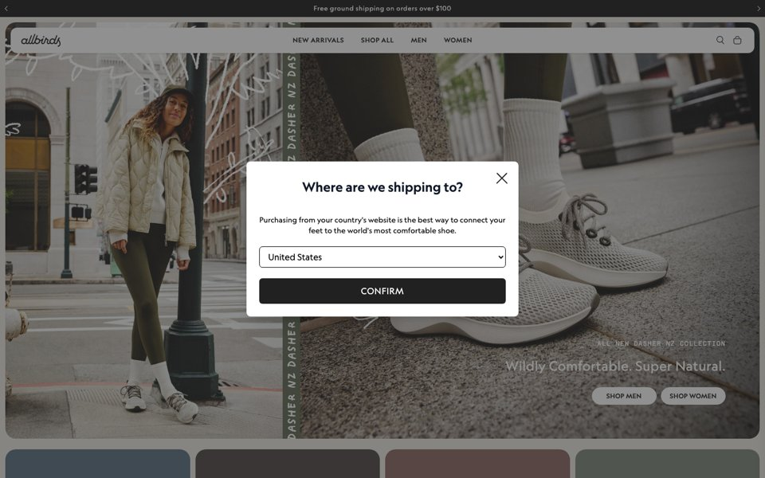
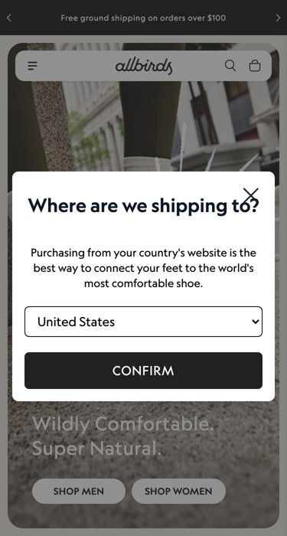
Evidence from outside, before we ever meet.
A SAMPLE OF THE CHECKS · REAL ALLBIRDS RUN
01
02
03
04
Backend & stack
Customer data flows
Speed
Mobile
9 found
5 tools
40 / 100
87 / 100
Opens talks on logistics,
data, finance and cloud
GA4, Clarity, Tag Manager,
Meta Pixel, Google Ads
16.9 s until main content
6.3 MB page weight
12 of 84 tap targets
too small
05
06
07
08
Accessibility
UX and design
AI-search visibility
Brand kit
70 / 100
60 / 100
62 / 100
Geograph
3 rules failed,
2 of them critical
Weakest area:
call-to-action clarity
No structured data
llms.txt present
#000000 · #ece9e2
CTA: Shop All
Screenshots and numbers are from a saved run on allbirds.com.
Notes:
Speed 40/100 (16.9 s until the main content appears, 6.3 MB page). Mobile 87/100 (12 of 84 tap targets too small). Accessibility 70/100 (3 rules failed, 2 critical). UX 60/100 (weakest: call-to-action clarity). AI search 62/100 (no structured data, llms.txt present). 9 technologies detected; they open talks on logistics, data, finance and cloud. Customer data goes to 5 tools (GA4, Clarity, Tag Manager, Meta Pixel, Google Ads). Brand kit: #000000 and #ece9e2, Geograph typeface, Shop All call to action.

Slide 12



















The website is the way in. The backend is the business.
BEYOND THE WEBSITE
WHAT THE AGENTS READ FROM OUTSIDE
WHERE THE CTO CONVERSATION GOES
Server & language
APIs & third parties
CDN & hosting
Cloud infrastructure
Commerce platform
CMS
Payments
Data pipelines
Analytics & tags
Monitoring
Security & consent
Logistics systems
Website
Performance
Accessibility
AI search
ERP & CRM integration
the entry point
DevOps & SRE
132 technologies · 17 categories · from traffic, headers and code
AI & data platforms
Cybersecurity
Modernisation
Notes:
The website is only the entry point. From outside, the agents already read the server and language, APIs and third parties, CDN and hosting, commerce platform, CMS, payments, analytics, monitoring, security and consent, performance, accessibility and AI search: 132 technologies in 17 categories. That earns the room with the CTO, where the conversation moves to cloud infrastructure, data pipelines, logistics systems, ERP and CRM integration, DevOps and SRE, AI and data platforms, cybersecurity and modernisation.

Slide 13
We read their network traffic like a flight recorder
THEIR TECHNOLOGY · REAL ALLBIRDS RUN
389
9
5
25
requests
technologies
tools get customer data
domains
Vue.js
Shopify
Google Analytics 4
Microsoft Clarity
Google Tag Manager
Meta Pixel
Google Ads
Cloudflare
Microsoft Azure
Every technology is a way into a conversation: logistics, data, finance and cloud, mapped to our people and our in-house innovations.
Notes:
From 389 network requests Nitro detected 9 technologies across 25 domains; customer data goes to 5 analytics, tag and ad tools. Each technology is a way into a conversation about logistics, data, finance and cloud, mapped to our people and our in-house innovations.

Slide 14

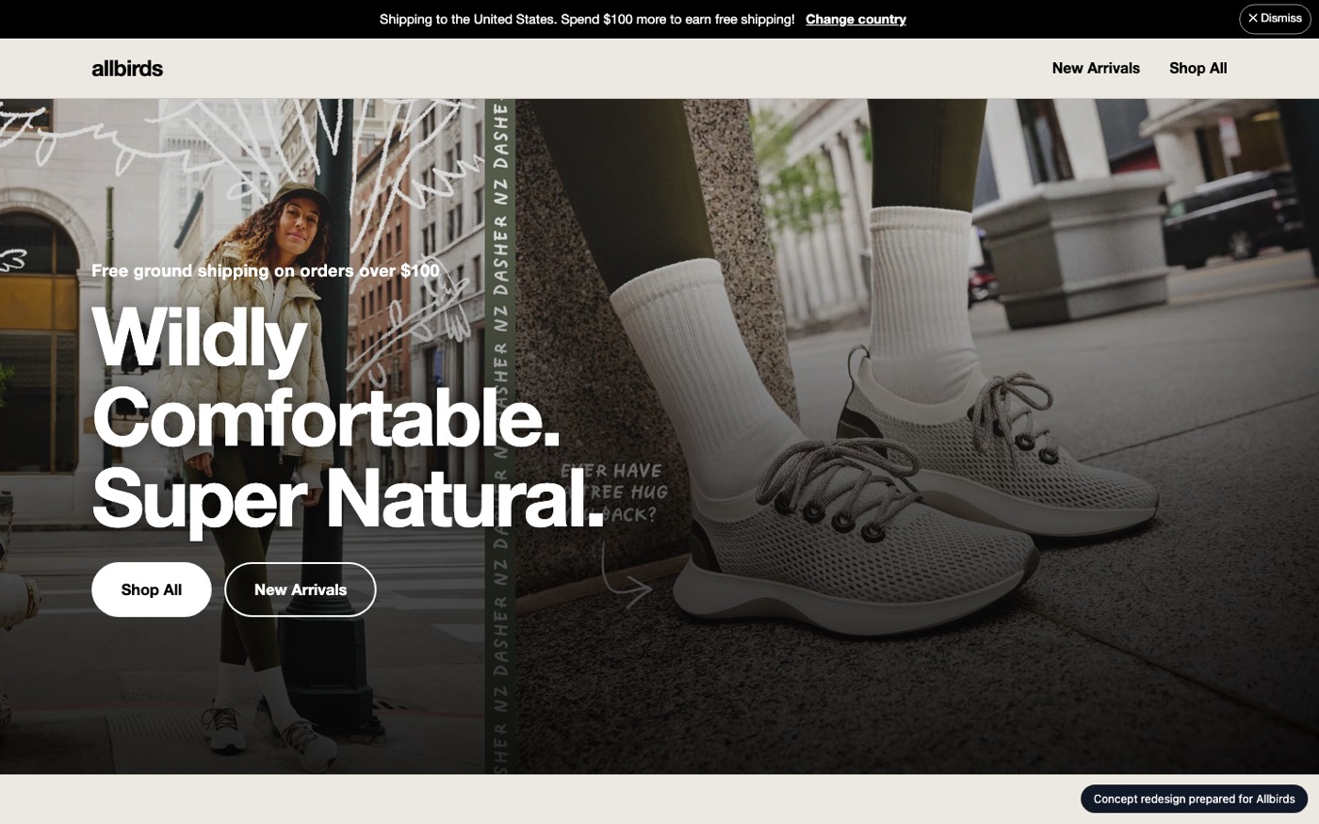
Their own site, improved, before they sign
THE REDESIGN · REAL ALLBIRDS RUN
BEFORE
AFTER
70 → 98
accessibility score
87 → 100
mobile score
✓
Built from their real colours, fonts and content
✓
Re-checked by the same inspectors
✓
Real HTML, designed in about 40 seconds
Notes:
The Designer extracts their colours, fonts and content and builds a new homepage in HTML in about 40 seconds. The same inspectors re-check it: accessibility 70 to 98, mobile 87 to 100.

Slide 15
Real developers who are free now
THE PEOPLE · SAMPLE ROSTER
Next.js / React
UX / UI design
QA automation
Web performance
Gap: Shopify / commerce
88
Aarav Mehta
93%
Dev Malhotra
93%
Senior Frontend Engineer
Senior Frontend Engineer
org match
Vikram Das
82%
Ananya Rao
72%
Design Systems Engineer
UX Designer
Isha Patel
72%
Zoya Ali
71%
QA Automation Engineer
Accessibility Specialist
Names, skills and match scores come from a sample roster. With real HR data the match also gives effort and price.
Notes:
The Team Matcher scores how well our organisation fits the work, names available experts and estimates effort and price. The roster, skills and rates shown here are sample data behind an adapter, ready for real HR data.

Slide 16
Every technology becomes a skill, a person and a plan
FROM THEIR STACK TO OUR PEOPLE · REAL ALLBIRDS RUN
FOUND ON THEIR SITE
SKILL WE NEED · OUR COVERAGE
WHO IS FREE · FROM PMS
Vue.js
front end
Vue / Nuxt
partial
Available experts
named
Shopify
commerce
Shopify / commerce
gap
Start dates
from roster
GA4 + Tag Manager
analytics
Web analytics
strong
Organisation match
score
Cloudflare + Azure
CDN, cloud
DevOps / CDN / cloud
strong
Billing forecast
next
Integrating with our project management system (PMS)
Live availability, skills and rates in; billing visible in advance, upcoming projects and staffing plans out. Today the roster is sample data behind an adapter, ready for PMS.
Notes:
On the Allbirds run, Vue.js maps to Vue/Nuxt skills (partial coverage), Shopify to commerce (a gap), GA4 and Tag Manager to web analytics (strong), Cloudflare and Azure to DevOps and cloud (strong). The matcher then names available experts and start dates. Integrating with our project management system (PMS) brings live availability, skills and rates in, and gives billing visibility in advance and upcoming projects. Today the roster is sample data behind an adapter.

Slide 17

A report and a pitch, ready for review
WHAT IT GENERATES
AUDIT
REDESIGN
ESTIMATE
Speed, mobile, accessibility, UX and AI search, each with evidence and ranked fixes.
Team
named experts
64
Effort
person-days
Hours
per skill
grade D
Accessibility 70 → 98
Mobile 87 → 100
Timeline
weeks
Cost
price range
Computed from the findings and the rate card.
Pitch deck
Proposal
Human review
PowerPoint, personalised to their site.
Written, with scope and team.
Nothing is sent without approval.
Notes:
Each run produces an audit (64/100, grade D on Allbirds, with evidence and ranked fixes), a redesigned homepage (accessibility 70 to 98, mobile 87 to 100), an estimate (named team, person-days, hours per skill, timeline and a price range computed from the findings and the rate card), a personalised PowerPoint deck and a written proposal. A human approves before anything is sent.

Slide 18

Only the AI model costs money. Everything else is free.
WHAT ONE ANALYSIS COSTS
Paid: model tokens
Free: everything else
$2 per 1M input tokens
✓
Lighthouse, Playwright and axe-core are open source
$10 per 1M output tokens
✓
Tech detection reads network traffic locally
✓
Replay of any past run costs nothing
Claude Sonnet 5.5. The dashboard now shows the tokens and cost of every agent, and the total for each run.
✓
Offline mode runs with no model at all
1.5–3 min
4
$0
per run in our tests
agents call the model; 7 use only tools
to replay a saved run
Notes:
The only paid part of a run is model tokens: Claude Sonnet 5.5 costs 2 dollars per million input tokens and 10 dollars per million output tokens. Four agents call the model (the Coordinator's planner, the UX Reviewer, the AI-Search Checker and the Designer); the other seven use free, open-source tools. The dashboard now shows the tokens and cost of every agent and the total for each run. Replaying a saved run costs nothing.

Slide 19
A deck ready for their CMO
THE PITCH
2 What is costing you customers
3 Before and after
4 Why us
1 Your site today
5 The plan
64
Speed
40
Team
named
UX
60
Effort
person-days
88/100
Timeline
weeks
AI search
62
organisation match
/ 100 · grade D
Accessibility 70 → 98
Price
range
9 slides plus a written proposal. Every number is read from the audit, the redesign and the match. Nothing is sent until a human approves.
Notes:
The Deck Writer produces a 9-slide PowerPoint deck and a written proposal: their site today (64/100, grade D), what is costing them customers, before and after, why us (88/100 organisation match), and the plan with team, effort, timeline and price. Every number comes from the audit, the redesign and the match. Nothing is sent until a human approves.

Slide 20
Great developers, in front of every client.
NITRO
Every prospect sees their better website before they sign.
Watch it work, live: npm start → localhost:3000
Notes:
Close: every prospect sees their better website before they sign. Run npm start and open localhost:3000 to watch it work live.

Slide 21
More detail
APPENDIX
Every pain point, each step of the run, the agent marketplace, the technology, trust, the roadmap and a one-slide recap.
Notes:
The appendix keeps the full detail: every pain point, each step of the run, the agent marketplace, the technology, trust, the business case, the roadmap and a one-slide recap.

Slide 22
Our best people are waiting for their next project
THE PROBLEM · 1 OF 6
Skilled developers between projects wait for work. That time is a real cost, and clients never see what these people can do.
z
z
z
z
z
z
z
z
z
z
z
z
✕
Skilled people wait instead of building
✕
Nothing they do is visible to clients
✕
Every week of waiting is cost we never recover
Developers waiting for their next project
Notes:
Skilled developers between projects are a cost to the organisation, and their time is not visible to clients.

Slide 23
Proposals are slow, generic and rarely convert
THE PROBLEM · 2 OF 6
1
2
3
4
5
Days of senior time for one pitch.
Find a lead
Research
Draft
Review
Send
Days
Few
Rare
of senior time per proposal
proposals actually sent
conversions
Notes:
A proposal needs a lead, research on the prospect's site and stack, a draft and a review. That takes days of senior time, so very few go out, and the ones that do are generic and seldom convert.

Slide 24



Reaching out is slow, and nobody knows where to aim
THE PROBLEM · 3 OF 6
No contacts
No direction
Slow reach-out
Who is the CTO? Who owns the website budget? Finding the right person takes days of digging, and the list is never ready.
Which companies? Which angle? Every seller invents their own approach, with no shared playbook for what to say.
By the time the research, the deck and the first email are done, the moment has passed and the prospect has moved on.
Result: the right person is rarely reached at the right moment.
Notes:
No contact list, no shared playbook, and so much preparation that the moment passes. These are qualitative pain points; real numbers will come from our own pipeline data.

Slide 25
We rarely match the skills we have to the work we chase
THE PROBLEM · 5 OF 6
WHAT THE CLIENT NEEDS
?
WHO IS AVAILABLE WITH THOSE SKILLS
Shopify
Accessibility
Web performance
Java
Python
Next.js
Manual QA
Adobe Analytics
No live view
Deals chased blind
The right people wait
Of who is available, with which skills.
Without knowing whether we can staff them.
While the right deals go elsewhere.
Notes:
There is no live view of who is available with which skills. Deals are chased without knowing whether we can staff them, and the right people wait while the right deals go elsewhere.

Slide 26




Pre-sales today is slow, costly and not personal
THE PROBLEM · IN SHORT
Slow reach
Expensive
Talent not used well
Finding a lead, researching and writing takes days. We reach only a few CTOs a month.
Senior architects spend days on each pitch. Most pitches lose, and that time is never recovered.
Developers between projects wait instead of building proof for the next client.
Not personalised
Does not scale
No proof in the room
The same slides go to every client. Nothing about their site, their stack or their customers.
Manual research means very few proposals go out, however many leads we have.
In a CTO meeting we talk about skills. We cannot show what we would fix on their site.
Result: fewer meetings, lower win rates, and unallocated capacity that keeps costing money.
Notes:
Summary of the pre-sales pain points: slow reach, expensive pitches, talent between projects used badly, no personalisation, no scale, and no proof in the room during CTO meetings.

Slide 27
One URL in. A send-ready pitch out.
HOW IT WORKS
1 · Paste URL
2 · Plan
3 · Audit
4 · Build
5 · Write
6 · You review
Checked to be a public site
Coordinator picks the next step
Seven checks in parallel
Redesign + team match
Deck and proposal
Nothing is sent without a human
A full run takes about 1.5 to 3 minutes. Every step streams live to the screen.
✓
Tools measure: Lighthouse, axe-core, Playwright, Chrome DevTools Protocol
✓
The model (Claude) plans, judges design and clarity, and designs
✓
Code guardrails keep the order, retries and step budget safe
Notes:
A run goes: paste a URL, the Coordinator plans, seven checks run in parallel, the Designer and Team Matcher build in parallel, the Deck Writer writes, and a human reviews. About 1.5 to 3 minutes.

Slide 28
A report card, with evidence
1 · THE AUDIT · REAL RUN ON ALLBIRDS.COM
64
grade D
Lighthouse (speed)
axe-core (accessibility)
Playwright (mobile)
Vision model (UX)
Every finding carries its evidence
Notes:
Real result from allbirds.com: 64 out of 100, grade D. Speed 40 (F), mobile 87 (B), accessibility 70 (C), UX 60 (D), AI search 62 (D). Every finding carries its evidence.

Slide 29
Every pain, answered. Honestly.
PAIN → ANSWER
THE PAIN | WHAT NITRO DOES | STATUS
Slow, expensive pitches | Agents do the research; experts only review | Today
Talent between projects | Matches available developers to the job and shows the capacity put to work | Today
Demos are slow to build | A redesigned homepage in about 40 seconds | Today
Not personalised | Built from their own site, stack, colours and content | Today
Skills not matched | Org match score, per-skill coverage, gaps and named people (sample data) | Today
No proof in the room | Before and after on their own site, during the meeting | Today
No direction | The audit gives a concrete, evidence-backed angle to open with | Partly
No contacts | Contact finder and outreach drafts | Next
Contact finding and outreach drafts are not built yet; they are the next items on the roadmap.
Notes:
Six of the eight pains are answered today. The audit gives a concrete angle to open with, which partly answers the lack of direction. Contact finding and outreach drafts are not built yet and are the first items on the roadmap.

Slide 30


From web front end to back end to DevOps
INSIGHTS ACROSS THE STACK
Web front end
Back end
DevOps and cloud
Frameworks (React, Next.js, Vue), layout, mobile, accessibility, UX and design, with HTML improvements.
Server languages (Java, .NET, Python, PHP), CMS and commerce. Next: API speed, errors, caching.
CDN, hosting and cloud (Cloudflare, Azure, AWS), security and cache headers. Next: TLS, HTTP/3.
TODAY
TODAY
TODAY
Performance first
Quality and testing
AI readiness
Lighthouse and Core Web Vitals (LCP, CLS, TBT), heavy scripts and third-party weight.
Automated tests, agent-driven user journeys and checks across locales and languages.
Visibility in AI search, structured data and llms.txt. If needed, a simple RAG chat demo.
TODAY
NEXT
TODAY
One URL, a full-stack view, and every insight mapped to the available experts who can deliver it.
Notes:
One URL gives a full-stack view. Today Nitro covers the front end, detects back-end and cloud technologies, measures performance and checks AI readiness. Deeper back-end checks, automated tests, journeys and locales are next.

Slide 31


Agents use the site like a real customer
AUTOMATED TESTS AND AGENT-DRIVEN JOURNEYS
Home
Search
Product
Cart ✕
Checkout
Page loads
Finds a product
Options work
Example: button hidden on phones
Not reached
Locales to test
✓
Each journey becomes an automated Playwright test the client keeps
en-IN
hi-IN
en-US
de-DE
ja-JP
✓
Runs across locales: languages, currency, dates, right-to-left
ar-AE (right-to-left)
✓
Every step gets an LLM score with a reason and a screenshot
Planned agents: Journey Runner, Test Writer and Locale Tester.
✓
Shows exactly where real customers get stuck
Notes:
Next in the marketplace: the Journey Runner walks key journeys (search, product, cart, checkout), the Test Writer turns them into Playwright tests the client keeps, and the Locale Tester runs them across languages and regions. Each step gets an LLM score with a reason.

Slide 32


Not just a report: things they can use
WHAT THE PROSPECT GETS
LLM scores
HTML fixes
RAG chat
Deck + proposal
Clear scores with reasons, same rubric for every site. Tools measure; the model judges design and clarity.
A redesigned homepage in real HTML, built from their brand. Next: ready-to-paste fixes per issue.
A small chat assistant built from their own pages, answering with source links.
A personalised pitch deck and proposal with a named team, effort and price.
BETA
TODAY
IF NEEDED
TODAY
1 URL
~3 min
0
is all we need to start
for a full run
things sent without a human
Notes:
Outputs: LLM scores with reasons using one rubric (beta), a redesigned homepage in real HTML (today), a simple RAG chat assistant built from their pages if needed (next), and a personalised deck and proposal (today).

Slide 33
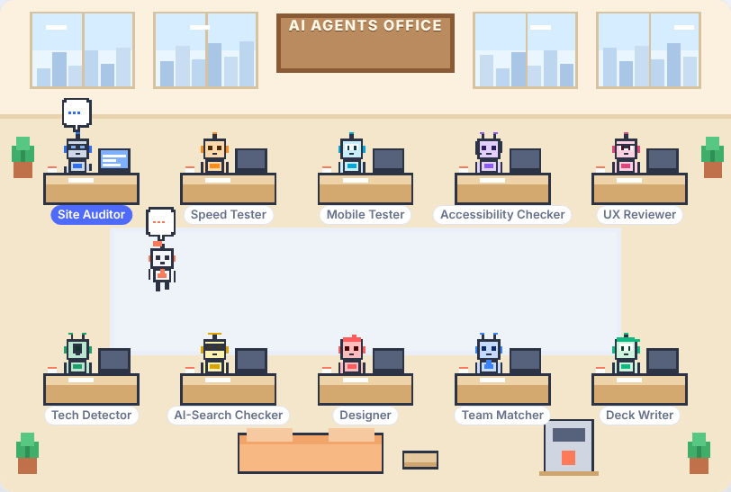
The whole run, live
WATCH IT WORK
✓
Every tool call posts to the live feed
✓
Results land as cards; the office shows who is busy
✓
Agents hand work to each other
✓
Every run is saved: replayed for free, at any speed
✓
At the end, the Coordinator asks a human to review
Notes:
In the app every tool call posts to a live feed, results land as cards, and a pixel-art office shows which agent is busy and who hands work to whom. Every run is saved and can be replayed for free. At the end, the Coordinator asks a human to review.

Slide 34
AI speed, combined with our amazing developers
AGENTS + PEOPLE
🤖 The agents do the heavy lifting
🧑‍💻 Our experts fine-tune it
✓
Crawl, measure and test the site
+
✓
Check every finding and number
✓
Detect the full tech stack
✓
Add real project know-how
✓
Score, redesign and draft the pitch
✓
Adjust the plan, team and price
✓
Work 24x7, run after run
✓
Own the conversation with the CTO
= A pitch that is fast, streamlined and fine-tuned, with real experts behind every word.
Notes:
Agents do the heavy lifting at scale, around the clock. Our experts check the numbers, add real project know-how, adjust plan, team and price, and own the CTO conversation. The result is fast, streamlined and fine-tuned.

Slide 35


Every review puts an available expert to work
ENGAGING OUR PEOPLE
Run finishes
Assigned
Notified
Reviews
Credited
Report ready
To an expert with the right skills
Gets the review task
Fine-tunes and signs off
Name on the pitch
✓
Time between projects turns into useful, visible work
✓
Developers learn new stacks from real client sites
✓
The client meets the named expert who reviewed their site
✓
More engaged people, and a team ready to start on day one
Notes:
When a run finishes, the Review Assigner (planned) gives it to an available developer with the right skills. They get a notification, review and fine-tune, sign off, and get credit on the pitch. Time between projects becomes useful, visible work.

Slide 36
Reach CTOs quickly, even during a live meeting
REACHING CTOS
0:00
0:30
3:00
10:00
Next day
Meeting starts
Paste the URL
Show results
Talk specifics
Follow up
The CTO mentions their website or app.
Nitro starts while we keep talking.
Score, tech stack and redesign on screen.
Their real issues, our named team, a price range.
Deck and proposal, reviewed by an expert.
✓
Personal outreach to many CTOs a week, each about their own site
✓
Proof in the room, not promises a week later
✓
Saved runs replay for free, so a demo never depends on the network
Notes:
During a CTO meeting we paste their URL and, about three minutes later, show the score, tech stack and redesign on screen. By minute ten we discuss their real issues with a named team and price range. The next day they get a deck reviewed by an expert.

Slide 37

Agents that work in the background, 24x7
ALWAYS ON
✓
Keep a watchlist of target accounts
✓
Re-check every site overnight, automatically
✓
Alert sales when a prospect's site slows down, breaks or relaunches
✓
A morning digest: the best leads, with the pitch already drafted
✓
Every run is saved and can be reviewed or replayed later
24x7
The team sleeps. The pipeline keeps growing. (Night Watch agent, next in the marketplace.)
Notes:
Planned Night Watch agent: keeps a watchlist of target accounts, re-checks every site overnight, alerts sales when a site slows down, breaks or relaunches, and sends a morning digest with the best leads and a drafted pitch.

Slide 38
Many more analyses, with far less effort
EFFORT SAVED
Today: by hand
With Nitro
✕
Open the site and check it manually
✓
Agents measure the site with real tools
✕
Guess the tech stack
✓
Tech stack read from network traffic
✕
Find who is free
✓
Available experts matched automatically
✕
Write the proposal from scratch
✓
Deck and proposal drafted
✕
Takes days of senior time
✓
A run takes minutes; an expert reviews it
1.5–3 min
3
24x7
per run in our tests
runs at the same time in the app
agents can keep running
Notes:
Manual research of a prospect's site, stack and pitch takes days of senior time. A Nitro run takes about 1.5 to 3 minutes in our tests, and the app runs up to 3 at the same time, so experts spend their time reviewing instead of researching. We will measure the real time saved.

Slide 39



A marketplace of agents to showcase across the org
AGENT MARKETPLACE · BUILT IN THE APP
Coordinator
Market Researcher
Tender Scout
Site Auditor
Tech Detector
Speed Tester
Mobile Tester
Accessibility Checker
UX Reviewer
AI-Search Checker
Designer
Team Matcher
Deck Writer
LLM Scorer
Journey Runner
Test Writer
Locale Tester
Backend & API Inspector
DevOps & Cloud Inspector
HTML Fixer
Chat Builder
Meeting Assistant
Outreach Writer
Night Watch
Review Assigner
✓
One catalogue of every agent: what it takes in, produces, how to showcase it
In the code
✓
Teams reuse agents instead of rebuilding: Connect links any agent over MCP
config/marketplace.json → /api/marketplace → /marketplace.html, with search and filters. Tests check every running agent is listed as live.
✓
Sales shows clients the agents by category: audit, test, build, people, sell, always on
Notes:
The marketplace lists 25 agents: 12 live, 2 beta and 11 planned, with what each takes in, produces and how to showcase it. It is built in the code: config/marketplace.json, the /api/marketplace endpoint and the /marketplace.html page, with tests.

Slide 40
Small, honest, and no build step
UNDER THE HOOD
Runtime
Measuring the web
The model
TypeScript · Node.js 20 · tsx · Server-Sent Events
Playwright · Lighthouse 12 · axe-core · Chrome DevTools Protocol
Claude Sonnet 5.5 · Anthropic Messages API · streaming · vision
Output
Interface
Quality
pptxgenjs (PPTX) · Markdown proposal · files in runs/
Vanilla HTML/CSS/JS · canvas pixel art · light and dark themes
Node test runner · guardrailed planner · offline fallbacks
13
25
12
132
43
49
agents
in marketplace
skills
tech signatures
logged decisions
tests
Notes:
TypeScript on Node.js 20; Playwright, Lighthouse 12, axe-core and the Chrome DevTools Protocol to measure; Claude through the Anthropic Messages API with streaming and vision; pptxgenjs for the deck; vanilla HTML, CSS and JavaScript for the interface; Node test runner, a guardrailed planner and offline fallbacks.

Slide 41

Models judge. Tools measure. Humans decide.
WHY YOU CAN TRUST IT
Real numbers
Guardrails
Always works
Fully documented
Speed, accessibility, traffic and technologies are measured by tools. Models only judge design and clarity. Findings carry evidence.
The planning model chooses the next step, but code enforces order, retry limits and a step budget. A bad answer falls back to rules.
No model key or network? Offline mode still runs end to end. Any past run replays for free.
43 logged decisions, 49 tests, and tagged releases to fall back to: v0.1.0, v0.2.0, v0.2.1.
Talent roster, org skills and pricing constants are labelled sample data until real data is connected.
Notes:
Real numbers come from tools; the model only judges design and clarity. Code guardrails control the planner. Offline mode and free replay mean it always works. Everything is documented: 43 decisions, 49 tests and tagged releases. Sample data is labelled as sample data.

Slide 42

From very few proposals to a pipeline
THE BUSINESS CASE
More reach
Better pitches
Talent put to work
Many more prospects analysed and contacted, each with a pitch about their own site.
Real findings, a redesign and a named team instead of a generic proposal.
Developers between projects review, fine-tune and get matched to new work.
What we will measure
Proposals sent per week
Replies from CTOs
Conversions
Revenue from new clients
Talent utilisation
Time from first contact to project start
We do not claim numbers we have not measured yet. The app's ROI panel takes real figures once they are available.
Notes:
Nitro lets us reach many more prospects with personalised proof, puts developers between projects to work, and shortens the path to a staffed project. We will measure the real impact: proposals sent, replies, conversions, revenue and talent utilisation.

Slide 43


Good for everyone involved
WHO WINS
Sales and pre-sales
Developers between projects
Delivery heads
More pitches, faster, each one personal. Better meetings with CTOs.
Real work, new skills and their name on the pitch.
Projects scoped from real data, with a team that is free now.
Leadership and finance
The client's CTO
The organisation
Lower unallocated cost, higher win rate, a measurable pipeline.
Free, useful insight on their own site, before signing anything.
Shows our AI and engineering skill in every single pitch.
Notes:
Sales get more, faster, personal pitches. Developers between projects get real work and credit. Delivery heads get projects scoped from data. Leadership gets lower unallocated cost and a measurable pipeline. The client CTO gets free, useful insight. The organisation shows its AI and engineering skill in every pitch.

Slide 44
Built in a hackathon. Ready to grow.
WHAT'S NEXT
Now · v0.2.1
Next
Later
URL to audit, stack, redesign, team, deck
Planner-driven lead agent
Live feed, office and free replay
Review window
Agent marketplace
Agent-driven journeys and automated tests
Locale testing
LLM scores and HTML fixes for every finding
Back-end and DevOps inspectors
Real talent and skills data (HR adapter)
Review assignment and notifications
24x7 background agents and watchlists
Simple RAG chat generator
Live-meeting assistant
CRM, approved send and win/loss loop
Multi-page redesign
Notes:
Now: the full URL-to-pitch pipeline, planner-driven lead agent, live feed, office and replay, review window and agent marketplace. Next: journeys and tests, locale testing, LLM scores and HTML fixes, back-end and DevOps inspectors, real talent data, review assignment. Later: 24x7 agents, RAG chat generator, live-meeting assistant, CRM and multi-page redesign.

Slide 45
The whole idea, in short
NITRO IN ONE SLIDE
Problem
Pre-sales is slow, expensive and generic, while skilled developers wait between projects.
Solution
Paste a URL. AI agents audit the site, read the tech stack, redesign the homepage, match our available experts and write the pitch.
How
A coordinator agent plans the work. Tools measure (Lighthouse, axe-core, Playwright). The model judges and designs. A human approves.
Proof
Real runs on allbirds.com, stripe.com and Samsung India. Live feed, office view, free replay, review window.
Impact
Many more prospects analysed, personalised outreach to CTOs, better use of our talent, engaged employees.
Next
Agent journeys, automated tests, locale testing, HTML fixes, RAG chat, 24x7 agents, all in the agent marketplace.
Pre-sales automation
Multi-agent AI
Talent utilisation
Personalised pitches
Front end · back end · DevOps
Performance
LLM scores
Automated tests
Agent journeys
Locales
HTML improvements
RAG chat
24x7 agents
Agent marketplace
Human in the loop
Notes:
Problem, solution, how, proof, impact and next steps on one page, followed by the key ideas as tags.

Slide 46
From a few generic pitches to a pipeline of personal ones
WHAT THIS LEADS TO
Reach many more
Better conversion
Talent at work
Agents that scale
Analyse and contact many more prospects, each with proof about their own site.
Personal findings, a redesign and a named team instead of a generic deck.
Available experts review, fine-tune and get matched to new projects.
An agent marketplace, and agents that can run 24x7 in the background.
▶ Live demo: one real run
Notes:
Nitro lets us reach many more prospects with proof about their own site, improve conversion with personal findings and a named team, put available experts to work, and scale with an agent marketplace and agents that can run 24x7. Next: a live demo replaying one real run.

