Slide 1
A better Samsung India homepage
Audit, concept redesign and delivery plan for Samsung India
Prepared 2026-10-25 · Samsung digital engineering

Slide 2
Your site today: 73/100 (C)
Measured on your live homepage, not a template
SPEED
91 · A
Main content shows in 1.0s; 2.1 MB over 111 requests.
MOBILE
81 · B
19 of 268 tap targets are too small on mobile.
A11Y
35 · F
5 accessibility rules failed (5 serious or critical).
UX
68 · C
Weakest area: navigation (2/5).
GEO
97 · A
Structured data found; llms.txt present.

Slide 3
What is costing you customers
Top fixes, ranked by severity
Certain ARIA roles must contain particular children
Inaccessible sites exclude users, invite legal risk (ADA / EAA) and lose search visibility.
Certain ARIA roles must be contained by particular parents
Inaccessible sites exclude users, invite legal risk (ADA / EAA) and lose search visibility.
Navigation has 8 items
Visitors decide in seconds; unclear hierarchy and actions send them to a competitor.
19 tap targets are too small
Mis-taps frustrate users right where you want them to act.
Text is too small to read comfortably
Unreadable copy means the message never lands.

Slide 4
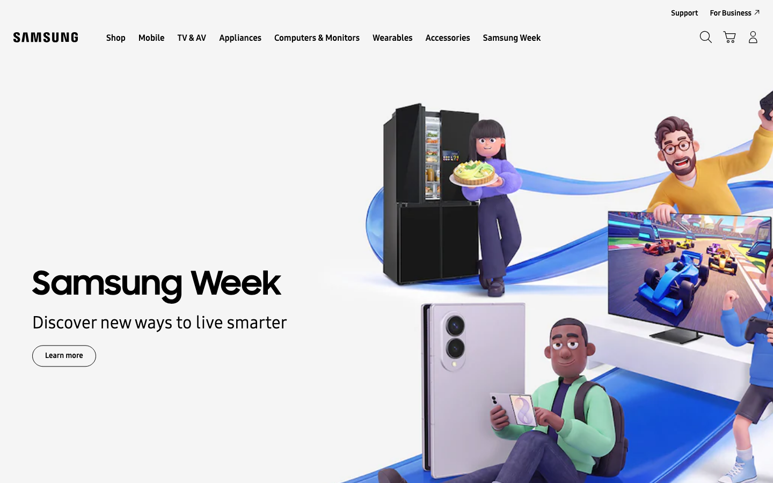
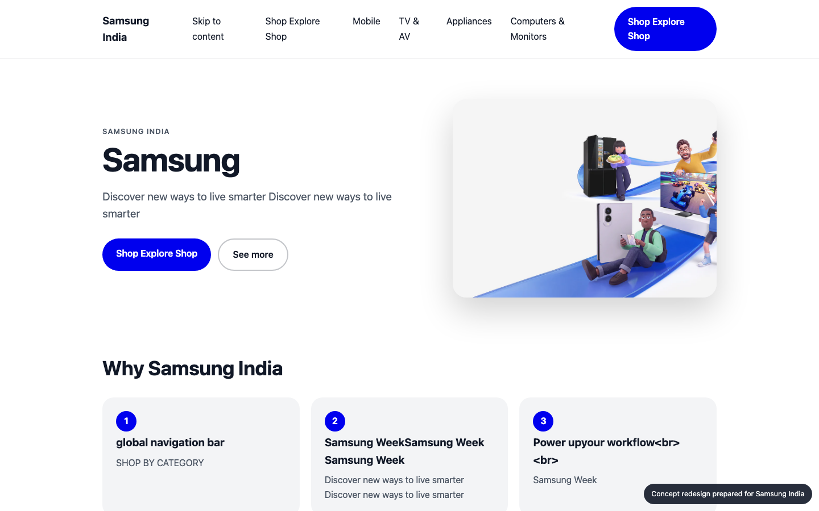
Your homepage, before and after
Concept built from your own brand colours, fonts and content
BEFORE
AFTER (concept)

Slide 5
What changed, and the proof
Same inspectors, run on the new prototype
A11Y
MOBILE
GEO
UX
35 → 98
81 → 100
97 → 97
68 → 68
Certain ARIA roles must contain particular children: Fix the flagged elements and add automated a11y checks to CI.
Certain ARIA roles must be contained by particular parents: Fix the flagged elements and add automated a11y checks to CI.
Navigation has 8 items: Group into 5-7 top-level items with clear labels.
19 tap targets are too small: Make interactive elements at least 44x44px with spacing between them.

Slide 6
Plan: 3 weeks, 70 person-days
Effort by workstream
Homepage rebuild (design + front end)
15 d
Responsive & mobile fixes
8 d
Accessibility remediation
28 d
UX & conversion redesign
4 d
QA & launch
9 d
Delivery management
6 d

Slide 7
Why us: 93/100 organisation match
Named people, free to start soon
Aarav Mehta · Senior Frontend Engineer
fit 93%
nextjs, responsive-ui · free from 2026-11-02
Dev Malhotra · Senior Frontend Engineer
fit 93%
nextjs, responsive-ui · free from 2026-11-09
Isha Patel · QA Automation Engineer
fit 89%
qa-testing, a11y · free from 2026-11-09
Vikram Das · Design Systems Engineer
fit 89%
design-systems, nextjs, responsive-ui · free from 2026-11-02
Zoya Ali · Accessibility Specialist
fit 78%
a11y, qa-testing, responsive-ui · free from 2026-11-02
Ananya Rao · UX Designer
fit 78%
ux-design, design-systems · free from 2026-11-02
No skill gaps for this scope.

Slide 8
Investment
A range until discovery is complete
₹7,28,000 – ₹9,30,000
Homepage and key templates only; no new backend features
Client provides brand assets and timely feedback
Blended day rate 8250 with a 40% margin
Estimate is +/- range until discovery is complete

Slide 9
Next steps
30-minute walkthrough of the prototype with your team
Discovery week to confirm scope and price
Team starts 2026-11-02

