Slide 1
A better Samsung India homepage
Audit, concept redesign and delivery plan for Samsung India
Prepared 2026-10-25 · Samsung digital engineering

Slide 2
Your site today: 60/100 (D)
Measured on your live homepage, not a template
SPEED
28 · F
Lighthouse mobile score 28; main content in 6.7s, blocking time 1105 ms.
MOBILE
81 · B
19 of 268 tap targets are too small on mobile.
A11Y
35 · F
5 accessibility rules failed (5 serious or critical).
UX
68 · C
Weakest area: navigation (2/5).
GEO
97 · A
Structured data found; llms.txt present.

Slide 3
What is costing you customers
Top fixes, ranked by severity
Main content takes 6.7s to appear on mobile
Every extra second of load time costs conversions; slow pages also rank lower in search.
Page is unresponsive for 1.1s while loading
Taps and scrolls feel broken while scripts run, so visitors leave before they act.
Certain ARIA roles must contain particular children
Inaccessible sites exclude users, invite legal risk (ADA / EAA) and lose search visibility.
Certain ARIA roles must be contained by particular parents
Inaccessible sites exclude users, invite legal risk (ADA / EAA) and lose search visibility.
Navigation has 8 items
Visitors decide in seconds; unclear hierarchy and actions send them to a competitor.

Slide 4
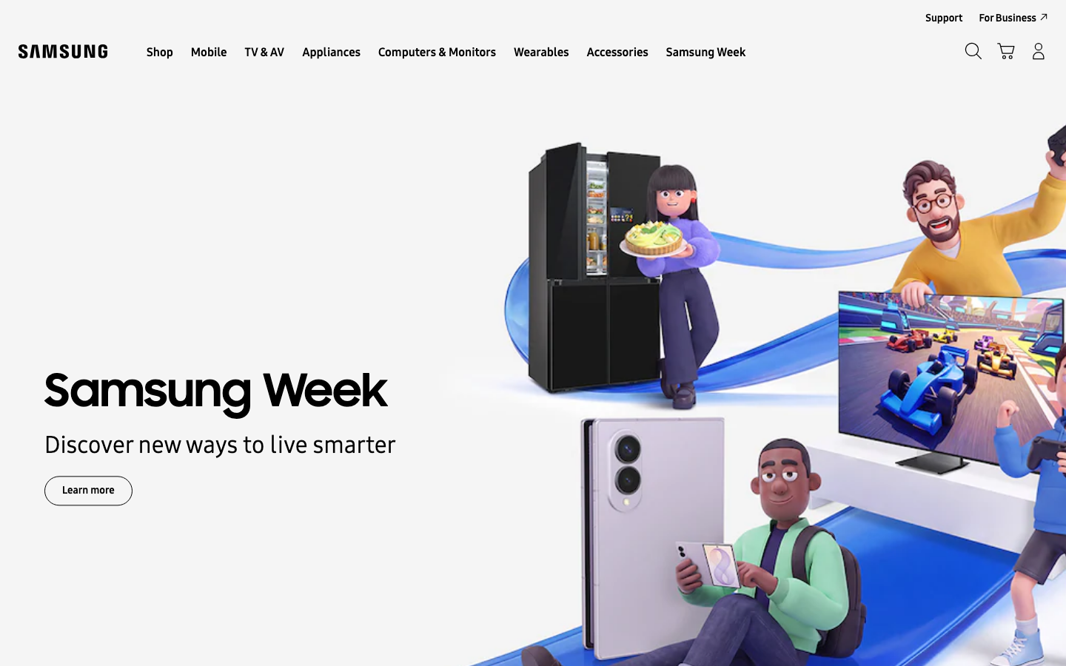
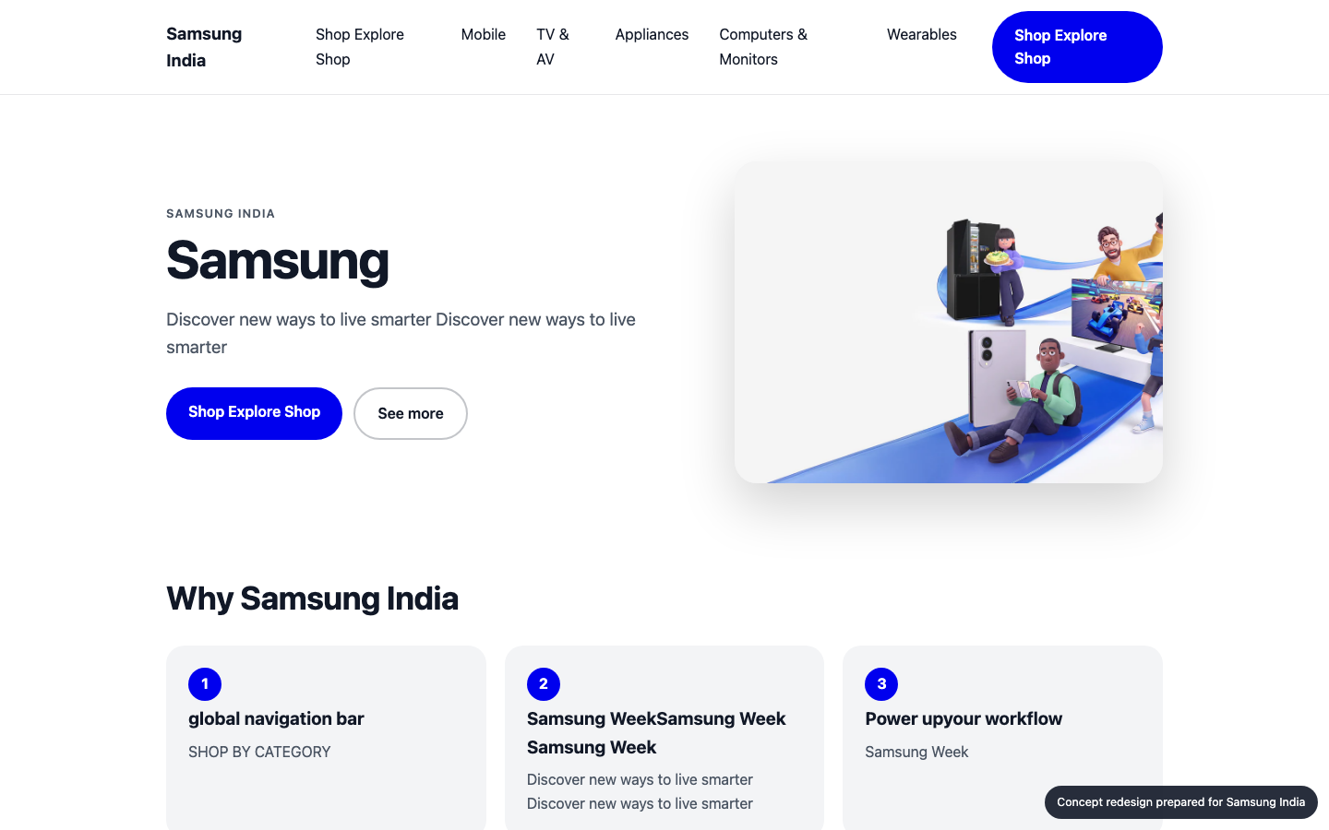
Your homepage, before and after
Concept built from your own brand colours, fonts and content
BEFORE
AFTER (concept)

Slide 5
What changed, and the proof
Same inspectors, run on the new prototype
A11Y
MOBILE
GEO
UX
35 → 98
81 → 100
97 → 97
68 → 68
Main content takes 6.7s to appear on mobile: Compress and preload the hero image, defer non-critical scripts, serve via a CDN.
Page is unresponsive for 1.1s while loading: Split and defer JavaScript, remove unused third-party scripts.
Certain ARIA roles must contain particular children: Fix the flagged elements and add automated a11y checks to CI.
Certain ARIA roles must be contained by particular parents: Fix the flagged elements and add automated a11y checks to CI.

Slide 6
Plan: 4 weeks, 103 person-days
Effort by workstream
Homepage rebuild (design + front end)
15 d
Performance engineering
26 d
Responsive & mobile fixes
8 d
Accessibility remediation
28 d
UX & conversion redesign
4 d
QA & launch
13 d
Delivery management
9 d

Slide 7
Why us: 95/100 organisation match
Named people, free to start soon
Aarav Mehta · Senior Frontend Engineer
fit 100%
nextjs, responsive-ui, web-performance · free from 2026-11-02
Dev Malhotra · Senior Frontend Engineer
fit 100%
nextjs, responsive-ui, web-performance · free from 2026-11-09
Isha Patel · QA Automation Engineer
fit 83%
qa-testing, a11y · free from 2026-11-09
Karan Shah · Performance Engineer
fit 83%
web-performance, nextjs · free from 2026-11-02
Zoya Ali · Accessibility Specialist
fit 78%
a11y, qa-testing, responsive-ui · free from 2026-11-02
Ananya Rao · UX Designer
fit 71%
ux-design, design-systems · free from 2026-11-02
No skill gaps for this scope.

Slide 8
Investment
A range until discovery is complete
₹10,82,000 – ₹13,82,000
Homepage and key templates only; no new backend features
Client provides brand assets and timely feedback
Blended day rate 8333 with a 40% margin
Estimate is +/- range until discovery is complete

Slide 9
Next steps
30-minute walkthrough of the prototype with your team
Discovery week to confirm scope and price
Team starts 2026-11-02

