Slide 1
A better Allbirds homepage
Audit, concept redesign and delivery plan for Allbirds
Prepared 2026-10-25 · Samsung digital engineering

Slide 2
Your site today: 63/100 (D)
Measured on your live homepage, not a template
SPEED
38 · F
Lighthouse mobile score 38; main content in 21.3s, blocking time 738 ms.
MOBILE
87 · B
12 of 84 tap targets are too small on mobile.
A11Y
70 · C
3 accessibility rules failed (2 serious or critical).
UX
56 · D
Weakest area: visual hierarchy (2/5).
GEO
65 · C
No structured data; llms.txt present.

Slide 3
What is costing you customers
Top fixes, ranked by severity
Blocking shipping modal hides the hero and the page's primary message
Visitors decide in seconds; unclear hierarchy and actions send them to a competitor.
Hero headline and CTAs have low contrast and low prominence
Visitors decide in seconds; unclear hierarchy and actions send them to a competitor.
Main content takes 21.3s to appear on mobile
Every extra second of load time costs conversions; slow pages also rank lower in search.
Page is unresponsive for 0.7s while loading
Taps and scrolls feel broken while scripts run, so visitors leave before they act.
Buttons must have discernible text
Inaccessible sites exclude users, invite legal risk (ADA / EAA) and lose search visibility.

Slide 4
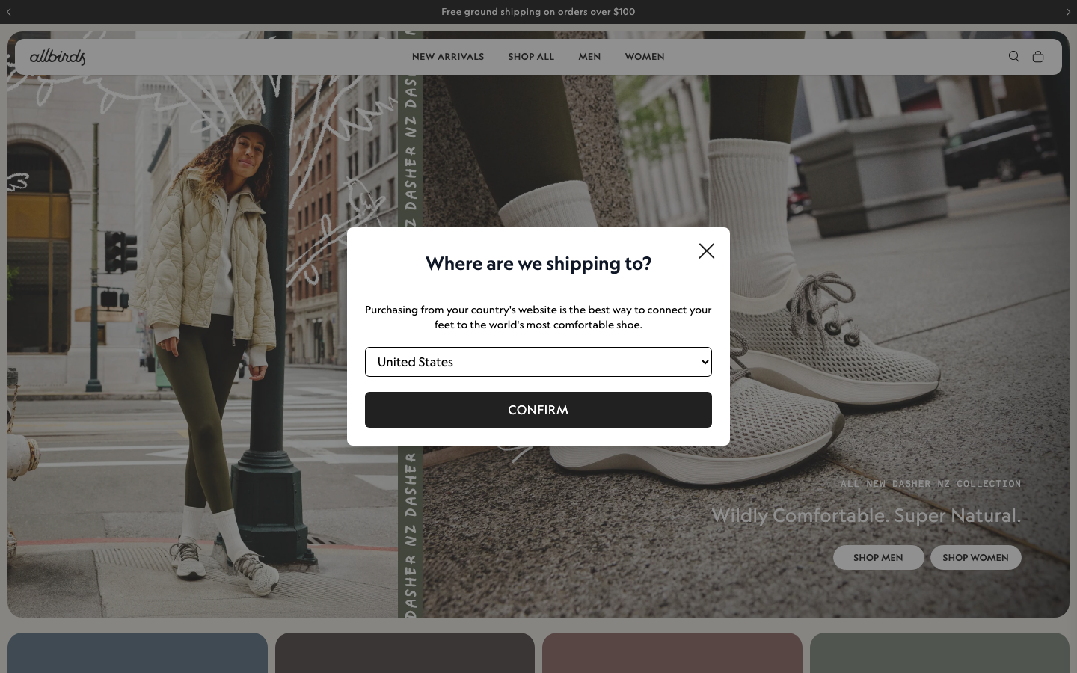
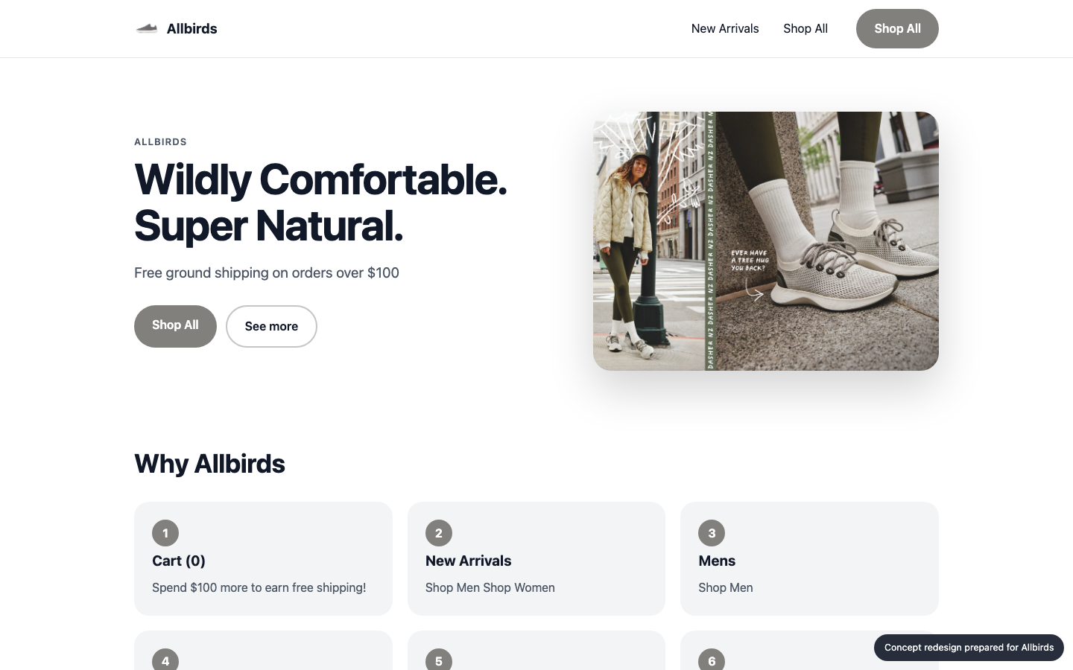
Your homepage, before and after
Concept built from your own brand colours, fonts and content
BEFORE
AFTER (concept)

Slide 5
What changed, and the proof
Same inspectors, run on the new prototype
A11Y
MOBILE
GEO
UX
70 → 83
87 → 100
65 → 62
56 → 60
Blocking shipping modal hides the hero and the page's primary message: Replace the modal with a non-blocking banner or a geo-detected default (e.g. 'Shipping to United States – change'). If a modal is kept, show it only when the detected country differs from the site's, and make it easy to dismiss.
Hero headline and CTAs have low contrast and low prominence: Add a scrim or move the text to a plain area. Use a larger white or dark headline with a solid high-contrast primary button (e.g. black 'Shop Men' and 'Shop Women'). Limit hero CTAs to one or two.
Main content takes 21.3s to appear on mobile: Compress and preload the hero image, defer non-critical scripts, serve via a CDN.
Page is unresponsive for 0.7s while loading: Split and defer JavaScript, remove unused third-party scripts.

Slide 6
Plan: 4 weeks, 119 person-days
Effort by workstream
Homepage rebuild (design + front end)
15 d
Performance engineering
25 d
Responsive & mobile fixes
8 d
Accessibility remediation
18 d
UX & conversion redesign
21 d
Structured data & AI-search
7 d
QA & launch
15 d
Delivery management
10 d

Slide 7
Why us: 92/100 organisation match
Named people, free to start soon
Aarav Mehta · Senior Frontend Engineer
fit 100%
nextjs, responsive-ui, web-performance · free from 2026-11-02
Dev Malhotra · Senior Frontend Engineer
fit 100%
nextjs, responsive-ui, web-performance · free from 2026-11-09
Vikram Das · Design Systems Engineer
fit 89%
design-systems, nextjs, responsive-ui · free from 2026-11-02
Ananya Rao · UX Designer
fit 79%
ux-design, design-systems · free from 2026-11-02
Isha Patel · QA Automation Engineer
fit 79%
qa-testing, a11y · free from 2026-11-09
Zoya Ali · Accessibility Specialist
fit 78%
a11y, qa-testing, responsive-ui · free from 2026-11-02
No skill gaps for this scope.

Slide 8
Investment
A range until discovery is complete
₹12,37,000 – ₹15,81,000
Homepage and key templates only; no new backend features
Client provides brand assets and timely feedback
Blended day rate 8250 with a 40% margin
Estimate is +/- range until discovery is complete

Slide 9
Next steps
30-minute walkthrough of the prototype with your team
Discovery week to confirm scope and price
Team starts 2026-11-02

